Slide 1
Properties of Electric Charges
PHYS104
By :
Eng.Abdulslam

Slide 2
What does the electrical charge mean ?

Slide 3
Types of Electrical Charge
Positive charge .
Negative charge .

Slide 4
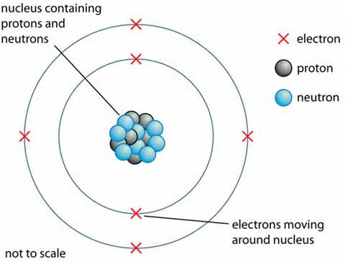
Atom Structure

Slide 5
Properties of Electrical Charge
Charges of the same sign ..
“ repel one another “ .
Charges with opposite signs ..
“ attract one another “ .

Slide 6
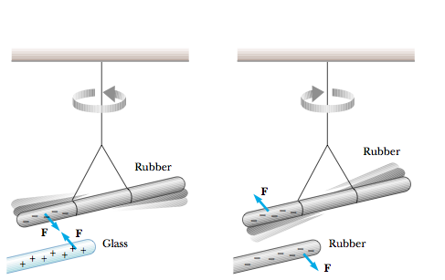
Properties of Electrical Charge

Slide 7
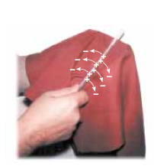
Properties of Electrical Charge
Electric charge is always conserved .

Slide 8
Properties of Electrical Charge
The electrical charge is always quantized .

Slide 9
Summery
There are two kinds of charges in nature; charges of opposite sign attract one another and charges of the same sign repel one another.
Total charge is conserved.
Charge is quantized.

Slide 10
Thank you

