Slide 1
Public Health and ELDERLY CARE

Slide 2
Objectives:
By the end of session, students will be able to:
Explain who are old.
Categorize old people.
Discuss morbidity in old age.
Identify health needs for old people.
Recognize components of geriatric care.
Express understanding how to be healthy old.
Discuss discrimination in care by gender.

Slide 3
TRADITION SPEAK…
Elderly are those 65 years and over.
World is ageing, people live longer, number of old age is increasing worldwide. (why?)
Globally, 70 percent of all older people now live in low or middle-income countries.
The form of elderly care provided varies greatly among countries and is changing rapidly

Slide 4
Worldwide Trend of Population of 60 Years and Above : 1980-2020
 | 1980 | 1990 | 2000 | 2010 | 2020
World | 381.2 | 484.7 | 608.7 | 754.2 | 1011.6
Developed | 173.3 | 203.6 | 234.6 | 232.4 | 308.2
Developing | 207.9 | 281.8 | 374.1 | 491.8 | 703.4
Africa | 23.4 | 30.9 | 41.8 | 57 | 82
Latin America | 23.4 | 31.7 | 41.9 | 56.4 | 80.7
Asia (excl. Japan) | 160 | 218.2 | 290 | 377.7 | 539.9
China | 78.6 | 101.2 | 131.7 | 167.9 | 238.9
India | 44.6 | 60.2 | 81.4 | 107 | 149.7
United Nations,World Demographic Estimate and Projections

Slide 5
Proportion of Aged 60 and Over Population (in Per cent)
 | 1980 | 1990 | 2000 | 2010 | 2020
World | 8.6 | 9.2 | 9.9 | 10.8 | 12.9
Developed | 15.2 | 16.8 | 18.4 | 19.7 | 22.4
Developing | 6.3 | 7 | 7.7 | 8.7 | 10.9
Africa | 4.9 | 4.8 | 4.8 | 4.9 | 5.6
Latin America | 6.5 | 7 | 7.7 | 8.8 | 11
Asia (excl. Japan) | 6.5 | 7.4 | 8.5 | 9.8 | 12.8
China | 7.4 | 9 | 10.5 | 12.4 | 16.6
India | 6.5 | 7.3 | 8.4 | 9.9 | 12.6
United Nations,World Demographic Estimate and Projections

Slide 6
Elderly Population-Facts!
Aging of population is an end product of demographic transition.
The number of elderly people in developing countries is almost 3-4 times of that of developed countries.
The developed countries have already experienced the consequences of this transition.
Older people are a heterogeneous group: independently pursuing career, retired, caring for family members, frail dependent upon others.

Slide 7
Definitions
Gerontology: science studying ageing.
Geriatrics: branch of medicine dealing with old age.
Geriatric care: elder care or senior health care.
Healthy ageing: process of optimizing opportunities for health, participation and security to enhance quality of life as people age. (WHO)

Slide 8
Categories of old age
Entering old age: have completed their career in paid employment and child rearing. (50-60 women, 50-65 men)
Transitional phase: between healthy active life and frailty. (up to 80)
Frail older people: vulnerable as a result of health problems e.g. stroke, dementia. (usually over 80)

Slide 9
Morbidity in old age
As a person ages, cumulative exposure to environmental risk increases causing chronic diseases and disability.
Alzheimer's Disease, Mental Illnesses Arthritis and Osteoarthritis Blood Pressure, Stroke, Cancer
Heart problems and Heart attack
Diabetes, Kidney disease, Obesity Prostate Enlargement, Osteoporosis, Tuberculosis, Eyes Diseases, Skin disease

Slide 10
Factors affecting well-being of old age
1. fear about neighbourhood can affect going out of home, physical health, mental health, social isolation.
2. inequalities of health care according to socio-economic status.

Slide 11
Objectives of geriatric health program
Maintenance of health to keep aging person in good health with satisfactory social life.
Prevention of health hazards associated with aging or retarding their onset.
Control of health hazards to minimize their sequelae and allow satisfactory function.
Management of disability and rehabilitation (medical, social, psychological) for self independence.

Slide 12
How to provide geriatric care?
encourage geriatric units in hospitals and clinics
infirmary care units
emphasis on family care of the aged through incentives and schemes for the needy families
promotion of values through formal education and media
subsidizing old age homes and day care centers

Slide 13
A significant aim of Public health is to increase the period of later life free from poor health, incapacity and dependency.
Prevention of morbidity and disability rather than mortality may be a more relevant focus for older people.

Slide 14
Health needs for old people
Health care and psychological care with other needed services such as: housing, home care services, nutritional services, assistance with activities of daily living, socialization programs, as well as financial and legal planning (e.g. banking, trusts).
Older people want help which enables them to remain independent .
Multi-professional care should aim to support individuals to achieve their goals rather than focusing on health deficit.

Slide 15
It is important to meet their long term care needs, improve their quality of life, and maintain their independence for as long as possible.
It entails working with persons of old age and their families in managing, rendering and referring various types of health and social care services.

Slide 16
Geriatric services
1. nutrition
2. social welfare
3. Health education
4. Socio-economic promotion
5. Health appraisal

Slide 17
1. Nutrition
Nutrition education of elderly and family.
Dietary supplementation by minerals and vitamins as needed.
Management of anorexia that contributes to nutritional deficiency.
Subsidized and geriatric foods.

Slide 18
2. Social welfare
Convenient living accomodations with his family or in geriatric home.
Suitable work or activity according to health status and social conditions.
Establishment of geriatric club for suitable physical activity and social recreation.

Slide 19
3. Health education
Teaching and counseling of elderly for principles of healthy life style (personal approach and mass media).
4. socio-economic promotion
Satisfactory income and social service to solve problems and provide support.
Convenient living conditions at home or geriatric home.

Slide 20
5. Health appraisal
Periodic medical examination.
Screening tests e.g glucoma, cancer.
Survey study to identify magnitude of geriatric problems , causes of morbidity.
Curative services: diagnosis and management of disease.
Home visits may be necessary for medical care, social service and health education.

Slide 21
Types of long-term care
A variety of services which help meet both the medical and non-medical needs of people with a chronic illness or disability who cannot care for themselves for long periods of time.
Long-term care provided formally in the home.
Informal long-term home care is care and support provided by family members, friends and other unpaid volunteers.

Slide 22
Nursing, drug therapy, physical therapy.
Installing hydraulic lifts, renovating bathrooms and kitchens.
Non-skilled care, such as assisting with normal daily tasks like dressing, bathing, and using the bathroom.
Can be covered by health insurance or long-term care insurance.

Slide 23
Suggestions to remain healthy
Drink enough water.
Exercise regularly.
Engage in recreational activities.
Well balanced diet.
Exercise your brain
Keep your eyes and ears fit by regular checkup
Check your BP
Walking Helps Us Preserve Memory
Sound Sleep
A 30-minute daily walk cuts cancer risk
Control your overweight

Slide 24
Traditionally, elderly care has been the responsibility of family members and was provided within the extended family home.
Increasingly in modern societies, elderly care is provided by state or charitable institutions.
The reasons: decreasing family size, the greater life expectancy of elderly people, the geographical dispersion of families, and the tendency for women to be educated and work outside the home

Slide 25
Gender discrepancies in elderly care
majority of informal family caregivers are women.
The average caregiver may be age 46, female, married and working outside the home.
Although men also provide assistance, female caregivers may spend as much as 50% more time providing care than male caregivers.”

Slide 26
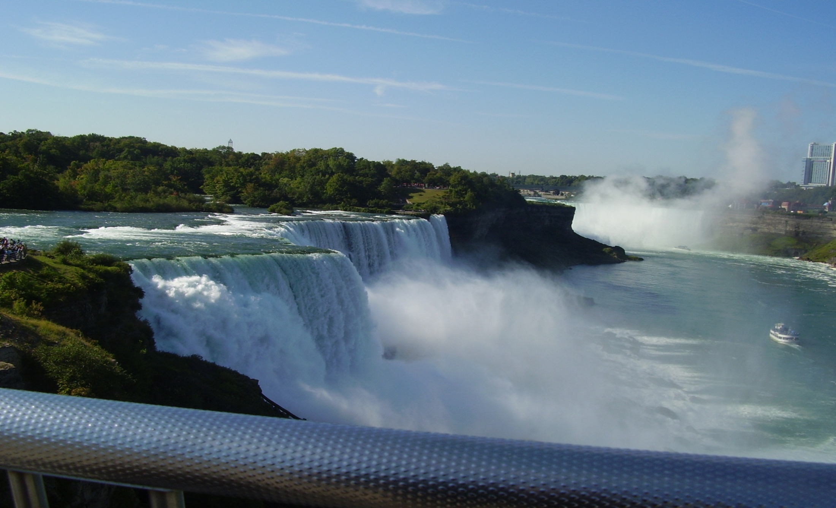
THANKS

