Slide 1
Operations Management and Quality for Producing Goods and Service
7

Slide 2
Explain the meaning of the term production or operations.
Identify the characteristics that distinguish service operations from goods production.
Explain how companies with different business strategies are best served by having different operations capabilities.
Identify the major factors that are considered in operations planning.
Discuss the information contained in four kinds of operations schedules—the master operations schedule, detailed schedule, staff schedule, and project schedule.
Discuss the two key activities required for operations control.
Identify the activities and underlying objectives involved in total quality management.
Explain how a supply chain strategy differs from traditional strategies for coordinating operations among firms.

Slide 3
What Does Operations Mean Today?
Operations (Production)
activities involved in making products — goods and services — for customers.
Service Operations (Service Production)
activities producing intangible and tangible products, such as entertainment, transportation, and education.
Goods Operations (Goods Production)
activities producing tangible products, such as radios, newspapers, buses, and textbooks
Notes:
The term operations (or production) refers to all the activities involved in making products—goods and services—for customers.

Slide 4
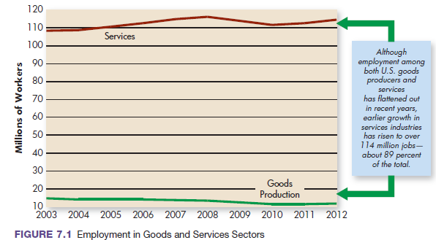
Growth in the Services and Goods Sectors
Notes:
Both goods and service industries are important, but as you can see from Figure 7.1, employment has risen significantly in the service sector and has leveled off at just 11 to 12 percent in goods-producing industries for years 2003 through 2012. Much of this growth comes from e-commerce, business services, health care, amusement and recreation, and education.

Slide 5
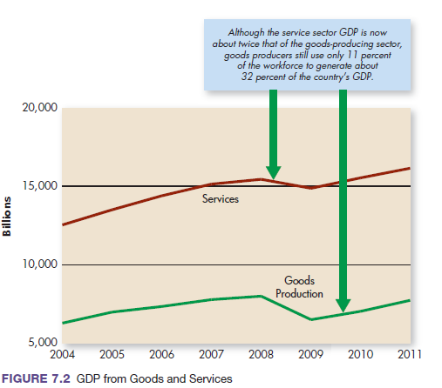
GDP from Goods and Services
Notes:
By 2011, the service sector’s growth generated about 68 percent of private-sector national income. As Figure 7.2 shows, the service sector’s greater percentage of GDP has hovered above 65 percent in recent years. At the same time, the smaller 11 percent of the workforce in goods-producing jobs produced 32 percent of national income.

Slide 6
Creating Value Through Operations
Production
makes products available: By converting raw materials and human skills into finished goods and services, production creates utility.
Utility
product’s ability to satisfy a human want or need (customer value)
Creating a product that customers value results from organized efforts (operation management).
Notes:
• Production makes products available: By converting raw materials and human skills into finished goods and services, production creates form utility, as when Regal Cinemas combines building materials, theater seats, and projection equipment to create entertainment.
• When a theater offers midday, afternoon, and evening shows seven days a week, it creates time utility; that is, it adds customer value by making products available when consumers want them.
• When a theater offers a choice of 15 movies, all under one roof at a popular location, it creates place utility: it makes products available where they are convenient for consumers.

Slide 7
Operations Management
Operations (Production) Management
systematic direction and control of the activities that transform resources into finished products that create value for and provide benefits to customers.
Operations (Production) Managers
managers responsible for ensuring that operations activities create value and provide benefits to customers.
Notes:
• Production makes products available: By converting raw materials and human skills into finished goods and services, production creates form utility, as when Regal Cinemas combines building materials, theater seats, and projection equipment to create entertainment.
• When a theater offers midday, afternoon, and evening shows seven days a week, it creates time utility; that is, it adds customer value by making products available when consumers want them.
• When a theater offers a choice of 15 movies, all under one roof at a popular location, it creates place utility: it makes products available where they are convenient for consumers.

Slide 8
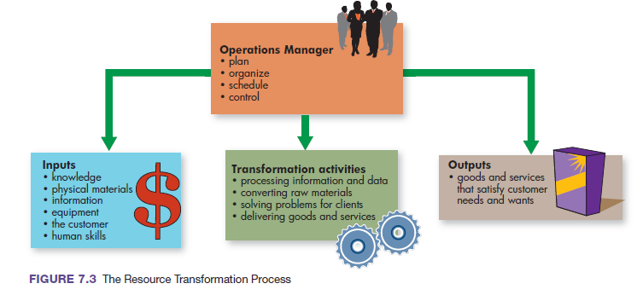
The Resource Transformation Process
Notes:
As Figure 7.3 shows, operations managers draw up plans to transform resources into products. First, they bring together basic resources: knowledge, physical materials, information, equipment, the customer, and human skills. Then, they put them to effective use in a facility where the service is provided or the physical good is produced. As demand for a product increases, operations managers schedule and control work to produce the required amount. Finally, they control costs, quality levels, inventory, and facilities and equipment. In some businesses, often in small startup firms such as sole proprietorships, the operations manager is one person.

Slide 9
Differences between Service and Goods Manufacturing Operations
Interacting with customers
The intangible and unstorable nature of some services
The customer’s presence in the process
Service quality considerations
Notes:
There are several obvious differences between service and manufacturing operations. Four aspects of service operations can make service production more complicated than simple goods production: (1) interacting with customers, (2) the intangible and unstorable nature of some services, (3) the customer’s presence in the process, and (4) service quality considerations.

Slide 10
Operations Processes
Operations Process
Set of methods and technologies used to produce a good or a service.
Operations processes for goods can be classified to whether “make-to-order or make-to-stock:
Make-to-Order Operations
activities for one-of-a-kind or custom-made production.
Make-to-Stock Operations
activities for producing standardized products for mass consumption.
Notes:
An operations process is a set of methods and technologies used to produce a good or a service. Banks, for example, use two processes—document shredding and data encryption—to protect confidential information. Automakers use precision painting methods (equipment and materials) to produce a glittering paint finish.
Clothing, such as evening gowns, is available either off-the-shelf in department stores or custom-made at a designer or tailor shop. The designer or tailor’s make-to-order operations respond to one-of-a-kind gown requirements, including unique patterns, materials, sizes, and shapes, depending
on customers’ characteristics. Make-to-stock operations, in contrast, produce standard gowns in large quantities to be stocked on store shelves or in displays for mass consumption.

Slide 11
Operations Processes
Operations processes for Services can be classified according to extent of customer contact:
Low-Contact System
level of customer contact in which the customer need not be part of the system to receive the service (e.g. postal operations).
High-Contact System
level of customer contact in which the customer is part of the system during service delivery (e.g. transportation).
Notes:
Consider the postal delivery operations at your local U.S. post office. Postal employees gather mail, sort it, and send it on its delivery journey to addressees. This operation is a low-contact system: Customers are not in contact with the post office while the service is performed. They receive the service— mail sent and mail received—without setting foot in the processing center.
High-Contact Systems Think about your local public transit system. The service is transportation; when you purchase transportation, you board a bus or train. For example, the Bay Area Rapid Transit (BART) system, which connects San Francisco with outlying suburbs is, like all public transit systems, a high-contact system

Slide 12
Business Strategy and Operations
Business strategy
Each firm selects a business strategy that attract customers such as: quality, low price, flexibility, and dependability).
Business strategy determines operations capabilities and successful firms design their operations to support the company’s business strategy.
Operations Capability (Production Capability)
special ability that production does especially well to outperform the competition.

Slide 13
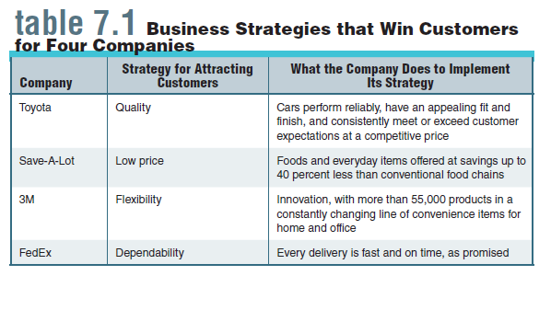
Business Strategies That Win Customers for Four Companies
Notes:
Consider the four firms listed in Table 7.1. Two are in goods production (Toyota and 3M), and two are in services.
These companies have contrasting business strategies and, as we shall see, they have chosen different operations capabilities.
All four firms have been successful, but they’ve taken quite different operations paths to get there.
Each company has identified a business strategy that it uses for attracting customers in its industry.

Slide 14
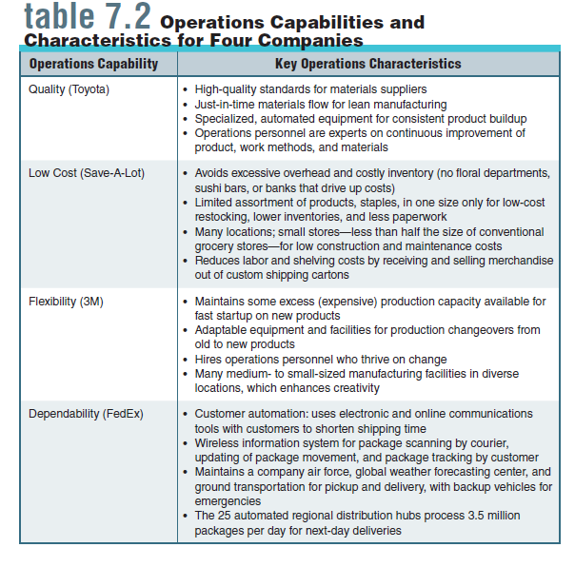
Operations Capabilities and Characteristics for Four Companies
Notes:
The top-priority operations capability (production capability)—the special ability that production does especially well to outperform the competition—is listed for each firm in Table 7.2, along with key operations characteristics for implementing that capability.

Slide 15
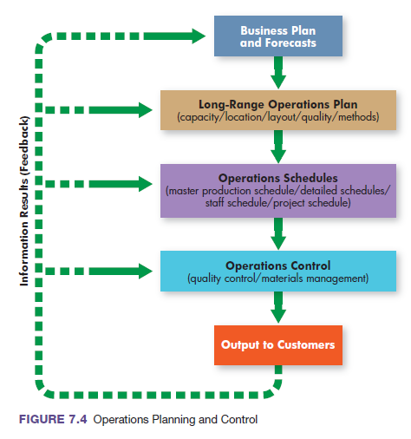
Operations Planning and Control
The business plan and forecasts developed by top managers provide guidance for long-term operations plans. Covering a two-to five-year period, the operations plan anticipates the number of plants or service facilities and the amount of labor, equipment, transportation, and storage needed to meet future demand for new and existing product.
Notes:
Let’s turn now to a discussion of production activities and resources that are considered in every business organization. Like all good managers, we start with planning. Managers from many departments contribute to decisions about operations. As Figure 7.4 shows, however, no matter how many decision makers are involved, the process is a logical sequence of decisions.

Slide 16
Operations Plan categories
Capacity Planning
determining the amount of a product that a company can produce under normal conditions.
A firm’s capacity depends on how many people it employs and the number and size of its facilities.
Location Planning
determining where production will happen based on costs and flexibility.
Layout Planning
planning for the layout of machinery, equipment, and supplies
Quality Planning
Every operations plan include activities for insuring the products meet quality standards.
Methods planning
It contain production steps and methods for performing them.
Notes:
The amount of a product that a company can produce under normal conditions is its capacity. A firm’s capacity depends on how many people it employs and the number and size of its facilities.

Slide 17
Layout Planning
Among the many layout possibilities, two well known are:
Process Layout (Custom-Product Layout)
physical arrangement of production activities that groups equipment and people according to function.
Product Layout (Same-Steps Layout)
physical arrangement of production steps designed to make one type of product in a fixed sequence of activities according to its production requirements.
Assembly Line Layout is a same-steps layout used in case of large volume or production, in which a product moves step by step through a plant on conveyor belts or other equipment until it is completed.
Notes:
In a process layout (also called custom-product layout), which is well suited to make-to-order shops (or job shops) specializing in custom work, equipment and people are grouped according to function. FedEx Office stores (formerly Kinko’s Copy Centers), for example, use custom-products layouts to accommodate a variety of custom jobs.
A product layout (also called a same-steps layout or assembly line layout) is set up to provide one type of service or make one type of product in a fixed sequence of production steps. All units go through the same set of steps.

Slide 18
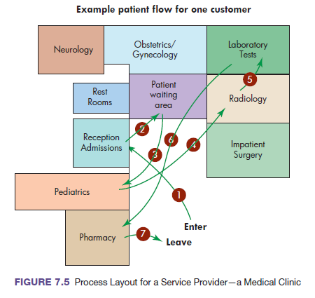
Process Layout for a Service Provider
Notes:
Figure 7.5 shows the process layout of a service provider—a medical clinic. The path taken through the facility reflects the unique treatments for one patient’s visit

Slide 19
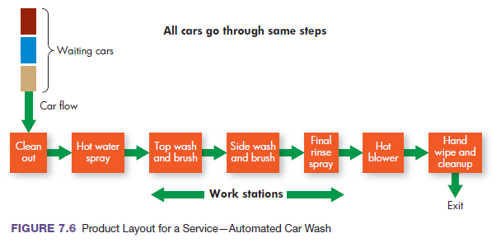
Product Layout for a Service
Notes:
Figure 7.6 shows a product layout at a service provider—an automatic car wash.

Slide 20
Quality Planning
Quality
combination of “characteristics of a product or service that bear on its ability to satisfy stated or implied needs”.
Early in the planning process, goals are established for both performance and consistency:
Performance: dimension of quality that refers to how well a product does what it is supposed to do.
Consistency: dimension of quality that refers to sameness of product quality from unit to unit.

Slide 21
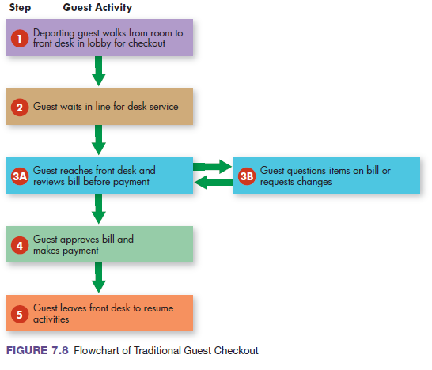
Methods panning Flowchart of Traditional Guest Checkout
Notes:
Consider, for example, the traditional checkout method at hotels. The process flowchart in Figure 7.8 shows five stages of customer activities.

Slide 22
Operations Scheduling
Master schedule
“the game plan” for upcoming production.
Detailed schedules
show day-to-day activities that will occur in production.
Staff schedules.
identify who and how many employees will be working, and when
Project schedules
provide coordination for completing large-scale projects.
Notes:
Scheduling of operation occurs at different levels. First, a top-level master operations schedule shows which services or products will be produced and when, in upcoming time periods.
Although the master production schedule is the backbone for overall scheduling, additional information comes from detailed schedules, schedules showing daily work assignments with start and stop times for assigned jobs at each work station.

Slide 23
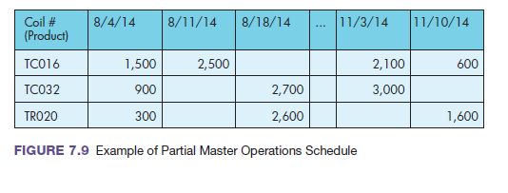
Example of Partial Master Operations Schedule

Slide 24
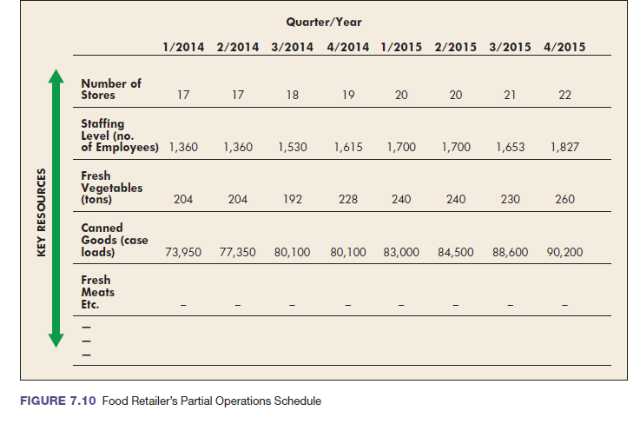
Food Retailer’s Partial Operations Schedule

Slide 25
Project Scheduling
Gantt Chart
production schedule that breaks down large projects into steps to be performed and specifies the time required to perform each step.
Pert Chart
production schedule specifying the sequence of activities, time requirements, and critical path for performing the steps in a project.
Notes:
A Gantt chart breaks down large projects into steps to be performed and specifies the time required to perform each one.
The project manager lists all activities needed to complete the work, estimates the time required for each step, records the progress on the chart, and checks the progress against the time scale on the chart to keep the project moving on schedule.

Slide 26
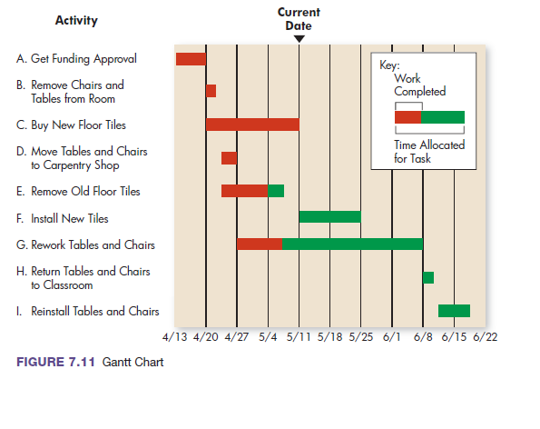
Gantt Chart
Notes:
Figure 7.11 shows a Gantt chart for the renovation of a college classroom. It shows progress to date and schedules for remaining work and that some steps can be performed at the same time (e.g., step D can be performed during the same time as steps C and E), but others cannot (e.g., step A must be completed before any of the others can begin). Step E is behind schedule; it should have been completed before the current date.

Slide 27
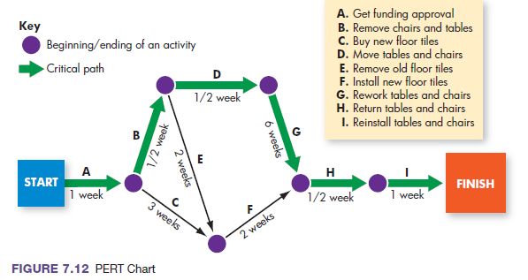
PERT Chart
Notes:
Figure 7.12 shows a PERT chart for renovating the college classroom. The project’s nine activities and the times required to complete them are identified. Each activity is represented by an arrow. The arrows are positioned to show the required sequence for performing the activities.

Slide 28
Operations Control
Operations Control
process of monitoring production performance by comparing results with plans and taking corrective action when needed.
Follow-Up
operations control activity for ensuring that production decisions are being implemented.
operations control includes:
material management
quality control.

Slide 29
Materials Management
Materials management
the process by which managers plan, organize, and control the flow of materials from sources of supply through distribution of finished goods.
Materials managers engage in the following areas that compose materials management of physical products:
1- Supplier Selection
process of finding and choosing suppliers from whom to buy
2- Purchasing
acquisition of the materials and services that a firm needs to produce its products.
Notes:
Most of us have difficulty keeping track of personal items now and then—clothes, books, cell phones, and so on. Imagine keeping track of thousands, or even millions, of things at any one time. That’s the challenge in materials management, the process by which managers plan, organize, and control the flow of materials from sources of supply through distribution of finished goods. For manufacturing firms, typical materials costs make up 50 to 75 percent of total product costs.
Supplier selection is the process of finding and choosing suppliers of services and materials. This step includes evaluating potential suppliers, negotiating terms of service, and maintaining positive buyer–seller relationships.
Purchasing is the acquisition of all the raw materials and services that a company needs to produce its products. Most large firms have purchasing departments to buy proper services and materials in the amounts needed.

Slide 30
Materials Management
3- Transportation
activities in transporting resources to the producer and finished goods to customers
4- Warehousing
storage of incoming materials for production and finished goods for distribution to customers
5- Inventory Control
process of receiving, storing, handling, and counting of all raw materials, partly finished goods, and finished goods
Notes:
Transportation is the means of transporting resources to the producer and finished goods to customers.
Warehousing is the storage of both incoming materials for production and finished goods for distribution to customers.
Inventory control includes the receiving, storing, handling, and counting of all raw materials, partly finished goods, and finished goods. It ensures that enough materials inventories are available to meet production schedules, while at the same time avoiding expensive excess inventories.

Slide 31
Materials Management
Lean Production System
production system designed for smooth production flows that avoid inefficiencies, eliminate unnecessary inventories, and continuously improve production processes.
Just-in-Time (JIT) Production
type of lean production system that brings together all materials at the precise time they are required at each production stage.
Notes:
Managers must take timing into consideration when managing materials, as well. Pioneered by Toyota, lean production systems are designed for smooth production flows that avoid inefficiencies, eliminate unnecessary inventories, and continuously improve production processes.
Just-in-time (JIT) production, a type of lean system, brings together all needed materials at the precise moment they are required for each production stage, not before, thus creating fast and efficient responses to customer orders. All resources flow continuously—from arrival as raw materials to final assembly and shipment of finished products.

Slide 32
Quality Control
Quality and productivity are watchwords in today’s competitive environment. Companies are not only measuring productivity; they also are requiring quality. Hence they do both quality control and productivity measurement.
Quality Control
action of ensuring that operations produce products that meet specific quality standards.
Productivity
the amount of output produced compared with the amount of resources used to produce that output
Notes:
Quality control is taking action to ensure that operations produce goods or services that meet specific quality standards. Consider, for example, service operations in which customer satisfaction depends largely on the employees who provide the service. By monitoring services, managers and other employees can detect mistakes and make corrections.

Slide 33
Managing for Quality
Total Quality Management (TQM)
all activities involved in getting high quality goods and services into the marketplace.
Quality Ownership
principle of total quality management that holds that quality belongs to each person who creates it while performing a job.
Notes:
Total quality management (TQM) includes all the activities necessary for getting high-quality goods and services into the marketplace. TQM begins with leadership and a desire for continuously improving both processes and products. It must consider all aspects of a business, including customers, suppliers, and employees. To marshal the interests of all these stakeholders, TQM first evaluates the costs of poor quality. TQM then identifies the sources causing unsatisfactory quality, assigns responsibility for corrections, and ensures that those who are responsible take steps for
improving quality.
The backbone of TQM, however, and its biggest challenge, is motivating all employees and the company’s suppliers to achieve quality goals. Leaders of the quality movement use various methods and resources to foster a quality focus, such as training, verbal encouragement, teamwork, and tying compensation to work quality. When those efforts succeed, employees and suppliers will ultimately accept quality ownership, the idea that quality belongs to each person who creates it while performing a job.

Slide 34
Tools for Total Quality Management
Competitive Product Analysis
process by which a company analyzes a competitor’s products to identify desirable improvements.
Value-Added Analysis
process of evaluating all work activities, materials flows, and paperwork to determine the value that they add for customers.
Quality Improvement Team
TQM tool in which collaborative groups of employees from various work areas work together to improve quality by solving common shared production problems.
Notes:
Hundreds of tools have proven useful for quality improvement, ranging from statistical analysis of product data, to satisfaction surveys of customers, to competitive product analysis, a process by which a company analyzes a competitor’s products to identify desirable improvements.
Value-added analysis refers to the evaluation of all work activities, materials flows, and paperwork to determine the value that they add for customers. It often reveals wasteful or unnecessary activities that can be eliminated without jeopardizing customer service.

Slide 35
Tools for Total Quality Management (cont.)
ISO 9000
program certifying that a factory, laboratory, or office has met the quality management standards set by the International Organization for Standardization.
ISO 14000
certification program attesting to the fact that a factory, laboratory, or office has improved its environmental performance.
Business Process Reengineering
rethinking and radical redesign of business processes to improve performance, quality, and productivity.
Notes:
The ISO 14000 program certifies improvements in environmental performance by requiring a firm to develop an environmental management system: a plan documenting how the company has acted to improve its performance in using resources (such as raw materials) and in managing pollution. A company must not only identify hazardous wastes that it expects to create, but it must also stipulate
plans for treatment and disposal.
Business process reengineering focuses on improving a business process—rethinking each of its steps by starting from scratch. Reengineering is the fundamental rethinking and radical redesign of business processes to achieve dramatic improvements as measured by cost, quality, service, and speed.

Slide 36
Adding Value Through Supply Chains
Supply Chain (Value Chain)
flow of information, materials, and services that starts with raw-materials suppliers and continues adding value through other stages in the network of firms until the product reaches the end customer
Supply Chain Management (SCM)
principle of looking at the supply chain as a whole to improve the overall flow through the system
Notes:
The term supply chain refers to the group of companies and stream of activities that work together to create a product. A supply chain (or value chain) for any product is the flow of information, materials, and services that starts with raw-materials suppliers and continues adding value through other stages in the network of firms until the product reaches the end customer.
Supply chain management (SCM) looks at the chain as a whole to improve the overall flow through a system composed of companies working together. Because customers ultimately get better value, supply chain management gains competitive advantage for each of the chain’s members.

Slide 37
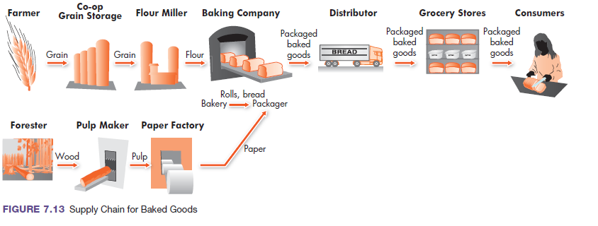
Supply Chain
Notes:
Figure 7.13 shows the chain of activities for supplying baked goods to consumers. Each stage adds value for the final customer.

Slide 38
Outsourcing and Global Supply Chains
Outsourcing
It is a strategy of replacing internal processes by paying suppliers and distributors to perform business processes or to provide needed materials or services.
Notes:
Outsourcing is the strategy of paying suppliers and distributors to perform certain business processes or to provide needed materials or services. The decision to outsource expands supply chains. The movement of manufacturing and service operations from the United States to countries such as China, Mexico, and India has reduced U.S. employment in traditional jobs. It has also created new operations jobs for SCM.

