Slide 1
E-MARKETING (INTERNET MARKETING)
Chapter – 5
Banner Advertising/
Banner Exchange
BY: Dr. Showkat Hussain Gani

Slide 2
Banner Advertising
Banner Exchange
A banner advertisement is an image placed at the top or bottom of a web page, to catch the viewer's eye and possibly prompt them to click on it.
It can either be static, that is, simply like a billboard displaying the name of a website, or dynamic, encouraging the user to click on the banner image to be transferred to that website.
Banner advertising is based on one-to-many advertising rather than one-to-one. It has traditionally been the most common form of promotion on the web.

Slide 3
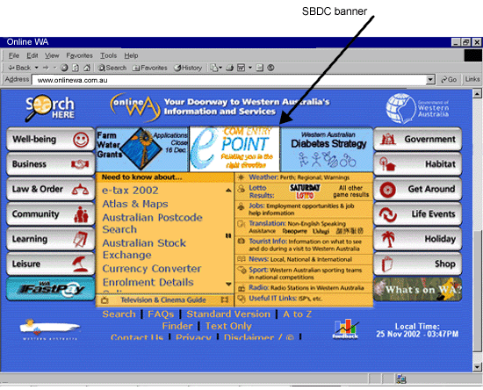
Banner Advertising
Banner Exchange

Slide 4
Banner/Link Exchanges
Banner Exchange
A banner exchange (link exchange) is a cooperative advertising program where participating businesses work together to promote each other's products/services and websites on an exchange rather than paid basis.
Banner exchanges have management systems that track when and where banners are displayed throughout the network. Every time you display the banner of another member, you receive a credit. Based on these credits, the management system ensures that your banner is displayed at other sites in the banner exchange network.

Slide 5
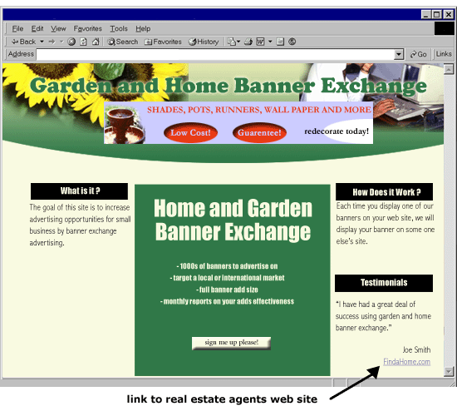
Banner/Link Exchanges
Banner Exchange

Slide 6
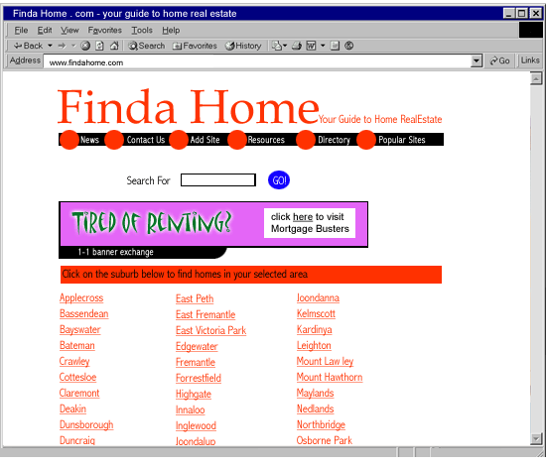
Banner/Link Exchanges
Banner Exchange

Slide 7
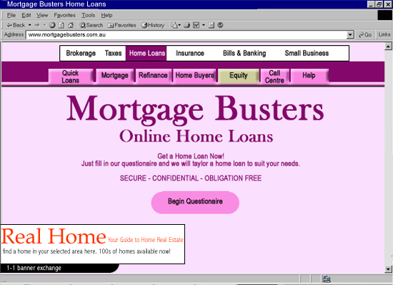
Banner/Link Exchanges
Banner Exchange

Slide 8
Banner Branding vs. Click-Throughs (impression vs click)
Banner
Banner Exchange
There are two goals of a banner campaign, branding and click-throughs.
A branding campaign is more concerned with how many people see the brand name and not as much with how often it is clicked.
Coke, for example, just wants to bring their name to mind, visiting their Web site, is secondary.

Slide 9
Banner Terminology
Banner Exchange
Banner Impression - You display a banner on your Web site one time.
Banner Exposure - A banner company displays your banner one time.
Exchange Ratio - How many impressions you must display to receive an exposure.
Click-Through Ratio (CTR) - the percentage of clicks on a banner relative to the total number of banner displays.
CPM - Cost per 1000 impressions, a typical purchase rate is $10 per thousand.
Banner Dimensions - The standard banner size for nearly all banner networks is 486x80, meaning 486 screen pixels wide and 80 pixels tall.
Real Traffic - any visitor who clicks a banner to visit a page then subsequently clicks a link on that page.

Slide 10
Banner Optimization
Banner Exchange
Banner Size
How quickly a banner loads can determine whether a banner is seen at all. Many banner networks will allow you to place a banner up to 10K in size, which can take 5 seconds to load. You should avoid any banners larger than 4K as this ensures your banners load in 2 seconds or less.

Slide 11
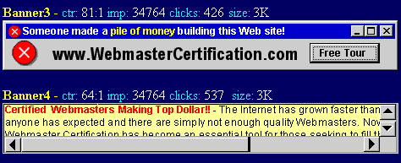
Banner Optimization
Banner Exchange
Banner Colors
Bright colors get the most mileage. Yellow, orange, and green attract more attention than red, blue and black. A banner that gives the appearance of a yellow page ad is highly effective.

Slide 12
Banner Optimization
Banner Exchange
Banner Graphics
Simple animated graphics and animated banners which switch between three frames of text are very effective.

Slide 13
Banner Optimization
Banner Exchange
Next, banners that look like error messages, selection boxes, submit buttons, or a scrollable windows are also very effective.

Slide 14
Banner Optimization
Banner Exchange
Banner Content
Of course the banner message is very important. The message should convey what is in it for the visitor: how they can save, how they can benefit, why them, etc. The content should focus on emotions like fear, curiosity, humor, or the big promise.
The word "FREE" is still the most powerful word in advertising. Offer a free drawing, free subscription to an e-zine, free advertising, free trial offer, free download for software, etc. For example, WebYoda offers a free tour of the Internet which is pulled as a sample of the Mastering the Internet course.

Slide 15
Banner Optimization
Banner Exchange
Banner Branding
Since nearly 99% of all banners are never clicked on, you need to get as much mileage out of the non-clicked banners as you can. Branding at least leaves the opportunity for the surfer to see your company name, Web address or logo.

Slide 16
Banner Optimization
Banner Exchange
The Submit Button Call to Action
A call to action is also known to raise response rates. Simple phrases such as "Click Here," "Visit Now" and "Enter Here" tend to improve response rates by 15%. These phrases should be strategically placed in the ad, preferably on the right side, as this is where the eye will be drawn.

Slide 17
Banner Optimization
Banner Exchange
Cloaked Banners
One fairly new technique is to build a banner with a clear background, no border, option buttons, and text instructions. When done correctly, the banner will appear to be an integral part of the Web site and lose the banner look all together.

Slide 18
Pay Per Banner Impressions
Banner Exchange
Overview
The www.doubleclick.net banner network is by far the largest pay per banner network, with fees starting around $15 per thousand impressions. A visit to any major site that displays banners other than their own is likely to feed from www.doubleclick.net.
Web Site Specific Banners
The key advantage to purchasing banners on a specific Web site is to ensure a quality demographics match. For example, if you sell sports cards, then placing a banner campaign at a sports cards magazine site, such as www.beckett.com, ensures your banners are displayed to visitors who are likely interested in sports cards.
Search Engine Banners
Another method to qualify your traffic is to purchase banners on a search engine site such as Yahoo.com, Google.com , and DirectHit.com. Google.com for example, places three banner ads to the right of all search results. The pricing is $15 per 1000 impressions.

Slide 19
Pay Per Banner Impressions
Banner Exchange
Banner Program Options
If you do decide to purchase a banner campaign, don't forget you may have options. First, consider purchasing click-throughs and not banner impressions as this will yield more quality traffic. If branding is your main focus, then a banner impression campaign may be right for you.
Next, be sure to target your banners to best fit the demographics of your potential traffic. Last, be sure to check your banner statistics supplied by the banner network regularly to see where your best traffic is coming from. This can help you fine tune your banner ad campaign.

Slide 20
Free Banner Exchanges
Banner Exchange
Free banner exchanges agree to display your banners for free in exchange for you displaying other member banners on your Web site. For new companies with little to no advertising budget, banner exchanges are an option to consider.
www.bcentral.com is by far the largest of the banner exchanges, meaning they have the largest Web site participation base. This does not always equate to the best option however, as we will see.
It is important to note that banner exchange networks also generate revenue by selling banners across their network, but you are NOT required to purchase banners.

Slide 21
Grading Banner Exchanges
Banner Exchange
Not All Banner Networks Are Equal
There are literally thousands of banner exchange networks, many of which come and go on a daily basis.
Banner Exchange Ratio
The typical banner exchange ratio is 1:2 or 50%, meaning for every two banners you display on your sight, your banner will be displayed once across the banner network. Some banner networks will give you an exchange ratio as high as 1:1 or 100%, but as we will see later, this may be too good to be true.

Slide 22
Using Banner Exchange
Banner Exchange
Real Traffic Per Week
Rank | Link Exchange URL | RT/Week
1 | http://www.hitexchange.net | 4.27
2 | http://www.exchangead.com | 3.19
3 | http://www.sitebrand.com | 2.77
4 | http://www.bcentral.com | 2.31
5 | http://www.LinkBuddies.com | 2.28
6 | http://nbe.net-on.net | 2.24
7 | http://www.click2net.com | 0.95
8 | http://www.ms-links.com | 0.81
9 | http://www.free-banners.com | 0.63
10 | http://www.exchange-it.com | 0.56
11 | http://bannersxchange.com | 0.11
12 | http://Webmasters.bpath.com | 0.07
Choose a banner exchange
First you must choose the banner exchanges in which you would like to participate. The chart below ranks our top 12 banner exchanges based on how many real visitors we received each week from them, with all other variables the same.

Slide 23
Using Banner Exchange
Banner Exchange
Starting a banner exchange campaign
The steps to starting a banner campaign are simple. Use the steps below as a guide for any of the banner exchanges.
1) Create a 486x80 banner.
2) Choose a banner network.
3) Enter your Web site information.
4) Upload your banner as per their instructions.
5) Grab HTML code from their site to add banners to yours.
6) Add the HTML code to the top of a page on your site.
7) Wait for banner approval.
8) You will be emailed when you are approved.

Slide 24
Using Banner Exchange
Banner Exchange
Test Banners
Test your banners to see which are the most effective. This is done by running multiple banners on the same banner campaign and watch how they fare against each other. You do not need separate accounts for each banner as most banner networks will allow you to rotate multiple banners at once.
You must allow banners to be displayed a minimum of 1000 times on the banner network for an effective gauge of how well they are performing. The example below was one of our banner tests.

Slide 25
Free Banner Drawbacks
Banner Exchange
Losing Visitors to Other Sites
When using free banner exchanges, you potentially lose traffic to the banners displayed on your site. This damage should be minimal if your site truly has something great to offer the visitor. People are typically compelled to leave only when they are not satisfied where they are.
Ugly Banners On Your Site
In most banner networks, you have little control over the quality of the banners displayed on your site. Fortunately, all of the top 12 banner networks we recommend review all banners before they are displayed.
Inappropriate Banners Displayed
In this case the damage from inappropriate banners can be minimized. In some banner networks, adult-oriented banners are allowed. None of the 12 we reviewed for this course promote adult-oriented Web sites.

Slide 26
Free Banner Drawbacks
Banner Exchange
Wasted Banner Exposures
Fake Banner Exposures - Faking the banner systems to think you are displaying banners. You will be caught!
Hidden Banner Displays - Hiding the banner you are supposed to display in a hidden frame. You will be caught!
Contest Sites - Requiring visitors to click hundreds of times on a site to receive a free prize.
Free Gambling Sites - Allowing visitors to gamble free for small prizes where each page has a new banner.
Free Game Sites - Free online games that refresh banners at the top while you play.

Slide 27
Paid vs. Free Banners
Banner Exchange
Paid banners are preferred if your advertising budget can afford it. The truth is, free banners come at a price. You are given free banner impressions by the network in exchange for cluttering your site with banners that may lead to traffic leaving.
On the flip side, if you have a minimal advertising budget, then the free banner exchange may be the best solution for you in the early stages.

Slide 28
Reciprocal links
Banner Exchange
Reciprocal links are very similar to banner exchanges except there is a simple agreement between two web sites rather than an organised exchange.
Your business places a linked banner on an associated web site and they put their banner on your web site. It is common that the two web sites will sell associated products or have some sort of common theme however this is not necessary.

Slide 29
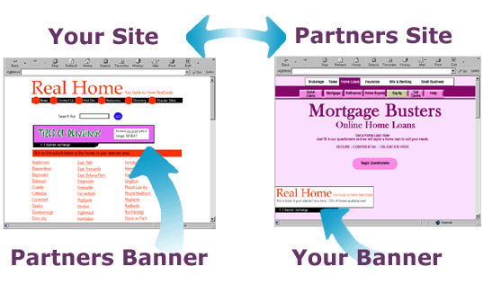
Reciprocal links
Banner Exchange

