Slide 1
E-MARKETING (INTERNET MARKETING)
Chapter – 2
Affiliate Marketing Program

Slide 2
Affiliate Marketing Program
Affiliate Program
Affiliate marketing is where you refer customers to other businesses via links to their web site from your web site or emails and receive commissions for each customer you refer to the other business. They are essentially revenue sharing arrangements between online vendors or sellers and resellers or affiliates.
If the business is "multi-level" you also receive commissions from the customers referred by other businesses you have introduced.
Conversely, you can set up your own affiliate marketing program to have other businesses sell your products and services for you by paying them a commission.

Slide 3
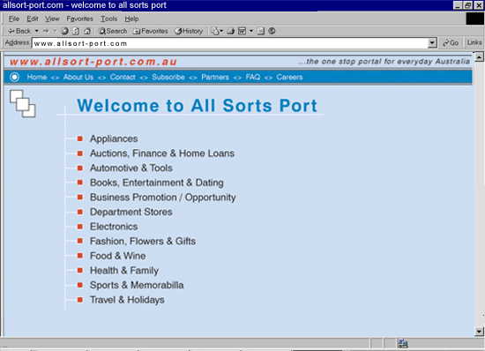
Affiliate Marketing Program
Affiliate Program

Slide 4
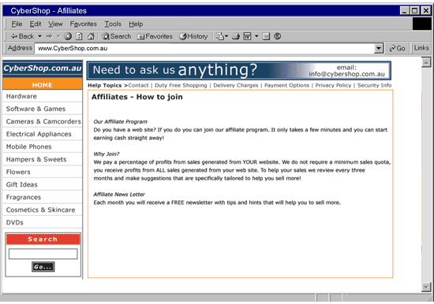
Affiliate Marketing Program
Affiliate Program

Slide 5
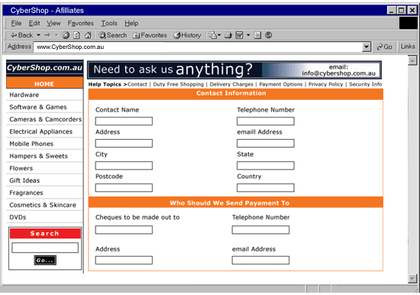
Affiliate Marketing Program
Affiliate Program

Slide 6
Affiliate Advantages
Affiliate Program
Increased sales.
Improves search engine link popularity.
The Internet becomes your sales team.
Low operating costs.
Sites with affiliate programs could be perceived as more significant.

Slide 7
Affiliate Disadvantages
Affiliate Program
Potentially expensive up-front costs.
Administrative overhead.
Accounting overhead.
Some profits go to the affiliate.

Slide 8
Affiliates vs. Advertising
Affiliate Program
In most cases, an affiliate program has a distinct advantage over an advertising campaign since you only pay your affiliates for traffic they generate to your site or sales they generate.
Thus, with an affiliate program, you pay for results after the fact, whereas advertising costs are all up-front and have no guaranteed results.

Slide 9
Affiliate Types
Affiliate Program
Commission Based
A commission-based program, also referred to as pay-per-sale, will pay the affiliate a commission for all sales that come directly from them. Meaning if a customer clicks a link on the affiliates site and then purchases from you, that affiliate would make a percentage of the total sale price. www.Amazon.com is the best example of this type program, they pay up to 15% of the sale price.
The commission is based on what the customer pays and not the retail price, so if the customer gets a discount, then the affiliate commission will be lower.

Slide 10
Affiliate Types
Affiliate Program
Flat-Fee Based
A flat-fee-based program, also called pay-per-lead, will pay a fixed amount for each new customer regardless of how much they spend. www.paypal.com is a good example of this model, they pay a $5 referral fee for all new customers sent by an affiliate.

Slide 11
Affiliate Types
Affiliate Program
Click-Through Based
A click-through-based program, also called pay-per-click, will pay the affiliate a fixed amount for each visitor they send to your Web site. www.overture.com is a good example of this model, they pay 2 cents for every click through. It doesn't sound like a lot, but it can add up quickly.

Slide 12
Affiliate Types
Affiliate Program
Banner-Impression Based
A banner-impression-based program, also called pay-per-impression, will pay the affiliate a fixed amount for each banner impression displayed on their site. www.doubleclick.com is a good example of this model, they pay about $5 per 1000 banners displayed.

Slide 13
Agreement Terms
Affiliate Program
The Affiliate Agreement Terms state how the affiliate will get paid, when they are paid, how refunds are handled, what the restrictions are, and any other terms on which you decide. The affiliate agreement is a very important part of your program and must be thought through completely.
This lesson will cover most of the considerations that will be in your affiliate agreement, but you will want to visit a major site such as www.Amazon.com for a more thorough sample of how affiliate terms should be worded.

Slide 14
Affiliate Payments
Affiliate Program
Payment Type
For consistency purposes, all payments should be made in U.S. dollars. This is because U.S. dollars are more universally accepted than any other currency. Next, be sure to mention United States Dollars (USD) when you refer to how much the affiliates will get paid so there is no confusion.
Payment Amount
To determine a fair price to pay your affiliate, first visit some sites with similar programs and see what they offer their affiliates. Next, in most companies it is assumed that about 12% of your budget is advertising. Thus you might allocate 10% of that towards the affiliate payments and 2% towards maintaining the program.
Payment Minimum
It is pretty standard practice for affiliate programs to have a reserve amount that must be met before payment is sent. For example www.amazon.com will not send you a check until you have accumulated $25 USD or more.
Payment Frequency
How often you send out payments can impact the loyalty of your affiliates as well. When possible, it is recommended that you send affiliate checks out once a month, or at worst quarterly. Be sure to define the payment schedule in your affiliate agreement and pay promptly according to that schedule.
Payment Delay
Due to fraud and refunds, it is necessary to have a built-in delay for payment in your affiliate program. Typical delays range from 45 days to 60 days. This allows time for any refunds or charge backs to surface before you pay out to the affiliates.

Slide 15
Building Affiliate Program
Affiliate Program
Out-sourcing
Creating the code to run your own affiliate program is the biggest task. Most Web site owners will choose to out-source this project to a Web development company that specializes in E-Commerce solutions. You are encouraged to review affiliate programs already in place by your out-source options before finalizing the deal.
Third Party Vendors
Another option is to purchase a third party package to add an affiliate program to your site. We recommend looking at www.AffiliateZone.com as a possible solution. They have a $75 USD setup fee and monthly fees of $34.95 USD per month.
Writing Your Own
The last option is to create your own. This requires some programming experience, but is a solution worth considering given the costs of outsourcing the project. Next it has the advantage of integrating completely into your site, unlike the results you might expect by attaching a third party affiliate program to your site.

Slide 16
Promote Affiliate Program
Affiliate Program
Mentioning your affiliate program in your newsletter is a great place to start promoting your affiliate program. You will also want one or more links to your affiliate program within your Web site. There are also some nice affiliate directories where you can list your program for free. Affiliate Directories
1. www.AssociatePrograms.com
2. www.Associate-it.com
3. www.CashPile.com
4. www.Refer-it.com

Slide 17
Affiliate Screening
Affiliate Program
You will want to review all Web sites requesting to participate in your affiliate program. This helps to ensure that sites with questionable content do not display a banner to your site. In most cases, the quality of the affiliate's Web site is not the issue, only the nature of the content for the site.

Slide 18
Affiliate Approval Notice
Affiliate Program
Once approved, you should send a confirmation email to new affiliates along with their affiliate ID and instructions on how to place the ad banner or link on their site. You should also remind them of any restrictions included in the affiliate agreement terms within the email.

Slide 19
Affiliate Code
Affiliate Program
For an affiliate to get credit, they need an affiliate ID. These typically come in two flavors, a promocode or an affiliate code. An affiliate code is granted to owners of Web sites that have been approved for linking to your site.
The affiliate code is added to their link to your site so that they can get credit for sales coming from their site. The example below passes the affiliate code 1047917. Affiliate link sample syntax: http://www.webmastercertification.com/wcoassociate.cfm?aff=1047917

Slide 20
Affiliate Tracking
Affiliate Program
Response tracking from an affiliate program can be handled easily by two methods. First, the campaign will contain a Web page address that is unique to the affiliate program with the affiliate ID tacked on the end. Then you will be able to track the sales for the associate ID.
Using both methods would allow you to compare how many people visited from the affiliate links relative to how many people purchased from them.

Slide 21
Affiliate Graphics
Affiliate Program
You will need to provide some graphics and link code to your affiliates so they can easily link to your site. The code would be the same for everyone except the affiliate ID would be different. The example below is a sample of what is used with Webmaster Certification Online's affiliate program. Result: Source Code: <a href=http://www.webmastercertification.com/aff.cfm?aff=21099> <img src=http://www.webmastercertification.com/images/aff3.gif width=230 height=33 border=0 hspace=0 alt="Get Webmaster Certified"></a>
You are encouraged to offer multiple graphic options in different sizes and colors to allow for more compatibility with your affiliate Web sites.

