Slide 1
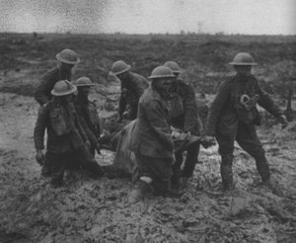
Dulce et decorum est
By Wilfred Owen

Slide 2
Context
Wilfred Owen fought and died in the First World War and much of his poetry is about the horrors of that conflict.
The Poet
Wilfred Owen is one of the most famous war poets. He was born in 1893 and died in 1918, just one week from the end of World War One. His poetry is characterised by powerful descriptions of the conditions faced by soldiers in the trenches.
World War One
World War One took place between 1914 and 1918 and is remembered particularly for trench warfare and the use of gas. Owing to the technological innovations in use during it, the war is often referred to as the first modern war.
The War Poets
Poets such as Wilfred Owen, Siegfried Sassoon, Isaac Rosenberg and Ivor Gurney have a strong association with World War One. As a group, their poems are often violent and realistic, challenging earlier poetry which communicated a pro-war message. The first-hand experience of war is arguably one reason why there is such a shift in the attitude of poets towards war.

Slide 3
Context
The war in brief:
The war in brief
1914
Germany invades Belgium.
Britain declares war on Germany.
Japan joins the Allied forces: Ottoman Empire soon joins the Central Powers.
War spreads to the seas.
1915
Women take up men's jobs.
Stalemate continues on the Western Front.
The Lusitania passenger liner is sunk, with 1,200 lives lost.
London attacked from the air by German Zeppelins.
1916
Conscription for men aged between 18 and 41.
A million casualties in ten months: Germany aims to 'bleed France white'.
At sea the Battle of Jutland takes place.
Armed uprisings in Dublin: the Irish Republic is proclaimed.
1917
German Army retreats to the Hindenburg Line.
United States joins the war and assists the Allies.
Tank, submarine and gas warfare intensifies.
Royal family change their surname to Windsor to appear more British.
1918
Germany launches major offensive on the Western Front.
Allies launch successful counter-offensives at the Marne and Amiens.
Armistice signed on November 11, ending the war at 11am.
In Britain, a coalition government is elected and women over 30 succeed in gaining the vote.

Slide 4

WW1 Poetry
Enthusiastic response to war and volunteering at first.
Propaganda – posters and war movies.
A wish for glory and adventure.
Patriotism
But then...
Disillusionment
Heavy number of casualties.
Conscription
An end to the illusion that problems could be solved peacefully.

Slide 5
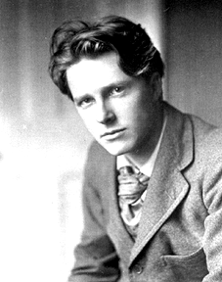
Early poetic response to war
Romantic sense of patriotic duty.
His war sonnets were written in the first flush of patriotism and enthusiasm as a generation unused to war rushed to defend king and country.
If I should die, think only this of me:
That there's some corner of a foreign field
That is for ever England. There shall be
In that rich earth a richer dust concealed;
A dust whom England bore, shaped, made aware….
(from war sonnets- sonnet V. the soldier)
Rupert Brook

Slide 6
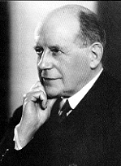
Early poetic response to war
England, in this great fight to which you go
Because, where Honour calls you, go you must,
Be glad, whatever comes, at least to know
You have your quarrel just.
Owen Seaman

Slide 7
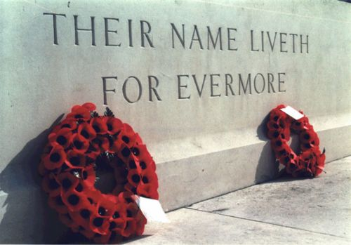
Background
Since ancient times it has been considered heroic to die in war.
Homer’s epic poem The Illiad celebrates, among other things, the nobility of dying on the battlefield.
This view continued well into the 19th Century (and even the 20th Century), and Tennyson’s popular poem ‘The Charge of the Light Brigade’ gives us an idea of how poets and people in general thought about the “valour” of fighting and dying for one’s country:

Slide 8
War Poets
Poets such as Sassoon and Owen changed all that with their efforts to give us an accurate representation of trench warfare.
Wilfred Owen fought in some of the major battles of World War I and the reality and horror of war shocked him.
In the face of the desperate suffering he saw around him, it was no longer possible to pretend warfare was adventurous and heroic.

Slide 9
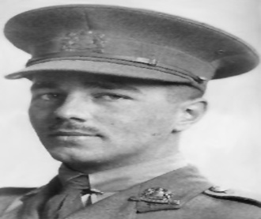
Wilfred Owen
From the age of nineteen Owen wanted to be a poet and immersed himself in poetry, being especially impressed by Keats and Shelley. He wrote almost no poetry of importance until he saw action in France in 1917.
From 1913 to 1915 he worked as a language tutor in France.
He felt pressured by the propaganda to become a soldier and volunteered on 21st October 1915. He spent the last day of 1916 in a tent in France joining the Second Manchesters. He was full of boyish high spirits at being a soldier.
Within a week he had been transported to the front line in a cattle wagon and was "sleeping" 70 or 80 yards from a heavy gun which fired every minute or so. He was soon wading miles along trenches two feet deep in water. Within a few days he was experiencing gas attacks and was horrified by the stench of the rotting dead; his sentry was blinded, his company then slept out in deep snow and intense frost till the end of January. That month was a profound shock for him: he now understood the meaning of war. "The people of England needn't hope. They must agitate," he wrote home.
He escaped bullets until the last week of the war, but he saw a good deal of front-line action: he was blown up, concussed and suffered shell-shock.
He was sent back to the trenches in September, 1918 and in October won the Military Cross by seizing a German machine-gun and using it to kill a number of Germans.
On 4th November he was shot and killed near the village of Ors. The news of his death reached his parents home as the Armistice bells were ringing on 11 November.

Slide 10
Dulce et Decorum est
Bent double, like old beggars under sacks,
Knock-kneed, coughing like hags, we cursed through sludge,
Till on the haunting flares we turned our backs
And towards our distant rest began to trudge.
Men marched asleep. Many had lost their boots
But limped on, blood-shod. All went lame; all blind;
Drunk with fatigue; deaf even to the hoots
Of tired, outstripped Five Nines that dropped behind.

Slide 11
Dulce et Decorum est
GAS! Gas! Quick, boys! An ecstasy of fumbling,
Fitting the clumsy helmets just in time;
But someone still was yelling out and stumbling
And floundering like a man in fire or lime.
Dim, through the misty panes and thick green light
As under a green sea, I saw him drowning.
In all my dreams, before my helpless sight,
He plunges at me, guttering, choking, drowning.

Slide 12
Dulce et Decorum est
If in some smothering dreams you too could pace
Behind the wagon that we flung him in,
And watch the white eyes writhing in his face,
His hanging face, like a devil's sick of sin;
If you could hear, at every jolt, the blood
Come gargling from the froth-corrupted lungs,
Obscene as cancer, bitter as the cud
Of vile, incurable sores on innocent tongues,
My friend, you would not tell with such high zest
To children ardent for some desperate glory,
The old Lie: Dulce et decorum est Pro patria mori.

Slide 13
Dulce et decorum est
Title of the poem comes from Horace’s Odes (“Dulce et decorum est pro patria mori”). Loose translation: “It is sweet and proper to die for one’s country”
Drafts of the poem were dedicated to the propaganda poet Jessie Pope, but this dedication was removed from the published copy.
Title is ironic – it’s intended meaning is the opposite of the literal. The aim is to shock the audience. The use of Latin reflects the classical education of the wealthier classes at the time and indicates that the audience Owen is writing for are well-educated Brits supporting the war in Europe.
Wilfred Owen
Wilfred Edward Salter Owen, MC (March 18, 1893 – November 4, 1918) - British poet and soldier, regarded by many as the leading poet of the First World War. He was influenced by his friend Siegfried Sassoon and sat in stark contrast to both the public perception of war at the time, and to the confidently patriotic verse written earlier by war poets such as Rupert Brooke. Died one week before the armistice.

Slide 14
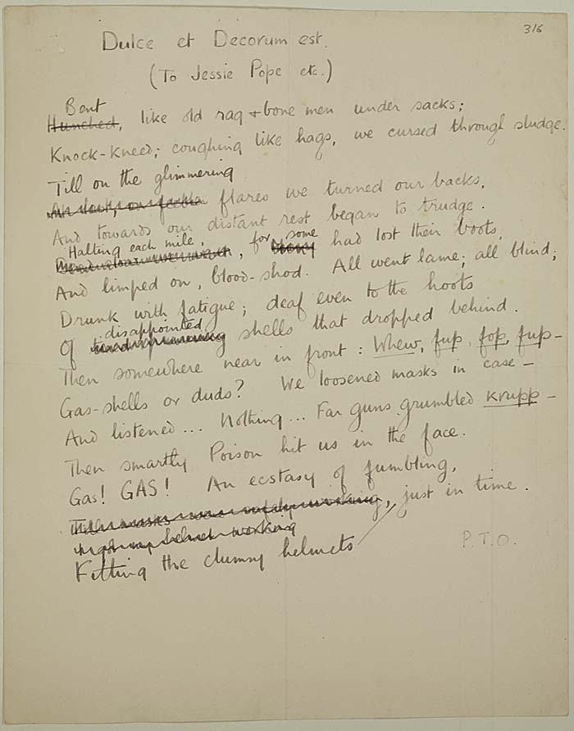

Slide 15
Powerful simile – no longer strong, young men. Starched uniforms have become rags.
Simile – compares men to ugly old women (“hags”) in their coughing – reader must remind themselves that these are in fact young men.
Persona introduced – one of the men.
Powerful verb (“cursed”) – we have an image of men at breaking point trudging in the mud
Caesura, a pause created for emphasis
Bent double, like old beggars under sacks,
Knock-kneed, coughing like hags, we cursed through sludge,
Till on the haunting flares we turned our backs
And towards our distant rest began to trudge.
Men marched asleep. Many had lost their boots
But limped on, blood-shod. All went lame; all blind;
Drunk with fatigue; deaf even to the hoots
Of tired, outstripped Five-Nines that dropped behind.
What kind of rest?
Image of men walking beneath the flares used to light the battlefield
“Shod” – term used for horse shoes. Men barely human with bloodied feet. Image supported by the word “lame”, also used for horses
War does sound like Wagner, it is “tired”. The men are strangely immune to the sound. The crashed of shells is reduced to “tired, outstripped Five-Nines”.
Stanza ends with a slow rhythm, reflecting the tiredness of the men.

Slide 16
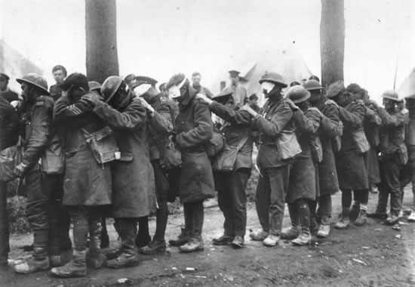

Slide 17
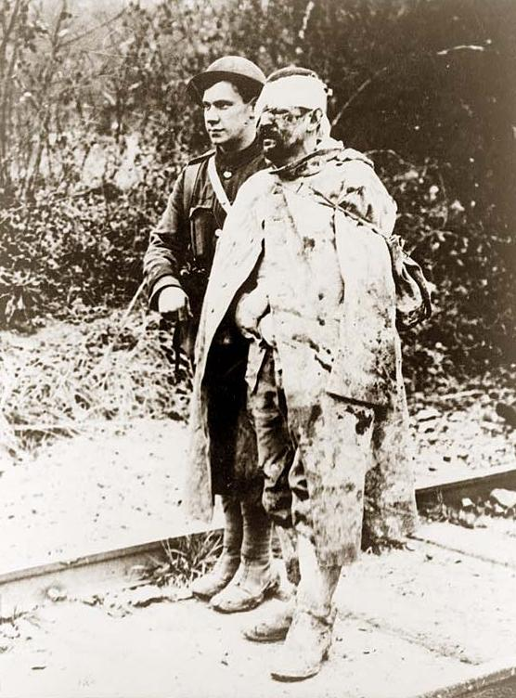

Slide 18
Sudden shift. Sudden urgency.
Interesting diction – “ecstasy” gives image of uncontrolled frantic fumbling
Imagery of the man’s pain as he inhales the gas.
Gas! GAS! Quick, boys! – An ecstasy of fumbling,
Fitting the clumsy helmets just in time;
But someone still was yelling out and stumbling,
And flound'ring like a man in fire or lime . . .
Dim, through the misty panes and thick green light,
As under a green sea, I saw him drowning.
The simile of the “green sea”, evokes drowning imagery – the effects of chlorine gas (mustard gas) on the lungs created the appearance of drowning as the lungs became blistered.

Slide 19
Lines establish that the persona is reflecting on these events some time after they happened. Helplessness lies at the heart of the persona’s anxiety.
In all my dreams, before my helpless sight,
He plunges at me, guttering, choking, drowning.
Repetition of drowning words – “plunges”, “guttering, choking, drowning”.

Slide 20
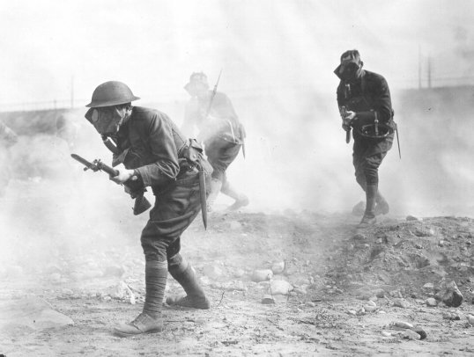

Slide 21
Direct address to the reader – who is the reader? Original manuscript said Jessie Pope, but this was deleted. Why?
Continuation on idea of nightmares from last stanza
If in some smothering dreams you too could pace
Behind the wagon that we flung him in,
And watch the white eyes writhing in his face,
His hanging face, like a devil's sick of sin;
If you could hear, at every jolt, the blood
Come gargling from the froth-corrupted lungs,
Obscene as cancer, bitter as the cud
Of vile, incurable sores on innocent tongues,
My friend, you would not tell with such high zest
To children ardent for some desperate glory,
The old Lie: Dulce et Decorum est
Pro patria mori.
Body is dehumanised. “Flung” in like a carcass. War’s true horror.
Strong visual imagery.
Repetition of “if” – creates an if/then pattern in the stanza.
Strong sound imagery
Who is “my friend” – sardonic.
This line from Horace was used on a number of war graves. It is an enormous challenge to call this a “Lie” (note the capital).

Slide 22
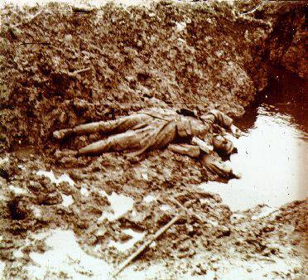

Slide 23
Theme
The theme of ‘Dulce et Decorum est’ is that
there is neither nobility in war, nor honour in fighting for your country.
Instead there is tragedy, futility and waste of human life.

Slide 24
Theme
Wilfred Owen fought in some of the major battles of World War I and the reality and horror of war shocked him.
In the face of the desperate suffering he saw around him, it was no longer possible to pretend warfare was adventurous and heroic.
Instead Owen recorded in his poetry how shocking modern warfare was and he sought to describe accurately what the conditions were like for soldiers at the Front

Slide 25
Theme
Owen wanted people who were not in the trenches – the people at home in England – to see the reality and misery of war.
He also wanted them to stop telling future generations the “old lie” Dulce et decorum est pro patria mori (“It is sweet and fitting to die for one’s country.”).
It is worth noting that these lines were written by the poet Horace, two thousand years earlier.

Slide 26
A Note on Form
Lyric poem
Loose iambic pentameter
Irregular verse length
Follows something of a narrative structure with a challenge:
  Stanza 1 – sets the scene
  Stanza 2 – gives the action
  Stanza 3 – the aftermath
  Stanza 4 – the challenge

