Slide 1
Dollar/Time Weighted
+
Forward Rates

Slide 2
Dollar Weighted
Is the Internal Rate of Return (i.e. yield rate) Using simple interest approximation for partial years.

Slide 3






Example
A fund has a starting balance of 100 . Three months later the balance of the fund is 120 and a deposit of 40 is made . Five months after the deposit the balance is 150 and a withdrawal of 60 is made . The balance of the fund at the end of the year 110 . Calculate the dollar-weighted rate of return.
$$B=100$$
$$B=120$$
$$B=150$$
$$B=110$$
$$D=40$$
$$W=60$$

Slide 4



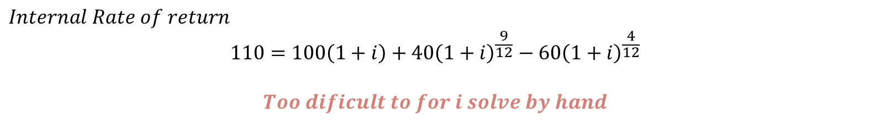







A fund has a starting balance of 100 . Three months later the balance of the fund is 120 and a deposit of 40 is made . Five months after the deposit the balance is 150 and a withdrawal of 60 is made . The balance of the fund at the end of the year 110 . Calculate the dollar-weighted rate of return.
$$B=100$$
$$B=120$$
$$B=150$$
$$B=110$$
$$D=40$$
$$W=60$$
$$t=0$$
$$t=\frac{3}{12}$$
$$t=\frac{8}{12}$$
$$t=1$$
$$Internal Rate of return$$
$$110=100\left(1+i\right)+40{\left(1+i\right)}^{\frac{9}{12}}−60{\left(1+i\right)}^{\frac{4}{12}}$$
$$Too dificult to for i solve by hand$$

Slide 5



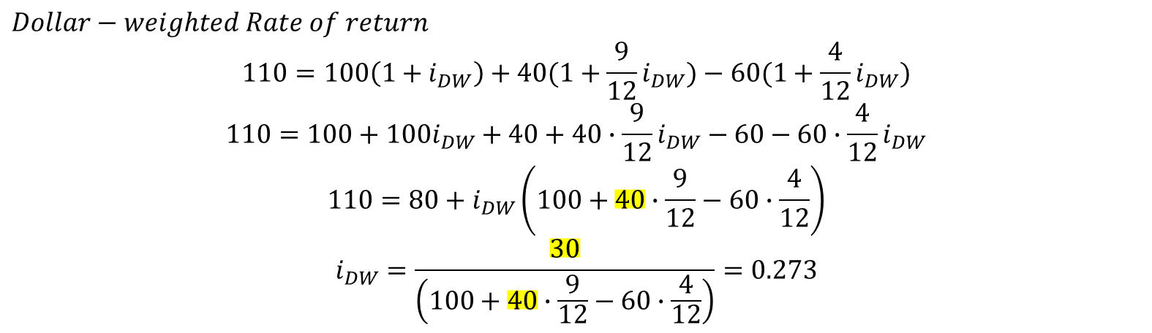







$$B=100$$
$$B=120$$
$$B=150$$
$$B=110$$
$$D=40$$
$$W=60$$
$$t=0$$
$$t=\frac{3}{12}$$
$$t=\frac{8}{12}$$
$$t=1$$
$$Dollar−weighted Rate of return$$
$$110=100\left(1+i_{DW}\right)+40(1+\frac{9}{12}i_{DW})−60(1+\frac{4}{12}i_{DW})$$
$$110=100+100i_{DW}+40+40∙\frac{9}{12}i_{DW}−60−60∙\frac{4}{12}i_{DW}$$
$$110=80+i_{DW}\left(100+40∙\frac{9}{12}−60∙\frac{4}{12}\right)$$
$$i_{DW}=\frac{30}{\left(100+40∙\frac{9}{12}−60∙\frac{4}{12}\right)}=0.273$$

Slide 6











Dollar Weighted formula
$$i_{DW}=\frac{I}{starting balance+C_{1}\left(1−t_{1}\right)+C_{2}\left(1−t_{2}\right)…}$$
$$I:Amount of interest$$
$$C_{t}:cashflow at time$$
$$I=110−\left[100+40−60\right]=30$$
$$B=100$$
$$B=120$$
$$B=150$$
$$B=110$$
$$D=40$$
$$W=60$$
$$t=0$$
$$t=\frac{3}{12}$$
$$t=\frac{8}{12}$$
$$t=1$$

Slide 7
Time Weighted
Rate of return
Calculated by compounding the returns over successive parts of the year.

Slide 8
Example
A fund has a starting balance of 100 . Three months later the balance of the fund is 120 and a deposit of 40 is made . Five months after the deposit the balance is 150 and a withdrawal of 60 is made . The balance of the fund at the end of the year 110 . Calculate the time-weighted rate of return.
$$B=100$$
$$B=120$$
$$B=150$$
$$B=110$$
$$D=40$$
$$W=60$$

Slide 9
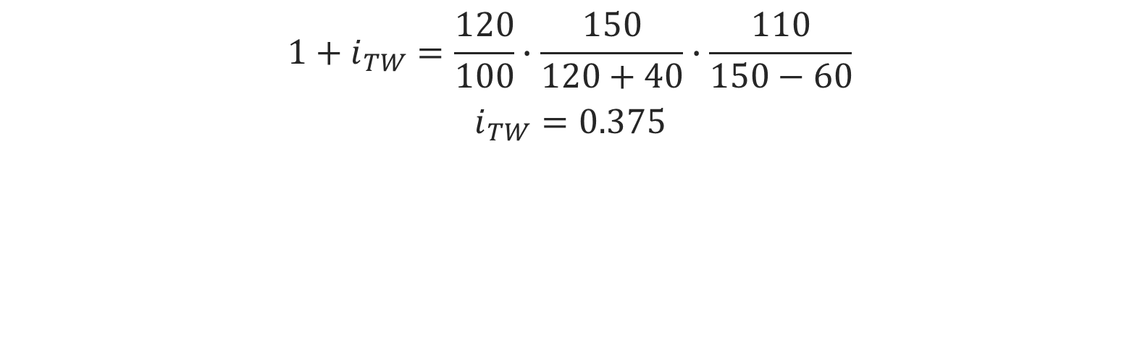
$$B=100$$
$$B=120$$
$$B=150$$
$$B=110$$
$$D=40$$
$$W=60$$
$$t=0$$
$$t=\frac{3}{12}$$
$$t=\frac{8}{12}$$
$$t=1$$
$$1+i_{TW}=\frac{120}{100}∙\frac{150}{120+40}∙\frac{110}{150−60}$$
$$i_{TW}=0.375$$

Slide 10
Forward Rates
“A forward rate is an interest rate applicable to a financial transaction that will take place in the future.” – Investopedia
“An m-year spot rate that comes into effect t-years in the future”-SOA

Slide 11
Illustration
3-year forward rate – deferred 1 year
1-year forward rate – deferred 2 years
2-year forward rate – deferred 2 years

Slide 12








Forward rates and Spot rate
$One−year Forward Rates$
$$f_{0,1}$$
$$f_{1,2}$$
$$f_{2,3}$$
$$f_{3,4}$$
$$Spot Rates$$
$$s_{2}$$
$$s_{3}$$

Slide 13


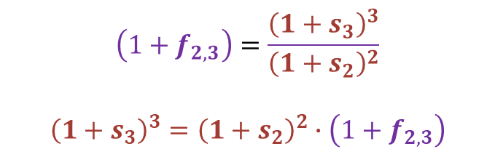

Forward rates and Spot rate
$$s_{2}$$
$$f_{2,3}$$
$$s_{3}$$
$$\left(1+f_{2,3}\right)=\frac{{\left(1+s_{3}\right)}^{3}}{{\left(1+s_{2}\right)}^{2}}$$
$${\left(1+s_{3}\right)}^{3}={\left(1+s_{2}\right)}^{2}∙\left(1+f_{2,3}\right)$$

Slide 14
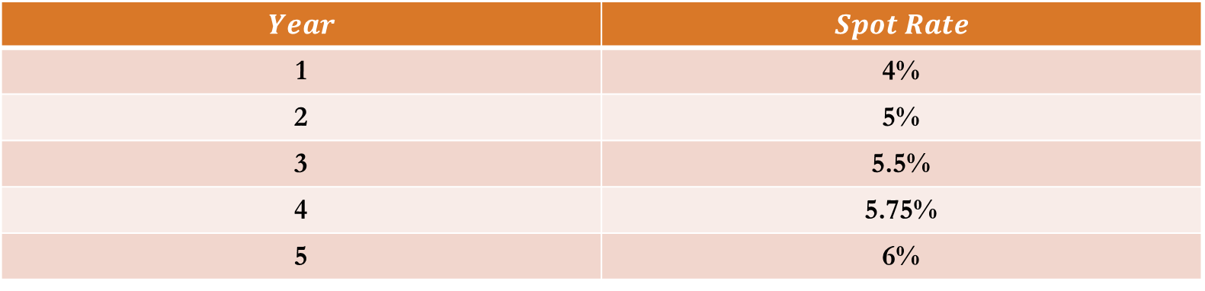

Example
$$You^{′}re given :$$
$$Year$$ | $$Spot Rate$$
1 | 4%
2 | 5%
3 | 5.5%
4 | 5.75%
5 | 6%
$$Calculate the 3−year forward rate , deffered for two years.$$

Slide 15
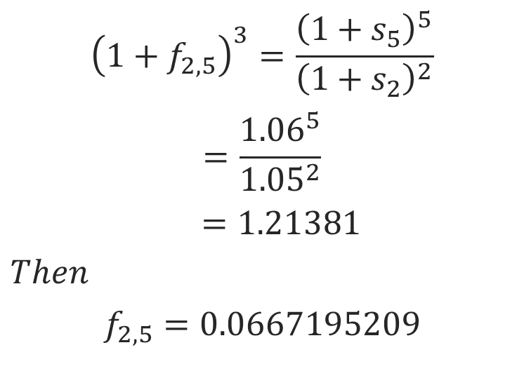
Example-Solution
$${\left({1+f}_{2,5}\right)}^{3}=\frac{{\left(1+s_{5}\right)}^{5}}{{\left(1+s_{2}\right)}^{2}}$$
$$=\frac{{1.06}^{5}}{{1.05}^{2}}$$
$$=1.21381$$
$$Then$$
$$f_{2,5}=0.0667195209$$
$$Calculate the 3−year forward rate , deffered for two years.$$

