Slide 1
Digital Filters
Analog Filters | Digital Filters
Cheap | Costly
Fast | Slow
Larger dynamic range
Low performance | Very high performance

Slide 2
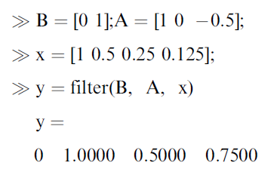
Digital Filtering: Realization
Digital Filtering:
Matlab Implementation:
3-tap (2nd order) IIR filter

Slide 3
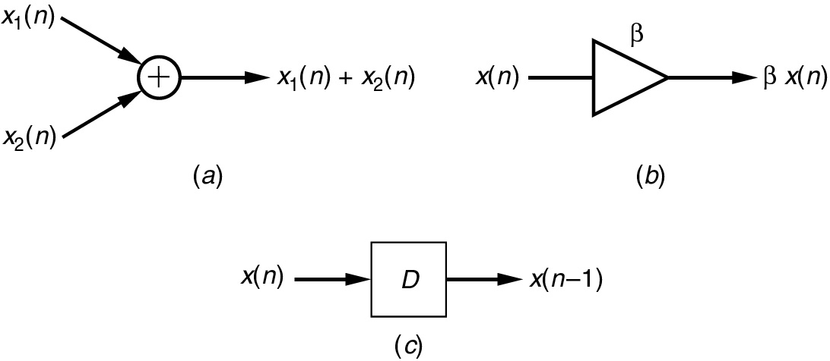
Adder, Multiplier & Delay
Three components of Filters
(a) Adder, (b) multiplier, (c) delay.

Slide 4
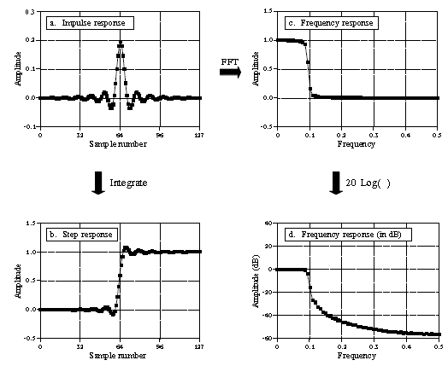
Digital Filters: Response (Impulse, Step, Frequency)
Input signal ⊗ impulse res. = output sig.
Filter Kernel
Convolution = weighted sum of input samples.
Finite Impulse Response (FIR) filters
Recursion = input sample + previous outputs
Impulse response of recursive filter
Exponentially decaying sinusoids
Infinitely long
Infinite Impulse Response (IIR) filters

Slide 5
FIR (Finite Impulse Response) Filter
Convolution

Slide 6
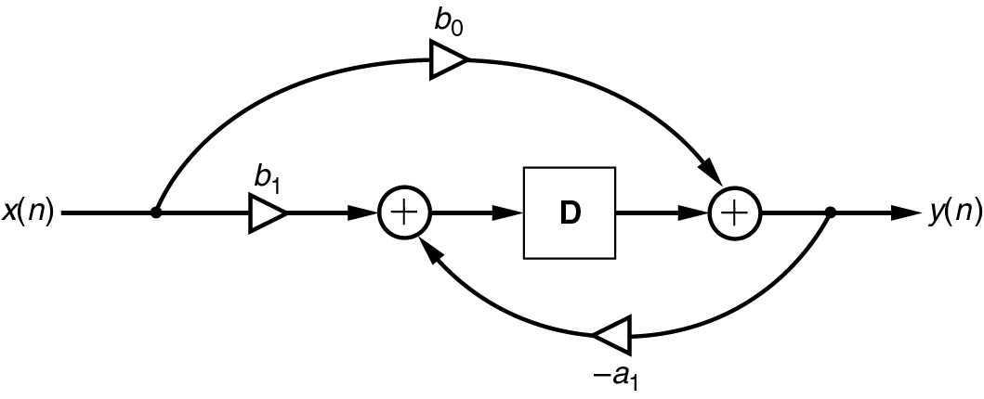
IIR (Infinite Impulse Response) Filter
First-order IIR filter.

Slide 7
IIR (Infinite Impulse Response) Filter
Second-order IIR filter.

Slide 8
Transfer Function
Differential Equation:
z- Transform:
Transfer Function:

Slide 9
Example: Transfer Function
Given:
z- Transform:
Rearrange:
Transfer Function:
Given:
Rearrange:
Differential Equation:

Slide 10
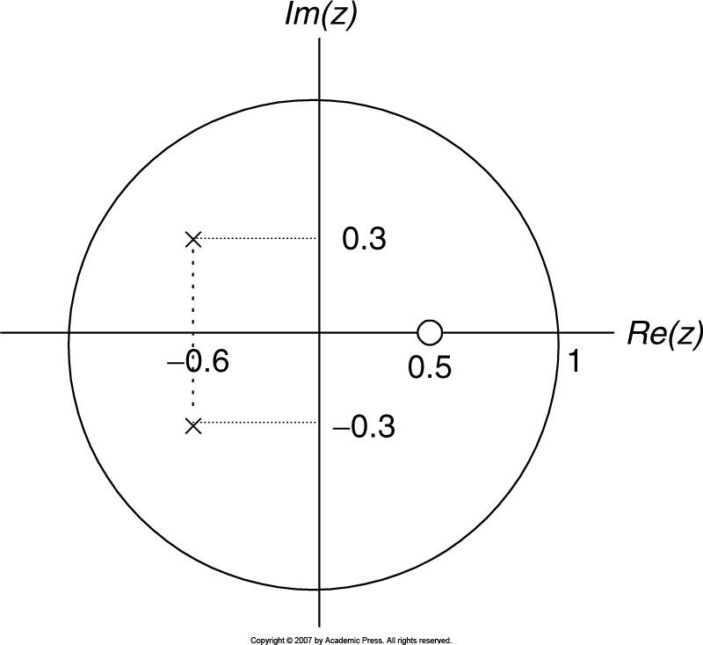
Pole – Zero from Transfer Function
The system is stable.
The zeros do not affect system stability.

Slide 11
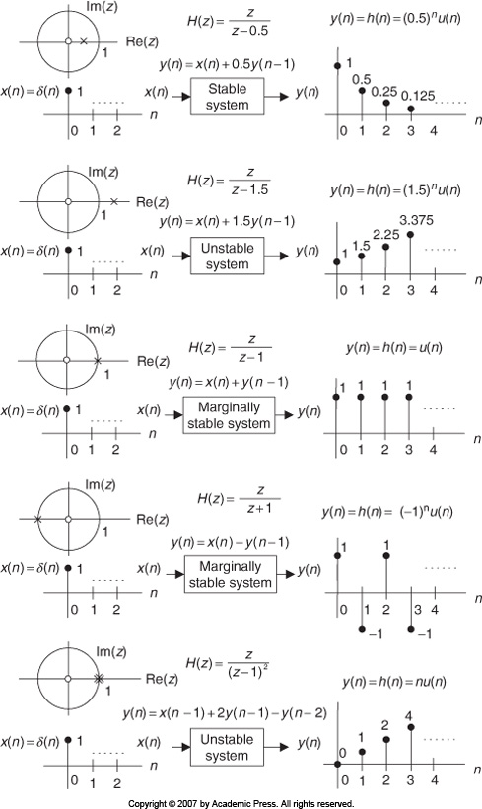
System Stability
Depends on poles’ location

Slide 12
Example: System Stability
Since the outermost pole is multiple order (2nd order) at z = 1 and is on the unit circle, the system is stable.

Slide 13
Digital Filter: Frequency Response
Magnitude frequency response
Phase response
Putting
Example:
Given
Sampling rate = 8k Hz
Transfer function:
Complete Plot!
Frequency response:
and

Slide 14
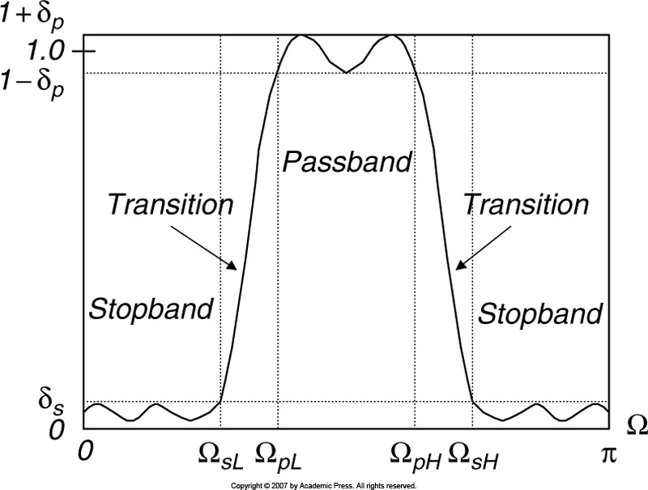
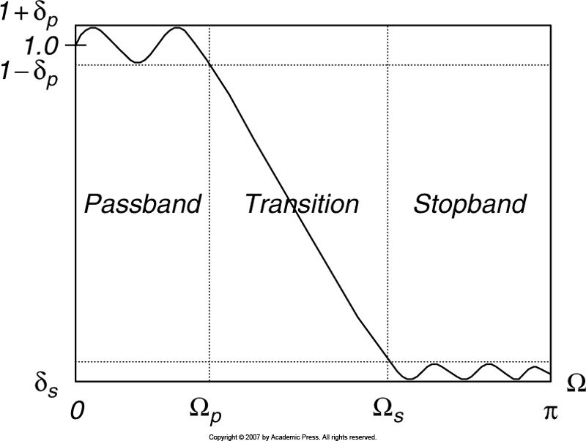
Digital Filter: Frequency Response – contd.
Low Pass Filter (LPF)
Band Pass Filter (BPF)
Matlab: Frequency Response

Slide 15
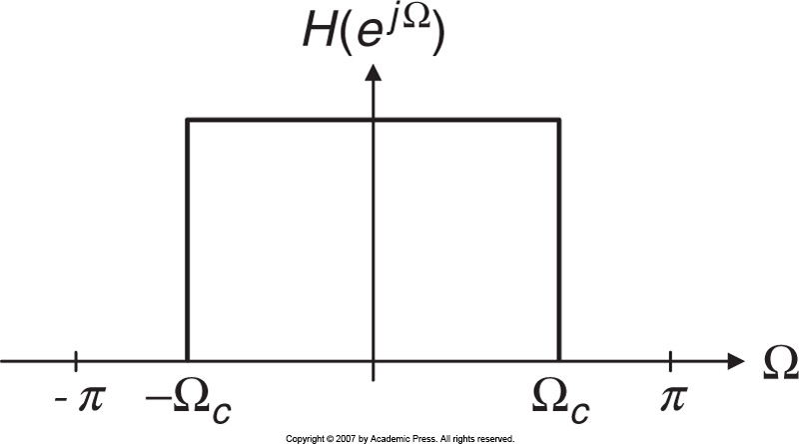
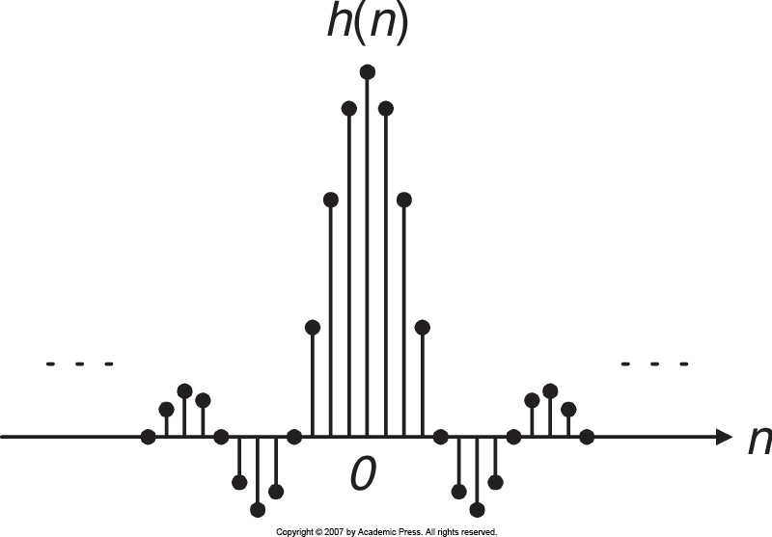
Impulse Response of FIR Filters
Frequency response of ideal LPF:
Impulse response of ideal LPF:
After truncating 2M+1 major components:
symmetric
Making causal,
Where,

Slide 16
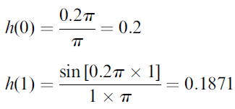
Ideal Low Pass Filter
Impulse Response:
Example:
3-tap FIR LPF with cutoff freq. = 800 Hz and sampling rate = 8k Hz.
Using symmetry:

Slide 17
Ideal Low Pass Filter – contd.
Delaying h(n) by M = 1 sample,
Filter coefficients
Transfer function
Differential Eq:
Frequency response
Magnitude:
Complete Plot!
Phase:

Slide 18
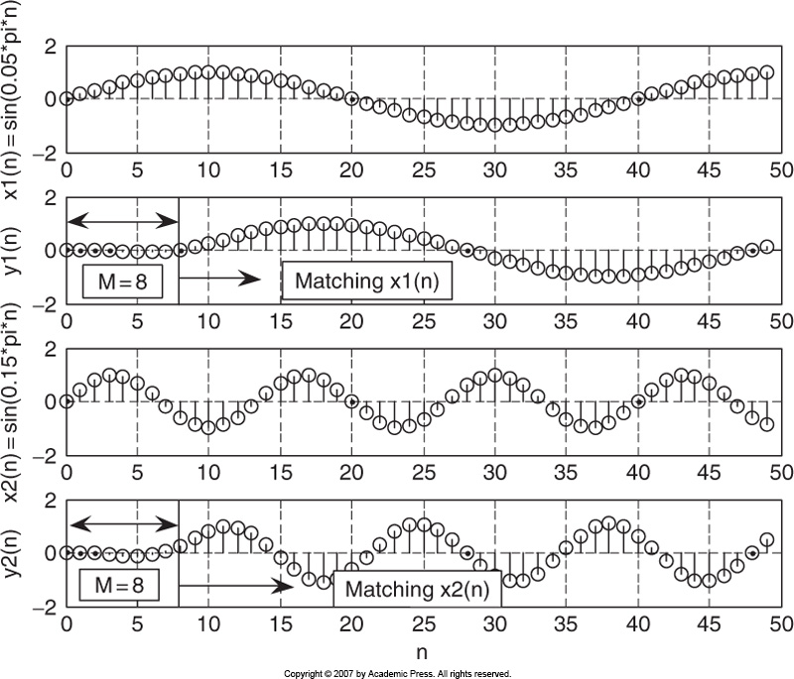
Linear Phase
If filter has linear phase property, the output will simply be a delayed version of input.
Let, 17-tap FIR filter with linear phase property.
8 samples delay
8 samples delay

Slide 19
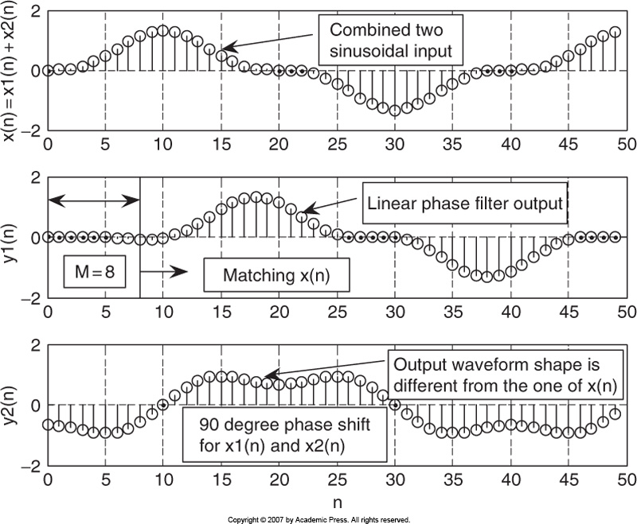
Nonlinear Phase
Input:
Linear phase filter output:
90 d phase delay filter output:
Input:
Linear phase filter output:
90 d phase delay filter output:
Distorted!

Slide 20
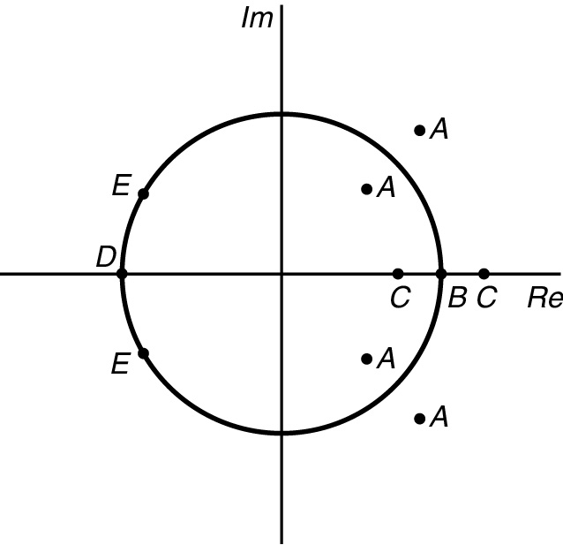
Linear Phase: Zero Placement
A single zero can be either at z = 1 or z = -1. ( B or D)
Real zeros not on the unit circle always occur in pairs with r and r⁻¹. (C)
If the zero is complex, its conjugate is also zero. (E) [on the unit circle]
Complex zeros not on the unit circle always occur in quadruples with r and r⁻¹. (A)

Slide 21
Example: FIR Filtering With Window Method
Problem:
Solution:
M = 2
Symmetry

Slide 22
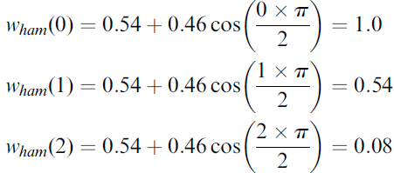
Example: Window Method – contd.
Hamming window function
Symmetry
Windowed impulse response
By delaying h_{w}(n) by M = 2 samples,

Slide 23
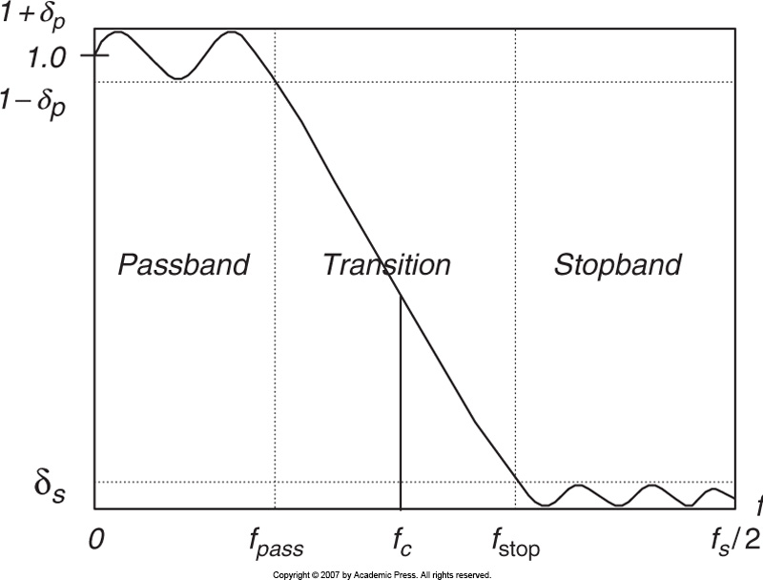
FIR Filter Length Estimation

Slide 24
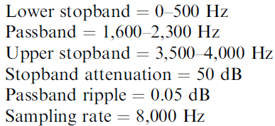
Example: FIR Filter Length Estimation
Problem:
Design a BPF with
Use Hamming window
Solution:
Choose nearest higher odd N = 25
Cutoff frequencies:
Normalized
Now design the filter with hint from slide 14.

Slide 25
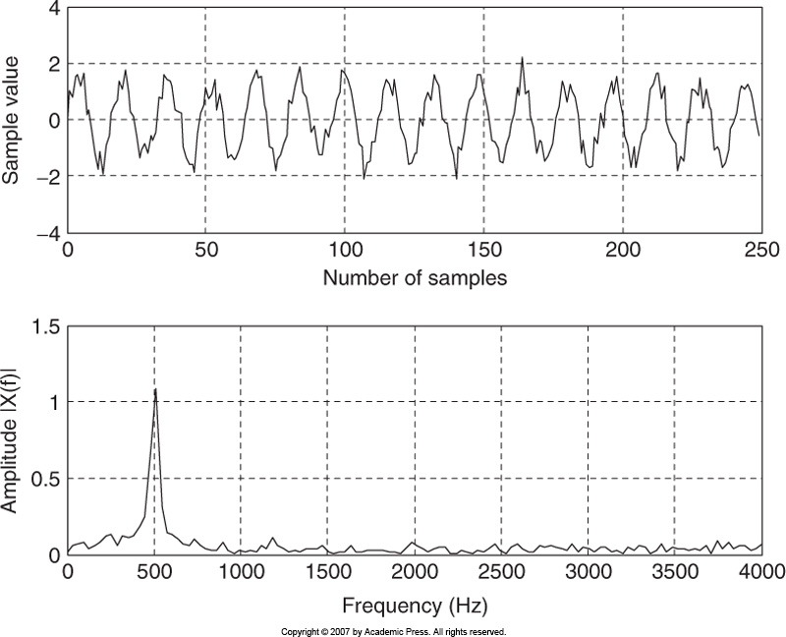
Application: Noise Reduction
Input waveform: sinusoid + broadband noise
Spectrum:
Want to remove this noise
Specification: LPF
Pass band frequency [0 – 800 Hz]
Stop band frequency [1000 – 4000 Hz]
Pass band ripple < 0.02 dB
Stop band attenuation = 50 dB

Slide 26
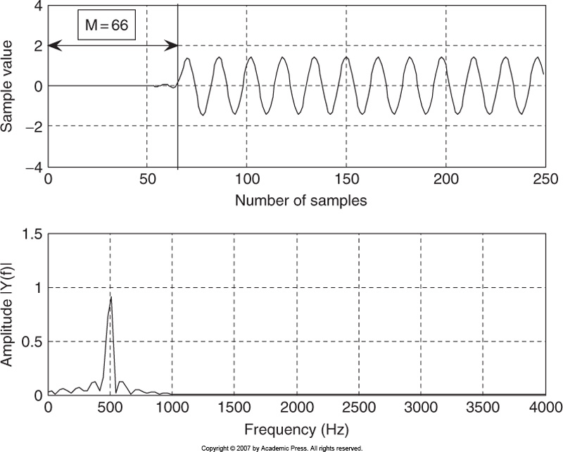
Application: Noise Reduction –contd.
133- tap FIR filter, so a delay of 66
However, noise reduction in real world scenario is not so easy!
Almost there is NO noise!

Slide 27
Frequency Sampling Design Method
Simple to design
Filter length = 2M + 1
Magnitude response in the range [ 0 ~ π]
Calculate FIR filter coefficients:
Use the symmetry:

Slide 28
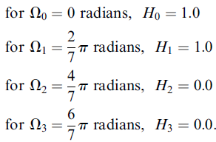
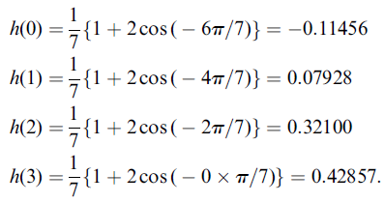
Example: Frequency Sampling Design Method
Problem:
Solution:
By symmetry:

Slide 29
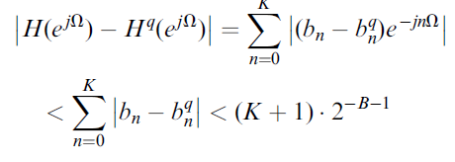
Coefficient Quantization Effect
Filter coefficients are usually truncated or rounded off for the application.
Transfer function with infinite precision:
Transfer function with quantized precision:
Error of the magnitude frequency response:
K = tap
Example
25 – tap FIR filter; 7 bits used for fraction
Error is bounded by
< 25 / 256 = 0.0977
Let infinite precision coeff. = 0.00759455135346
Quantized coeff. = 1 / 2⁷ = 0.0078125

Slide 30
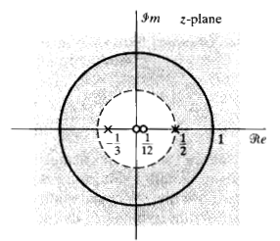
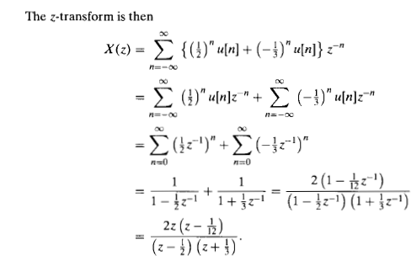
Complementary Example - I

Slide 31
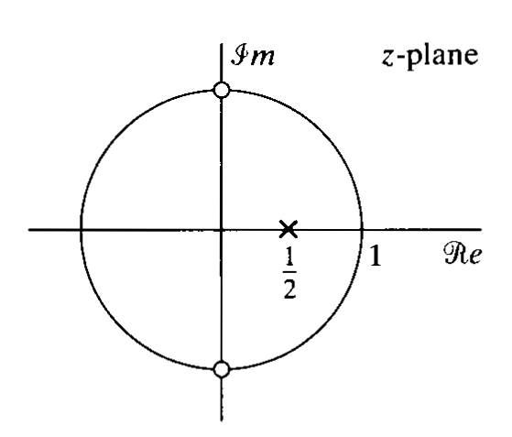
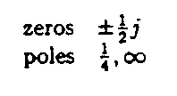
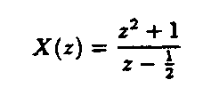
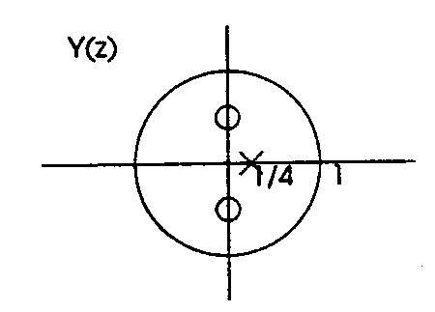
Complementary Example - II
Given:
Given:

Slide 32
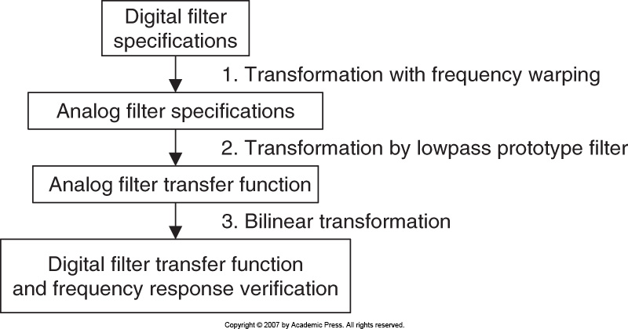
IIR Filter Design: Bilinear Transformation Method

Slide 33
Bilinear Transformation Method
For LPF and HPF:
Frequency Warping
For BPF and BRF:
From LPF to LPF:
From LPF to HPF:
Prototype Transformation
From LPF to BPF:
From LPF to BRF:
Obtained Transfer Function:

Slide 34
Example 1: Bilinear Transformation Method
Problem:
Solution:
First-order LP Chebyshev filter prototype:
Applying transformation LPF to HPF:
Applying BLT:

Slide 35
Example 2: Bilinear Transformation Method
Problem:
Solution:
A first-order LPF prototype will produce second-order BPF prototype.

Slide 36
Example 2: Bilinear Transformation Method
Contd.
1st order LPF prototype:
Applying transformation LPF to BPF:
Applying BLT:

Slide 37
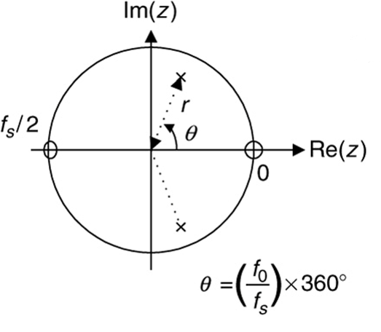
Pole Zero Placement Method
Second-Order BPF Design
r: controls bandwidth
θ: controls central frequency
Location of poles & zeros:
controls magnitude
Location of pole:
determines stability
Number of zero:
determines phase linearity

Slide 38
Pole Zero Placement Method
Second-Order BRF Design
Example

Slide 39
Pole Zero Placement Method
First-Order LPF Design
Example
100 Hz <

Slide 40
Pole Zero Placement Method
First-Order HPF Design
Practice examples.

Slide 41
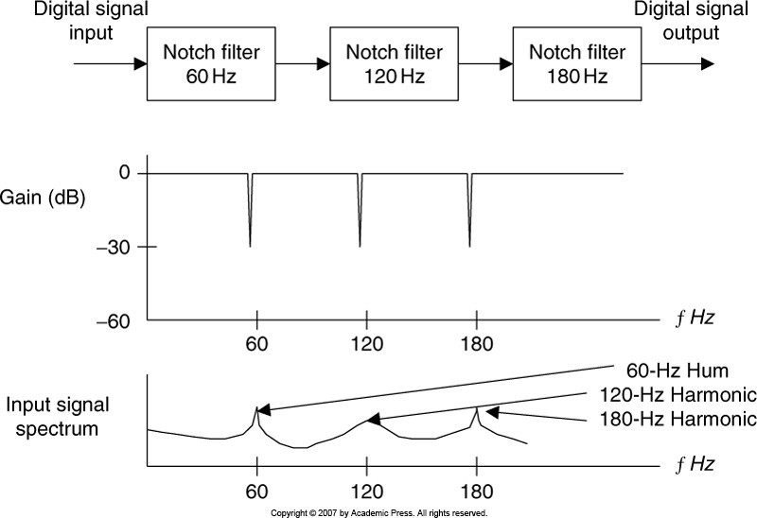
Application: 60 – Hz Hum Eliminator
Hum noise: created by poor power supply or electromagnetic interference and characterized by a frequency of 60 Hz and its harmonics.
Hum eliminator
Frequency response of Hum eliminator
Corrupted by hum & harmonics

Slide 42
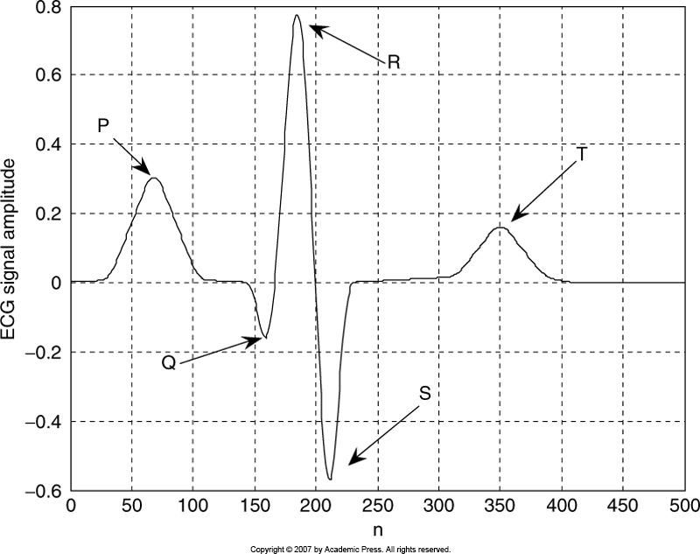
ECG Pulse
QRS Complex
ECG + Hum → makes difficult to analyze.
nth R
(n+1)th R
T
ms
Heart beat /min = 60000 / T

Slide 43
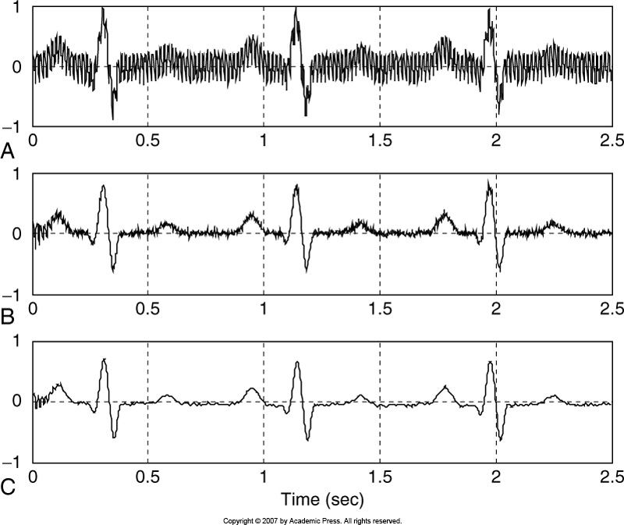
Heart Beat Detection Using ECG Pulse
2
3
1
To filter muscle noise ≈ 40 Hz
1
2
Practice example
3

