Slide 1
Discrete Fourier Transform (DFT)
DFT transforms the time domain signal samples to the frequency domain components.
Signal Spectrum
Amplitude
DFT
Amplitude
Time
Frequency
DFT is often used to do frequency analysis of a time domain signal.

Slide 2
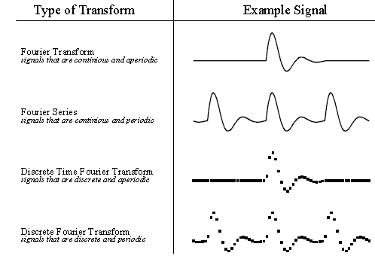
Four Types of Fourier Transform

Slide 3
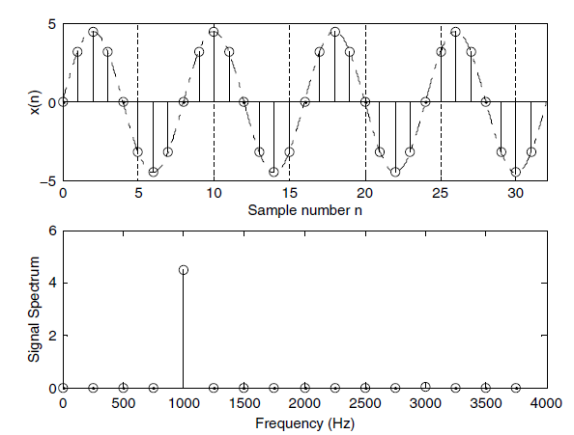
DFT: Graphical Example
1000 Hz sinusoid with 32 samples at 8000 Hz sampling rate.
DFT
Sampling rate
8000 samples = 1 second
32 samples = 32/8000 sec
= 4 millisecond
Frequency
1 second = 1000 cycles
32/8000 sec = (1000*32/8000=) 4 cycles

Slide 4
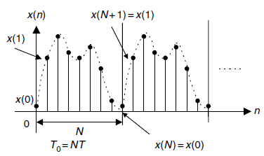
DFT Coefficients of Periodic Signals
Periodic Digital Signal
Equation of DFT coefficients:

Slide 5
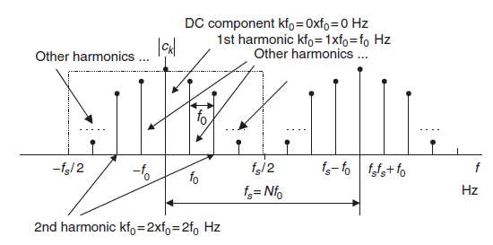
DFT Coefficients of Periodic Signals
Fourier series coefficient c_{k} is periodic of N
Copy
Amplitude spectrum of the periodic digital signal

Slide 6
Example 1
The periodic signal:
is sampled at
Solution:
Fundamental frequency
a.
We match
with
and get f = 1 Hz.
Therefore the signal has 1 cycle or 1 period in 1 second.
Sampling rate f_{s} = 4 Hz
1 second has 4 samples.
Hence, there are 4 samples in 1 period for this particular signal.
Sampled signal

Slide 7
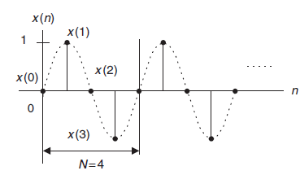
Example 1 – contd. (1)
b.

Slide 8
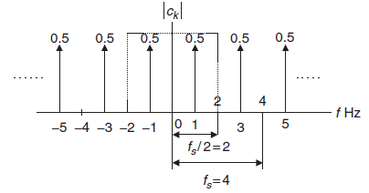
Example 1 – contd. (2)

Slide 9
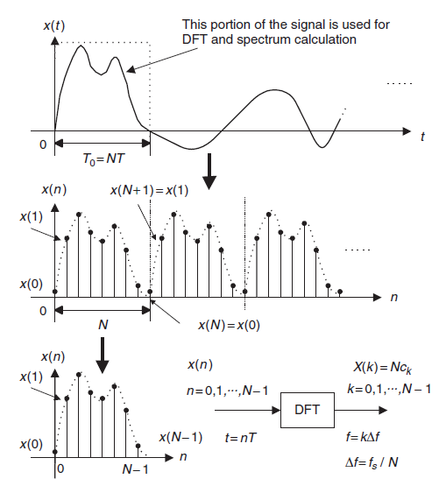
On the Way to DFT Formulas
Imagine periodicity of N samples.
Take first N samples (index 0 to N -1) as the input to DFT.

Slide 10
DFT Formulas
Where,
Inverse DFT:

Slide 11
MATLAB Functions
FFT: Fast Fourier Transform

Slide 12
Example 2
Solution:

Slide 13
Example 2 – contd.
Using MATLAB,

Slide 14
Example 3
Inverse DFT of the previous example.

Slide 15
Example 3 – contd.
Using MATLAB,

Slide 16
Relationship Between Frequency Bin k and Its Associated Frequency in Hz
Frequency step or frequency resolution:
Example 4
In the previous example, if the sampling rate is 10 Hz,

Slide 17
Example 4 – contd.
a.
Sampling period:
For x(3), time index is n = 3, and sampling time instant is
Δf
b.
Frequency resolution:
• • • • • • • •
k
Frequency bin number for X(1) is k = 1, and its corresponding frequency is
Similarly, for X(3) is k = 3, and its corresponding frequency is

Slide 18
Amplitude and Power Spectrum
Since each calculated DFT coefficient is a complex number, it is not convenient
to plot it versus its frequency index
Amplitude Spectrum:
To find one-sided amplitude spectrum, we double the amplitude.

Slide 19
Amplitude and Power Spectrum –contd.
Power Spectrum:
For, one-sided power spectrum:
Phase Spectrum:

Slide 20
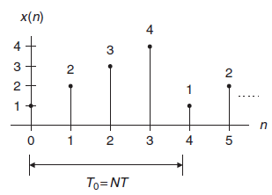
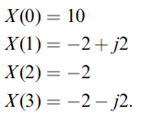
Example 5
Solution:
See Example 2.

Slide 21
Example 5 – contd. (1)

Slide 22
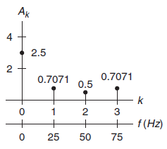
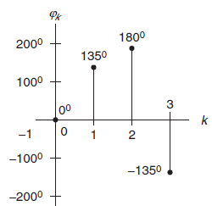
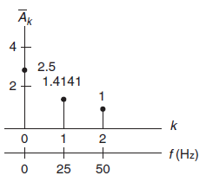
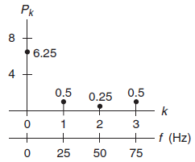
Example 5 – contd. (2)
Amplitude Spectrum
Phase Spectrum
One sided Amplitude Spectrum
Power Spectrum

Slide 23
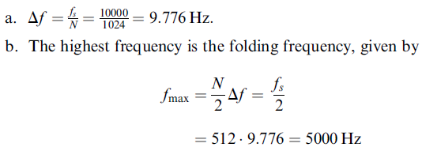
Example 6
Solution:

Slide 24
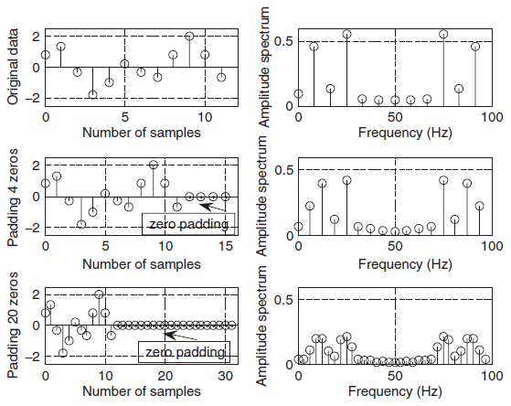
Zero Padding for FFT
FFT: Fast Fourier Transform.
A fast version of DFT; It requires signal length to be power of 2.
Therefore, we need to pad zero at the end of the signal.
However, it does not add any new information.

Slide 25
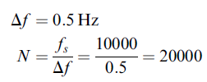
Example 7
Consider a digital signal has sampling rate = 10 kHz. For amplitude spectrum we need frequency resolution of less than 0.5 Hz. For FFT how many data points are needed?
Solution:
For FFT, we need N to be power of 2.
2¹⁴ = 16384 < 20000
And
2¹⁵ = 32768 > 20000
Recalculated frequency resolution,

Slide 26
MATLAB Example - 1
f_{s}
xf = abs(fft(x))/N; %Compute the amplitude spectrum

Slide 27
MATLAB Example – contd. (1)

Slide 28
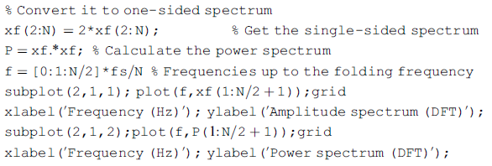
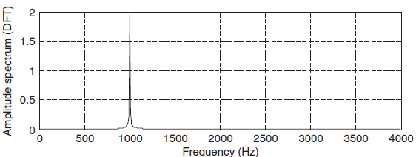
MATLAB Example – contd. (2)

Slide 29
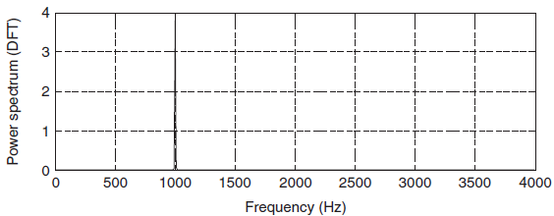
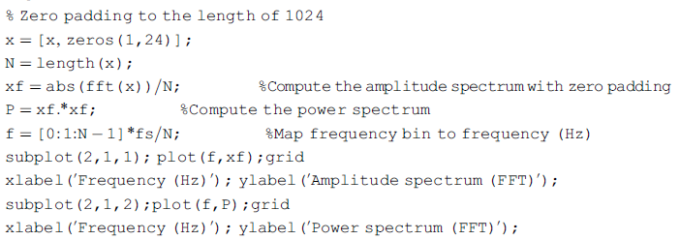
MATLAB Example – contd. (3)
………..

Slide 30
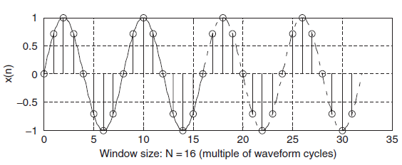
Effect of Window Size
When applying DFT, we assume the following:
1. Sampled data are periodic to themselves (repeat).
2. Sampled data are continuous to themselves and band limited to the folding frequency.
1 Hz sinusoid, with 32 samples

Slide 31
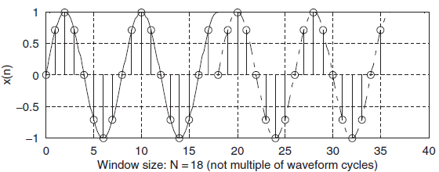
Effect of Window Size –contd. (1)
If the window size is not multiple of waveform cycles:
Discontinuous

Slide 32
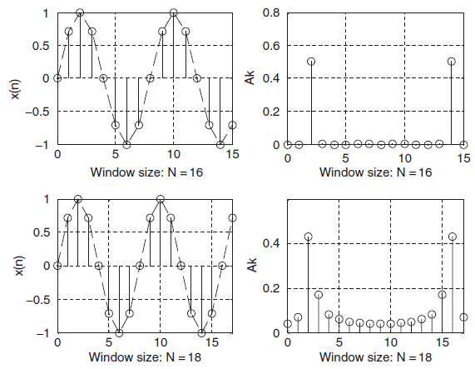
Effect of Window Size –contd. (2)
2- cycles
Mirror Image
Produces single frequency
Produces many harmonics as well.
Spectral Leakage
The bigger the discontinuity, the more the leakage

Slide 33
Reducing Leakage Using Window
To reduce the effect of spectral leakage, a window function can be used
whose amplitude tapers smoothly and gradually toward zero at both ends.
Window function, w(n)
Data sequence, x(n)
Obtained windowed sequence, x_{w}(n)

Slide 34
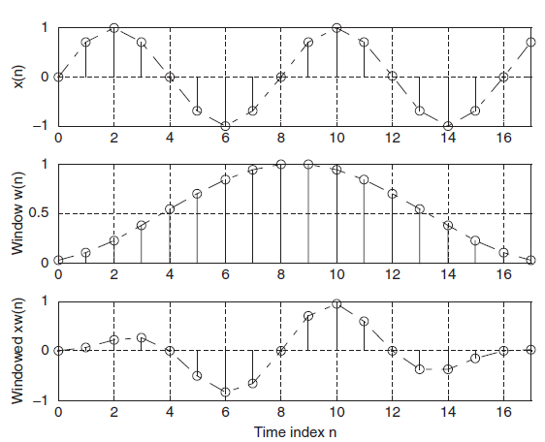
Example 8
Given,
Calculate,

Slide 35
Different Types of Windows
Rectangular Window (no window):
Triangular Window:
Hamming Window:
Hanning Window:

Slide 36
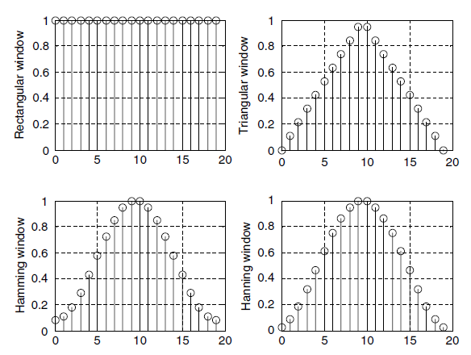
Different Types of Windows –contd.
Window size of 20 samples

Slide 37
Example 9
Problem:
Solution:
Since N = 4, Hamming window function can be found as:

Slide 38
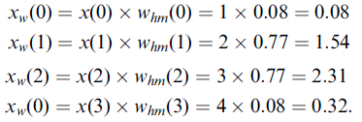
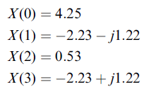
Example 9 – contd. (1)
Windowed sequence:
DFT Sequence:

Slide 39
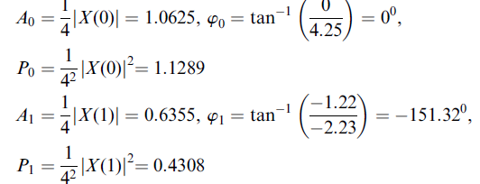
Example 9 – contd. (2)

Slide 40
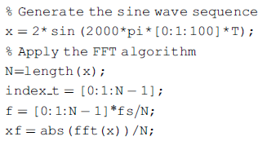
MATLAB Example - 2

Slide 41
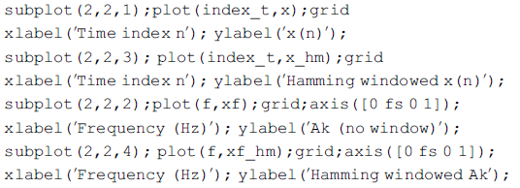
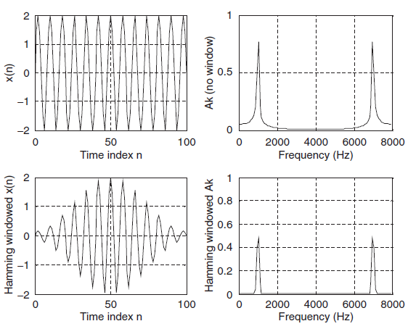
MATLAB Example – 2 contd.

Slide 42
DFT Matrix
Frequency Spectrum
Multiplication Matrix
Time-Domain samples

Slide 43
DFT Matrix
Let,
Then
DFT equation:
DFT requires N² complex multiplications.

Slide 44
FFT
FFT: Fast Fourier Transform
A very efficient algorithm to compute DFT; it requires less multiplication.
The length of input signal, x(n) must be 2^{m} samples, where m is an integer.
Samples N = 2, 4, 8, 16 or so.
If the input length is not 2^{m}, append (pad) zeros to make it 2^{m}.
4
5
1
7
1
4
5
1
7
1
0
0
0
N = 5
N = 8, power of 2

Slide 45
DFT to FFT: Decimation in Frequency
DFT:

Slide 46
DFT to FFT: Decimation in Frequency
Now decompose into even (k = 2m) and odd (k = 2m+1) sequences.

Slide 47
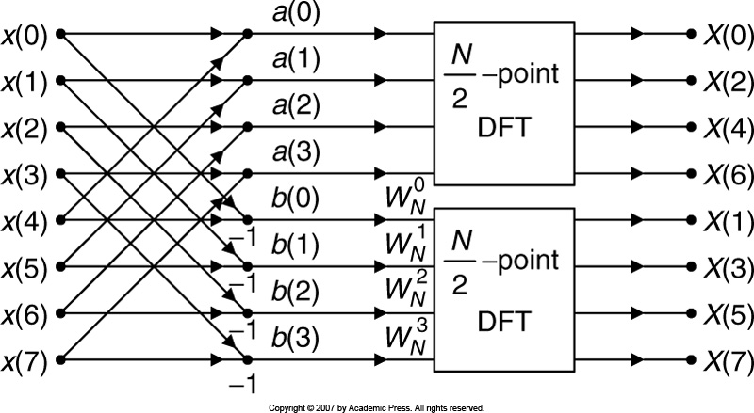
DFT to FFT: Decimation in Frequency

Slide 48
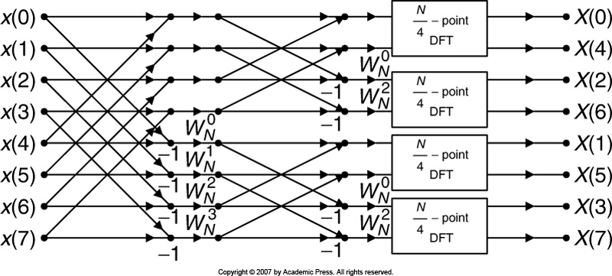
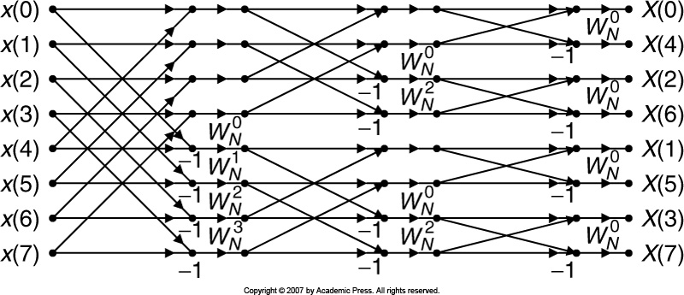
DFT to FFT: Decimation in Frequency
12 complex multiplication

Slide 49
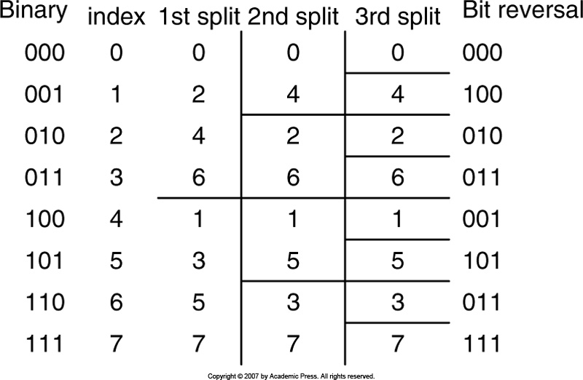
DFT to FFT: Decimation in Frequency
For 1024 samples data sequence,
DFT requires 1024×1024 = 1048576 complex multiplications. FFT requires (1024/2)log(1024) = 5120 complex multiplications.

Slide 50
IFFT: Inverse FFT

Slide 51
FFT and IFFT Examples
FFT
Number of complex multiplication =
IFFT

Slide 52
DFT to FFT: Decimation in Time
Split the input sequence x(n) into the even indexed x(2m) and x(2m + 1), each with N/2 data points.
Using

Slide 53
DFT to FFT: Decimation in Time
As,

Slide 54
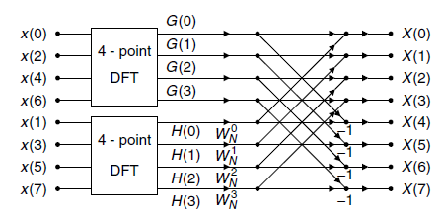
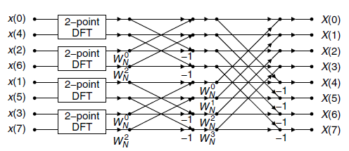
DFT to FFT: Decimation in Time
First iteration:
Second iteration:

Slide 55
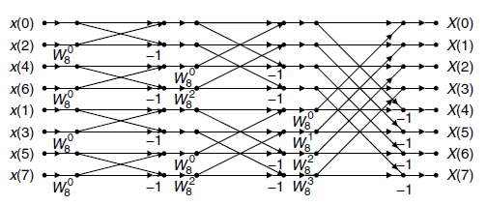
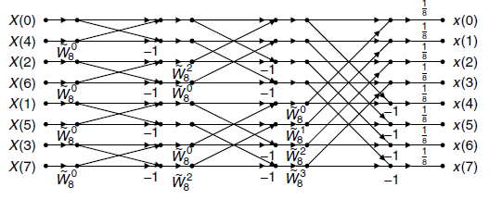
DFT to FFT: Decimation in Time
Third iteration:
IFFT

Slide 56
FFT and IFFT Examples
FFT
IFFT

Slide 57
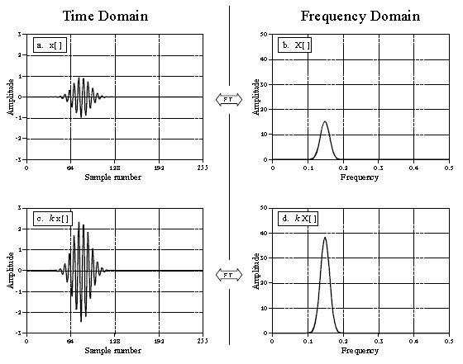
Fourier Transform Properties (1)
FT is linear:
Homogeneity
Additivity
Homogeneity:
x[] X[]
kx[] kX[]
DFT
DFT
Frequency is not changed.

Slide 58
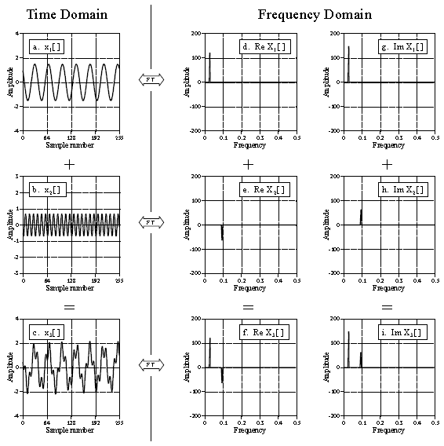
Fourier Transform Properties (2)
Additivity

Slide 59
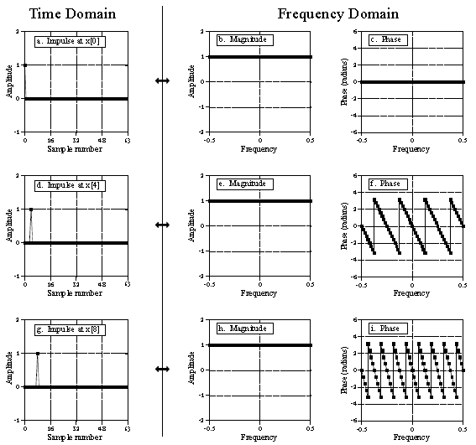
Fourier Transform Pairs
Delta Function Pairs in Polar Form
Delta Function
Shifted Delta Function
Same Magnitude, Different Phase
Shifted Delta Function

