Slide 1
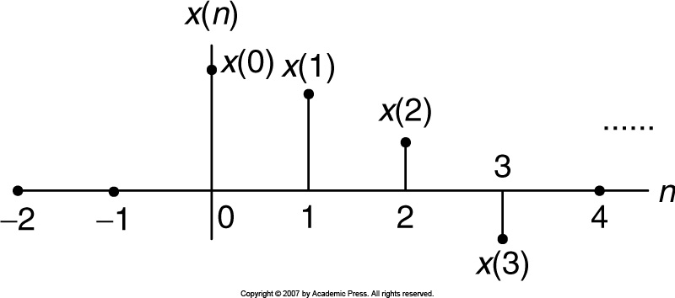
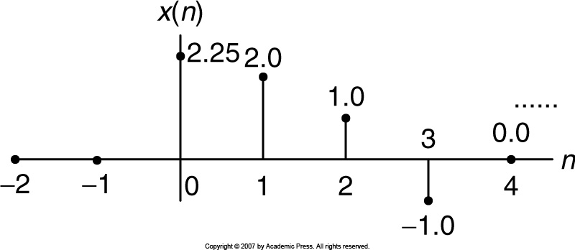
Digital Signals
For floating point DS processor, the amplitudes can be floating points.

Slide 2
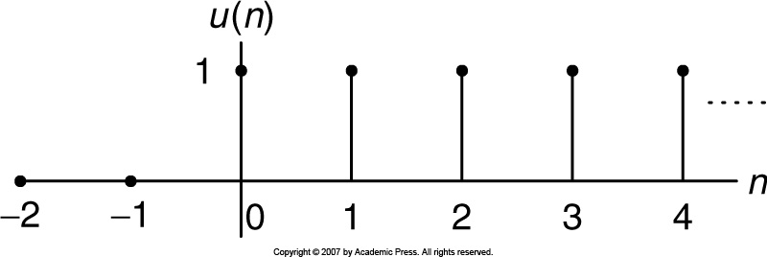
Common Digital Sequences
Unit-impulse sequence:
Unit-step sequence:

Slide 3
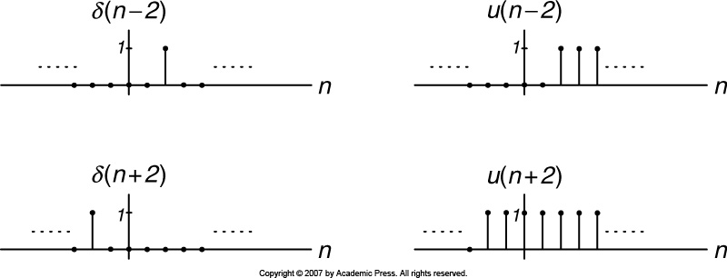
Shifted Sequences
Shifted unit-impulse
Shifted unit-step
Right shift by two samples
Left shift by two samples

Slide 4
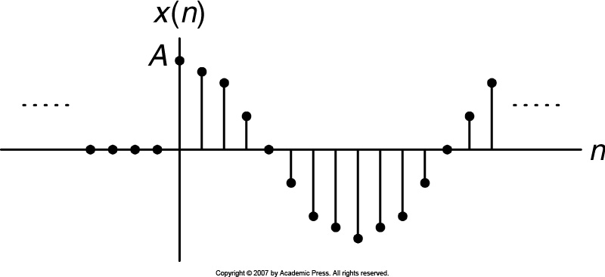
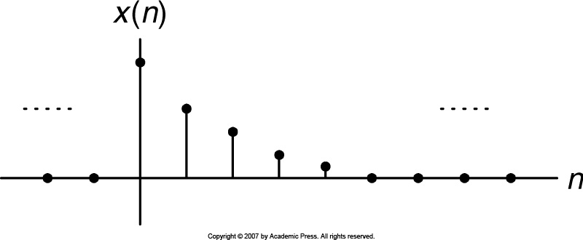
Sinusoidal and Exponential Sequences
Example
Sinusoidal
Example
Exponential

Slide 5
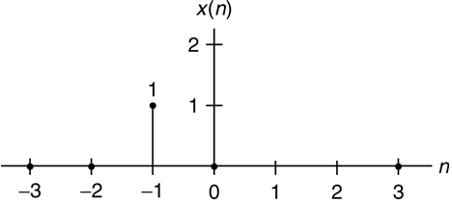
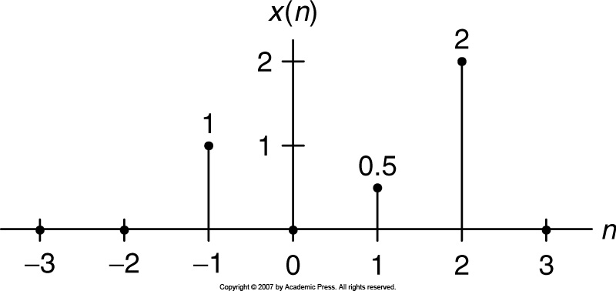
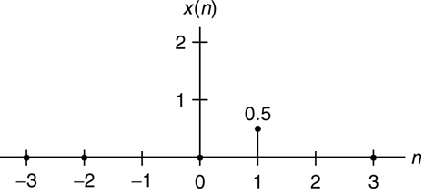
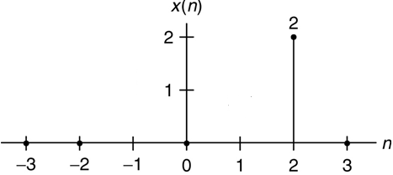
Example 1
Solution:

Slide 6
Generation of Digital Signals
x(n): digital signal
x(t): analog signal
Let, sampling interval,
Also
Example 2
Convert analog signal x(t) into digital signal x(n), when sampling period is 125 microsecond, also plot sample values.
Solution:

Slide 7
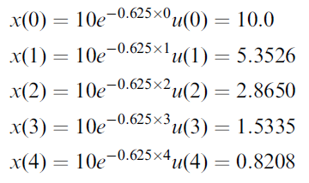
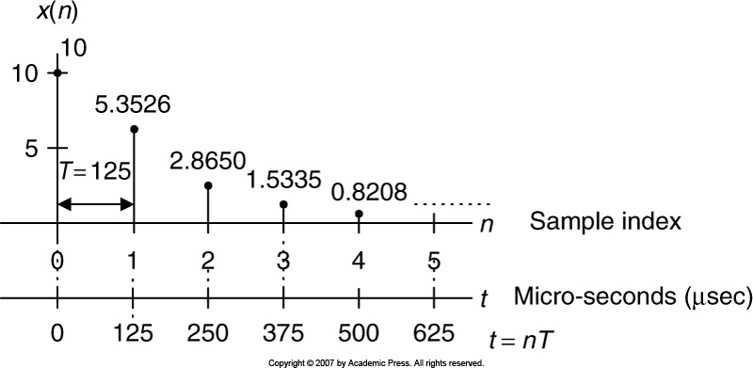
Example 2 (contd.)
The first five sample values:
Plot of the digital sequence:

Slide 8
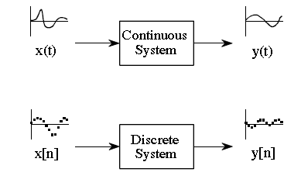
Linear System
System: A system that produces an output signal in response to an input signal.
Continuous system & discrete system.
Time, t
Sample number, n

Slide 9
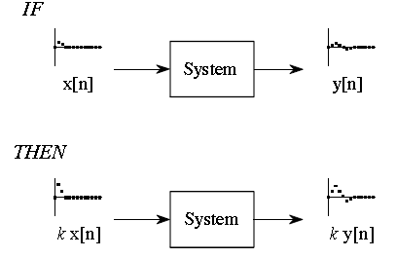
Linear Systems: Property ₁
Homogeneity
Additivity
Must for all linear systems
3. Shift invariance
Must for DSP linear systems
Homogeneity: (deals with amplitude)
If x[n] → y[n], then kx[n] → ky[n]
K is a constant

Slide 10
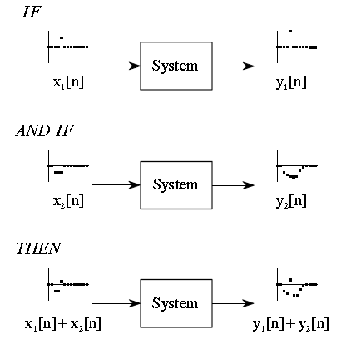
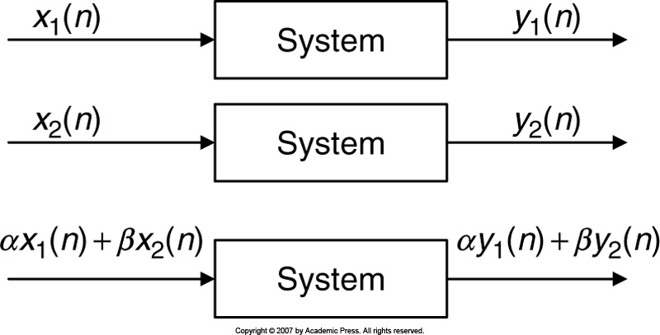
Linear Systems: Property ₂
Additivity
Homogeneity & Additivity

Slide 11
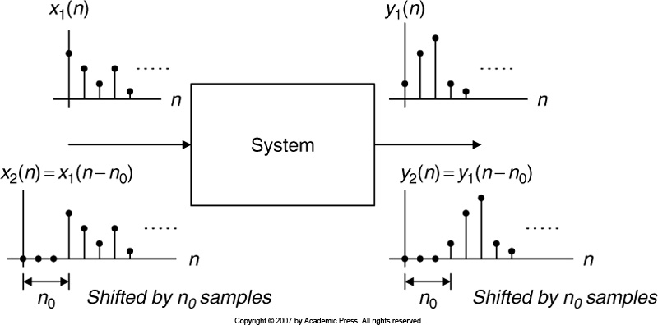
Linear Systems: Property ₃
Shift (time) Invariance

Slide 12
Example 3
Let a digital amplifier,
X 10
If the inputs are:
Outputs will be:
X 10
X 10
If we apply combined input to the system:
The output will be:
Linear System
+
Individual outputs:
X 10
X 10

Slide 13
Example 4
System
System
System
If the input is:
Then the output is:
Non Linear System
Individual outputs:
+

Slide 14
Example 5 (a)
Given the linear system
, find whether the system is time invariant or not.
Solution:
System
Let the shifted input be:
Therefore system output:
Equal
Shifting
by n₀ samples leads to
Time Invariant

Slide 15
Example 5 (b)
Given the linear system
, find whether the system is time invariant or not.
Solution:
System
Let the shifted input be:
Therefore system output:
NOT Equal
Shifting
by n₀ samples leads to
NOT Time Invariant

Slide 16
Causality
Causal System:
Output y(n) at time n depends on current input x(n) at time n or previous inputs, such as x(n-1), x(n-2), etc.
Example:
Non Causal System:
Output y(n) at time n depends on future inputs, such as x(n+1), x(n+2), etc.
Example:
The non causal system cannot be realized in real time.

Slide 17
Difference Equation
A causal, linear, and time invariant system can be represented by a difference equation as follows:
Outputs
Inputs
After rearranging:
Finally:

Slide 18
Example 6
Identify non zero system coefficients of the following difference equations.
Solution:
Solution:

Slide 19
System Representation Using Impulse Response
Impulse input with zero initial conditions
Impulse Response
Any input
y(n) = x(n) ⊗ h(n)
Convolution

Slide 20
Example 7 (a)
Given the linear time-invariant system:
Solution:
a.
Therefore,
b.
c.

Slide 21
Example 7 (b)
Solution:
a.
Then
Infinite!

Slide 22
Example 7 (b) – contd.
b.
c.
Finite Impulse Response (FIR) system:
When the difference equation contains no previous outputs, i.e. ‘a’ coefficients are zero. < See example 7 (a) >
Infinite Impulse Response (IIR) system:
When the difference equation contains previous outputs, i.e. ‘a’ coefficients are not all zero. < See example 7 (b) >

Slide 23
BIBO Stability
BIBO: Bounded In and Bounded Out
A stable system is one for which every bounded input produces a bounded output.
Let, in the worst case, every input value reaches to maximum value M.
Using absolute values of the impulse responses,
If the impulse responses are finite number, then output is also finite.
Stable system.

Slide 24
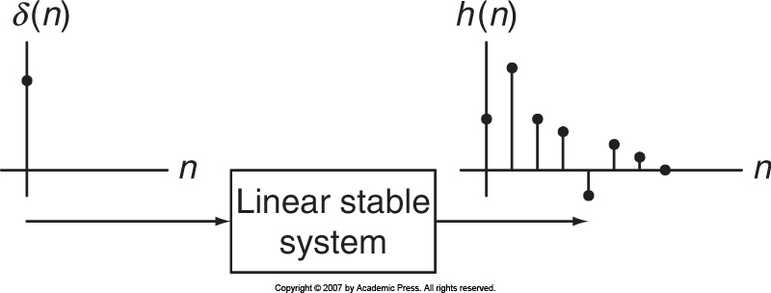
BIBO Stability – contd.
To determine whether a system is stable, we apply the following equation:
Impulse response is decreasing to zero.

Slide 25
Example 8
Given a linear system given by:
Which is described by the unit-impulse response:
Determine whether the system is stable or not.
Solution:
Using definition of step function:
For a < 1, we know
Therefore
The summation is finite, so the system is stable.

Slide 26
Digital Convolution
The sequences are interchangeable.
Commutative
Convolution sum requires h(n) to be reversed and shifted.
If h(n) is the given sequence, h(-n) is the reversed sequence.

Slide 27
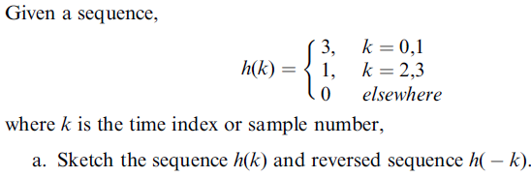
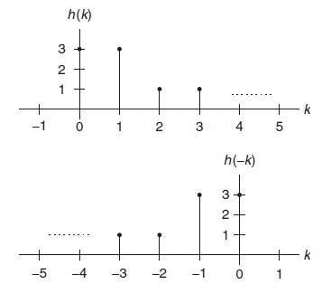
Reversed Sequence
Solution:
a.

Slide 28
Convolution Using Table Method
Example 9
Solution:
Length = 3
Length = 3
Convolution length = 3 +3 – 1 = 5

Slide 29
Convolution Using Table Method
Example 10
Length = 3
Length = 2
Solution:
Convolution length = 3 + 2 – 1 = 4

Slide 30
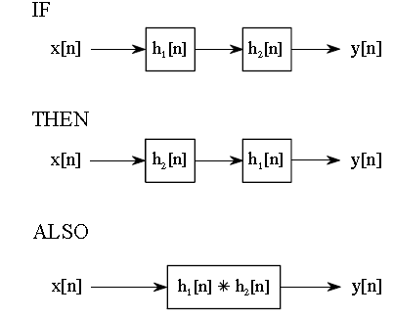
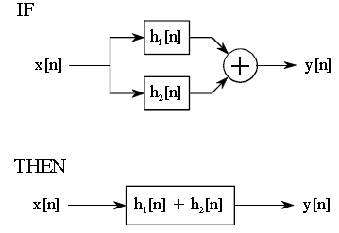
Convolution Properties
Commutative:
Associative:
Distributive:
Distributive
Associative

