Slide 1
Digital Signal
Analog Signal
Discrete-time Signal
Continuous amplitude
Continuous amplitude
Continuous time
Discrete time
Discrete amplitude
Digital Signal
Discrete time

Slide 2
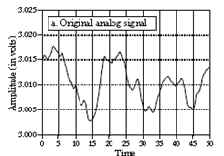
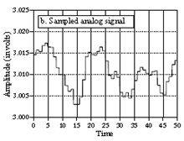
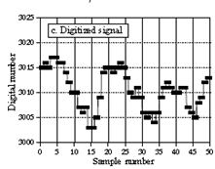
Digital Signal – contd.
Discrete-time Signal
Analog Signal
Digital Signal

Slide 3
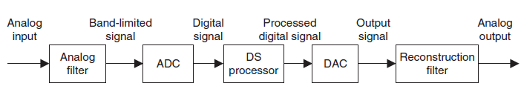
DSP (Digital Signal Processing)
A digital signal processing scheme
Analog to Digital Converter
Digital to Analog Converter
To avoid aliasing for sampling
To avoid aliasing for sampling
Computer / microprocessor / micro controller/ etc.

Slide 4

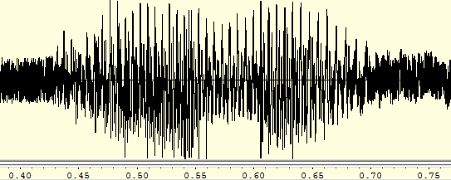
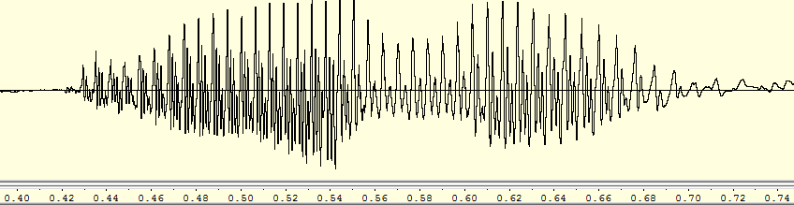
Some Applications of DSP
Noise removal from speech.
Noisy Speech
Clean Speech

Slide 5
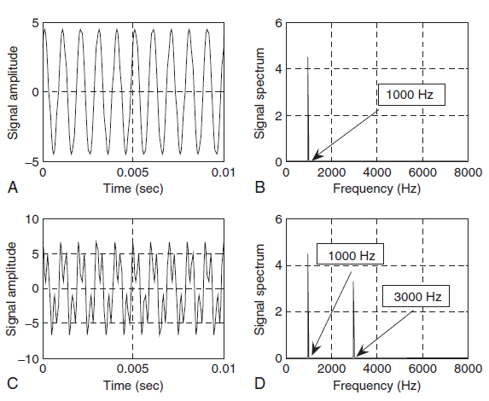
Some Applications of DSP
Signal spectral analysis.
Time domain
Frequency domain
Single tone: 1000 Hz
Double tone: 1000 Hz and 3000 Hz

Slide 6
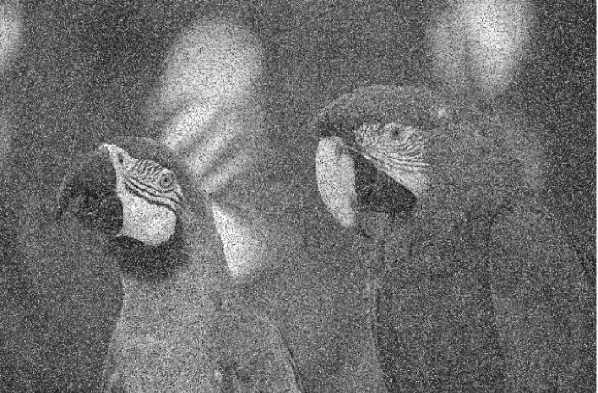

Some Applications of DSP
Noise removal from image.

Slide 7
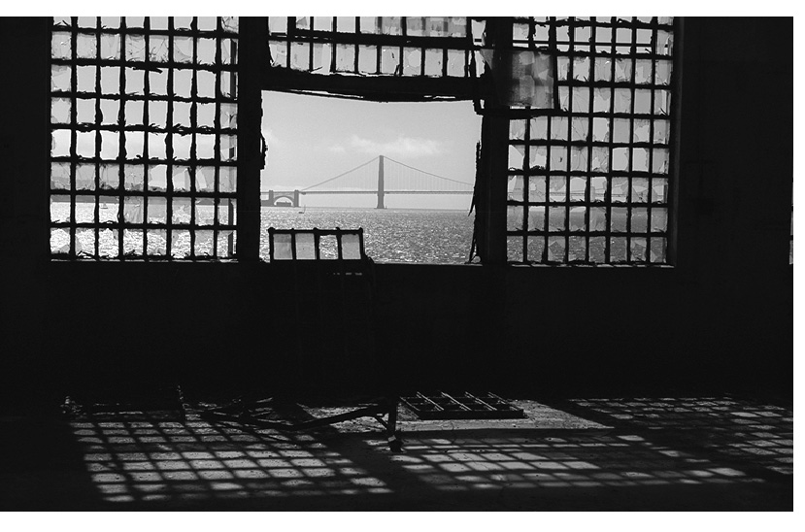
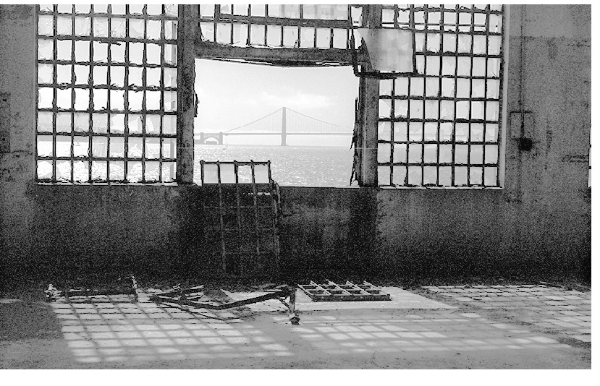
Some Applications of DSP
Image enhancement.

Slide 8
Summary Applications of DSP
Speech recognition
Speaker recognition
Speech synthesis
Speech enhancement
Speech coding
Digital speech and audio:
Image enhancement
Image recognition
Medical imaging
Image forensics
Image coding
Digital Image Processing:
Internet audio, video, phones
Image / video compression
Text-to-voice & voice-to-text
Movie indexing
Multimedia:
……..

Slide 9
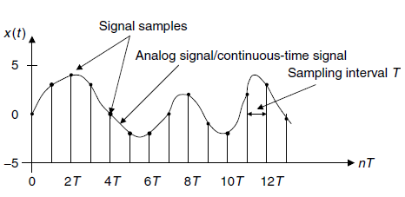
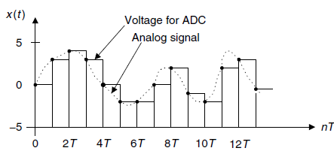
Sampling
For a given sampling interval T, which is defined as the time span between two sample points, the sampling rate is given by
samples per second (Hz).
For example, if a sampling period is T = 125 microseconds, the sampling rate is
determined as fs =1/125 μs or 8,000 samples per second (Hz).
Sample and Hold

Slide 10
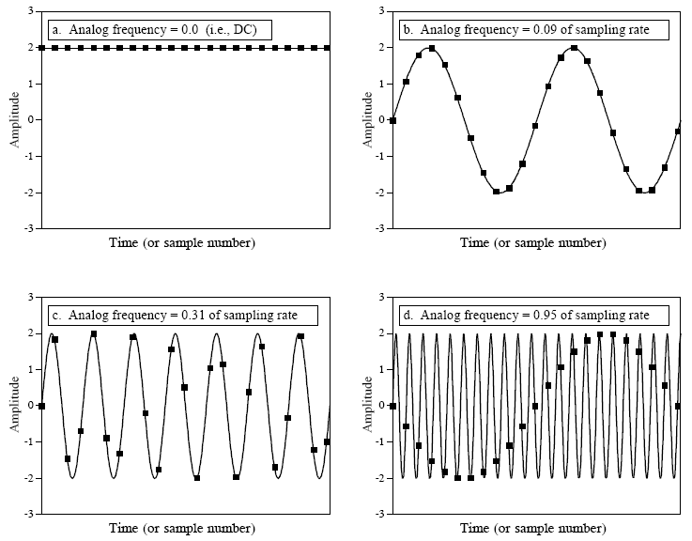
Sampling - Theorem
Freq. = 2 / 23
Freq. = 7 / 23
Freq. = 22/ 23

Slide 11

Sampling - Theorem
The sampling theorem guarantees that an analog signal can be in theory perfectly recovered as long as the sampling rate is at least twice as large as the highest-frequency component of the analog signal to be sampled.
The condition is:
For example, to sample a speech signal containing frequencies up to 4 kHz, the minimum sampling rate is chosen to be at least 8 kHz, or 8,000 samples per second.

Slide 12
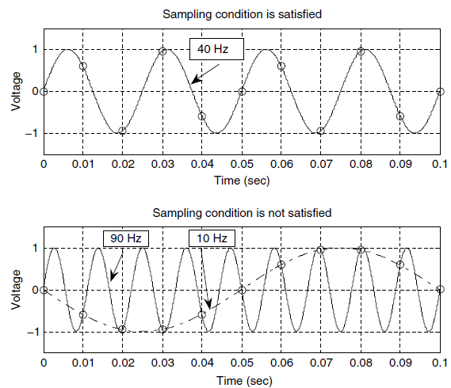
Sampling - Theorem
Sampling interval T= 0.01 s
Sampling rate f_{s}= 100 Hz
Sinusoid freq. = 4 cycles / 0.1 = 40 Hz
Sampling condition is satisfied, so reconstruction from digital to analog is possible.
Do this by yourself!

Slide 13

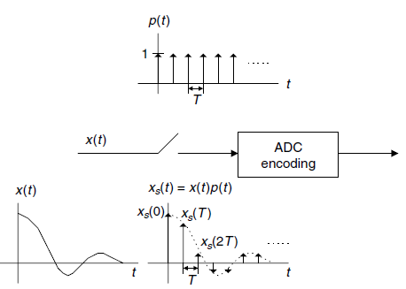
Sampling Process
x(t): Input analog signal
p(t): Pulse train

Slide 14


Sampling Process
In frequency domain:
X_{s}(f): Sampled spectrum
X(f): Original spectrum
X(f±nf_{s}): Replica spectrum

Slide 15
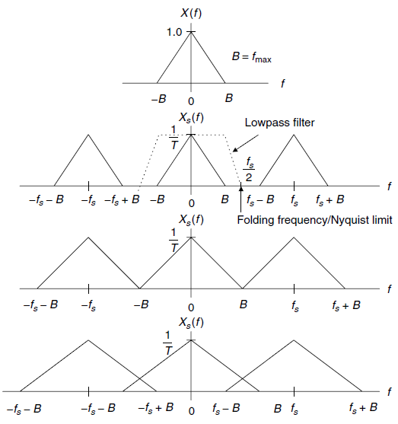
Sampling Process
Original spectrum
Original spectrum plus its replicas
Original spectrum plus its replicas
Minimum requirement for Reconstruction
Reconstruction not possible
Original spectrum plus its replicas

Slide 16

Shannon Sampling Theorem
For a uniformly sampled DSP system, an analog signal can be perfectly recovered as long as the sampling rate is at least twice as large as the highest-frequency component of the analog signal to be sampled.
Half of the sampling frequency f_{s}/2 is usually called the Nyquist frequency
(Nyquist limit), or folding frequency.

Slide 17
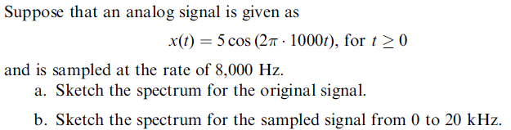

Example 1
Problem:
Solution:
Using Euler’s identity,
Hence, the Fourier series coefficients are:

Slide 18
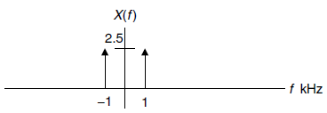
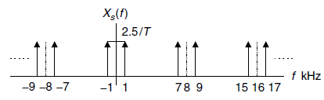
Example 1 – contd.
a.
b.
After the analog signal is sampled at the rate of 8,000 Hz, the sampled signal spectrum and its replicas centered at the frequencies ±nf_{s}, each with the scaled amplitude being 2.5/T
Replicas, no additional information.

Slide 19
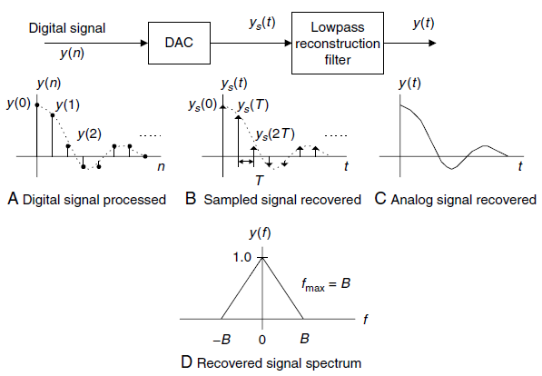
Signal Reconstruction
First, the digitally processed data y(n) are converted to the ideal impulse train y_{s}(t), in which each impulse has its amplitude proportional to digital output y(n), and two consecutive impulses are separated by a sampling period of T;
second, the analog reconstruction filter is applied to the ideally recovered sampled signal y_{s}(t) to obtain the recovered analog signal.

Slide 20

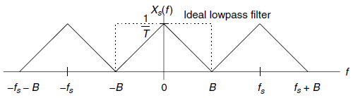

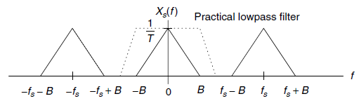
Signal Reconstruction

Slide 21

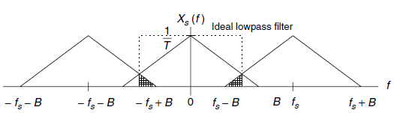
Signal Reconstruction
Aliasing
Perfect reconstruction is not possible, even if we use ideal low pass filter.

Slide 22
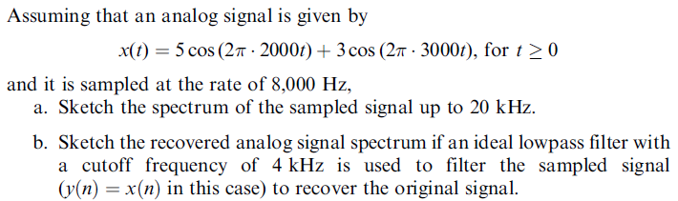

Example 2
Problem:
Solution:
Using the Euler’s identity:

Slide 23
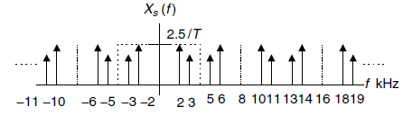
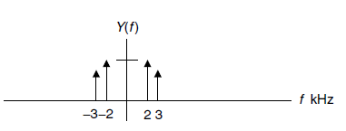
Example 2 – contd.
a.
b.
The Shannon sampling theory condition is satisfied.

Slide 24
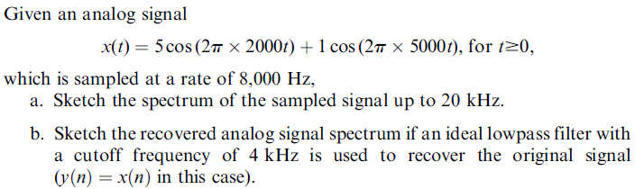
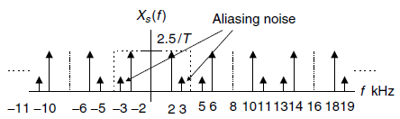
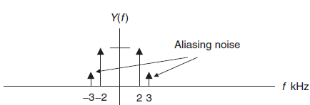
Example 3
Problem:
Solution:
a.
b.

Slide 25
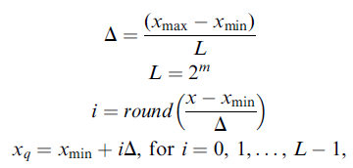
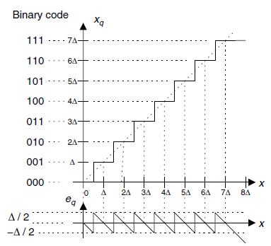
Quantization
L: No. of quantization level
m: Number of bits in ADC
Δ: Step size of quantizer
i: Index corresponding to binary code
x_{q}: Quantization level
x_{max}: Max value of analog signal
x_{min}: Min value of analog signal
Example:
Unipolar

Slide 26
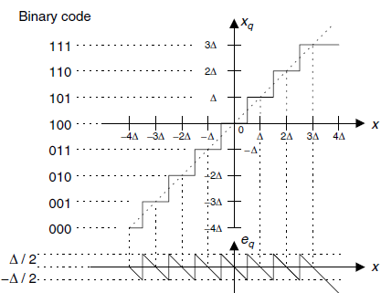
Quantization – contd.
Bipolar

Slide 27
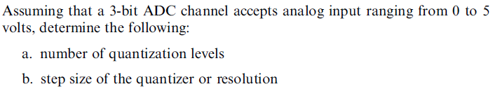





Example 4
Problem:
Solution:
c.
a.
b.
Quantization error:
d.
101

