Slide 1
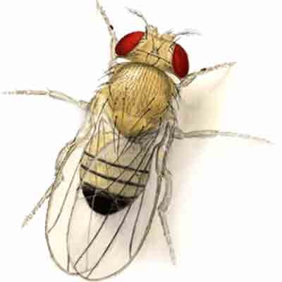
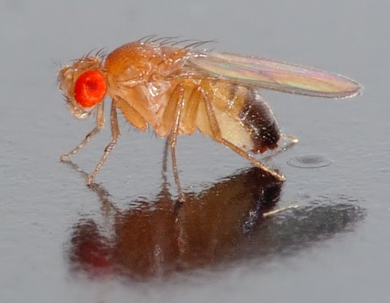
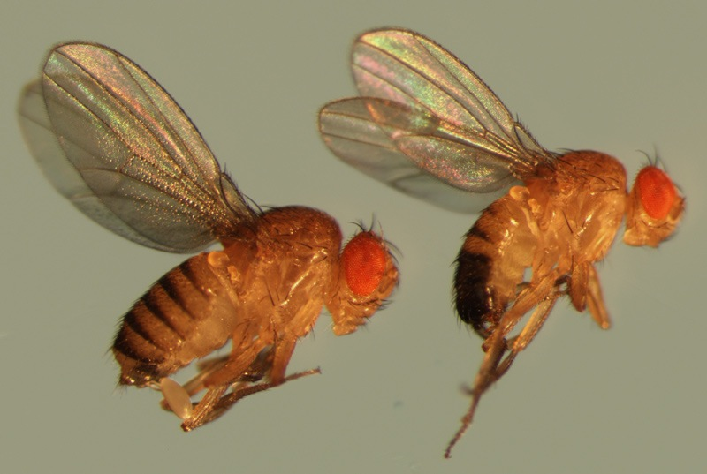
Drosophila Melanogaster

Slide 2
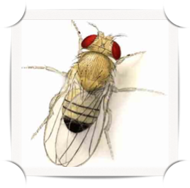
Why work with Drosophila?
Drosophila melanogaster is classified in the Family: Drosophilidae and Order: Diptera.
Drosophila melanogaster, the common fruit fly, is a commonly used model research organism in genetics.
They are found near ripe fruit. In the wild, adults and larvae feed on yeasts and bacteria growing on rotting fruit.
In the Lab they can be fed on the yeast cells growing on a high carbohydrate prepared diet.

Slide 3
Drosophila was one of the first organisms to be studied genetically, why?
Ready availability : it's cheap and easy to keep large numbers of the fruit flies in lap. (they can be fed on the yeast cells growing on a high carbohydrate)
They have a short life-cycle of just two weeks, (10 ~14 days at 25oC)
Short generation time.
Produce high amounts of offspring (an adult female can lay 400-500 eggs in 10 days).
It has four pairs of chromosomes: the X/Y sex chromosomes and the autosomes 2, 3, and 4.
Gaint or Polytene chromosomes found in the larval salivary gland.

Slide 4
Culture media
Cornmeal-Molasses-Agar Medium.
B. Instant Drosophila Medium.

Slide 5
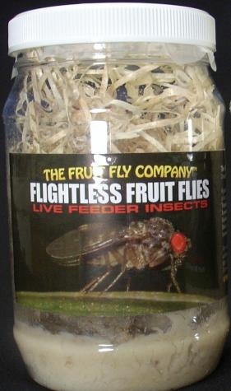
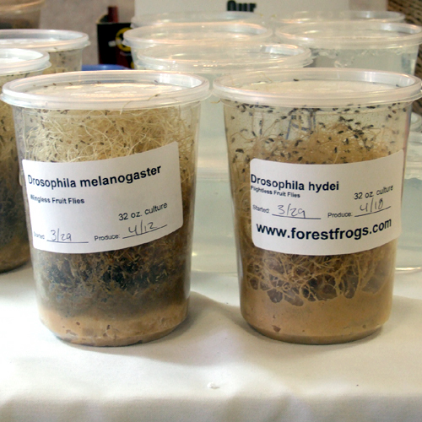
Instant Drosophila Medium
We Can be obtained media from some companies then we need to mix equal amount of media in same amount of distilled water .
2. Add 6-8 ml from propionic acid (Inhibiting the growth of fungi and microorganisms) and add 0.5 ml of mycostatin (inhibition of fungal growth) into the appropriate bottle filled by water to a total volume of 1 L .
3. poured equal amounts of the papered media into fly vials to a depth of about 2-3 cm and Add the equal amounts from the solution that prepared in step 2 into the new media in the breeding vial.
4. Use the cultured vials after a minute
or two of preparation.
5. Clean the lap and tools .

Slide 6
life cycle of Drosophila
The fruit fly’s life cycle has many stages:
The egg: Eggs are small, oval shaped, and have two filaments at one end.
The larval stage: The larva look like worms. They use black mouth hooks to eat. Three larval stages.
The pupal stage: A pupa undergoes four days of metamorphosis. They form a hard and dark pupal case.
The adult stage: Adult flies have a head, thorax, abdomen, six legs, and two wings.

Slide 7
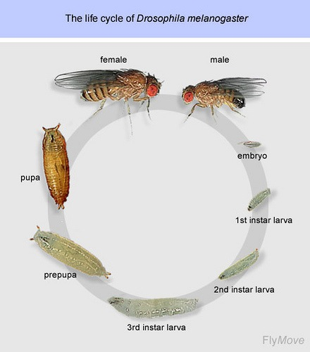

Slide 8
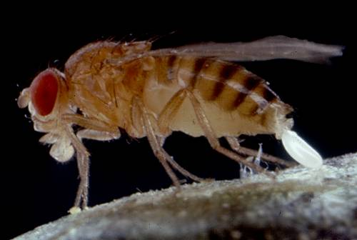
Egg Laying in D. melanogastor

Slide 9
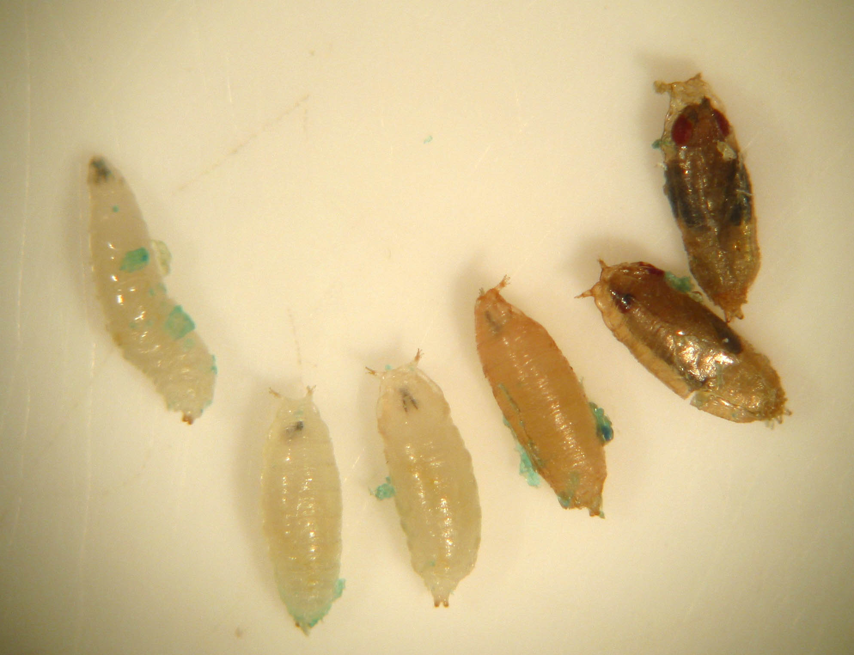
Larva to Pupa Stages
Larvae are mobile
Pupal
stages

Slide 10
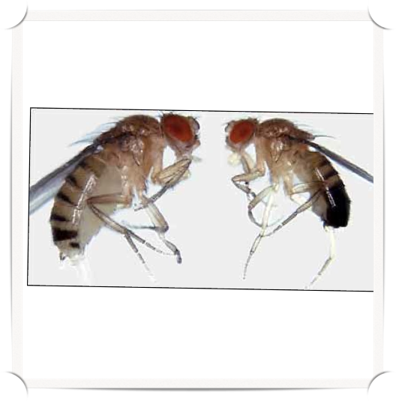
Identify males versus females
1-Size: Female larger than the male.
Female
Male

Slide 11
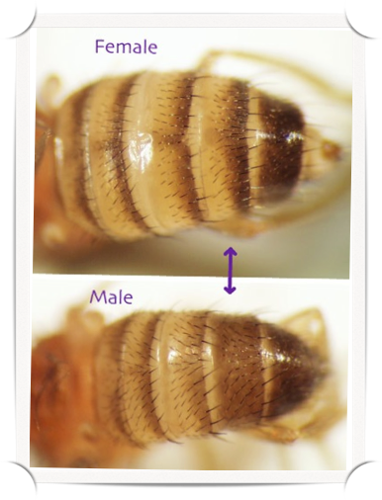
Identify males versus females
2- Shape of abdomen: The female abdomen curves to a point; the male abdomen is round.
3- Markings on the abdomen: Alternating dark and light bands can be seen on the entire rear portion of the female; the last few segments of the male are fused and dark bands. .

Slide 12
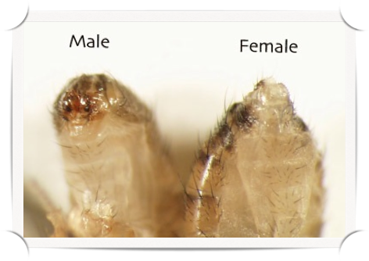
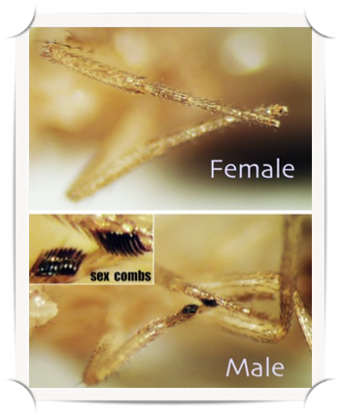
Identify males versus females
4- External genitalia on abdomen: Located at the tip of the abdomen, the ovipositor of the female is pointed. The claspers of the male are darkly pigmented, arranged in circular form, and located just ventral to the tip.
5- Appearance of sex comb: On males there is a tiny tuft of hairs on the front legs

Slide 13
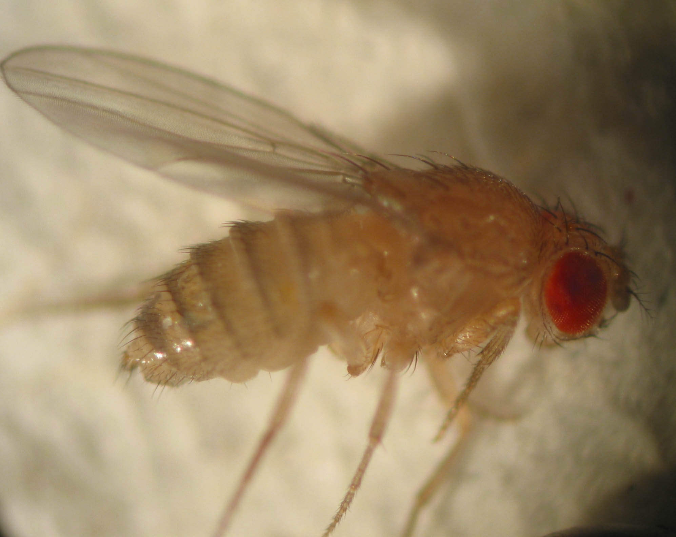
This is a *female* fruit fly
Notice the tiger-striped abdomen and the
simple tag-like tip on the abdomen.

Slide 14
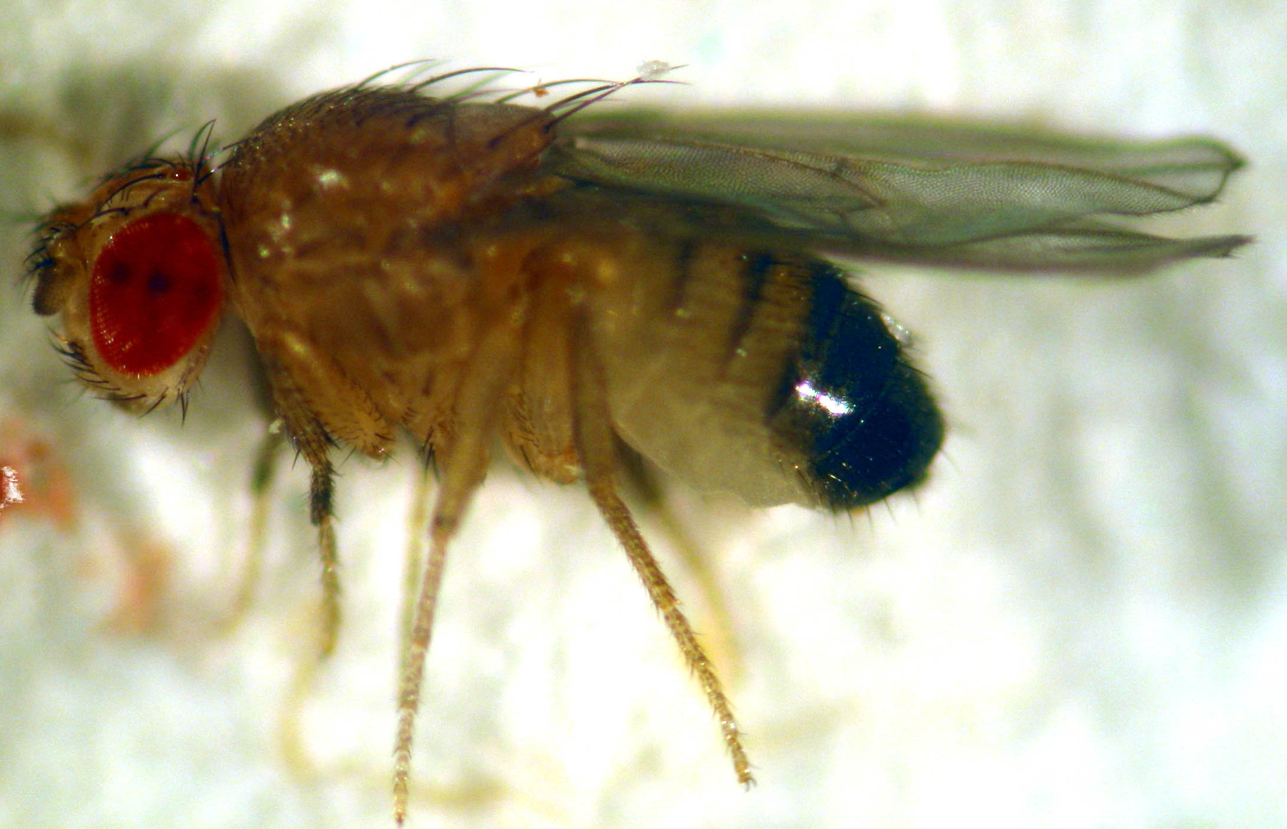
This is a mature male fruit fly
Mature males have a prominent black abdominal end.
Males also have tiny “sex combs” on their front pair of legs.

Slide 15
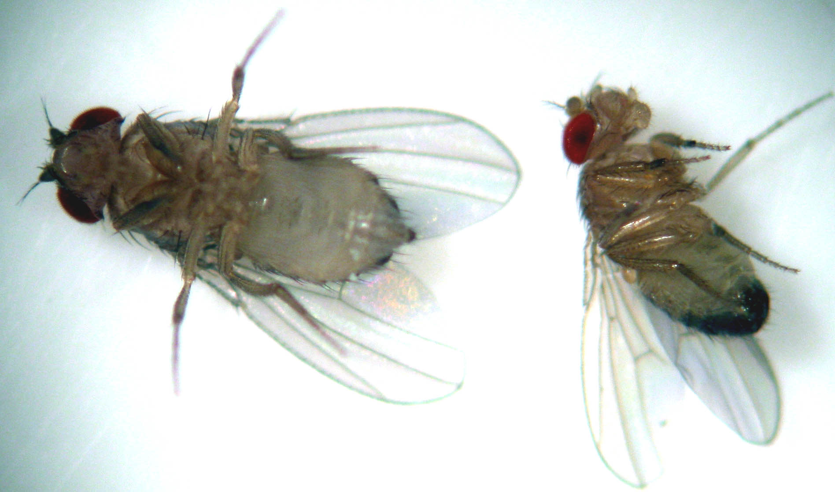
Ventral view of a male and female
Find their distinguishing features

Slide 16
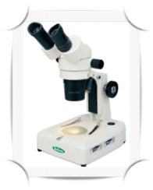
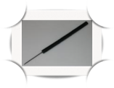
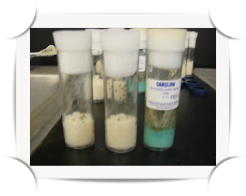
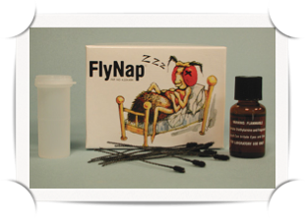
Dealing with the fruit fly
Materials used:
Dissecting microscope.
Tools and material insects anesthesia (anesthetic for insects Fly Nap).
Tweezers.
Special fine hair brushes.
Needle- wand.
A4 paper.
Glass cup contains 70% alcohol.
Breeding vials or flask.
Incubator .

Slide 17
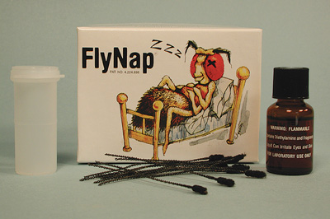
Method
Anesthetizing
1
2
Anesthetized the flies by ether
Anesthetized the flies by FlyNap

Slide 18
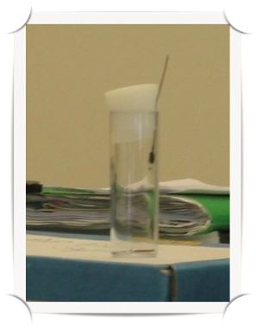
Anesthetized the flies by FlyNap Method
Anesthetized the flies by using Fly Nap, then Dip wand into Fly Nap.
Insert the Fly Nap loaded wand into the inner surface of the breeding vial.
Observe the vial carefully! When all flies have stopped moving, wait about 4 minutes.
Open spongy plug and dump them onto white paper to identified the characteristics of napped flies.
While we are re putting the flies in breeding vial.
Note :
- While re insects to the vials, we must take into account Place the vial ON ITS SIDE.
- Do NOT leave the vial upright. (The flies will fall into the food and get stuck!!) .

Slide 19
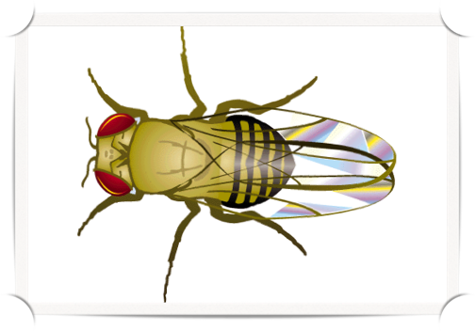
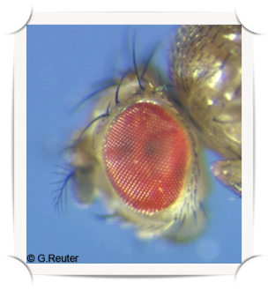
Wild type
Wild type

Slide 20
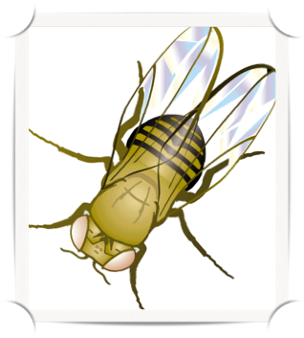
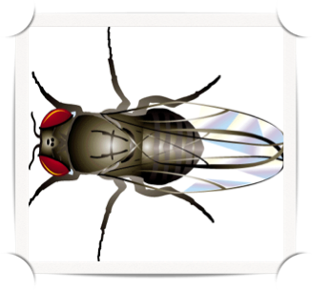
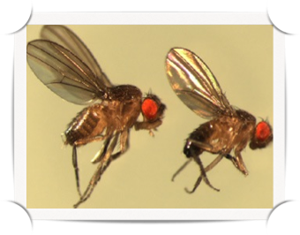
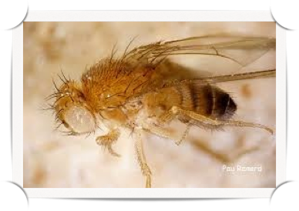
Mutant type
Mutant type

Slide 21
“Thank you”

