Slide 1
Design of Experiments (Lecture V)
Dr. Adham Ragab

Slide 2
Outline
Confidence Interval (CI)
Assuming known variance
Assuming unknown variance
Test of Hypothesis
Types of Errors

Slide 3
Objectives
By the end of this lecture the student should be able to:
Define the confidence level and confidence interval
Calculate the confidence interval.
Understand the basics of tests of hypothesis.
Recognize type I and type II errors.

Slide 4
Confidence Interval
confidence interval (CI): is a type of interval estimate of a population parameter.
Confidence level: the percentage of all possible samples that can be expected to include the true population parameter.
α = (1-confidence level) the marginal accepted error in estimating a population parameter.

Slide 5
Calculating CI When σ² is known
Comparing two means

Slide 6
Example I
A random sample of 225 1st year statistics tutorials was selected from the past 5 years and the number of students absent from each one recorded.
The results were: sample mean =11.6 and standard deviation = 4.1 absences. Estimate the mean number of absences per tutorial over the past 5 years with 90% confidence.

Slide 7
Example II
Referring to Example I, another sample of 170 students of 2nd year statistics tutorial was tested for absences.
The results were: sample mean =9.3 and standard deviation = 4.6 absences. Estimate the difference in mean number of absences per tutorial over the past 5 years between the 1st and 2nd year students with 90% confidence.

Slide 8
Student’s t distribution
Note: t Z as n increases
Standard Normal
t (df = 13)
t-distributions are bell-shaped and symmetric, but have ‘fatter’ tails than the normal
t (df = 5)
t
0

Slide 9
Calculating CI When σ² is Unknown

Slide 10
Calculating CI When σ² is Unknown, cont.
Comparing two means assuming equal variances

Slide 11
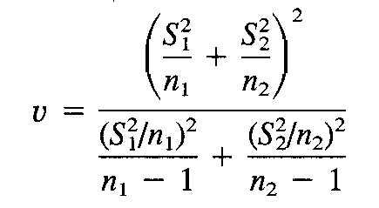
Calculating CI When σ² is Unknown, cont.
Comparing two means assuming non equal variances

Slide 12
Example III
A random sample of 7 students in IE 333 class had GPAs: 3.78, 4.25, 4.69, 3.52, 3.22, 4.16 and 3.77.
Estimate the mean GPA of IE 333 classes with 95% confidence.

Slide 13
Example IV
The GPAs of another sample of 9 students in IE 352 were: 4.88, 4.63, 3.21, 2.89, 3.89, 3.55, 4.66, 4.09 and 3.43.
Estimate the difference in mean GPA between IE 333 and IE 352 students with 95% confidence.
a. assuming equal variances.
b. assuming non equal variances.

Slide 14
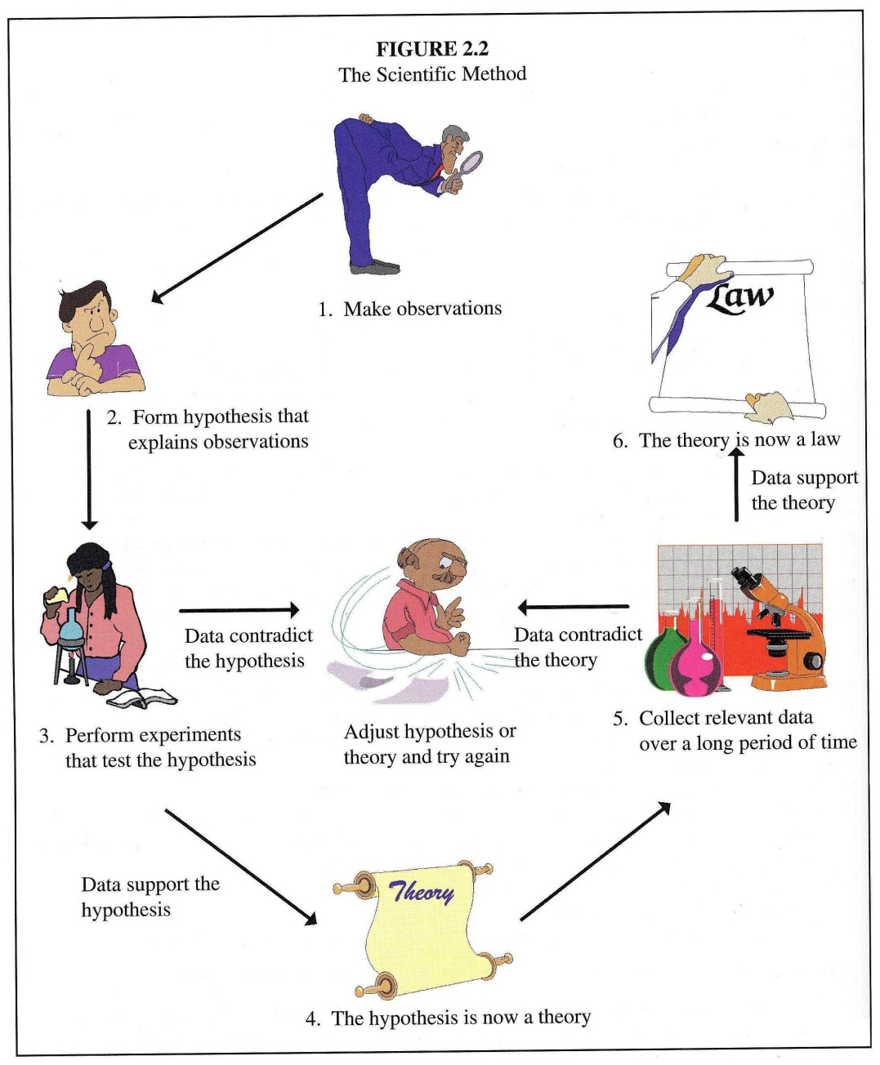
What is hypothesis?

Slide 15
The Hypothesis Testing Framework
Statistical hypothesis testing is a useful framework for many experimental situations
Origins of the methodology date from the early 1900s

Slide 16
What is test of hypothesis?
Hypothesis: It is a claim that we want to test.
Null hypothesis: H_{o}, current accepted value for a parameter.
Alternative hypothesis: H_{a}, the research hypothesis. Involves the claim to be tested.
H_{o} and H_{a} are mathematical opposites.

Slide 17
What is test of hypothesis?, cont.
Example: A manufacturer claims that the thickness of the gum it produces is 1mm. A quality control engineer thinks it is not. Write both the hypothesizes.
Answer: H_{o}: µ=1mm
H_{a}: µ≠1mm
Possible outcomes of this test:
We reject the Null hypothesis.
Fail to reject the Null hypothesis.

Slide 18
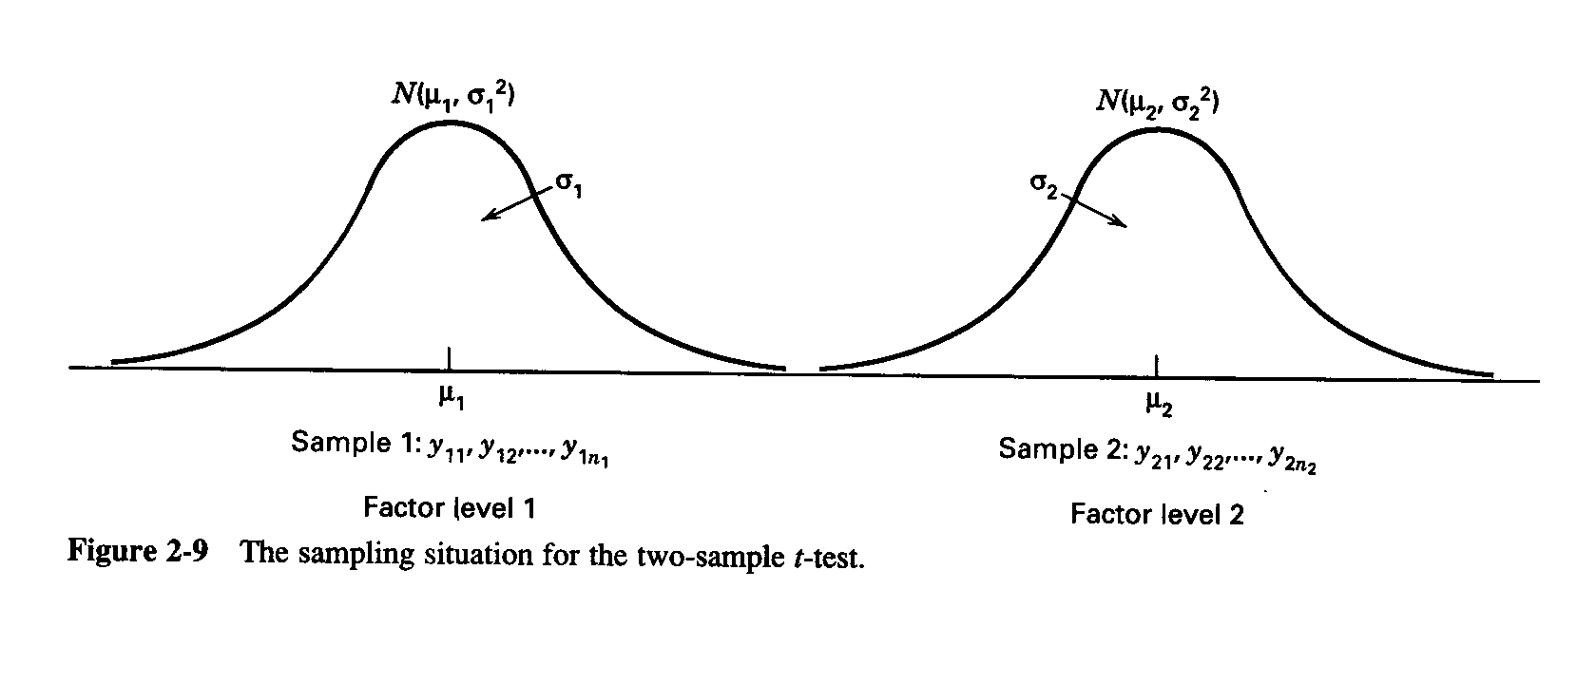
What is test of hypothesis?, cont.
Test statistic: calculated from sample data and used to decide about the Null hypothesis.

Slide 19
Types of Errors
Two kinds of errors may be committed when testing hypotheses.
If the null hypothesis is rejected when it is true, a “type I error” has occurred.
If the null hypothesis is not rejected when it is false, a “type I1 error” has been made. The probabilities of these two errors are given special symbols:

Slide 20
Types of Errors
α = P(type I error) = P(reject Ho I Ho is true)
β = P(type I1 error) = P(fai1 to reject Ho I Ho is false)
Sometimes it is more convenient to work with the power of the test, where
Power = 1 - β = P(reject Ho 1 Ho is false)
α = 1- confidence level

