Slide 1
Design of Experiments (Lecture III)
Dr. Adham Ragab

Slide 2
Sampling methods
Probability Sampling: Sample has a known probability of being selected
Simple Random Sampling (SRS)
Stratified Sampling
Cluster Sampling
Systematic Sampling
Multistage Sampling (in which some of the methods above are combined in stages)

Slide 3
Sampling methods
Non-probability Sampling: Sample does not have known probability of being selected
volunteer samples
haphazard (convenience) samples
Judgmental Sampling

Slide 4
Simple random sample
A simple random sample (SRS) of size n is a sample chosen by a method in which each collection of n population items is equally likely to comprise the sample, just as in the lottery.

Slide 5
Stratified Sampling
Stratified Sampling is possible when it makes sense to partition the population into groups based on a factor that may influence the variable that is being measured. These groups are then called strata. An individual group is called a stratum.

Slide 6
Stratified Sampling
With stratified sampling one should:
partition the population into groups (strata)
obtain a simple random sample from each group (stratum)
collect data on each sampling unit that was randomly sampled from each group (stratum)

Slide 7
Cluster Sampling
With cluster sampling one should
divide the population into groups (clusters).
obtain a simple random sample of so many clusters from all possible clusters.
obtain data on every sampling unit in each of the randomly selected clusters.

Slide 8
Systematic Sampling
Systematic sampling: is a method in which sample members from a larger population are selected according to a random starting point and a fixed periodic interval.
This interval, called, the sampling interval, is calculated by dividing the population size by the desired sample size.

Slide 9
Multistage Sampling
In statistics, multistage sampling is the taking of samples in stages using smaller and smaller sampling units at each stage. Multistage sampling can be a complex form of cluster sampling because it is a type of sampling which involves dividing the population into groups (or clusters).

Slide 10
Histogram
A histogram is a plot that lets you discover, and show, the underlying frequency distribution (shape) of a set of continuous data. This allows the inspection of the data for its underlying distribution (e.g., normal distribution), outliers, skewness, etc.

Slide 11
Histogram

Slide 12
Histogram
A symmetric distribution is one in which the 2 "halves" of the histogram appear as mirror-images of one another. A skewed (non-symmetric) distribution is a distribution in which there is no such mirror-imaging.

Slide 13
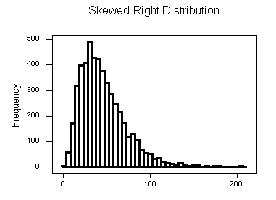
Histogram
A "skewed right" distribution is one in which the tail is on the right side.

Slide 14
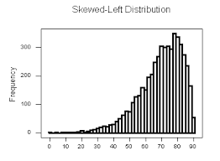
Histogram
A "skewed left" distribution is one in which the tail is on the left side.

Slide 15
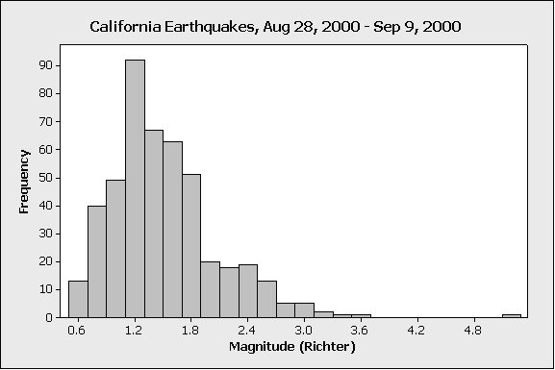
Histogram
An outlier is an observation that lies outside the overall pattern of a distribution

Slide 16
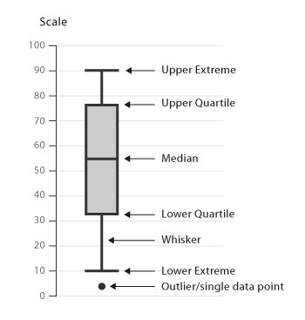
Box plot

Slide 17
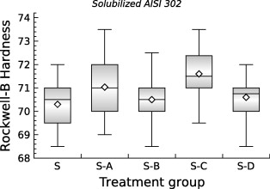
Box plot

