Slide 1
Design of Experiments (Lecture II)
Dr. Adham Ragab

Slide 2
Outline
Review of simple statistics

Slide 3
Objectives
By the end of this lecture the student should be able to:
Recognize the applications of statistics in real life
Define the terms “Population” and “Sample”
Define and calculate different statistical variables (mean, standard deviation, median, etc.)

Slide 4
Statistics is the science of conducting studies to collect, organize, summarize, analyze, present, interpret and draw conclusions from data.
Any values (observations or measurements) that have been collected

Slide 5
Statistics in Our Life
Finance
Crimes and legal system
Medical
Quality
Etc.
https://www.youtube.com/watch?v=jbkSRLYSojo

Slide 6
Statistical Lies
http://www.physics.csbsju.edu/stats/display.html

Slide 7
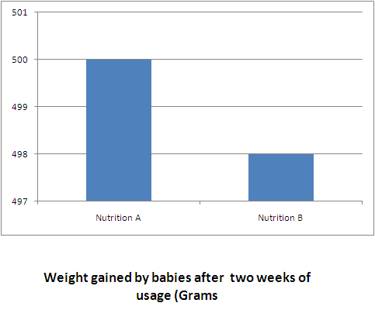
Statistical Lies

Slide 8
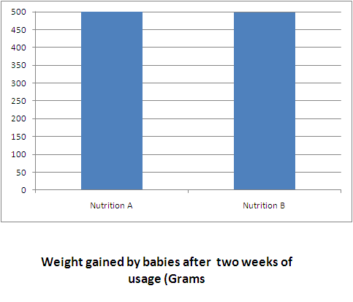
Statistical Lies

Slide 9
Definitions
Following slides are copied from different resources

Slide 10
Variables
A variable is a characteristic or condition that can change or take on different values.
Most research begins with a general question about the relationship between two variables for a specific group of individuals.

Slide 11
Experiments
The goal of an experiment is to demonstrate a cause-and-effect relationship between two variables; that is, to show that changing the value of one variable causes changes to occur in a second variable.

Slide 12
Types of Variables
Variables can be classified as discrete or continuous.
Discrete variables (such as class size) consist of indivisible categories, and continuous variables (such as time or weight) are infinitely divisible into whatever units a researcher may choose. For example, time can be measured to the nearest minute, second, half-second, etc.

Slide 13
Population
The entire group of individuals is called the population.
For example, a researcher may be interested in the relation between class size (variable 1) and academic performance (variable 2) for the population of third-grade children.

Slide 14
Sample
Usually populations are so large that a researcher cannot examine the entire group. Therefore, a sample is selected to represent the population in a research study. The goal is to use the results obtained from the sample to help answer questions about the population.

Slide 15
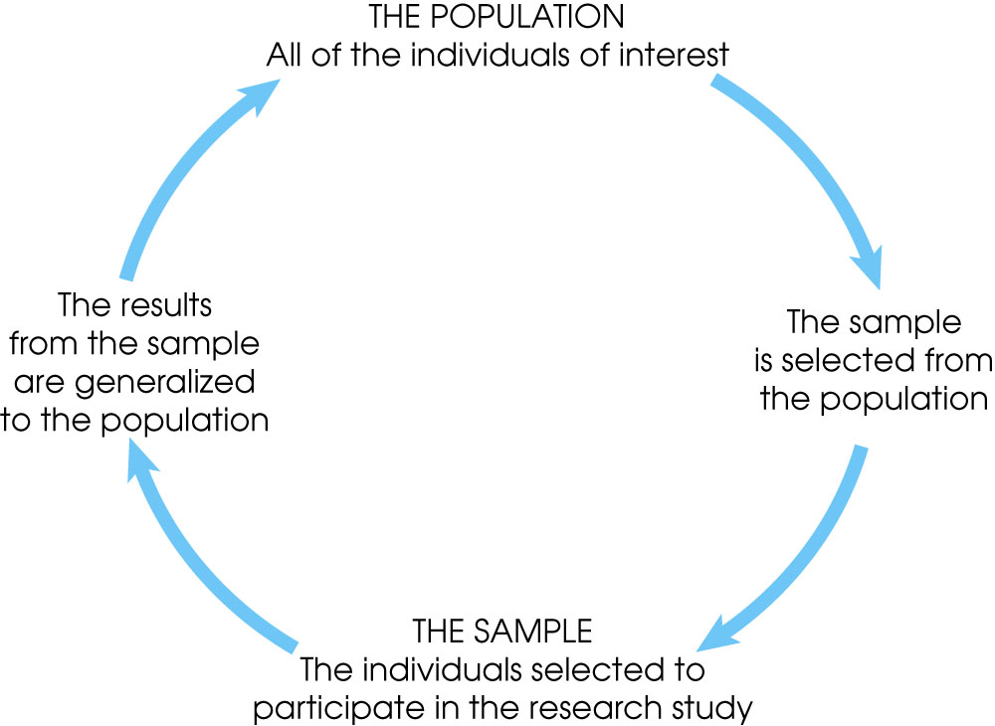
Notes:
Figure 1.1
The relationship between a population and a sample.

Slide 16
Simple random sample
A simple random sample (SRS) of size n is a sample chosen by a method in which each collection of n population items is equally likely to comprise the sample, just as in the lottery.

Slide 17
Independent Items
The items in a sample are independent if knowing the values of some of the items does not help to predict the values of the others.
Items in a simple random sample may be treated as independent in most cases encountered in practice. The exception occurs when the population is finite and the sample comprises a substantial fraction (more than 5%) of the population.

Slide 18
Descriptive Statistics
Descriptive statistics are methods for organizing and summarizing data.
For example, tables or graphs are used to organize data, and descriptive values such as the average score are used to summarize data.
A descriptive value for a population is called a parameter and a descriptive value for a sample is called a statistic.

Slide 19
Inferential Statistics
Inferential statistics are methods for using sample data to make general conclusions (inferences) about populations.
Because a sample is typically only a part of the whole population, sample data provide only limited information about the population. As a result, sample statistics are generally imperfect representatives of the corresponding population parameters.

Slide 20
Sampling Error
The discrepancy between a sample statistic and its population parameter is called sampling error.
Defining and measuring sampling error is a large part of inferential statistics.

Slide 21
Types of Data
Numerical or quantitative if a numerical quantity is assigned to each item in the sample.
Continuous:
Height
Weight
Age
Discrete
Number of students in class
Number of equipment in a project

Slide 22
Types of Data
Categorical or qualitative if the sample items are placed into categories (always discrete)
Nominal (if there is no natural order between the categories)
Gender
Hair color
Zip code
Ordinal (if an ordering exists)
Customer satisfaction surveys.
Students grades.

Slide 23
Summary Statistics
Sample Mean:
Sample Variance:
Sample standard deviation is the square root of the sample variance.

Slide 24
Definition of a Median
The median is another measure of center, like the mean. To find it:
If n is odd, the sample median is the number in
position
If n is even, the sample median is the average
of the numbers in positions

Slide 25
Summary
Importance of statistics.
Population versus sample.
Mean, median and standard deviation.

