Slide 1
Spectral Characterization of DNA
BCH 302 [practical]

Slide 2
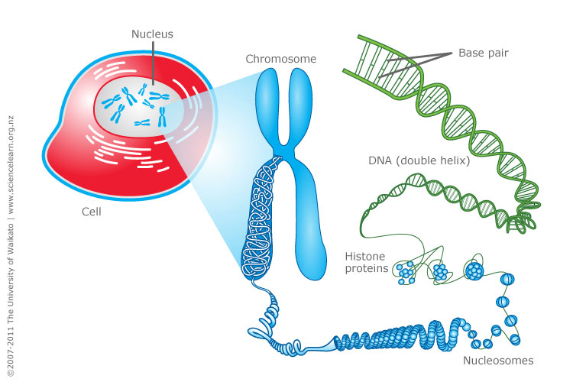
DNA [Deoxyribonucleic acid].

Slide 3
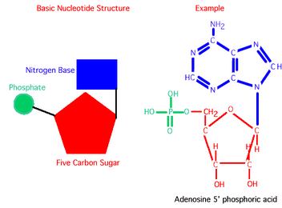
-DNA is made of 2 polynucleotide chains which run in opposite direction. [antiparallel]
-DNA has a double helical structure.
Each polynucleotide chain of DNA consists of monomer units of nucleotides.
-A monomer unit, [each nucleotide] consists of 3 main components that are:
  1-sugar,
  2-phosphate,
  3-nitrogenous base.

Slide 4
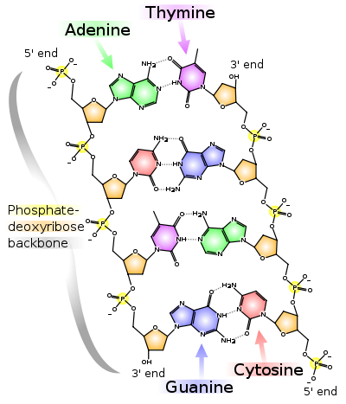
-DNA double helical structure.
[antiparallel]

Slide 5
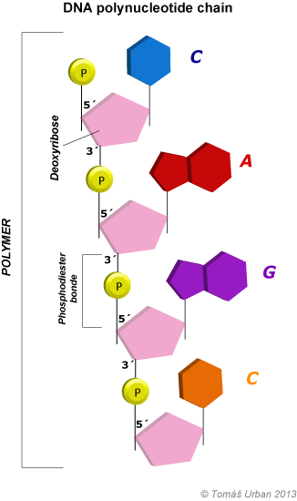
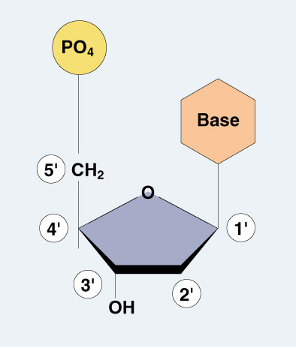
Nucleotide
Monomer

Slide 6
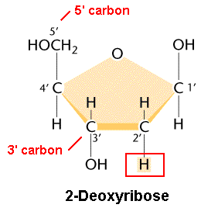
DNA Structure:
Deoxyribose sugar:
Is a monosaccharide 5-Carbon Sugar, Its name indicates that it is a deoxy sugar, meaning that →
[ it is derived from the sugar ribose by loss of an oxygen atom ].

Slide 7
2. Phosphate Group:
The sugars are joined together by phosphate groups that form phosphodiester bonds between the third and fifth carbon atoms of adjacent sugar rings.

Slide 8
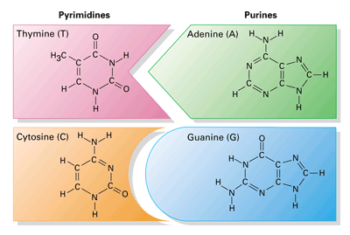
Nitrogenous bases:
is a nitrogen-containing organic molecule having the chemical properties of a base.
They are classified as the derivatives of two parent compounds,
  Purine.
    [ Adenine, Guanine ]
  Pyrimidine.
    [ Cytosine, Thymine ]

Slide 9
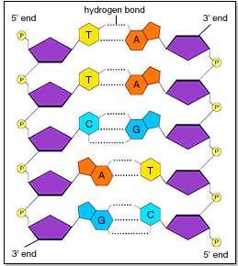
4. Hydrogen bond:
The H-bonds form between base pairs of the antiparallel strands.
The base in the first strand forms an H-bond only with a complementary base in the second strand.
Those two bases form a base-pair (H-bond interaction that keeps strands together and form double helical structure).
Sugars and phosphates are located outside of the double helical structure.

Slide 10
Denaturation of DNA:
Denaturation is a process by which nucleic acids, such as DNA, lose their three-dimensional structures and consequently their primary functions.
Many different substances or environmental conditions can denature nucleic acids, such as
-strong acids, organic solvent
-heating
-Exposure to Radiation/ UV light

Slide 11
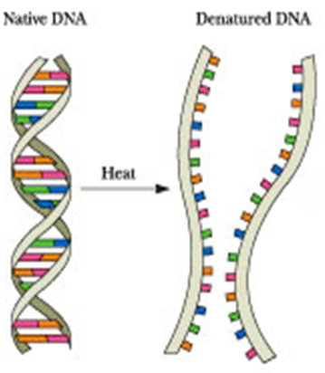

Slide 12
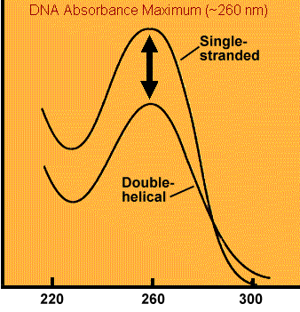
Optical density of DNA:
-Nucleic acid have maximum absorbance at 260nm, It absorbs at this wavelength because of the nitrogenous bases (A, G, C and T) of DNA.
Absorbance
Weave length [nm]

Slide 13
Hyperchromicity
In general The increase of absorbance (optical density) of a material.
the hyperchromicity of DNA that occurs when the DNA duplex is denatured.
when DNA denatures [e.g. by heat ], it's strands separate, allowing more light to be absorbed by the non-stacked bases[single DNA strands].
Explanation:
Due to denaturation of DNA the bases become exposed to the surface and able to absorb more light at 260 nm.
This action is calling the hyperchromic effect.
Note:
The opposite, a decrease of absorbance is called hypochromicity

Slide 14
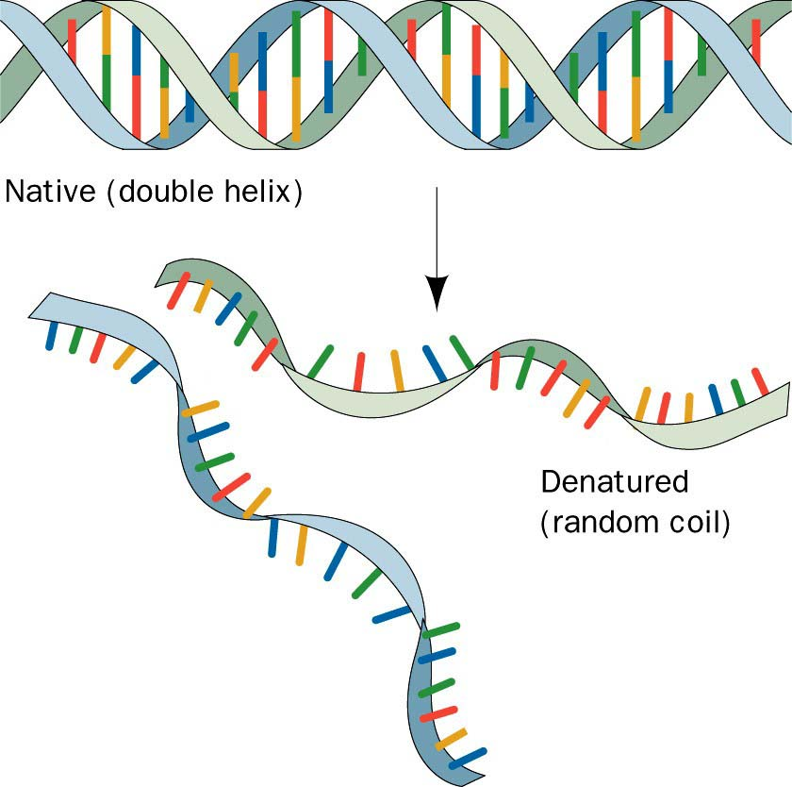
Denaturation of DNA the bases become exposed to the surface and able to absorb more light at 260 nm.
This action is calling the hyperchromic effect.

Slide 15
Objective:
1- To establish the effect of temperature on the absorbance of DNA or [hyperchromic effect].
2- To determine the optimum wave length for DNA.

Slide 16
The effect of temperature on the absorbance of DNA:
Principle:
Heat denaturation of DNA, causes the double helix structure to unwind to form single stranded DNA. When DNA in solution is heated above its melting temperature (usually more than 80 °C), the double-stranded DNA unwinds to form single-stranded DNA.
The bases become unstacked and can thus absorb more light.
Note:
In their native state, the bases of DNA absorb light in the 260-nm wavelength region. When the bases become unstacked, the wavelength of maximum absorbance does not change, but the amount absorbed increases by 30-40%. a double strand DNA dissociating to single strands produces a sharp cooperative transition.

