Slide 1
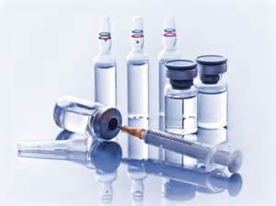
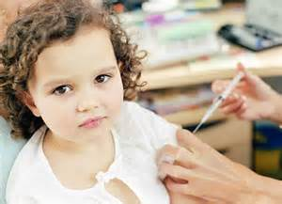
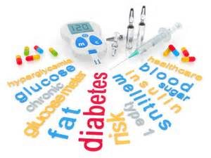
Endocrine system Diabetes Mellitus
Demonestrator/Khulud Essa Hadi

Slide 2
General objectives: at the end of this lecture, the students will be able :
- Recognize the introduction
-Define the diabetes mellitus
-list types of diabetes mellitus
-Identify the causes of diabetes mellitus
Specific objectives:
-list the symptoms of diabetes mellitus
-Explain the complications of diabetes mellitus
-comparison between type 1 and type 2 diabetes.
-Specify Treatment of diabetes mellitus.
-Numerical Nursig diagnosis and nursing intervention.

Slide 3
Introduction:
Diabetes Mellitus is a chronic disease that can cause another serious health complications such as heart disease, kidney failure, stroke, and even blindness.
Diabetes Mellitus reported has been experienced by about 12-20% of the The population of the world and in saudi arabia about 34.1% in males and 27.6% in females .

Slide 4
Definition:
Diabetes mellitus is a condition where the pancreas not able to produces insulin in its proper amount.
In this condition in which glucose, often mentions as blood sugar, is too high and could not be controlled.
-The normal range of blood glucose 80–120 mg/dL (4.4–6.6 mmol/L).

Slide 6
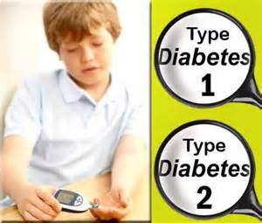
Types of dibetes mellitus in children:
1/Type 1 Diabetes:
Type 1 diabetes in children is a condition in which your child's pancreas no longer produces the insulin your child needs to survive, and you'll need to replace the missing insulin. Type 1 diabetes in children used to be known as juvenile diabetes or insulin-dependent diabetes.
The diagnosis of type 1 diabetes in children can be overwhelming at first. Suddenly you and your child — depending on his or her age — must learn how to give injections, count carbohydrates and monitor blood sugar.

Slide 7
Continue….
2/Type 2 Diabetes:
Type 2 diabetes in children is a chronic condition that affects the way your child's body metabolizes sugar (glucose).
Type 2 diabetes is a disease more commonly associated with adults. In fact, it used to be called adult-onset diabetes. But type 2 diabetes in children is on the rise, fueled largely by the obesity epidemic.

Slide 8
Comparison between type 1 and type 2 diabetes:

Slide 9
Causes childhood diabetes:
As with adults, the cause of childhood diabetes is not understood. It probably involves a combination of genes and environmental triggers such as foods, viruses, and toxeins, obesity and Physical Inactivity, stress.
The majority of children who develop Type 1 don't have a family history of diabetes.

Slide 10
What are the symptoms?
frequent urination (polyuria)
being very thirsty or drinking a lot (polydipsia)
eating a lot or extreme hunger (polyphagia)
unusual weight loss
extreme fatigue and irritability
blurred vision
increased risk of infections or frequent infections
cuts and bruises that heal slowly
numbness or tingling in the hands and feet
Symptoms that are more typical for children include:
-tummy pains.(abdominal pain)
-headaches.
-behaviour problems.

Slide 12
Complications:
-Heart and blood vessel disease including coronary artery disease with chest pain (angina), heart attack, stroke, high blood pressure.
-Nerve damage (neuropathy) tingling, numbness, burning or pain. Nerve damage usually happens gradually over a long period of time.
-Kidney damage (nephropathy) can lead to kidney failure or irreversible end-stage kidney disease, requiring dialysis or a kidney transplant.
-Eye damage. Diabetes can damage the blood vessels of the retina (diabetic retinopathy). Diabetic retinopathy can cause blindness. Diabetes can also lead to cataracts and a greater risk of glaucoma.
-Foot damage. Nerve damage in the feet or poor blood flow to the feet increases the risk of various foot complications. Left untreated, cuts and blisters can become serious infections.
-Skin conditions including bacterial infections, fungal infections and itching.

Slide 13
Continue….
-metabolic complications:
(1)low blood glucose levels(hypoglycemia)also known as insulin shock occurs when the blood sugar level becomes abnormally low (below 60 mg/dl).
-Factors that may lead to hypoglycemia include:
Poorly planned too much exercise
Not enough food
Inappropriate insulin dose
Symptoms of hypoglycemia:
Irritable and may behave poorly
Pale,cold and weak
May complain of feeling hungry

Slide 14
Continue….
-Sweating
-Mentally confused
-Headache and giddy
-Muscular coordination is affected
-If hypoglycemia untreated, coma and convulsions can occur
The immediate treatment of hypoglycemia:
-Administering sugar in some form such as hard candy
-If the child begins to feel better within a few menutes and the blood sugar level exceeds 80mg/dl,the child may eat a small amount of protien or starch (sandwich, milk, cheese) to prevent another reaction.

Slide 15
Continue….
(2)high blood glucose levels (hyperglycaemia) which occurs after the blood glucose level reaches 180 mg/dl and may be glucose in the urine (glycosuria).
Sever hyperglycemia lead to diabetic ketoacidosis(diabetic coma).

Slide 16
:Diabetic Ketoacidosis (DKA)
Diabetic ketoacidosis (DKA) is a life-threatening complication caused by severe insulin deficiency.
Common symptoms can include:
•Decreased alertness
•Deep, rapid breathing
•Dry skin and mouth
•Flushed face
•Frequent urination or thirst that lasts for a day or more
•Fruity-smelling breath
•Headache
•Muscle stiffness or aches
•Nausea and vomiting
•Stomach pain

Slide 17
Hypoglycemia vs. ketoacidosis
ketoacidosis | hypoglycemia
Caused by insulin deficiency Appears over hours or days Blood sugar >200/dl,ketonuria Initial symptoms of thirst, dry skin, abdominal pain, flushed, restless, fruity odor to breath Late symptoms of acidosis, dehydration, kussmaul breathing, coma, death. | Caused by insulin excess Sudden onset in healthy child Blood sugar <55 mg/dl Initial symptoms of sweating, tremor, feeling cold, anxiety, hunger Late symptoms of confusion, weakness, dizziness, nausea and voiting, headach, stupor, convulsions.

Slide 18
How is diabetes treated in children?
-Most children with diabetes need insulin treatment. If this is the case, your child will need an individual insulin routine, which will be planned with the diabetes team.
-Most now use frequent daily dosage regimes of fast-acting insulin during the day and slow-acting insulin at night.
-Very small children normally don't need an injection at night, but will need one as they grow older.
Increasing numbers of older children use continuous insulin pumps

Slide 19
Continue…
Often in the first year after diagnosis, your child may need only a small dose of insulin. This is referred to as 'the honeymoon period'.
As well as insulin treatment, good glucose control and avoidance of ‘hypos’ (low blood glucose attacks) is important. This is because many of the complications of diabetes increase with the length of time diabetes has been present.

Slide 20
Types of insulin :
Rapid-acting insulin. This starts working within a few minutes and lasts for a couple of hours.
Regular- or short-acting insulin. It takes about 30 minutes to work fully and lasts for 3 to 6 hours.
Intermediate-acting insulin. This takes 2 to 4 hours to work fully. Its effects can last for up to 18 hours.
Long-acting insulin. There are no peak levels in the bloodstream, and it can keep working for an entire day (24 hours).

Slide 21
INSULIN TYPES AND ACTIONS
Brand Name | Generic Name | Onset | Peak | Duration
RAPID ACTING
Apidra | Insulin Glulisine | <15 minutes | 1-2 hours | 3-4 hours
Humalog | Insulin Lispro | <15 minutes | 1-2 hours | 3-4 hours
Novolog | Insulin Aspart | <15 minutes | 1-2 hours | 3-4 hours
REGULAR
Humulin R | Regular | 1/2 - 1 hour | 2-3 hours | 3-6 hours
Novolin R | Regular | 1/2 - 1 hour | 2-3 hours | 3-6 hours
INTERMEDIATE ACTING
Humulin N | NPH | 2-4 hours | 4-10 hours | 10-16 hours
Novolin N | NPH | 2-4 hours | 4-10 hours | 10-16 hours
LONG ACTING
Levemir | Insulin Detemir | 3/4 - 2 hours | minimal peak action | up to 24 hours
Lantus | Insulin Glargine | 2-4 hours | no peak | 20-24 hours

Slide 22
Total daily insulin requirements:
Initial dose: 0.5-0.8 unit/kg/day subcutaneously Honeymoon phase: 0.2-0.5 unit/kg/day subcutaneously Split dose therapy: 0.5-1.2 unit/kg/day subcutaneously Adolescents during growth spurts: 0.8-1.5 units/kg/day subcutaneously.

Slide 23
Insulin injection:

Slide 24
Sites of insulin injection:

Slide 25
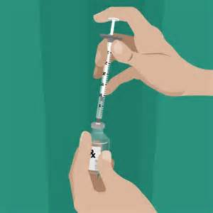
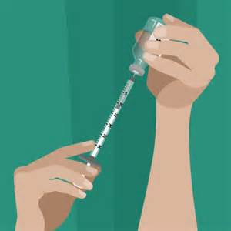
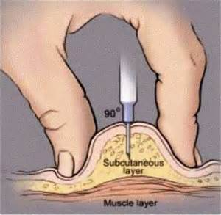
How to give insulin injection?

Slide 26
Insulin pump:
An insulin pump is a medical device used for the administration of insulin in the treatment of diabetes mellitus, also known as continuous subcutaneous insulin infusion therapy.

Slide 28
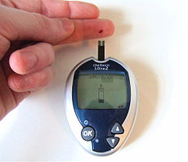
Blood glucose self monitoring:
Home glucose monitoring should be taught to all young patients or their caretakers.it is important that the patients not only be skilled in the techniques but understand the results and how to incorporate them into the daily regimen.

Slide 29
Diabetic nutrition:
There are 3 main nutrients in foods—fats, proteins, and carbohydrates. These essential nutrients affect blood glucose in different ways.
Fats: Fat typically doesn't break down into sugar in your blood, and in small amounts, it doesn't affect your blood glucose levels. But fat does slow down digestion, and this can cause your blood glucose to rise slower than it normally would. After a high-fat meal, your child's blood glucose may be elevated up to 12 hours after the meal.
Proteins: Protein doesn't affect blood glucose unless you eat more than your body needs.
Carbohydrates: Carbohydrates affect your blood glucose more than any other nutrient. All of the carbohydrates in food turn into sugar in the blood, and they get into the blood at a much quicker rate than fats and proteins. Carbs usually enter the blood stream an hour after consumption and are usually out of the blood stream in 2 hours. That's why you should check your child's blood glucose levels before he or she eats, and then again 2 hours later. Ideally, the measurement after the meal should be within 30-50 points of the pre-meal levels. If it's not, you will need to adjust the carb content of the meal or adjust your child's insulin dosage.

Slide 31
:Foot Care
Measures to Prevent Foot Ulcers. Preventive foot care can significantly reduce the risk of ulcers and amputation. Some tips for preventing problems include:
Patients should inspect their feet daily and watch for changes in color or texture, odor, and firm or hardened areas, which may indicate infection and potential ulcers.
When washing the feet, the water should be warm (not hot) and the feet and areas between the toes should be thoroughly dried afterward. Check water temperature with the hand or a thermometer before stepping in.
Apply moisturizers, but NOT between the toes.
Gently use pumice to remove corns and calluses (patients should not use medicated pads or try to shave the corns or calluses themselves).
Trim toenails short and file the edges to avoid cutting adjacent toes.
Well-fitting footwear is very important. People should be sure the shoe is wide enough. Patients should also avoid high heels, sandals, thongs, and going barefoot. Shoes with a rocker sole reduce pressure under the heel and front of the foot and may be particularly helpful. Custom-molded boots increase the surface area over which foot pressure is distributed. This reduces stress on the ulcers and allows them to heal.
Change shoes often during the day.
Wear socks, particularly with extra padding.
Patients should avoid tight stockings or any clothing that constricts the legs and feet.
Consult a specialist in foot care for any problems.

Slide 32
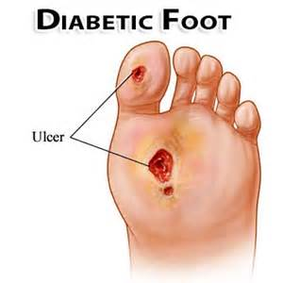

Slide 33
Nursing diagnosis:
1)Imbalanced Nutrition Less Than Body Requirements related to reduction of carbohydrate metabolism due to insulin deficiency, inadequate intake due to nausea and vomiting.
Goal:digest the amount of calories / nutrients right
Shows the energy level is usually
Stable or increasing weight.
Nursing intervention:
1.) Determine the patient's diet and eating patterns and compared with food that can be spent by the patient..
2.) Weigh weight per day or as indicated..
3.) Identification of preferred food.
4.) Involve patients in planning the family meal as indicated.
5.) Give regular insulin treatment as indicated.

Slide 34
2) Fluid Volume Deficit related to osmotic diuresis from hyperglycemia, polyuria, decreased fluid intake. Goal:Demonstrate adequate hydration evidenced by stable vital signs, palpable peripheral pulse, skin turgor and capillary refill well, individually appropriate urinary output, and electrolyte levels within normal limits. Nursing intervention:
1.) Monitor vital signs.
2.) Assess peripheral pulses, capillary refill, skin turgor, and mucous membranes.
3.) Monitor input and output, record the specific gravity of urine.
4.) Measure weight every day.
5.) Provide fluid therapy as indicated

Slide 35
3) Impaired Skin Integrity related to decreased sensory sensation, impaired circulation, decreased activity / mobilization, lack of knowledge of skin care.
Goal:Peripheral Circulation remain normal, achievement of the wound healing process.
Nursing intervention:
1)Teach the child or parent to mobilize
2)Teach about the factors which can increase blood flow :
Elevate feet slightly lower than the heart (the position of elevation at rest), avoid crossing legs, avoiding tight bandage, avoid the use of pillows, hamstrings and so forth.
3)Teach about the modification of risk factors such as :
Avoid a diet high in cholesterol, relaxation techniques, smoking cessation, and drug use vasoconstriction.
4)Collaborate with other health team in giving vasodilators, checking blood sugar regularly and oxygen therapy.
5)Assess the wound area and state as well as the healing process.
6)Treat wounds with good and true: clean wound abseptik use solution that is not irritating, lift the rest of the bandages that stick to the wound and nekrotomi dead tissue.
7)Collaboration with physicians for the administration of insulin, pus culture examination, examination of blood sugar, giving anti-biotic.

Slide 36
4)Risk for Infection related to hyperglycemia
Goal:Identify interventions to prevent / reduce the risk of infection and demonstrate techniques, lifestyle changes to prevent infection.
Nursing intervention:
1). Observed signs of infection and inflammation.
2). Improve efforts to prevention by good hand washing for all people in contact with patients including the patients themselves.
3). Maintain aseptic technique in invasive procedures.
4). Give your skin with regular care and earnest.
5). Make changes to the position, effective coughing and encourage deep breathing.

Slide 37
5) Activity Intolerance related to weakness due to decreased energy production.
Goal:Verbalize increase in energy level and display improved ability to participate in desired activities.
Nursing intervention:
1.Assess response to activity
2.Assess muscle strength of patient and functional level of activity.
3.Discuss with patient the need for activity
4.Alternate activity with periods of rest/ uninterrupted sleep.
5.Monitor pulse, respiration rate and blood pressure before/after activity
6.Perform activity slowly with frequent rest periods
7.Promote energy conservation techniques by discussing ways of conserving energy while bathing, transferring and so on.
8.Provide adequate ventilation
9.Provide comfort and safety
10.Instruct patient to perform deep breathing exercises
11.Instruct client to increase Vitamins A, C and D and protein in her diet.
12.Instruct also patient to increase iron in diet
13.Administer oxygen as ordered

Slide 38
6) High risk of injury associated with decreased sensation sensory (visual), weakness, and hypoglycemia.
Goal:prevent any injury.
Nursing intervention:
1.Times when blood sugar should be checked.
2.When and how much your child should eat during snacks and meals
3.Your child’s behavioral symptoms of high and low blood sugar
4.Specific actions to be taken during high and low readings, which could include giving food, insulin.
5.Any modifications to routine diabetes management before or after exercise.
6.Which diabetes care tasks your child is able to do on his or her own
7.Emergency numbers for parents, health care provider and others and when each should be called.
8.Recommend regular ophthalmologic examinations.
9. .Provide meticulous skin care, especially to the feet and legs.

Slide 39
7) Anxiety related to a lack of knowledge (diabetes management), the ability to remember the less, diagnosis or treatment of a new way, cognitive limitations. Goal:reduce anxiety
Nursing intervention:
1. Assess the level of knowledge of the client and family about the disease.
2. Give an explanation to the client about diseases and conditions now.
3.Encourage expression of feelings and anxieties
4.Provide a safe and quiet environment
5.Take Due meds on time

Slide 40
Thank you

