Slide 1
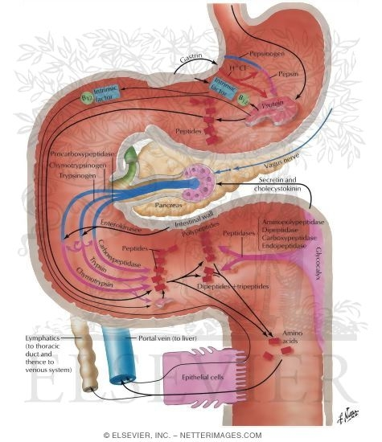
Protein Digestion

Slide 2
Digestion of proteins
(introduction)
Proteolytic enzymes responsible for degrading proteins
are produced by three different organs: the stomach, the
pancreas, and the small intestine.
● The digestion of proteins begins in the stomach, which secretes gastric juice—a unique solution containing
hydrochloric acid and the proenzyme, pepsinogen.

Slide 3
Pepsinogen is activated to pepsin, either by HCl, or
autocatalytically by other pepsin molecules that have
already been activated.
● On entering the small intestine, large polypeptides
produced in the stomach by the action of pepsin are further
cleaved to oligopeptides and amino acids by a group of
pancreatic proteases.
●Oligopeptides digested by enzymes of the small intestine

Slide 5
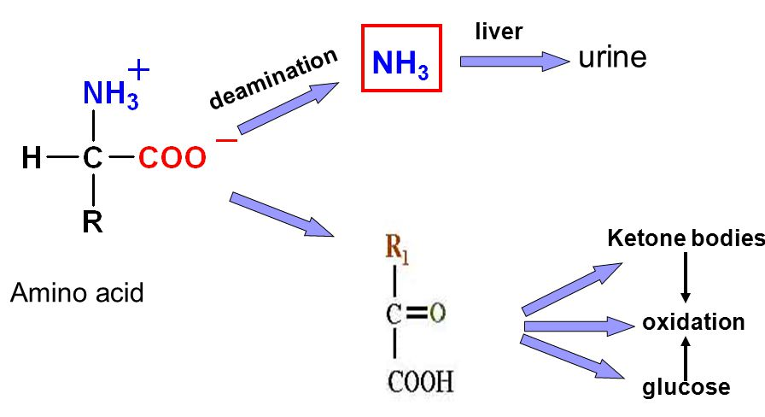
Amino acid metabolism:
After absorption of amino acids, these amino acids used:
● for protein synthesis and as N and C donors for the synthesis of other types of macromolecule e.g the nucleic acids as well as numerous small molecular compounds.
● Deamination (i.e., removal of the amino group):
amino acid
NH3 α-oxo acid

Slide 6
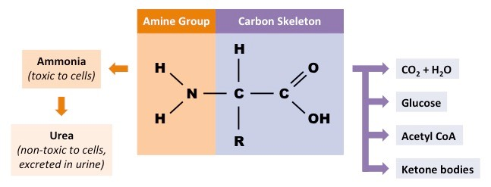
- After deamination,
The carbon skeleton may be used for:
• the formation of glucose
• or it may be oxidized to CO2 and water with the
production of metabolic energy.
The ammonia produced by amino acid degradation is
detoxified by conversion to urea in the liver.(urea cycle)

