Slide 1
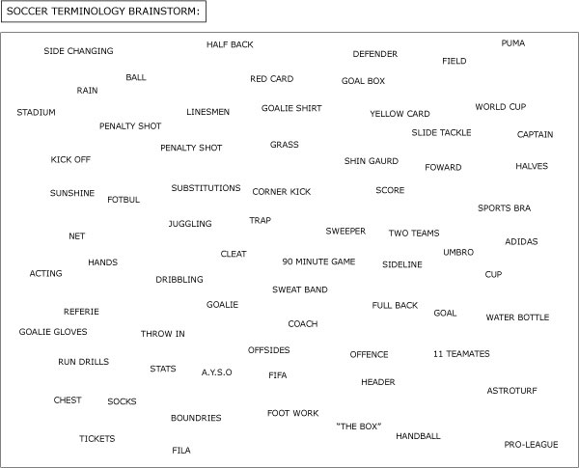
Have you ever watched a soccer game?
You probably heard the players yelling strange phrases and words like these:

Slide 2
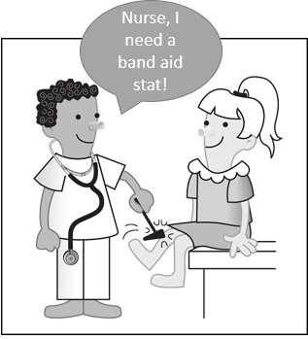
or maybe you might have watched one of those soap operas about Doctors and heard the phrase :
“IV, Stat!”

Slide 3
The vocabulary of a group of people, language or field is called a lexicon.

Slide 4
In the English language the word ‘tackle’ has a meaning -make determined efforts to deal with (a problem or difficult task).
So, ‘to tackle' is a part of the English vocabulary or lexicon.
To ‘tackle’ is also a part of the special lexicon of soccer players. When a soccer player yells ‘tackle,' it means to take the ball, or attempting to take the ball, from an opponent.
Words or phrases that have meaning in a lexicon are called lexemes.

Slide 5
Bonjour! Caio! Hola! سلام! These are all ways to say hello in different languages - French, Italian, Spanish, Arabic. These words for hello are part of the vocabulary or lexicon of these languages.
Any group of people that has a specific set of words they use to communicate has a lexicon. This includes entire nations that speak a specific language or smaller groups of people, like teenagers, who have their own vocabulary or slang.

Slide 6
Just like entire nations can have a lexicon, an individual person can have their own lexicon if they use a unique vocabulary to communicate.
There are entire dictionaries written to help readers understand Shakespeare's lexicon, who is said to have invented over 1700 words.

Slide 7

The word 'muggle.' This lexeme is a word that J.K. Rowling created for her Harry Potter series, which means non-magical person. It became used so often because of the popularity of the series, that it can now be found in the dictionary!

Slide 8
So what is a lexicon in linguistics?

Slide 9
Lexicon (noun)
​All the words and phrases used in a particular language or subject; all the words and phrases used and known by a particular person or group of people
the lexicon of finance and economics
​A list of words on a particular subject or in a language in alphabetical order (a dictionary)
a lexicon of technical scientific terms

Slide 10
Lexicography
video

Slide 11
Lexicography may refer to:
Practical lexicography is the art or craft of writing dictionaries.
Theoretical lexicography is the theory or scholarly discipline of analyzing and describing dictionaries.

Slide 12
Lexicology
Some use the term as a synonym for theoretical lexicography, others use it for a branch of linguistics relating to the inventory of words in a particular language i.e. the study of forms, meanings and behaviors of words.

Slide 13
Fundamental questions for lexicographers
Users – who will use the dictionary?
Uses (purpose) – what will the dictionary be used for?
Answers to such questions will inform design and publication decisions for dictionary maker, e.g. monolingual vs. bilingual, encyclopedic vs. compact, general purpose vs. specialist etc.

Slide 14
What is a Dictionary?!
video

Slide 15
A list of words with their definitions, a list of characters with their glyphs (symbols), or a list of words with corresponding words in other languages.
A reference book containing words, usually alphabetically arranged along with information about their forms, pronunciations, functions, and meanings.
A reference book listing terms or names important to a particular subject along with a discussion of their meanings. A sample sentence, pronunciation information, word derivations, histories, or etymologies, illustrations, usage guidance are often included.

Slide 16
Exercise
Look up the following words in your E-E dictionaries.
Provide as much info about the word as possible.
Bamboozled, Discombobulate, Abaya, Meme, Scrupulous

