Slide 1
Determination of blood glucose
Done by: Sahar Al-Subaie

Slide 2
Redox titration:
Redox titration (also called oxidation-reduction titration) is one type of titration based on a redox reaction between the analyte and titrant.

Slide 3
Principle:
Cu⁺² + glucose ph Cu⁺ + (oxi)glucose
2Cu⁺ + I₂ 2I⁻ + 2Cu²
I₂
I₂ I₂
I₂ + 2S₂O₃^{2- Starch} 2I⁻ + S₄O₆²⁻ back titration

Slide 4
The source of iodine:
It comes from acidic standard : Potassium iodide – Potassium iodate solution:
KIo₃ + 5KI + 6H⁺ → 3I₂ + 6K⁺ + 3H₂o

Slide 5
Procedure:

Slide 6
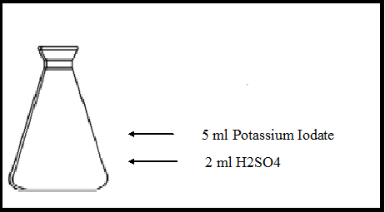
Standardization of thiosulfate

Slide 7
Analysis of sample :
Blank
Test

Slide 8
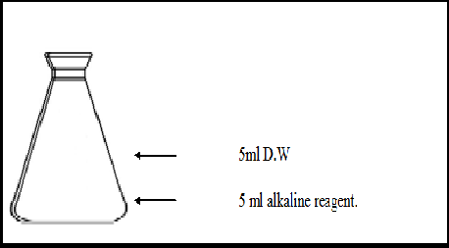
Blank:

Slide 9
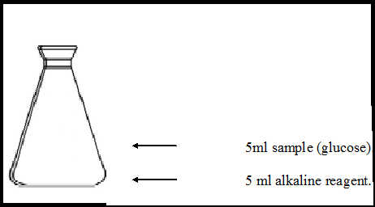
Test:

Slide 10
Titration:
Titrate with thiosulfate until the color change from brown to pale yellow.
Add one ml of 1% starch, the solution will turns to blue.
Continue the titration untill the blue color disappear(colorless)

Slide 11
CALCULATION:

Slide 12
Standardization of thiosulfate:
Normality of Thiosulfate = V ( Iodate Used )X N (Iodat)
V (Thiosulphate)
= 5 ml X 0.01 N = 0.0055 N
9 ml

Slide 13
Analysis of sample(Unknown):
Meq I₂ in Blank = N ThiosulfateX Volume of Thiosulphate used
= 0.0055 N X 13 ml
= 0.0715 meq
Meq I₂ in Test = N Thiosulfate X Volume of Thiosulphate used
= 0.0055 N X 9 ml
= 0.0495 meq
Meq I₂ ( reduced by Cu⁺) = Meq I₂ in Blank - Meq I₂ in Test
0.0495 - = 0.0715
= 0.022 meq
Meq I₂ ( reduced by Cu⁺) = Meq Cu²⁺ ( reduced by glucose)

Slide 14
Mg Cu²⁺ (reduced)= Meq Cu²⁺ ( reduced ) X 63.54 mg Cu²⁺
1 Meq Cu²⁺
= 0.022 meq X 63.54 mg
1meq
=1.397 mg
The percent glucose in the sample is obtained directly from (Table 1) using value for the mg Cu²⁺ reduced.
The percent glucose in the sample = 0.132 %

