Slide 1
King Saud University College of Business Administration Department of Health Administration Masters` Program
PA 507 – Introduction to Public Health
First Semester 1440/ 1441
Mohammed S. Alnaif, Ph D. alnaif@ksu.edu.sa

Slide 2
DATA FOR PUBLIC HEALTH
LEARNING OBJECTIVES
Define surveillance.
Identify key sources of public health data, Census, vital statistics, national surveys, and registries.
Understand the reasons why topics are chosen for surveillance activities in public health.
Describe how data apply to the core public health function of assessment.
Recognize the types of information available through common public health data systems.

Slide 3
DATA FOR PUBLIC HEALTH
Public health data are key to performing the core public health function of assessment.
Many of the activities that make up public health assessment and surveillance are conducted by epidemiologists, biostatisticians, and demographers, other disciplines in public health are involved as well.

Slide 4
DATA FOR PUBLIC HEALTH
For example, data may be collected by nurses and physicians as part of their clinical and patient treatment work or by laboratory technicians and medical records specialists in health care settings.
We will take a closer look at death certificate data as one key component to public health data.
Death certificates form a key part of national vital statistics data

Slide 5
DATA FOR PUBLIC HEALTH
Public health surveillance is defined as “the ongoing, systematic collection, analysis, and interpretation of health-related data essential to planning, implementation, and evaluation of public health practice.”
Includes data collection, analysis, and dissemination to those responsible for prevention and control.
Surveillance systems are useful in public health because their ongoing nature provides information over time.

Slide 6
DATA FOR PUBLIC HEALTH
Public health surveillance
Systematic, ongoing…
Collection
Analysis
Interpretation
Dissemination
…of health outcome data
Health action
investigation
control
prevention

Slide 7
DATA FOR PUBLIC HEALTH
Public health surveillance
It is important to note that collecting data is merely one step in carrying out surveillance.
A critical goal of surveillance is to control and/or prevent diseases.
Therefore, any data collected must be organized and carefully examined, and any results need to be communicated to the public health and medical communities.

Slide 8
DATA FOR PUBLIC HEALTH
Public health surveillance
It is vital to communicate results during a potential outbreak so that the public health and medical communities can help with disease prevention and control efforts, but it is also important during non-outbreak times to provide information about baseline levels of disease.
These baseline measurements provide important information to public health officials in monitoring health at a community level and serve as important references in any future outbreaks.

Slide 9
DATA FOR PUBLIC HEALTH
Public health surveillance
Typically, surveillance questions are consistent across populations or geographic areas.
Surveillance data are useful in making decisions about what health topics to address and how and where to spend public health dollars efficiently.

Slide 10
DATA FOR PUBLIC HEALTH
Uses of Public Health Surveillance
Estimate magnitude of the problem
Portray the natural history of a disease
Determine distribution and spread of illness
Detect outbreaks
Generate hypotheses, stimulate research
Evaluate control and prevention measures
Monitor changes in infectious agents
Detect changes in health practices
Facilitate planning

Slide 11
DATA FOR PUBLIC HEALTH
Public health surveillance
There are many health problems that we might want to understand. Individuals and even the general public may have strong opinions about what topics are important enough to be included in surveillance systems.
Recent public outcry about the problem of medical errors in hospitals raises the question, why don’t we have a national list (or data) regarding the problem of medical mistakes?

Slide 12
DATA FOR PUBLIC HEALTH
Public health surveillance
The Agency for Healthcare Research and Quality (AHRQ) estimates that there are as many as ninety - eight thousand deaths each year in the United States due to medical errors, making it the eighth most common cause of death.

Slide 13
DATA FOR PUBLIC HEALTH
Public health surveillance
Hospitals are not the only place medical errors take place: pharmacies, nursing homes, and clinics would have to be included in surveillance as well.
Currently, no consistent data collection or surveillance system for medical errors exists across the many health arenas in which they occur.
However, some data are collected, and there is ongoing effort to change policies to reduce medical errors.

Slide 14
DATA FOR PUBLIC HEALTH
Public health surveillance public cost
Public health provides some of the input to help set policies, usually at the national level, regarding what to include in surveillance systems.
We cannot afford to collect information on all health issues, nor would many people want to have every aspect of our health, our personal medical experiences, and our health behavior monitored.
Surveillance systems require substantial time and money to establish and maintain.

Slide 15
DATA FOR PUBLIC HEALTH
Public health surveillance public cost
Therefore, six criteria are generally used to decide what health events should be chosen for surveillance activities:
the frequency of the health event (incidence, prevalence, mortality);
the severity (case-fatality, hospitalization rate, disability rate, years of potential life lost),
cost, (direct and indirect)
preventability,
communicability; and
public interest in the health event.

Slide 16
DATA FOR PUBLIC HEALTH
Public health surveillance – Outcomes
Surveillance is outcome oriented.
Can measure frequency of an illness or injury (e.g., number of cases, incidence, prevalence)
Can measure severity of the condition (e.g., hospitalization rate, disability, case fatality)
Can measure impact of the condition (e.g., cost)
Orient data by person, place, and time

Slide 17
DATA FOR PUBLIC HEALTH
Data Sources
Vital Statistics
Notifiable Diseases
Registries
Sentinel Surveillance (A condition whose occurrence serves as a warning signal)
Syndromic Surveillance (Uses pre-diagnostic indicators to identify emerging health problems)
Surveys
Administrative Data

Slide 18
DATA FOR PUBLIC HEALTH
Syndromes
Complaints tallied into syndrome categories
Death
Sepsis (serious infection)
Rash
Respiratory (e.g., cough)
Gastrointestinal (e.g., diarrhea)
Unspecified Infection (fever)
Neurological (e.g., dizziness)
Other

Slide 19
DATA FOR PUBLIC HEALTH
Public health surveillance public cost
The issue of communicability (the disease passes from one person, object, or animal to another) is important in surveillance because by consistently collecting data about a communicable disease, we may be able to stop its spread.

Slide 20
DATA FOR PUBLIC HEALTH
Public health surveillance public cost
Think about the kinds of public announcements you may have heard on the news. In recent years, new strains of influenza virus have been identified and have spread rapidly around the globe.
Influenza surveillance activities have allowed these new strains to be identified quickly and have detected how rapidly and to what areas the virus has spread.

Slide 21
DATA FOR PUBLIC HEALTH
Public health surveillance public cost
This information allows public health officials to alert the public to be vigilant about hand washing and other preventive precautions and also to be alert if traveling to or living in certain areas or participating in specific activities.
Public health surveillance activities are the likely reason that these events are detected.
As a result, warnings can be publicized, keeping more people from contracting an illness.

Slide 22
DATA FOR PUBLIC HEALTH
Planning a Surveillance System
Establish objectives
Develop case definitions
Determine data source or data collection mechanism
Field test methods
Develop and test analytic approach
Develop dissemination mechanism
Assure use of analysis and interpretation

Slide 23
DATA FOR PUBLIC HEALTH
Surveillance Methods: Case Definition
Important to clearly define condition
Ensures same criteria are used by all
Makes the data more comparable
Include person, place, time
May define suspected and confirmed cases
May include symptoms, lab values, time period, population as appropriate

Slide 24
DATA FOR PUBLIC HEALTH
Universal Surveillance Systems and Activities
Typically, it is not feasible to collect surveillance information about every person in a population.
However, several examples of universal (all - inclusive) surveillance systems exist, including the Census and vital statistics systems.

Slide 25
DATA FOR PUBLIC HEALTH
Universal Surveillance Systems and Activities
The Census We often overlook the decennial (every ten years) Saudi Arabia Census as a source of public health information.
But in addition to providing a count of how many people reside in the Saudi Arabia, the Census contains information on where and how people live.

Slide 26
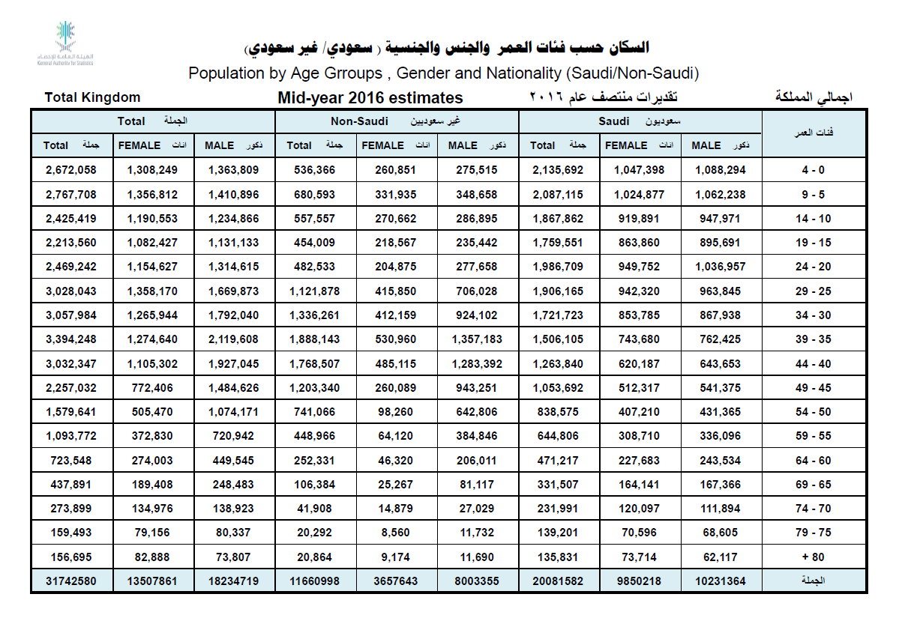

Slide 27
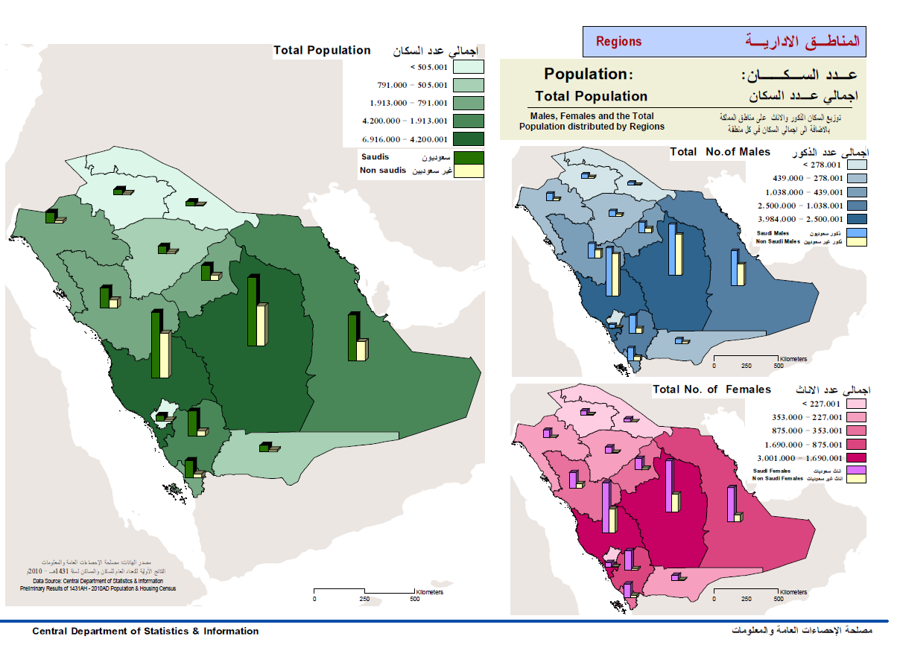

Slide 28
Saudi Arabia Census as a source of public health information
National Health and Nutrition Examination Survey (NHANES)
Prevalence of chronic conditions, distribution of physiologic and anthropomorphic measures, and nutritional status for representative samples of the population
National Health Care Survey, includes
National Hospital Discharge Survey
National Ambulatory Medical Care Survey

Slide 29
DATA FOR PUBLIC HEALTH
Objectives of the demographic survey include:
To provide data on the demographic and social composition of the Saudi and non-Saudis population in the Kingdom at the level of different regions in addition to extraction of indicators and demographic benchmarks, for example:
Crude mortality rate in addition to the age-specific and gender-specific mortality rates
Child and Infant mortality rates
Total fertility rate in addition to the age-specific fertility rates
The normal growth rates and natural increase in Saudi population
Population age and gender structure
Population structure by marital and educational status
Marriage and divorce levels.

Slide 30
DATA FOR PUBLIC HEALTH
Objectives of the demographic survey include:
To provide details on people with disabilities in the kingdom according to the rate, type and cause of the disability in addition to its social and demographic characteristics as well as the geographical distribution.
To study effects of the housing and environment characteristics on the different demographical characteristics through:
Provision of the necessary housing and environment data.
Provision of data needed to develop an environment improving program.

Slide 31
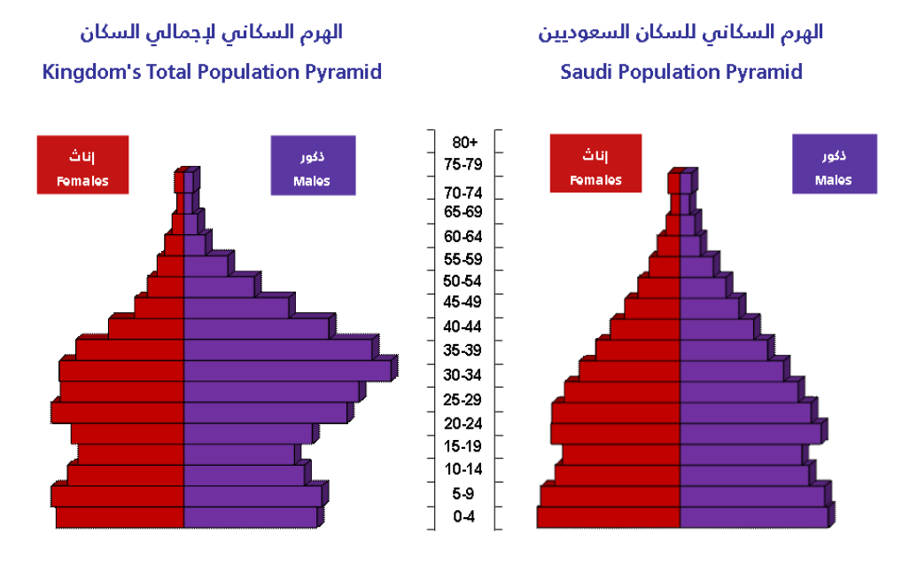

Slide 32
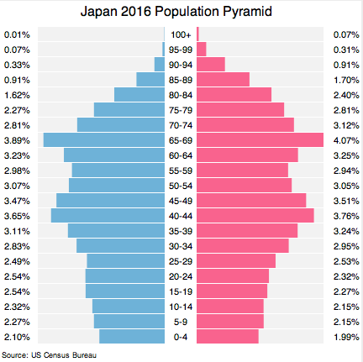

Slide 33
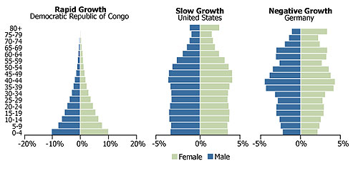

Slide 34
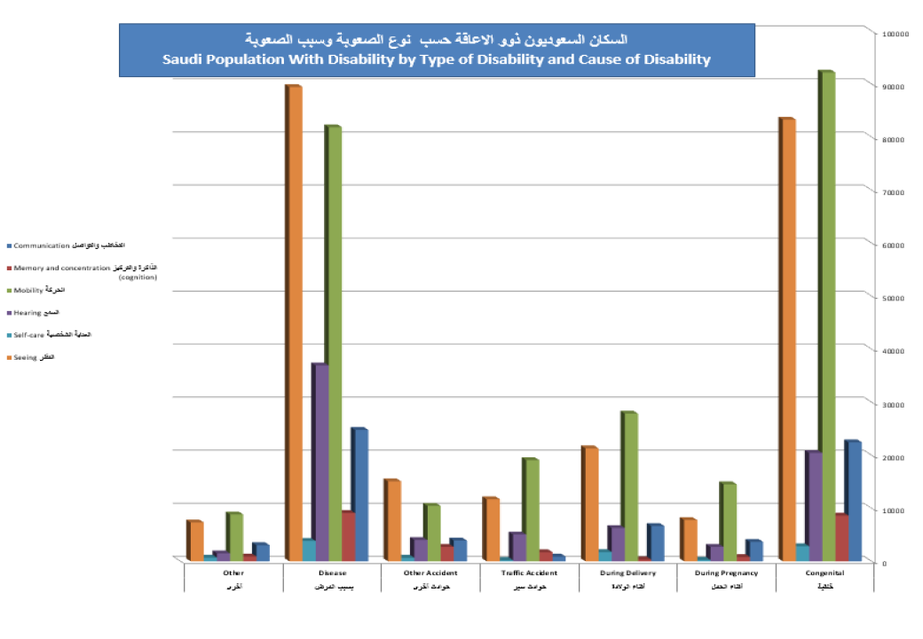

Slide 35
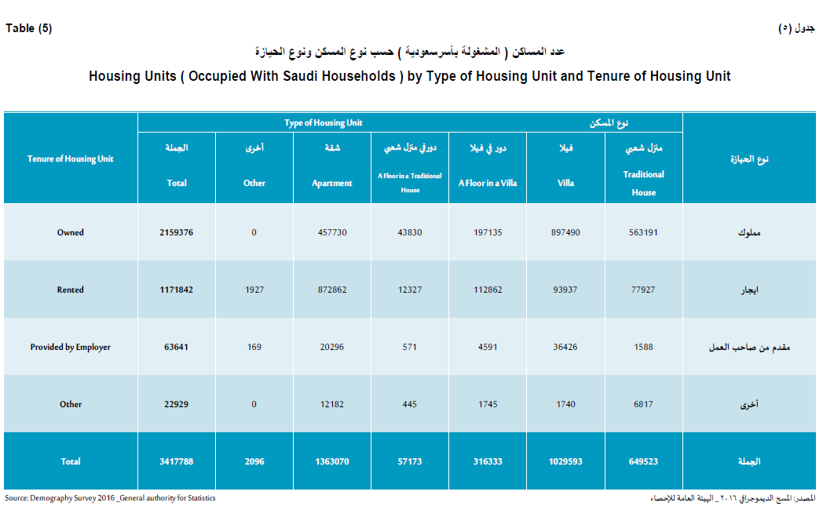

Slide 36
DATA FOR PUBLIC HEALTH
Vital Statistics
In all countries, records about births and deaths, called vital statistics, form an important part of public health surveillance.
These documents are used primarily as a legal certification of births and deaths; that is, they are part of a legal and administrative system of information.
For example, you typically need a certified copy of a birth certificate to enroll a child in school, and a widow needs a legal copy of a death certificate to receive pension benefits from her husband’s employment.
In most countries, the information from these documents is collected and used to examine trends and shifts in population health.

Slide 37
DATA FOR PUBLIC HEALTH
Uses of Vital Statistics Data
Monitoring long-term trends
Identifying differences in health status within racial or other population subgroups
Assessing differences by geographic area
Monitoring deaths that are preventable
Generating hypotheses about causation
Monitoring progress toward improved health of the population; health-planning

Slide 38
DATA FOR PUBLIC HEALTH
Vital Statistics
In developing nations, documents about births and deaths may not be universally available.
For example, in Turkey the government estimates that a formal death certificate is completed for about 60 percent of people who die and notes that death certificates are more common for people who live in major urban centers.
By custom, Turkish people are typically buried quickly, often within twenty - four hours.
The death certificate is important to have because it provides a more accurate representation of mortality and causes of death.

Slide 39
DATA FOR PUBLIC HEALTH
Vital Statistics
Birth certificates are rich sources of health information about childbirth, infant conditions, maternal health, and even social circumstances and medical care.
Table 3.1 provides examples of the data collected at the time of birth that are used to describe mothers and their pregnancy experiences, the infant health and condition, and aspects of the delivery and health care.

Slide 40
Table 3.1 Examples of Information Available from Standard Birth Certificates
Data on mothers | Age, education, height, pre-pregnancy, and weight at birth, smoking before and during pregnancy, diabetes, health insurance status, and prior births
Data on newborns | Weeks of gestation, birth weight, sex, congenital anomalies (e.g., Down syndrome, spina bifida, limb reduction), and breast - fed at hospital discharge
Data about health care | Labor induced, mother’s health insurance status, and cesarean section

Slide 41
DATA FOR PUBLIC HEALTH
Survey Data
These surveys form a vital component of what we know about the nation’s health because they are first - hand accounts rather than information from records and observations of others.
An example, The demographic surveys are one of the most important sources of data, necessary for development planning in the economic and social fields at the domestic and national levels. Its importance lies in the fact that it provides data covering the relatively long intervals between a census and another.

Slide 42
DATA FOR PUBLIC HEALTH
Survey through these surveys, many of the demographic, economic and social phenomena can be studied in more meticulous detail than what is available in population censuses
Other Survey Examples
Exit interviews at health facilities
Special studies
Risk-behavior
Cluster surveys
Rapid surveillance after emergencies

Slide 43
DATA FOR PUBLIC HEALTH
Registries
A registry is a different type of data source from that which we have discussed up to now. Rather than collecting information from everyone in a population (Census, vital statistics) or selecting a representative sample of the population (surveys), registries seek to identify all individuals in a population with a specific exposure or health condition.
Perhaps the most well - known example of a registry in the United States is the Surveillance Epidemiology and End Results (SEER) Program, maintained by the National Cancer Institute (NCI).

Slide 44
DATA FOR PUBLIC HEALTH
Registries
Establishing and maintaining a registry is time intensive and costly.
A registry must begin with a clear case definition, a thorough description of quantifiable and objective clinical symptoms or diagnostic criteria or exposure classification, depending on the type of registry.
This ensures the registry contains the individuals with the exposure or disease of interest, limiting misclassification.

Slide 45
DATA FOR PUBLIC HEALTH
Registries
Identifying the cause of a new syndrome
Ideally, registries include a mechanism of active surveillance for new cases, that is, seeking out people newly exposed or diagnosed by contacting health care providers or by searching medical records.
Active surveillance occurs when the health department contacts health care providers or laboratories requesting information about conditions or diseases to identify possible cases.

Slide 46
DATA FOR PUBLIC HEALTH
Registries
Passive surveillance, in contrast, occurs when health care providers or patients are encouraged to report the exposure or disease to the registry, but no case - finding effort is made by the registry personnel.
The first step is passive surveillance, the local public health agencies relies on reports submitted voluntarily by local physicians and other agencies.

Slide 47
DATA FOR PUBLIC HEALTH
Registries
The major advantage of passive surveillance is that no single agency is always on the lookout for an outbreak of something, especially if they do not know what that something is or indeed anything is breaking out at all.
The downside of remaining passive is that reporting is extremely sporadic. Passive surveillance can alert people that something is happening, but it cannot really say how big the problem is or where the hot spots are.

Slide 48
DATA FOR PUBLIC HEALTH
Registries
Identifying the cause of a new syndrome
Active surveillance, Once an agency suspects that a problem may exist, it usually relies on active surveillance.
The agency becomes more active and tries to solicit complete reporting of the new syndrome by contacting family physicians, medical officers of health, or laboratories.
Depending on the degree of cooperation received, it is now possible to get a better handle on the magnitude of the problem and perhaps to develop some hypotheses about what may be causing the outbreak if there is one.

Slide 49
DATA FOR PUBLIC HEALTH
Data Source: Administrative Data
Routinely collected for other reasons.
E.g., hospital discharge data collected for billing purposes, emergency department data, data collected by primary healthcare centers and other healthcare organizations.
MOH publish annual statistical report.

Slide 50
DATA FOR PUBLIC HEALTH
Usefulness of Administrative Data Depends on:
What information is computerized
Standardization of codes for diagnoses, symptoms, procedures, reasons for the visit (ICD-9/ICD-10)
Time between occurrence of health event and availability of data
Ability to link with other data systems (integration)
Whether supplementary information can be obtained

Slide 51
THANK YOU

