Slide 1
D- Xylose Absorption Test

Slide 2
- Objectives
a) To test the function of the upper small intestine.
b) To learn the technique of D-xylose estimation

Slide 3
- Introduction:
The small intestine can be studied in two parts ,the upper small intestine and the lower small intestine.
Vitamin B12 absorption is the best test for the lower small bowl, while D- xylose absorption test is considered the best test for the upper small intestinal function.

Slide 4
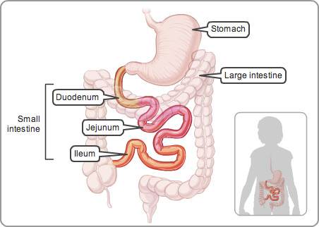
Small intestine

Slide 5
Impaired absorption of D- xylose occurs in conditions where there is flattening of the intestinal villi and this results in abnormally low urinary excretion of the test does of D-xylose.
In adults , the standard oral dose is 25 g after which the urinary output during the next five hours is 5.8 g ( about 25% of the dose) in normal subjects.
In children, a 5g dose of D- xylose, and the normal output in the urine is 25 % of the dose.

Slide 6
Using the 25g dose , 5 hours excretion of less than 2.5g occurs in patients with:
1- Gluten sensitive enteropathy (coeliac or celiac disease).
2- Non-gluten sensitive enteropathies (idiopathic steatorrhea)
3- Tropical sprue .

Slide 7
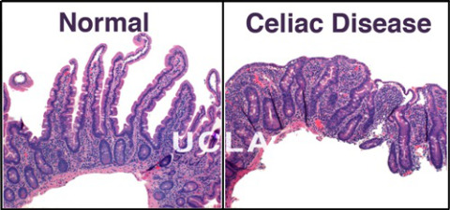
Intestinal villi

Slide 8
Tropical sprue
- Tropical sprue is a disorder of unknown cause (infection..) affecting people living in tropical areas who develop abnormalities of the small intestine structure (destruction of the villi), leading to malabsorption and deficiencies of many nutrients.

Slide 9
The test is a diagnostic value since in children the test is most useful in the differential diagnosis of coeliac disease and cystic fibrosis.
Treatment of coeliac disease with a gluten free diet improves D-xylose absorption but it remains low normal.
In case of impaired renal function, the D-xylose level in a 5- hours urine sample is low ,which can lead to false diagnosis of coeliac disease.

Slide 10
- What happens to the D-xylose?
- When D- xylose is given orally most of D-xylose will be absorbed in the small intestine (duodenum and jejunum).
- The rest will be subsequently excreted by the kidneys.
- The amount of D-xylose detected in urine or blood in a specified time interval after administration of a measured dose of D-xylose, is used to evaluate Intestinal Absorption Ability.
- Low Absorption of D-Xylose is observed in Intestinal Malabsorption.
- When there is a problem in the small intestine that prevent absorption, D-xylose ( ingested orally) is not absorbed by the intestine, and its level in blood and urine will be low.

Slide 11
- Principle
D- xylose is a pentose which produces a brown color with o- toluidine in the presence of acetic acid and heat.
A brown complex will be formed with a maximum absorption at 475 nm which is used for the estimation of xylose.

Slide 12
- METHOD:
The patient/volunteer should keep an over night fast, in the morning empties the bladder and discards the urine.
Before breaking the fast, 25g of D-xylose in 250ml water is taken by mouth.
The patient /volunteer should then drink water at one and two hours after drinking the D-xylose solution .
All urine passed during the next five hours is collected .
Normal value: 5.8-10 gm
Abnormal value: less than 2.5 gm

Slide 13
- Estimation of D-xylose in urine:
 | Urine | Standard | dH2O | O-toluidine reagent
Sample (A)Test (1) | 0.1 | ـــــ | ـــــ | 7 ml
Sample (A)Test (2) | 0.1 | ـــــ | ـــــ | 7 ml
Sample (B) Test (3) | 0.1 | ـــــ | ـــــ | 7 ml
Sample (B) Test (4) | 0.1 | ـــــ | ـــــ | 7 ml
Standard (1) | ـــــ | 0.1 | ـــــ | 7 ml
Standard (2) | ـــــ | 0.1 | ـــــ | 7 ml
Blank | ـــــ | ـــــ | 0.1 | 7 ml
Cover tubes by aluminum foil Mix the contents of each tube
Boiling water bath for 5 minutes
cool the tubes for 1-3 min
Read absorbance at 475 nm

Slide 14
- Result:
Tubes | Absorbance at 475
Test (1)
Test (2)
Test (3)
Test (4)
Standard (1)
Standard (2)

Slide 15
- Calculations:
- Conc. Of Std.= 0.01 g/ml Dilution factor= 10
- Total volume sample 1= 5 ml
- Total volume sample 2= 5 ml
- Conc. Of urine D-xylose (Sample 1)= Mean abs of test 1 x 0.01 = g/ml
Mean abs of std.
- Conc. Of urine D-xylose (Sample 2)= Mean abs of test 2 x 0.01 = g/ml
Mean abs of std.

Slide 16
- Example:
Abs. sample 1= 0.843 Abs. std.= 0.558
Abs. sample 2= 0.234 Dilution factor= 10
- Conc. Of urine D-xylose (Sample 1)= 0.843 x 0.01 x 10 = 0.151 g/0.1 ml
0.558
- Conc. Of urine D-xylose (Sample 1)= 0.151 g 0.1 ml
? 1 ml
= 1.51 g/ml
1.51 g 1 ml
? 5 ml
- Conc. Of urine D-xylose (Sample 1)= 7.6 gm/5 ml Normal

Slide 17
- Conc. Of urine D-xylose (Sample 2)= 0.235 x 0.01 x 10 = 0.04 g/0.1 ml
0.558
- Conc. Of urine D-xylose (Sample 2)= 0.04 g 0.1 ml
? 1 ml
= 0.42g/ml
0.42 g 1 ml
? 5 ml
- Conc. Of urine D-xylose (Sample 2)= 2.1 gm/5ml Abnormal

Slide 18
Thank you

