Slide 1
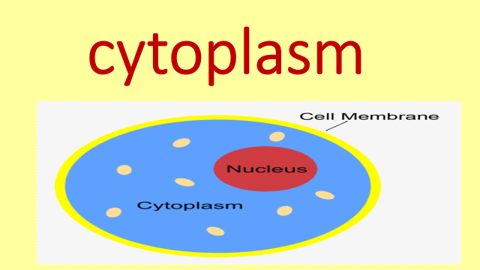
3

Slide 2
Vesicles
Vesicles are cellular organelles that are composed of a lipid bilayer
Vesicles also function in metabolism and enzyme storage as well

Slide 3
Types of Vesicles
secretory vesicles
vacuoles
transport vesicles
lysosomes

Slide 4
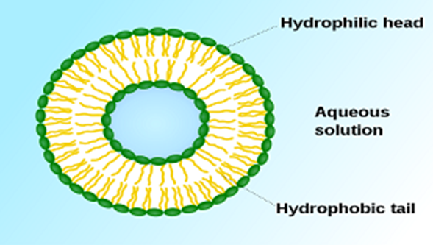
Vacuoles
vesicles that contain mostly water
They are able to regulate the pressure and water level of the cell to control the conditions of the internal environment.

Slide 5
Lysosome
They are spherical vesicles which contain hydrolytic enzymes that can break down virtually all kinds of biomolecules.
The lumen's pH (4.5 - 5.0) is optimal for the enzymes involved in hydrolysis
Besides degradation of polymers, the lysosome is involved in various cell processes, including secretion, plasma membrane repair, cell signalling, and energy metabolism
The lysosomes also act as the waste disposal system of the cell by digesting unwanted materials in the cytoplasm

Slide 6
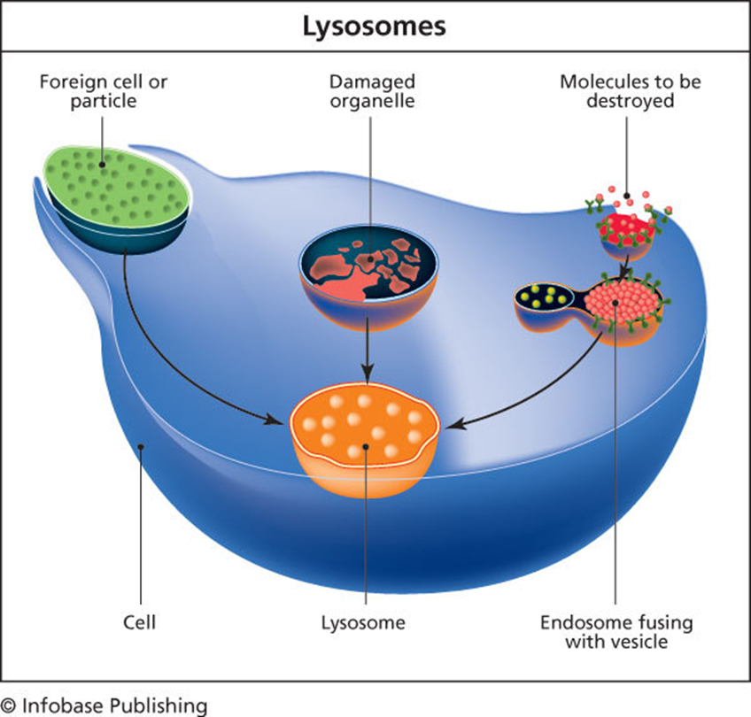
Lysosomes are known to contain more than 60 different enzymes. Enzymes of the lysosomes are synthesised in the rough endoplasmic reticulum. The enzymes are imported from the Golgi apparatus in small vesicles, which fuse with larger acidic vesicles.

Slide 7
Centrioles
All animal cells have two small organelles known as centrioles. The centrioles help the cell to divide.
Centrioles are seen the process of mitosis and meiosis. The centrioles together are typically located near the nucleus in the centrosome.
Centrioles are made of nine bundles of microtubules, that are arranged in a ring.
The absence of centrioles causes divisional errors and delays in the mitotic process.

Slide 8
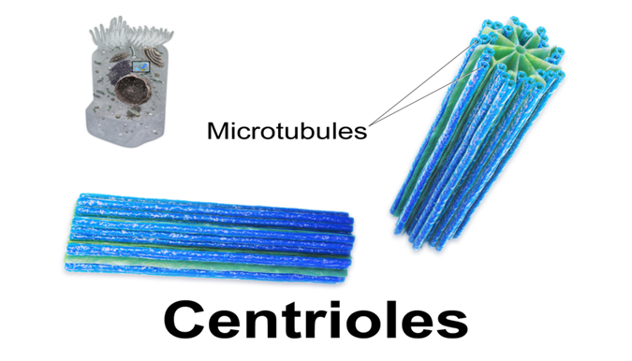

Slide 9
The Nucleus
The cell nucleus acts like the brain of the cell
Not all cells have a nucleus
eukaryotic
prokaryotic
nucleoid
nucleus

Slide 10
Nucleus has two major functions
it stores the cell's hereditary material, or DNA
it coordinates the cell's activities, which include growth, intermediary metabolism, protein synthesis, and reproduction

Slide 11
