Slide 1
Heart
Pericardium
Cardiac muscle
Chambers
Valves
Cardiac vessels
Conduction system

Slide 2
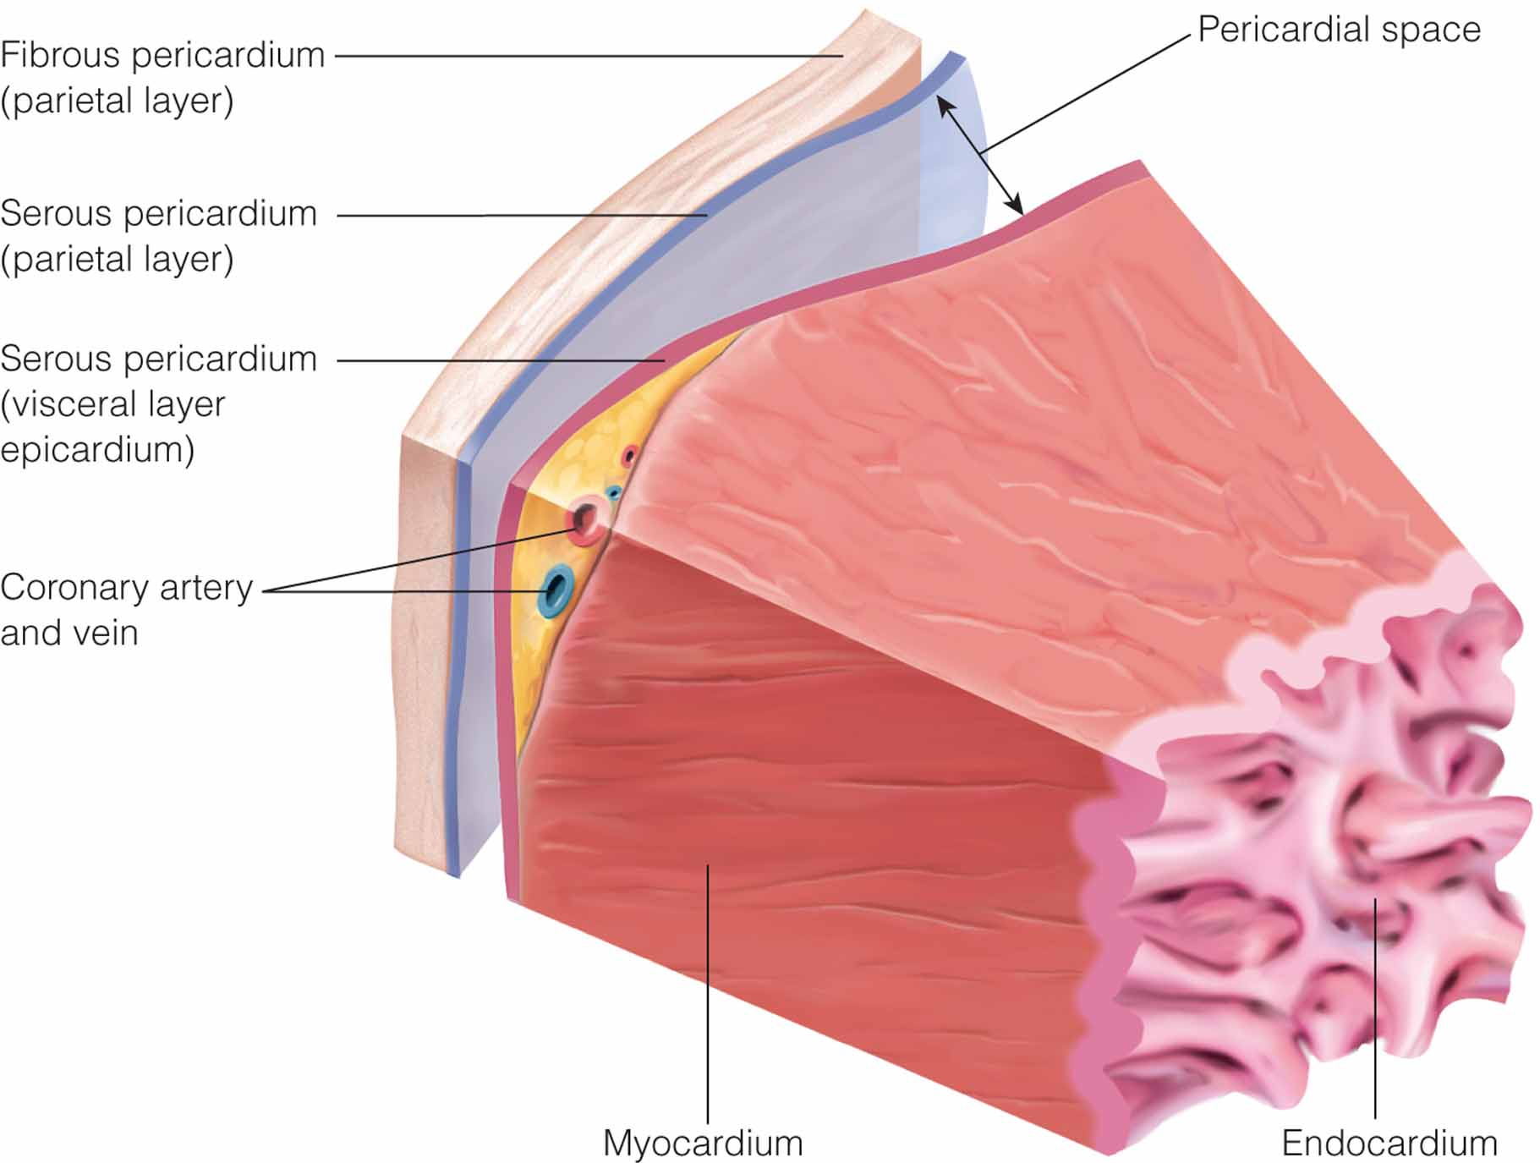
Layers of the heart.
Notes:
2

Slide 3
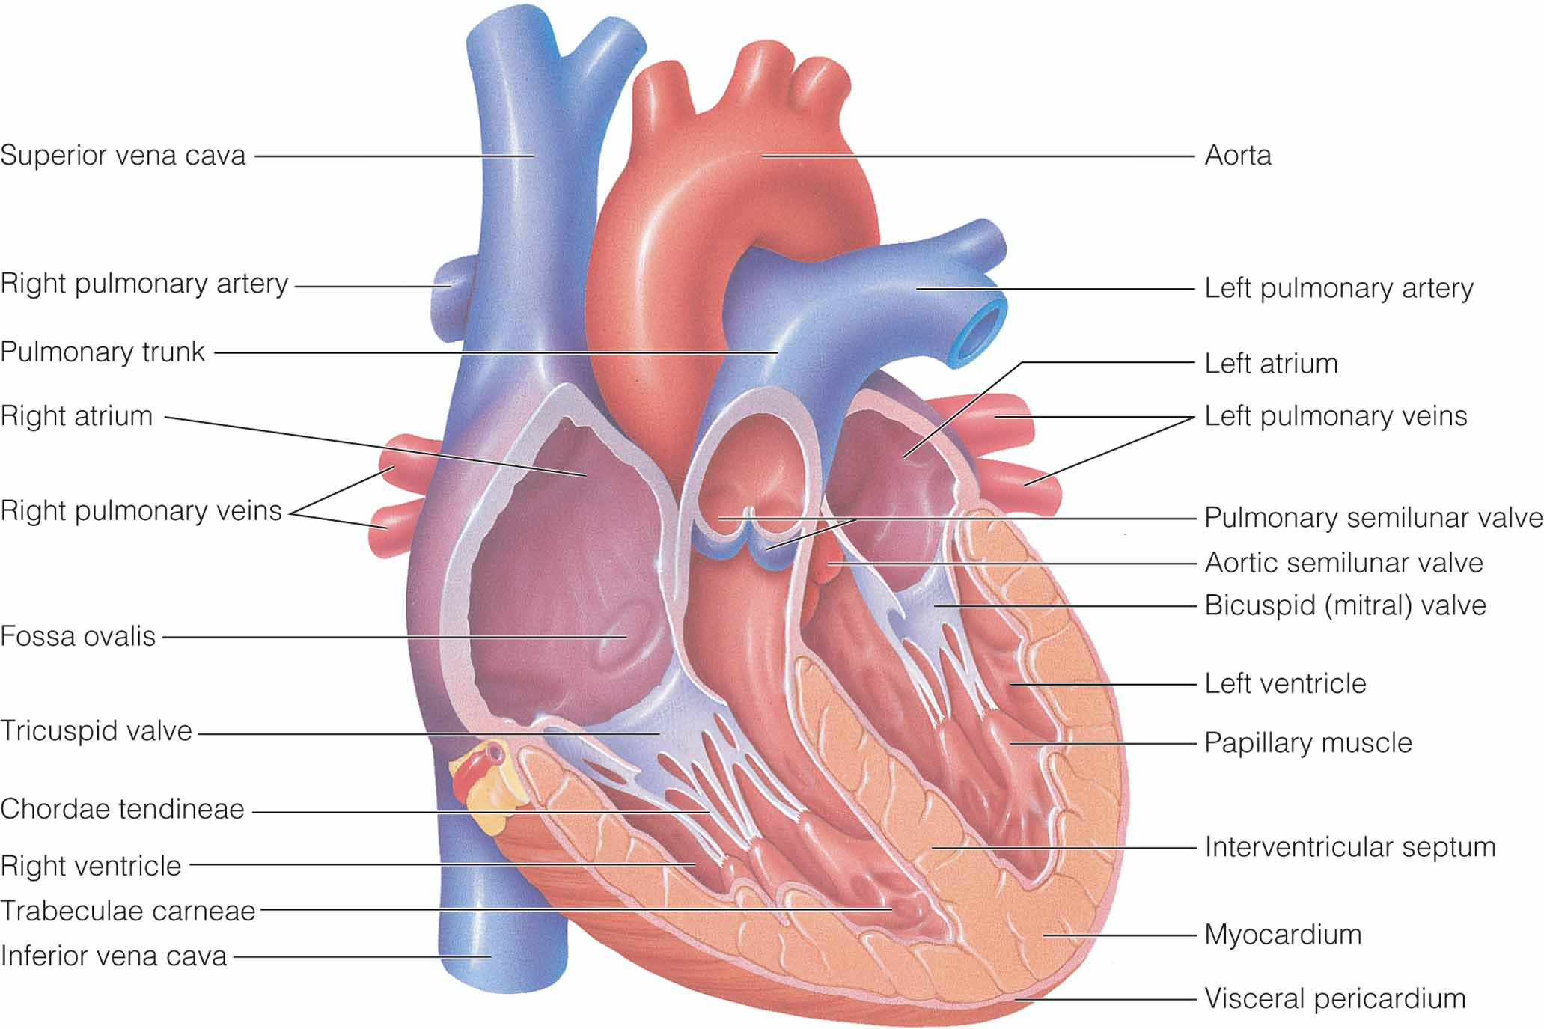
Structural components of the heart
Notes:
3

Slide 4
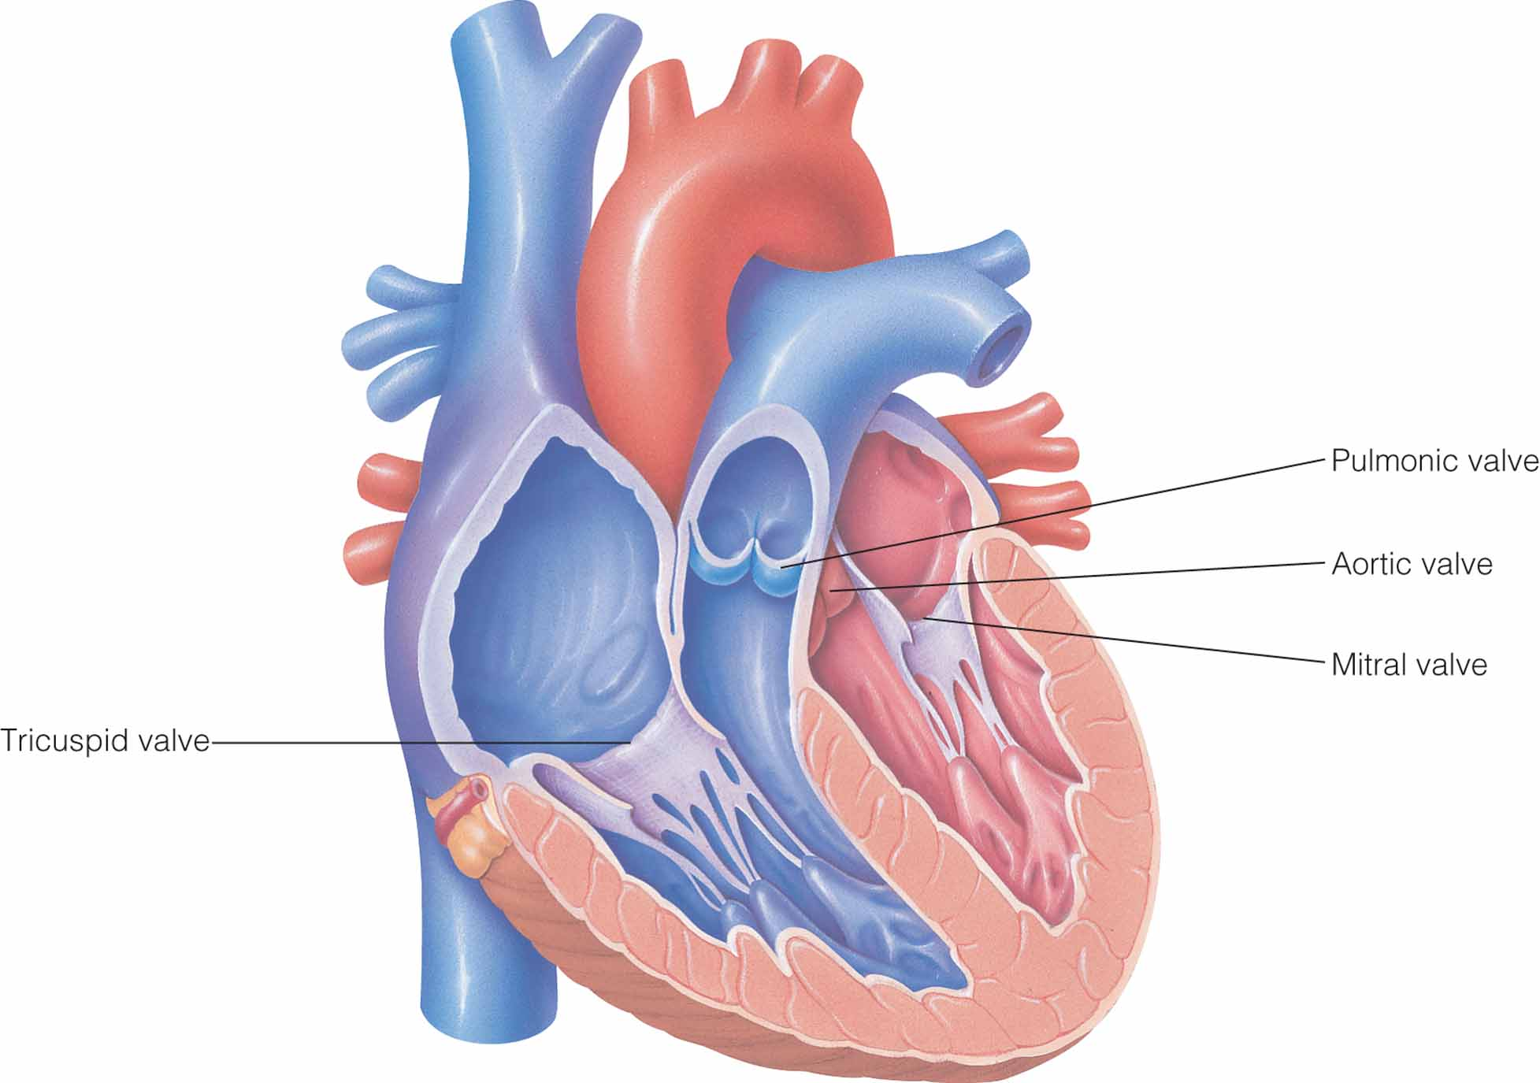
Valves of the heart
Notes:
4

Slide 5
Pericardium
Thin Sac Composed of Fibroserous Material That Surrounds the Heart
Outer layer
Inner layer
Fluid between the layers

Slide 6
Heart Muscle
Base
Apex
Epicardium
Myocardium
Endocardium

Slide 7
Chambers in the Heart
Left and right atria
Left and right ventricles

Slide 8
Valves
Permit the Flow of Blood Between Chambers and Into Blood Vessels
Atrioventricular (AV)
Tricuspid
Mitral
Semilunar
Pulmonary
Aortic

Slide 9
Heart Sounds
S₁
S₂

Slide 10
S1
S1 - Closure of mitral
and tricuspid valves
Beginning of systole.
(think of the heart starting to contract – what is happening ?)
Relates to QRS complex.
Generally described as the “lub”.
10 48

Slide 11
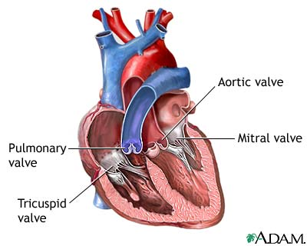

What does it mean?
S1 - Closure of mitral and tricuspid valves.
Beginning of systole.
Listen with the diaphragm.
Best heard over Apex –
but can be heard over entire
Precordium.
Can hear it in any position.
11 48

Slide 12
Lub Dub
S2
Systole
Diastole
Systole
S1
12 48

Slide 13
Diastole
Filling of the ventricles with blood.
At this time the atrioventricular valves must be open but the pulmonic and aortic must close.
Diastole – in two parts – early and late.
13 48

Slide 14
Closure of aortic and pulmonic valves
S2 -
Beginning of diastole.
Diastole is generally longer than systole.
Generally described as the “dub”.
Heard over entire precordium - best at base.
Shorter, higher pitched than S1.
14 48

Slide 15
How does it sound ?
S2 - Closure of aortic and pulmonic valves.
May be split - normal - changes with inspiration.
Instead of a clean “dub” you may hear “T-dub”.
Split S2 - only heard in Pulmonic valve area.
15 48

Slide 16
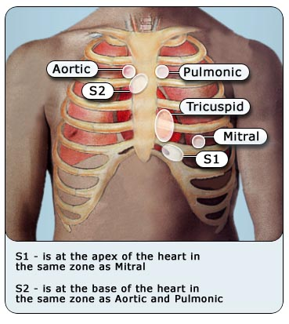
HEART SOUNDS
Sites:
AORTIC
PULMONIC
ERB’S POINT
TRICUSPID
MITRAL
16 48

Slide 17
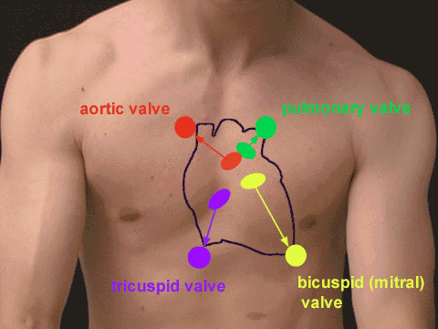
(http://www.med.umich.edu/lrc/coursepages/M1/anatomy/html/surface/thorax/hsounds.htm)l
17 48

Slide 18
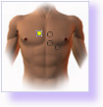
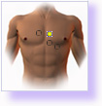
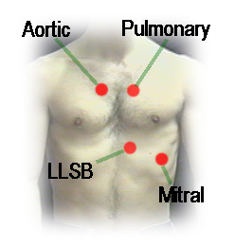
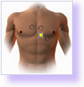
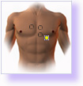
Aortic Valve Area
Pulmonic Valve Area
Tricuspid Valve Area
Mitral Valve Area
Tricuspid
18 48

Slide 19

Abnormal Heart Sounds
Gallop rhythm
S3
First clinical sign of congestive cardiac failure
Occurs early in diastole.
Occurs in a dilated ventricle and results from the rapid flow of blood into non pliable ventricles.
Filling of ventricles with limited distensibility.
The ventricles are resisting the filling because they are already congested because of the failure.
19 48

Slide 20
Lub Dub A
S2
S3
Systole
Diastole
Systole
S1
20 48

Slide 21
Abnormal Heart Sounds
S3 sounds like Lub Dub A
Ventricular gallop
Main cause: heart failure, volume overload.
Can also be caused by hypertension.
Some valve problems:
Mitral, aortic or tricuspid insufficiency.
Use the bell in mitral area as is low pitched.
May be normal in children and young adults.
S3
normal
21 48

Slide 22
Abnormal Heart Sounds
S4 - atrial gallop
Associated with the atrial kick - late diastole.
Atrial contraction is more forceful than normal – trying to push against increasing resistance.
Implies decreased compliance or a stiff left ventricle.
Heard in:
Myocardial infarction in a large infarct .
A slightly damaged noncompliant left ventricle can accommodate the blood that enters through the initial filling phase.
However it can’t accommodate the blood at end of diastole – S4
S4
22 48
Notes:
22
Hypertension.
Some valve disorders: aortic or pulmonic stenosis.
Cardiomyopathies.

Slide 23
S2
S4
Systole
Diastole
Systole
S1
23 48

Slide 24
How do they sound ?
S3
Sound of a stone dropping into the water at the bottom of the well, dull and thuddy.
S4
Hollow, snappy sound.
Don’t always expect to hear two distinct sounds, gallops often sound as mere distortions of the normal heart. Abnormal sounds low pitched can be hard to hear….don’t be discouraged if learning and can’t initially hear.
24 48

Slide 25
Murmurs
Any reason that causes a turbulence in blood flow, or any alteration in movement of blood.
The movement of blood is significantly altered when there is leakage through insufficient valves or turburlence across a narrowed outlet as with stenosis:
Valves:
Stenosis – turbulence across narrow outlet (stiff).
Regurgitation – (leaking).
Defects in the heart.
25 48

Slide 26
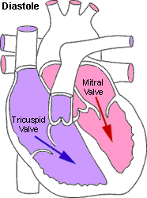
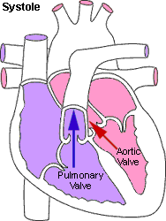
Aortic stenosis is a heart valve disorder that narrows or obstructs the aortic valve opening. Narrowing of the aortic valve prevents the valve from opening properly and obstructs the flow of blood from the left ventricle to the aorta.
Notes:
26
Thinner chest of child makes it easier to hear an innocent murmur.
Systolic.
They reflect the contractile force of the heart that results in great blood flow velocity during early or mid systolic.
Usually grade 1 to 2.
Can also occur with high cardiac output states:
Fever
Pregnancy
Anxiety

Slide 27
Contraction and Relaxation Phases of the Heart
Systole
Diastole

Slide 28
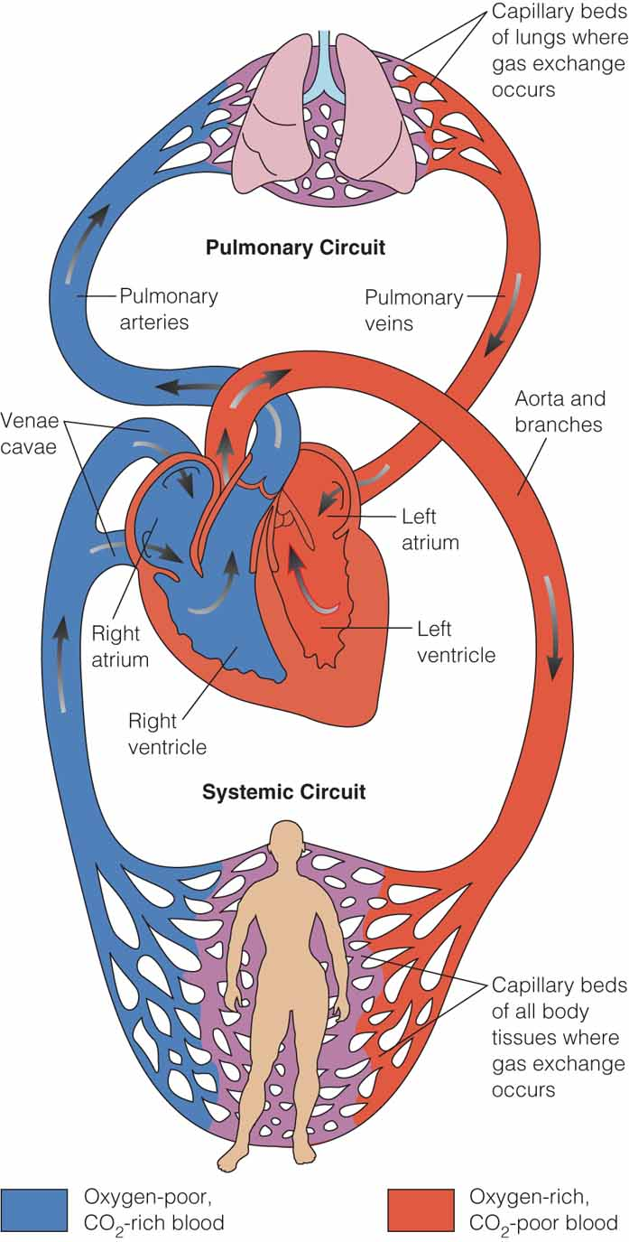
Figure 17.8 Pulmonary and systemic circulation. The left side of the heart pumps oxygenated blood (indicated in red) into the arteries of the systemic circulation, which provides oxygen and nutrients to the cells. Deoxygenated blood (indicated in blue) returns via the venous system into the right side of the heart, where it is transported to the pulmonary arterial system to be reoxygenated.
Notes:
28

Slide 29
Circulation of the Heart
Coronary arteries
Left main
Right coronary
Left anterior descending
Circumflex

Slide 30
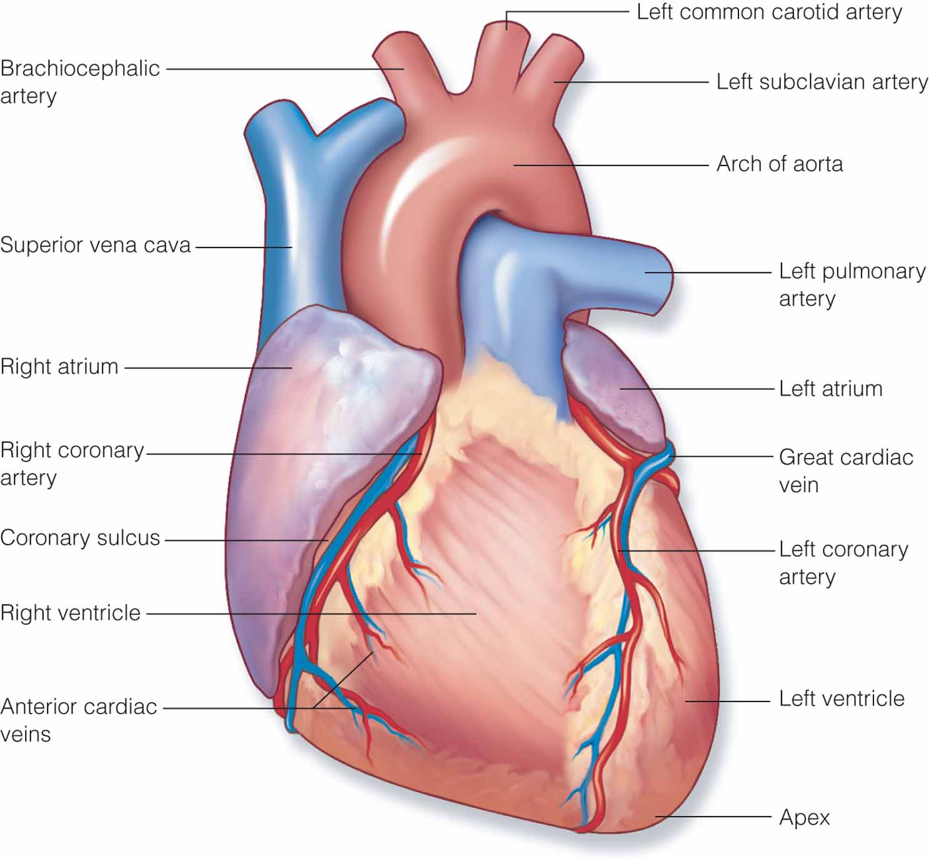
Figure 17.6 Vessels of the heart. A. Anterior.
A
Notes:
30

Slide 31
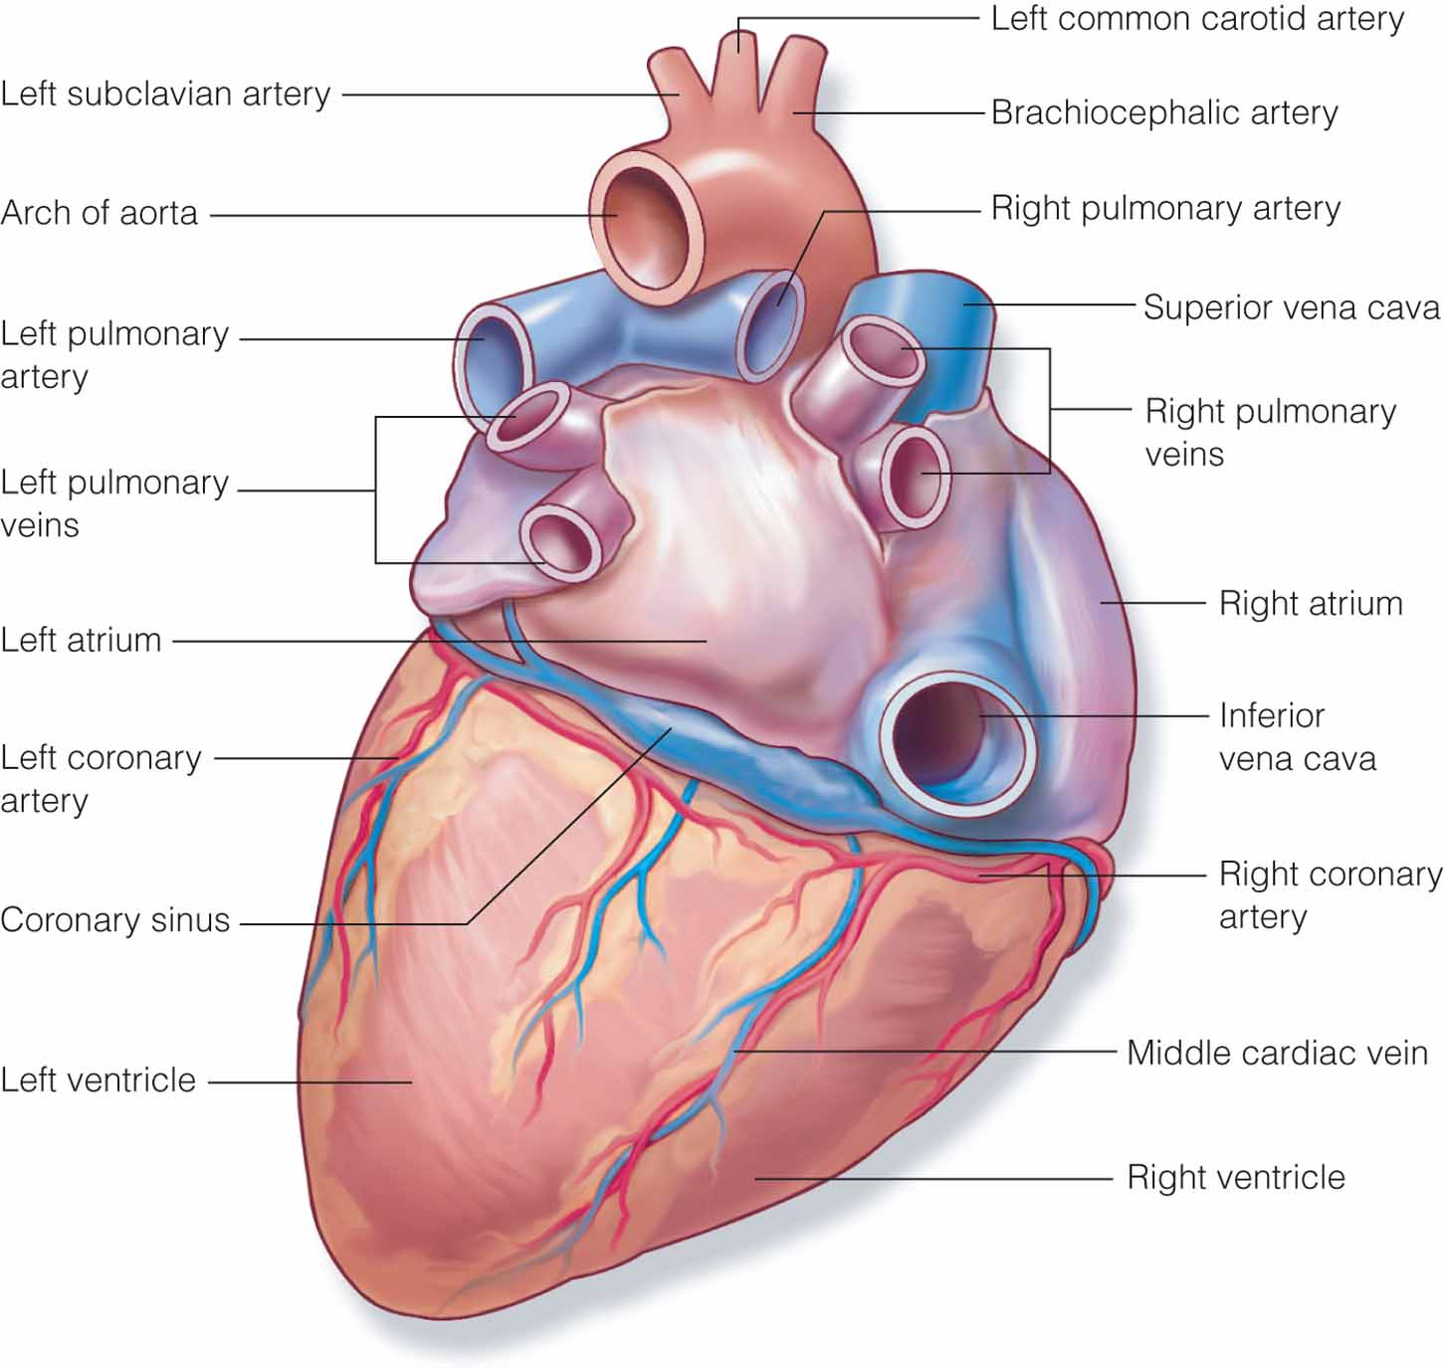
Figure 17.6 (continued) Vessels of the heart. B. Posterior.
B
Notes:
31

Slide 32
Conduction System of the Heart
Sinoatrial (SA) node
Intra-atrial pathways
AV node
Bundle of His
Right and left bundle branches
Purkinje fibers

Slide 33
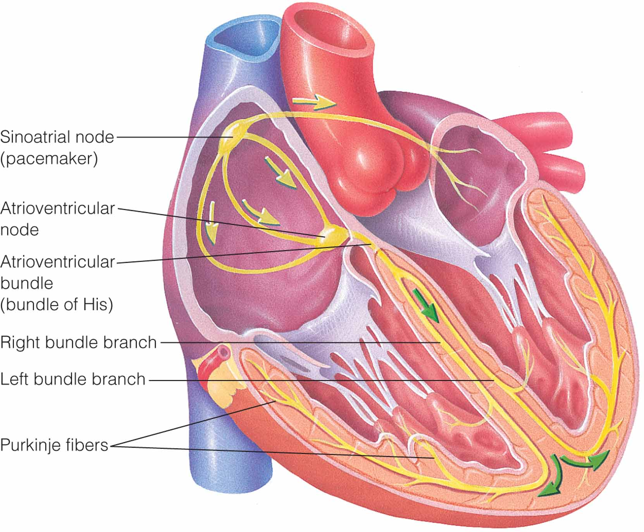
Figure 17.7 Conduction system of the heart.
Notes:
33

Slide 34
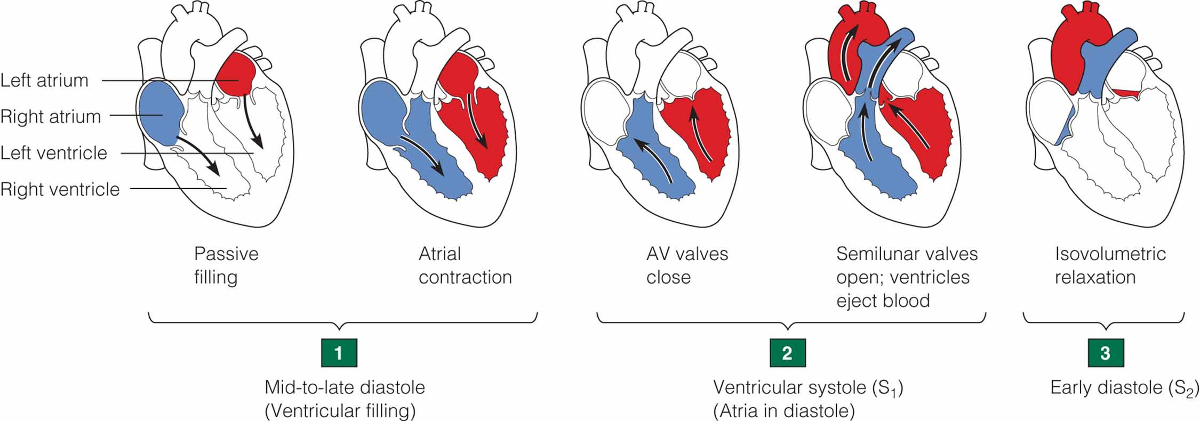
Cardiac Cycle: Contraction and Relaxation of the Chambers
Notes:
34

Slide 35
Cardiac Cycle
Ventricular filling
Ventricular systole
Isovolumetric relaxation

Slide 36
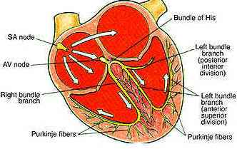
Electrocardiogram (ECG)
Paper Recording of Deflections That Represent the Cardiac Cycle
Electrical deflections
P wave
PR interval
QRS interval
T wave

Slide 37
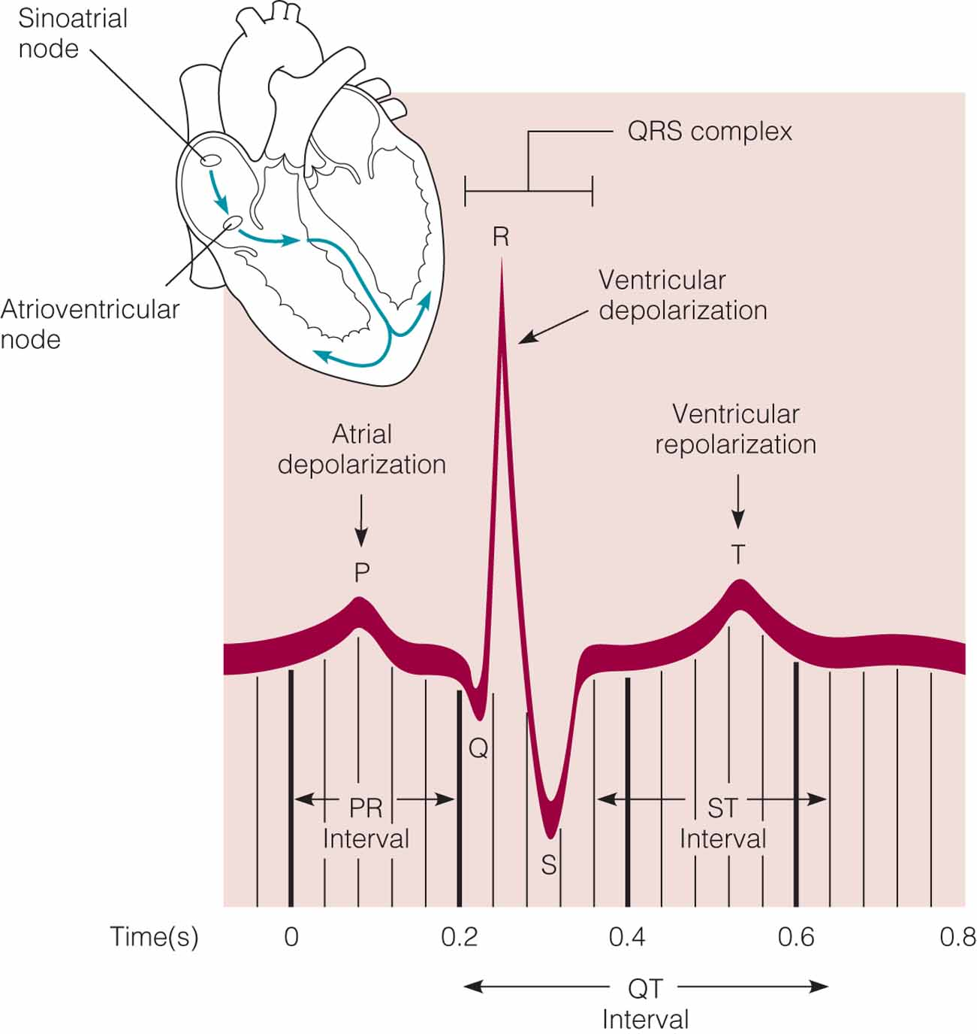
Electrocardiogram wave
Notes:
37

Slide 38
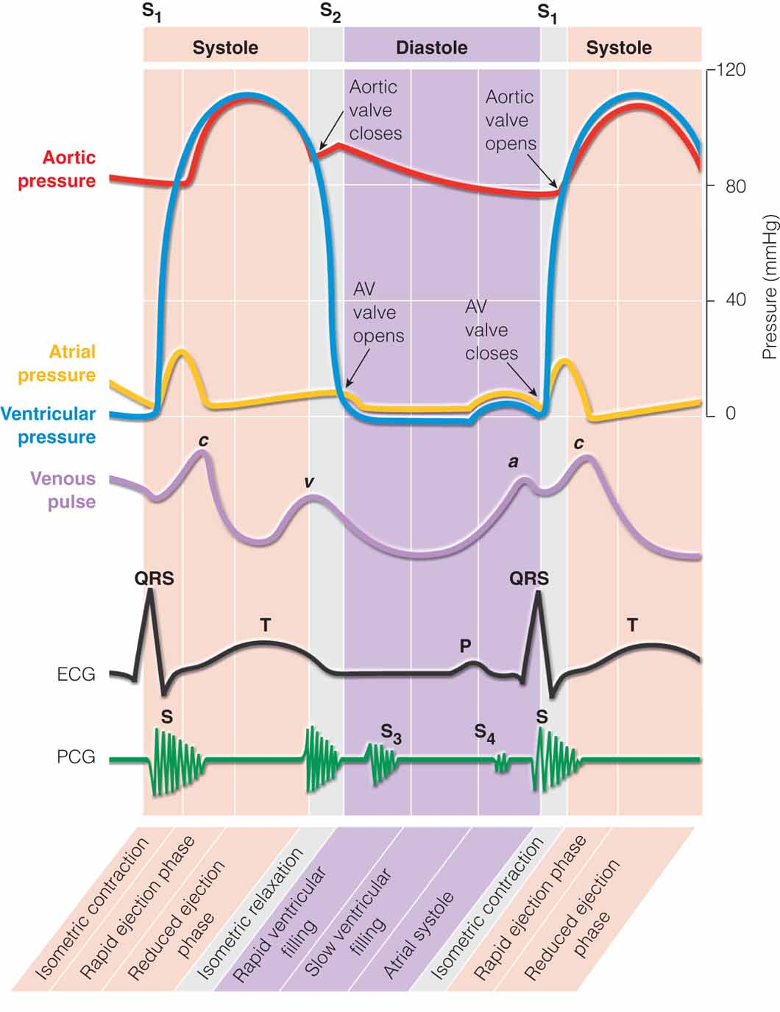
Figure 17.12 Events of the cardiac cycle.
Notes:
38

Slide 39
Cardiac Function
Stroke volume
Amount of blood that is ejected with each heartbeat
Cardiac output
Amount of blood ejected from the left ventricle over 1 minute
Cardiac index
Measurement accounting for an individual’s weight when evaluating the pumping action of the heart

