Slide 1
DEFINING HRM HRM refers to those activities undertaken by an organization to effectively utilize its human resources by: 1-Human resource planning. 2- Staffing (recruitment, selection, placement).
Chapter 1 Review

Slide 2
3- Performance management. 4- Training and development. 5 -Compensation (remuneration) and benefits. 6 -Industrial relations.

Slide 3
DEFINING INTERNATIONAL HRM
IHRM definition
Morgan’s “3-D” definition
Stahl-Björkman-Morris def.

Slide 4
Morgan’s “3-D” definition of IHRM
The HR activities of procurement, allocation & utilization
The countries where IHRM occurs:
Host-country where subsidiary may be located
Parent-country where firm is headquartered
Other-countries that may be source of labor, finance & other inputs
The employees of an international firm:
HCNs (host country nationals)
PCNs (parent .. .. )
TCNs-Third Country Nationals (host country nationals)
In an international firm, a TCN is a person whose nationality is different from that of the firm, and of the country in which the firm is operating: for example, a UK manager working for an Australian-based subsidiary of a Japanese company.

Slide 5
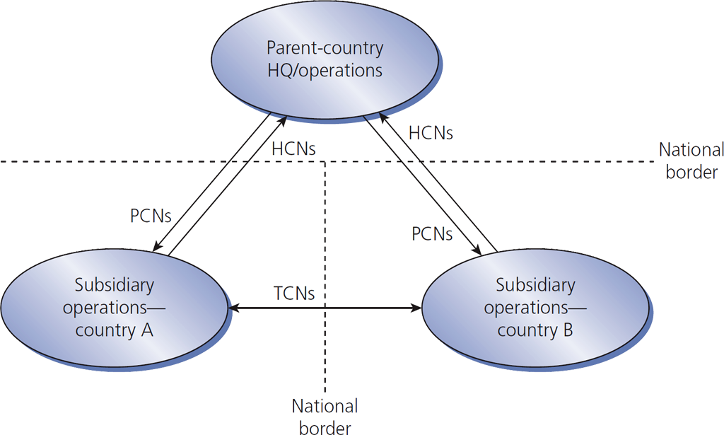
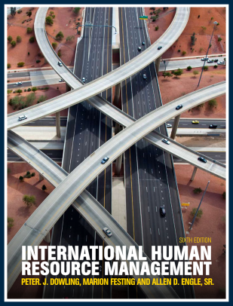
Figure 1.2
International assignments create expatriates

Slide 6
Stahl-Björkman-Morris def. of IHRM
The field of IHRM covers
All issues related to firm outcomes
A wide range of HR issues facing MNEs in different parts of their organizations
This definition includes comparative analyses of HRM in different countries.

Slide 7
Domestic vs. international - HRM
IHRM has …
more HR activities
a need for a broader perspective
more involvement in employees’ personal lives
changes of emphasis as the mix of expatriates & locals varies
more risk exposure
broader external influences

Slide 8
IHRM has international HR activities
International taxation
International relocation & orientation
Administrative services for expatriates
Host-government relations
Language translation services

Slide 9
International relocation involves:
Arranging for pre-departure training
Providing immigration & travel details
Providing housing, shopping, medical care, recreation & schooling information
Finalizing compensation details such as:
Delivery of salary overseas
Determination of overseas allowances
Taxation treatment

Slide 10
Four more moderators in addition to IHRM complexity
The cultural environment
The industry(ies) with which the MNE is primarily involved
The extent to which the MNE relies on its HC domestic market
The attitudes of senior management

Slide 11
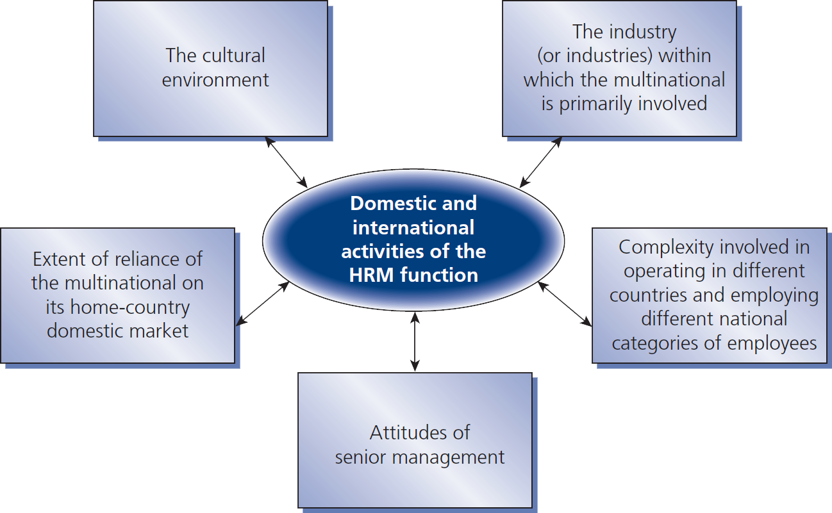
Figure 1.3
A model of all 5 variables that moderate the differences between domestic and international HRM

Slide 12
DISCUSSION QUESTIONS Chapter 1
1 - What are the main similarities and differences between domestic and international HRM?
2 - Define these terms: international HRM, PCN, HCN and TCN?
3 - Discuss two HR activities in which a multinational firm must engage that would not be required in a domestic environment?
4 - Why is a greater degree of involvement in employees’ personal lives inevitable in many international HRM activities?
5 - Discuss at least two of the variables that moderate differences between domestic and international HR practices.

Slide 13
THE CULTURAL CONTEXT OF IHRM
Chapter 2

Slide 14
Key Objectives
Definitions of CULTURE
Cultural concepts
Results of various intercultural mgmt. studies: Hofstede & GLOBE
Development of cultures

Slide 15
Historical events of Culture studies
Foreign environment is seen in the literature as a key problem of international management
It was called intercultural comparative research then became Cross cultural management
cross-cultural management studies by Hofstede3 and the Global Leadership and Organizational behavior (GLOBE) study are the main source of this chapter.

Slide 16
Goals of cross-cultural management studies made in the early 1960s.
Description of organizational behavior within countries and cultures
Comparison of organizational behavior between countries and cultures
Explanation and improvement of interaction between employees, customers, suppliers or business partners from different countries and cultures

Slide 17
Definition of culture
1950, Kluckhohn and Kroeber
1991, Dutch researcher Geert Hofstede
Hansen
Schein’s concept of culture

Slide 18
Kluckhohn & Kroeber def. of culture
Culture consists of patterned ways of
Thinking
Feeling
Reacting
acquired & transmitted mainly by symbols, constituting/ organising the distinctive achievements of human groups, including their embodiments/ expressions in artefacts/ objects
The
essential
core of
culture
traditional ideas &
their attached values
consists of

Slide 19
Geert Hofstede def. of culture
‘Using the analogy of the way in which computers are programmed, this book will call such patterns of thinking, feeling, and acting mental programs, or, as the subtitle goes: ‘‘software of the mind’’. This does not mean, of course, that people are programmed the way computers are. A person’s behavior is only partially determined by her or his mental programs: (s)he has a basic ability to deviate from them, and to react in ways which are new, creative, destructive, or unexpected. The ‘‘software of the mind’’ . . . only indicates what reactions are likely and understandable, given one’s past.’

Slide 20
Hansen’s 4 elements of culture:
Standardization of
Communication
Thought
Feeling
Behavior

Slide 21
Schein’s concept of culture
Schein considers various levels of culture: artefacts or creations, values and underlying assumptions. Artefacts are described as visible organization structures and processes.
They can be analyzed using conventional methods of empirical social research, but their meaning is often hard to decipher.
The middle level comprises values of a company or society. They are found in the intermediate level of consciousness; in other words, they are conscious and partly unconscious.
The third level is described as underlying assumptions, which are often presumed to be self-evident.

Slide 22
Intro to cross-cultural mgmt. research
1- Hofstede’s cross-cultural management study
2- The GLOBE study

Slide 23
Goals of cross-cultural mgmt. studies
organizational behavior between countries & cultures
Describe
Compare
Explain & improve interaction between employees, customers, suppliers or business in different countries & cultures

Slide 24
The Hofstede study
1- it was the first major study in this field. It can be positioned on the values level, the intermediate level of Schein’s concept of culture.
2- In his original study, Hofstede identified four cultural dimensions based on preliminary theoretical considerations and statistical analyses, which can be used to describe cultural differences between countries. This is the most comprehensive study on this subject ever conducted by means of one questionnaire.

Slide 25
3- In total, the analysis was based on 116 000 questionnaires from IBM employees. The surveyed employees represented all hierarchical levels of the company and possessed various qualifications, from unskilled workers to university graduates. Employees from a total of 38 various profession groups were surveyed. In addition, the study was conducted during two different periods in IBM subsidiaries (1967–1969 and 1971–1973). 4- The questionnaire was translated into 20 different languages in total.32 Out of 150 questions, 60 were based on convictions and values of the respondents.

Slide 26
5- These dimensions together explained 49 per cent of the variance. Hofstede named them power distance, uncertainty avoidance, femininity vs. masculinity, and individualism vs. collectivism. A later study involving participants from the Asian Pacific region included a fifth dimension, Confucianism or long-term orientation.

Slide 27
Hofstede’s 5 culture dimensions
Power distance: Describes how people belonging to a specific culture view powerrelationships - superior/subordinate relationships
Uncertainty avoidance: is a society's tolerance for uncertainty
Femininity vs. masculinity
Individualism vs. collectivism: Collectivist cultures, such as those of China, Korea, and Japan, emphasize family and work group goals above individual needs or desires. Collectivism and individualism deeply pervade cultures. People simply take their culture's stance for granted.
Confucianism or long-term orientation:

Slide 28
Power distance

Slide 29
Uncertainty avoidance

Slide 30
Femininity vs. masculinity

Slide 31
Individualism vs. collectivism

Slide 32
Confucianism or long-term orientation
Long term and short term

Slide 33
Long-term cultures characterized by:
Great endurance/strength, persistence/ determination in pursuing goals
Position of ranking based on status
Adaptation of traditions to modern conditions
Respect of social & status obligations within limits
High savings rates & high investment activity
Readiness to subordinate oneself to a purpose
The feeling of shame

Slide 34
Short-term cultures characterized by:
Personal candor/ honesty/ frank & stability
Avoiding loss of face
Respect of social & status obligations without consideration of costs
Low savings rates & low investment activity
Expectations of quick profit
Respect for traditions
Greetings, presents & courtesies based on reciprocity

Slide 35
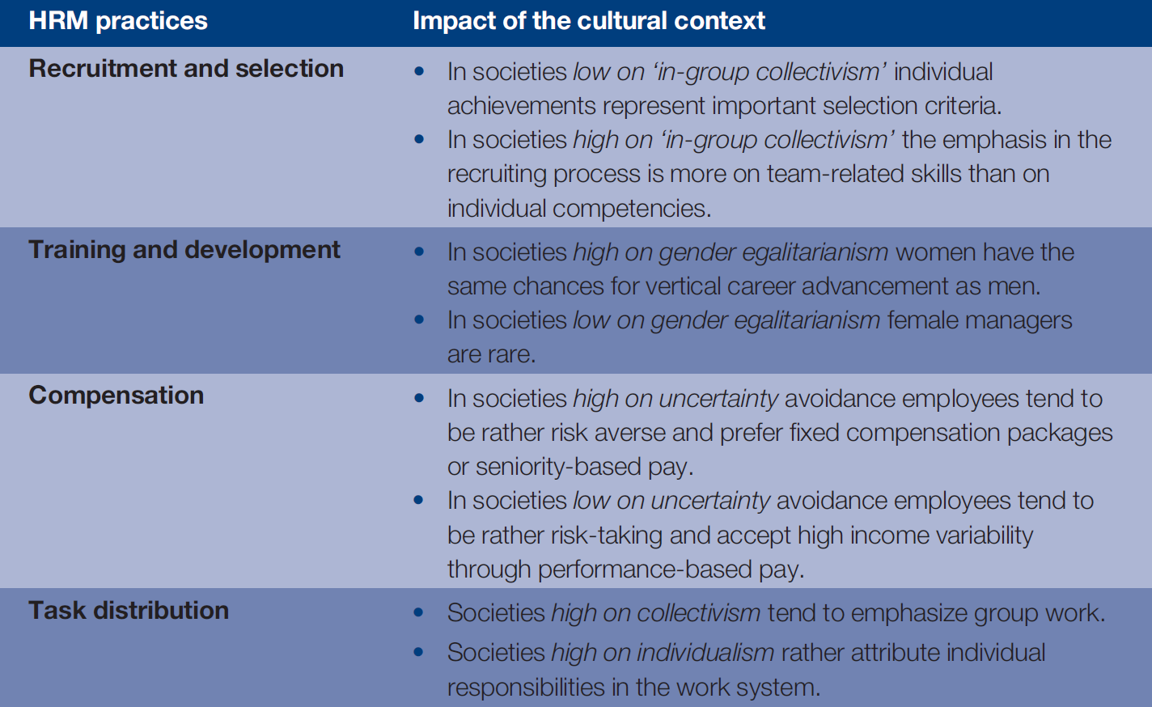
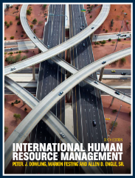
Table 2.1
Impact of the cultural context on HRM practices
In-group collectivism is "the degree to which individuals express pride, loyalty, and cohesiveness / unified in their organizations or families
Gender equality/ gender egalitarianism is the view that everyone should receive equal treatment and not be discriminated against based on their gender.
Uncertainty avoidance is a society's tolerance for uncertainty. It reflects the extent to which members of a society attempt to cope with anxiety by minimizing uncertainty.
Collectivism is the practice or principle of giving a group priority over each individual in it
Individualism:favouring freedom of action for individuals over collective
Chapter 2

Slide 36
The GLOBE study

Slide 37
GLOBE’s 8 culture dimensions
Institutional collectivism: the degree to which organizational and societal institutional practices encourage and reward collective distribution of resources and collective action
In-group collectivism: the degree to which individuals express pride, loyalty, and cohesiveness in their organizations or families
Uncertainty avoidance: is a society's tolerance for uncertainty
Power distance: Describes how people belonging to a specific culture view powerrelationships - superior/subordinate relationships
Gender egalitarianism: equality and equal treatment across gender
Assertiveness: quality of being self-assured and confident without being aggressive
Performance orientation: is characterized by the belief that success is the result of superior ability and of surpassing one's peers
Humane orientation: Degree to which an organization or society encourages and rewards individuals for being fair, altruistic, friendly, generous, caring, and kind to others

Slide 38
Cultures change
There is increasing
International connectedness. E.g. Social networking sites
Global economy coordination
Harmonization/ Coordination/ Syncronization of laws & regulations
Migration/ Relocation

Slide 39
DISCUSSION QUESTIONS Chapter 2
1- Define culture. How can culture be conceptionalized?
2- Outline the cross-cultural management study by Hofstede and discuss it?
3- Outline the methodical procedure and the results of
the GLOBE study?
4- Compare cross-cultural management studies and list
advantages and disadvantages?
5- To what extent do cultures undergo changes Illustrate your statement by an example?
6- What do you think about the statement: ‘Cultures in
Europe are becoming more similar?

