Slide 1
Chapter 12 Wireless Sensor Networks
1
Notes:
1

Slide 2
Outline
12.1 Introduction
12.2 Sensor Network Architecture
12.3 Data Dissemination
12.4 Data Gathering
12.5 MAC Protocols for Sensor Networks
12.6 Location Discovery
12.7 Quality of a Sensor Network
12.8 Evolving Standards
12.9 Other Issues
2

Slide 3
12.1 Introduction
Sensor networks are highly distributed networks of small, lightweight wireless node, deployed in large numbers to monitor the environment or system.
Each node of the sensor networks consist of three subsystem:
Sensor subsystem: senses the environment
Processing subsystem: performs local computations on the sensed data
Communication subsystem: responsible for message exchange with neighboring sensor nodes
The features of sensor nodes
Limited sensing region, processing power, energy
3

Slide 4
The advantage of sensor networks
Robust : a large number of sensors
Reliable :
Accurate : sensor networks covering a wider region
Fault-tolerant : many nodes are sensing the same event
Two important operations in a sensor networks
Data dissemination : the propagation of data/queries throughout the network
Data gathering : the collection of observed data from the individual sensor nodes to a sink
The different types of sensors
Seismic, thermal, visual, infrared
4

Slide 5
12.1.2 Comparison with Ad Hoc Wireless Networks
Different from Ad Hoc wireless networks
The number of nodes in sensor network is larger than the number of nodes in an ad hoc network.
Sensor nodes are more easy to failure and energy drain, and their battery sources are usually not replaceable or rechargeable.
Sensor nodes may not have unique global identifiers (ID), so unique addressing is not always suitable in sensor networks.
Sensor networks are data-centric, the queries in sensor networks are addressed to nodes which have data satisfying some conditions. Ad Hoc networks are address-centric, with queries addressed to particular nodes specified by their unique address.
Data fusion/gathering: the sensor nodes gather the local information before moving. The goals are reduce bandwidth consumption, media access delay, and power consumption for communication.
5

Slide 6
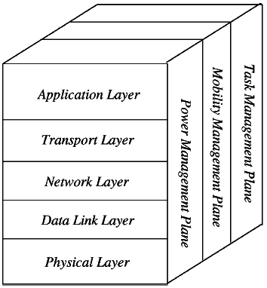

Slide 7
Application Layer
The application layer is liable for traffic management and offers software for numerous applications that convert the data in a clear form to find positive information. Sensor networks arranged in numerous applications in different fields such as agricultural, military, environment, medical, etc.
Transport Layer
The function of the transport layer is to deliver congestion avoidance and reliability where a lot of protocols intended to offer this function are either practical on the upstream. These protocols use dissimilar mechanisms for loss recognition and loss recovery. The transport layer is exactly needed when a system is planned to contact other networks.
Providing a reliable loss recovery is more energy efficient and that is one of the main reasons why TCP is not fit for WSN. In general, Transport layers can be separated into Packet driven, Event driven. There are some popular protocols in the transport layer namely STCP (Sensor Transmission Control Protocol), PORT (Price-Oriented Reliable Transport Protocol and PSFQ (pump slow fetch quick).

Slide 8
Network Layer
The main function of the network layer is routing, it has a lot of tasks based on the application, but actually, the main tasks are in the power conserving, partial memory, buffers, and sensor don’t have a universal ID and have to be self-organized.
The simple idea of the routing protocol is to explain a reliable lane and redundant lanes, according to a convinced scale called metric, which varies from protocol to protocol. There are a lot of existing protocols for this network layer, they can be separate into; flat routing and hierarchal routing or can be separated into time driven, query-driven & event driven.
Data Link Layer
The data link layer is liable for multiplexing data frame detection, data streams, MAC, & error control, confirm the reliability of point–point (or) point– multipoint.

Slide 9
Physical Layer
The physical layer provides an edge for transferring a stream of bits above physical medium. This layer is responsible for the selection of frequency, generation of a carrier frequency, signal detection, Modulation & data encryption. IEEE 802.15.4 is suggested as typical for low rate particular areas & wireless sensor network with low cost, power consumption, density, the range of communication to improve the battery life. CSMA/CA is used to support star & peer to peer topology. There are several versions of IEEE 802.15.4.V.

Slide 10
Characteristics of Wireless Sensor Network
The characteristics of WSN include the following.
The consumption of Power limits for nodes with batteries
Capacity to handle with node failures
Some mobility of nodes and Heterogeneity of nodes
Scalability to large scale of distribution
Capability to ensure strict environmental conditions
Simple to use
Cross-layer design

Slide 11
Advantages of Wireless Sensor Networks
The advantages of WSN include the following
Network arrangements can be carried out without immovable infrastructure.
Apt for the non-reachable places like mountains, over the sea, rural areas and deep forests.
Flexible if there is a casual situation when an additional workstation is required.
Execution pricing is inexpensive.
It avoids plenty of wiring.
It might provide accommodations for the new devices at any time.
It can be opened by using a centralized monitoring.

Slide 12
12.1.3 Issues and Challenges in Designing a Sensor Network
Issues and Challenges
More energy-efficient
Self-sufficiency in power supply .
Design more energy-efficient of the circuit, or to adopt more energy-efficient electronic components
Integrating more sensors
For multiple purposes such as detecting human’s motion, temperature, blood pressure and heartbeat at the same time
Higher processing performance
In future, more complex application need more powerful computation
12

Slide 13
More Robust and Secure
Not easy damaged or be destroyed
Secure transmission of sensing data and not easy being tapped
Easy to buy and deployment
Low price and easy to use
13

Slide 14
12.2 Sensor Network Architecture
The two basic kinds of sensor network architecture
Layered Architecture
Clustered Architecture
14

Slide 15
12.2.1 Layered Architecture
A layered architecture has a single powerful base station (BS), and the layers of sensor nodes around it correspond to the nodes that have the same distance to the BS.
The BS acts an access point to a wired network, and small nodes form a wireless backbone to provide wireless connectivity.
The advantage of a layered architecture is that each node is involved only in short-distance, low-power transmissions to nodes of the neighboring layers.
15

Slide 16
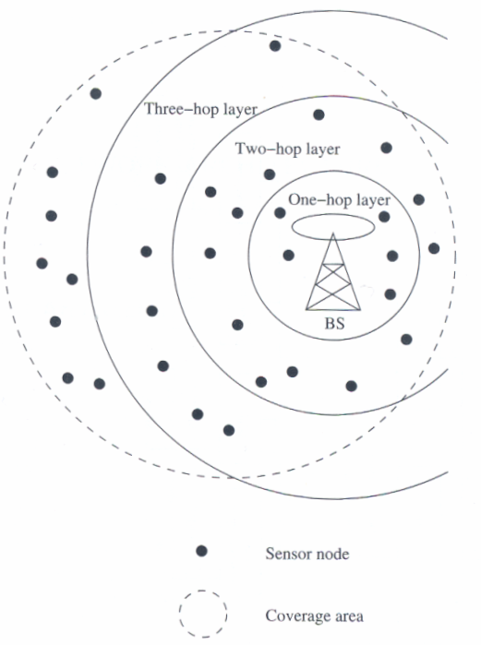
Figure 12.2 Layered architecture
16

Slide 17
Unified Network Protocol Framework (UNPF)
UNPF is a set of protocols for complete implementation of a layered architecture for sensor networks
UNPF integrates three operations in its protocol structure:
Network initialization and maintenance
MAC protocol
Routing protocol
17

Slide 18
Network initialization and maintenance
The BS broadcasts its ID using a known code on the common control channel.
All node which hear this broadcast then record the BS ID. They send a signal with their own IDs at their low default power levels.
Those nodes which the BS can hear form layer one
BS broadcasts a control packet with all layer one node IDs.
All nodes send a signal again.
The layer one nodes record the IDs which they hear (form layer two) and inform the BS of the layer two nodes IDs.
Periodic signaling updates neighbor information and change the layer structure if nodes die out or move out of range.
18

Slide 19
MAC protocol
During the data transmission phase, the distributed TDMA receiver oriented channel (DTROC) assignment MAC protocol is used.
Two steps of DTROC :
Channel allocation : Each node is assigned a reception channel by the BS, and channel reuse is such that collisions are avoided.
Channel scheduling : The node schedules transmission slots for all its neighbors and broadcasts the schedule. This enables collision-free transmission and saves energy, as nodes can turn off when they are not involved on a send/receive operation.
19

Slide 20
Routing protocol
Downlink from the BS is by direct broadcast on the control channel. Uplink from the sensor nodes to BS is by multi-hop data forwarding.
The node to which a packet is to be forwarded is selected considering the remaining energy of the nodes. This achieves a higher network lifetime.
20

Slide 21
UNPF-R
Optimize the network performance by make the sensor nodes adaptively vary their transmission range.
Because while a very small transmission range cause network partitioning, a very large transmission range reduce the spatial reuse of frequencies.
21

Slide 22
12.2.2 Clustered Architecture
A clustered architecture organizes the sensor nodes into clusters, each governed by a cluster-head.
The nodes in each cluster are involved in message exchanges with their cluster-heads, and these heads send message to a BS.
Clustered architecture is useful for sensor networks because of its inherent suitability for data fusion.
The data gathered by all member of the cluster can be fused at the cluster-head, and only the resulting information needs to be communicated to the BS.
The cluster formation and election of cluster-heads must be an autonomous, distributed process.
22

Slide 23
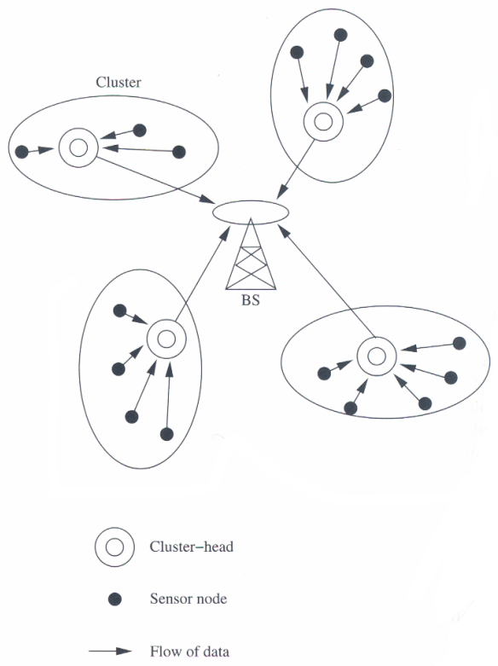
Figure 12.3 Clustered architecture
23

Slide 24
Low-Energy Adaptive Clustering Hierarchy (LEACH)
LEACH is a clustering-based protocol that minimizes energy waste in sensor networks.
The operation of LEACH is spilt into two phases : setup and steady.
Setup phase:
Cluster heads are selected.
The cluster-heads advertise their selection to all nodes.
All nodes choose their nearest cluster-head by signal strength.
The cluster-heads then assign a schedule for their cluster members.
Steady phase:
Data transmission takes place based on the schedule.
The cluster-heads perform data aggregation/fusion.
After a certain period of time in the steady phase, cluster-heads are selected again through the setup phase.
24

Slide 25
12.3 Data Dissemination
Data dissemination: is the process by which queries or data are routed in the sensor network.
The data collected by sensor nodes has to be communicated to the node which interested in the data.
The node that generates data is called source.
the information to be reported is called an event.
A node which interested in an event is called sink.
Data dissemination consist of a two-step process: interest propagation and data propagation.
Interest propagation: for every event that a sink is interested in, it broadcasts its interest to is neighbor, and across the network.
Data dissemination: When an event is detected, it is reported to the interested nodes (sink).
25

Slide 26
12.3.1 Flooding
Each node which receives a packet (queries/data) broadcasts it until the packet reaches the destination node.
Disadvantages :
Implosion :
Happens when duplicate messages sent to the same node.
Occurs when a node receives copies of the same messages from many of its neighbors.
Overlap :
the same event may be sensed by more than one node due to overlapping regions of coverage.
This results in their neighbors receiving duplicate reports of the same event.
Resource blindness : the flooding protocol does not consider the available energy at the nodes and results in many redundant transmissions. Hence, it reduces the network lifetime.
26

Slide 27
12.3.2 Gossiping
Modified version of flooding
The nodes do not broadcast a packet, but send it to a randomly selected neighbor.
Avoid the problem of implosion
It takes a long time for message to propagate throughout the network.
It does not guarantee that all nodes of network will receive the message.
27

Slide 28
12.4 Data Gathering
The objective of the data gathering problem is to transmit the sensed data from each sensor node to a BS.
The goal of algorithm which implement data gathering is
maximize the lifetime of network
Minimum energy should be consumed
The transmission occur with minimum delay
28

Slide 29
MAC Protocols for Sensor Networks
The challenges posed by sensor network MAC protocol
No single controlling authority, so global synchronization is difficult
Power efficiency issue
Frequent topology changes due to mobility and failure
There are three kinds of MAC protocols used in sensor network:
Fixed-allocation
Demand-based
Contention-based
29

Slide 30
Fixed-allocation MAC protocol
Share the common medium through a predetermined assignment.
It is suitable for sensor network that continuously monitor and generate deterministic data traffic
Provide a specific delay values for each node
Fixed-allocation MAC protocol is not good in for bursty traffic.
30

Slide 31
Demand-based MAC protocol
Used in such cases, where the channel is allocated according to the demand of the node
Variable rate traffic can be efficiently transmitted
Require the additional overhead of a reservation process
31

Slide 32
Contention-based MAC protocol
Random-access-based contention/competition for the channel when packets need to be transmitted
Suitable for bursty traffic
Susceptible to collisions and no delay guarantees
Not suitable for delay-sensitive or real-time traffic

Slide 33
Security Threats
The Sybil attack
When a single node presents itself as multiple entities to the network. This can affect the fault tolerance of the network and mislead geographic routing algorithms.
A selective forwarding attack
When certain nodes do not forward any of messages they receive
Sinkhole attack
A node act as BS or a very favorable to the routing
And do not forward any of messages it receive
33

Slide 34
Security Threats
Wormhole attack
Make the traffic go through a very long path by giving false information to the node about the distance between them.
Increase latency
Hello flood attack
Broadcast a Hello packet with very high power, so that a large number of node even far away in the network choose it as the parent.
Increase delay
34

Slide 35
Localized Encryption and Authentication Protocol (LEAP)
LEAP uses different keying mechanisms for different packets depending on their security requirements.
Every sensor node maintains four types of keys:
Individual key :share with BS, loaded into the node before deployment
Group key :share with all node of the network & BS
Cluster key :share between a node and its neighbor
Pairwise share key :share with each neighbor
35

Slide 36
Localized Encryption and Authentication Protocol (LEAP)
In this way, pairwise shared key are generated between all immediate neighbors.
The cluster key is established by a node after the pairwise key establishment.
Then group key is established by cluster key.

Slide 37
Intrusion Tolerant Routing in Wireless Sensor Networks (INSENS)
The protocol cannot totally rule out attack on nodes, but minimizes the damage caused to network.
It constructs routing tables at each node, & passing malicious node in the network.
Only BS is allowed to broadcast, no individual node can masquerade as the BS.
Control information about routing must be authenticated by BS, prevent injection of false data.
37

Slide 38
Intrusion Tolerant Routing in Wireless Sensor Networks (INSENS)
INSENS has two phases:
First Phase: Route discovery phase:
BS send a request message to all node in the network by multi-hop
Any node receiving a request, record the Id of sender.
The nodes respond with their local topology by sending feedback
The messages is protected using shared key mechanism.
BS calculates forwarding table for all node
Second Phase: Data forwarding phase:
Transport data by the routing table.
38

Slide 39
What will Wireless Sensor Networks Look Like in the Near Future?

Slide 40
Large-Scale Deployments
Sensor networks will grow in size because of:
Lower cost
Better protocols
Advantages of dense networks

Slide 41
Heterogeneous Sensors
Homogeneous network of sensors has been the typical assumption, but not the future!!
Combining sensors with different functions
Hierarchy of sensors – a few expensive powerful sensors with more cheap sensors
Useful for special communication nodes
A few sensor nodes with expensive sensors, such as GPS-equipped sensors

Slide 42
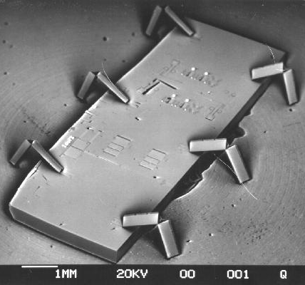
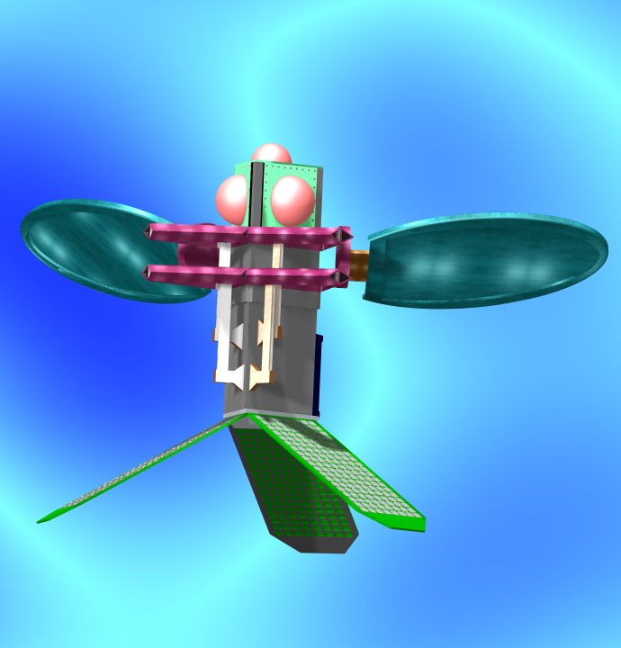
Mobile Sensors
Sensors with Micromachines
Low-Power Motors that Support Mobility

Slide 43
General Purpose Sensors
Single-purpose network is the typical assumption, but not the future!!
Sensors for evolving applications
Sensors that can adapt to changing objectives
More memory and CPU will allow more complex applications
Flexibility increases marketability

Slide 44
Overlapping Coverage Areas
Sensors will be deployed for specific applications, but
These deployments will overlap physically
Sensors will have different properties
Users will want to combine these different sensors for new applications:
Temperature sensors
Location tracking of employees
Combine these for fire rescue operations

Slide 45
Mixture of Wired and Wireless
Wireless sensors will become a seamless part of larger networks!
Combining wired sensors with wireless sensors
Wired sensors can have more power
Wired sensors can run TCP/IP
Accessing wireless sensors through the Internet
Need a gateway to translate requests
Uploading/downloading information remotely
Modifying wireless sensor tasks remotely
Increased direct user interaction

