Slide 1
Chapter 1 & 2
Introduction to Databases
Edited by: Nada Alhirabi
Pearson Education © 2009

Slide 2
Objectives
common uses of database systems.
Database Concepts & term.
Characteristics & problems of file-based systems.
Database Management System (DBMS) & its function.
Major components of the DBMS environment.
Advantages and disadvantages of DBMSs.
Pearson Education © 2009

Slide 3
Examples of Database Applications
Purchases from the supermarket
Purchases using your credit card
Booking a holiday at the travel agents
Local Examples :
Edugate and ERegister.
KSU Library.
Saudi Airlines Reservations.
Pearson Education © 2009

Slide 4
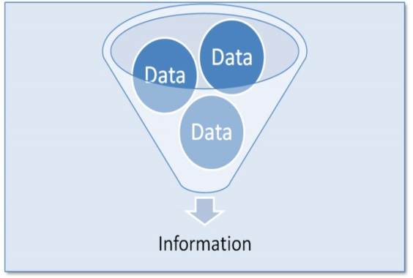
Database Concepts
Data is a meaningless static value. e.g. Ali, 3421. What does 3421 means?
Information is the data you process in a manner that makes it meaningful. Information can be provided only if proper data exists. e.g. “Ali ID number is 0987”.
A database (DB) is a shared collection of logically related data (and a description of this data), designed to meet the information needs of an organization.
Data is what you store in database.
Information is what you retrieve from a database.
Pearson Education © 2009

Slide 5
File-Based Systems
Collection of application programs that perform services for the end users (e.g. reports)where each program defines and manages its own data.
Data
Entry & Reports
File
handling
User 1 (Sales)
File Def
Sales Application Program
Sales File
Data
Entry & Reports
File
handling
User 2 (HR)
File Def
HR Application Program
HR File
Pearson Education © 2009

Slide 6
Limitations of File-Based Approach
Separation and isolation of data
Each program maintains its own set of data.
Users of one program may be unaware of potentially useful data held by other programs.
Duplication of data
Same data is held by different programs.
Wasted space and potentially different values and/or different formats for the same item.
Both property and client details are duplicated
Pearson Education © 2009

Slide 7
Limitations of File-Based Approach
Data dependence
File structure is defined in the application code.
Incompatible file formats
Programs are written in different languages, and so cannot easily access each other’s files.
Fixed Queries/Proliferation of application programs
Programs are written to satisfy particular functions.
Any new requirement needs a new program.
Pearson Education © 2009

Slide 8
Database Approach
These limitations of the FBS approach attributed to two factors :
Definition of data was embedded in application programs, rather than being stored separately and independently.
No control over access and manipulation of data beyond that imposed by application programs.
Result:
the database and Database Management System (DBMS).
Pearson Education © 2009

Slide 9
Database Concepts
A database application is a collection of data and the programs that allow the manipulation of these data to meet the information needs of an enterprise.
Database Management System (DBMS): A software system that enables users to define, create, maintain, and control access to the database, i.e. implementing database application.
application program ( of a Database) :a computer program that interacts with database by issuing an appropriate request (SQL statement) to the DBMS.

Slide 10
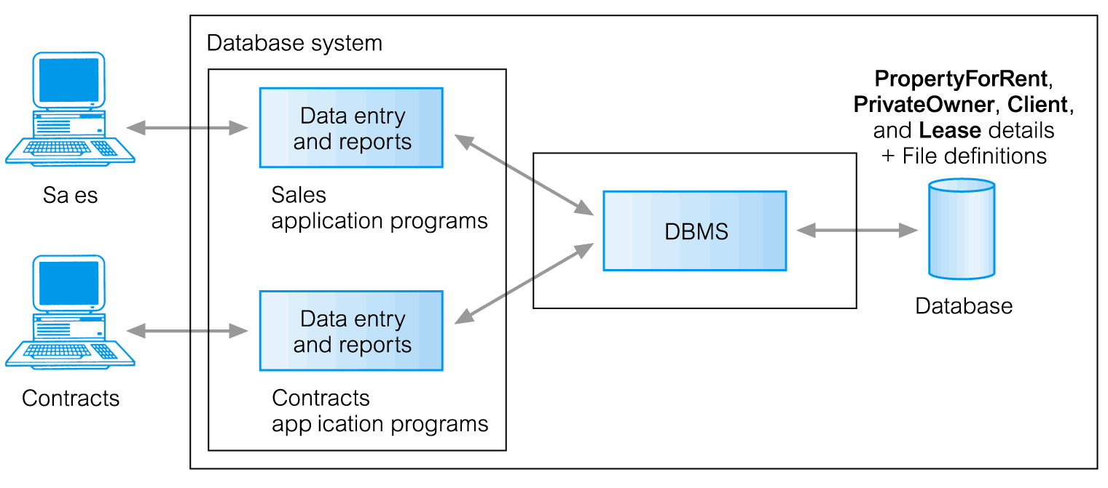
Database Systems (DBS)
Database System (DBS): is a single large repository of data, defined once and managed using DBMS while used by many application programs (DBMS + Application Program).
DBS
Data
Entry & Reports
User 1 (Sales)
Sales Application Program
DBMS
Data
Entry & Reports
Database
User 2 (HR)
HR Application Program
Pearson Education © 2009

Slide 11
Database Management System (DBMS)
A software system that enables users to define, create, maintain, and control access to the database.
DBMS facilitates the following:
Create and Define a DB through Data Definition Language (DDL).
Construct and Load a DB contents.
Manipulate a DB -query & update the DB- through Data Manipulation Language (DML).
Control access to data (security, integrity, concurrency, recovery)
Both DDL and DML are usually not considered distinct languages. Rather, they are included in a comprehensive integrated language.
For example, SQL relational database language is a comprehensive DB language which represents a combination of DDL and DML.
Pearson Education © 2009

Slide 12
DBS Environment
Users/Programmers
DBS
Application Programs
DBMS
Query Process
Data Access
Database
Meta-Data
Data
Pearson Education © 2009

Slide 13
Database Languages
Data Definition Language (DDL)
Allows the DBA or user to describe and name entities, attributes, and relationships required for the application together with any associated integrity and security constraints.
DDL is a descriptive language for defining and constructing the database.
Allows users to specify the data types and structures and the constraints on the data to be stored in the DB.
DDL compiler generates the meta-data that is stored in the data dictionary.

Slide 14
Database Languages
Data Manipulation Language (DML)
Provides basic data manipulation operations on data held in the database.
DML is a language for retrieving and updating (insert, delete, & modify) the data in the DB.
Types of DML:
Procedural Language (3GL): user specifies what data is required and how to get those data(allows user to tell system exactly how to manipulate data.) Ex:Java
Nonprocedural Language(4GL): user specifies what data is required without specifying how to get those data(allows user to state what data is needed rather than how it is to be retrieved.) Ex:SQL

Slide 15
Functions of a DBMS
Data Storage, Retrieval, and Update.
A User-Accessible Catalog.
Transaction Support.
Concurrency Control Services.
Recovery Services.
Authorization Services.
Support for Data Communication.
Integrity Services.
Services to Promote Data Independence.
Utility Services.

Slide 16
Advantages of DBMSs
Control of data redundancy
Data consistency
More information from the same amount of data
Sharing of data
Improved data integrity
Improved security
Enforcement of standards (ex: data format)
Balance conflicting requirements (DBA)
Improved data accessibility and responsiveness
Increased productivity (DBMS tools)
Improved maintenance through data independence
Increased concurrency
Improved backup and recovery services
Pearson Education © 2009

Slide 17
Disadvantages of DBMSs
Complexity
Size (disk, memory)
Cost of DBMS
Additional hardware costs
Cost of conversion existing application
Higher impact of a failure (central DB )
Pearson Education © 2009

Slide 18
Schemas versus Instances
Database Schema: The description of the database(structure, data types, and the constraints on the database).
It rarely changes.
Database Instance (snapshot): The actual data stored in a database at a particular moment in time.
Changes rapidly.
The concepts of Schema & Instances corresponds to Types & Values in programming languages, respectively.

Slide 19
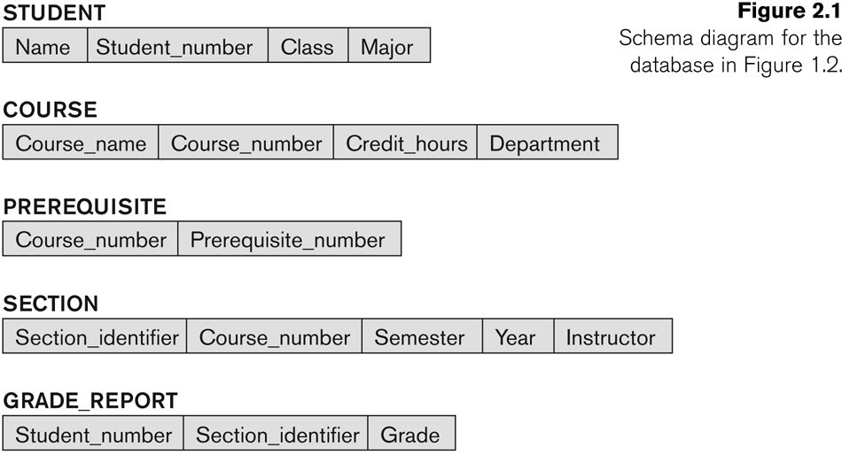
Example
Schema
Instance

Slide 20
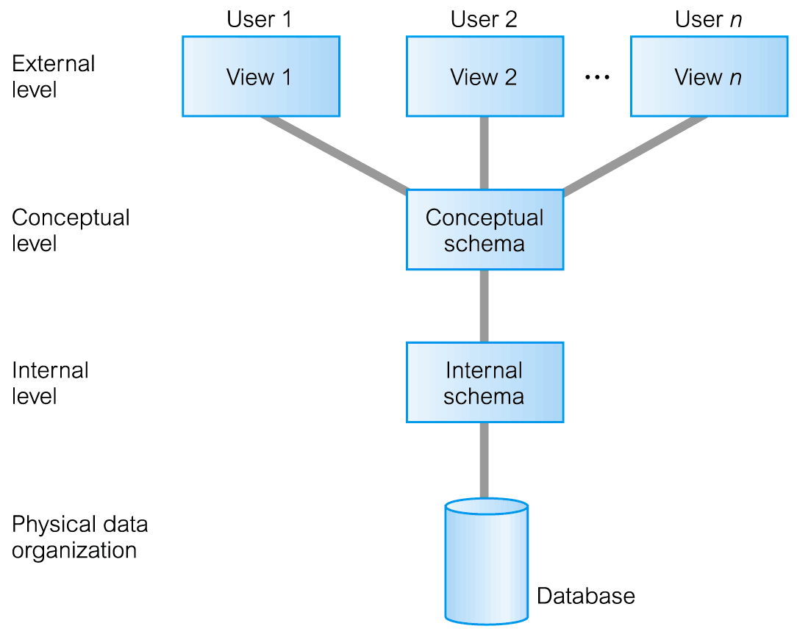
Three-Level Architecture
ANSI-SPARC
External Level
Users’ view of the database.
Describes that part of database that is relevant to a particular user.
The way perceived by end users.

Slide 21
ANSI-SPARC Three-Level Architecture
Conceptual Level
Community view of the database.
Describes what data is stored in database and relationships among the data.
The way perceived by the DBA & programmers.
Internal Level
Physical representation of the database on the computer.
Describes how the data is stored in the database.
The way perceived by the DBMS & OS.

Slide 22
Differences between Three Levels

Slide 23
Objectives of Three-Level Architecture
All users should be able to access same data.
A change in a user’s view should not affect other users’ views.
Users should not need to know physical database storage details.
DBA should be able to change database storage structures without affecting the users’ views.
Internal structure of database should be unaffected by changes to physical aspects of storage.
DBA should be able to change conceptual structure of database without affecting all users.

Slide 24
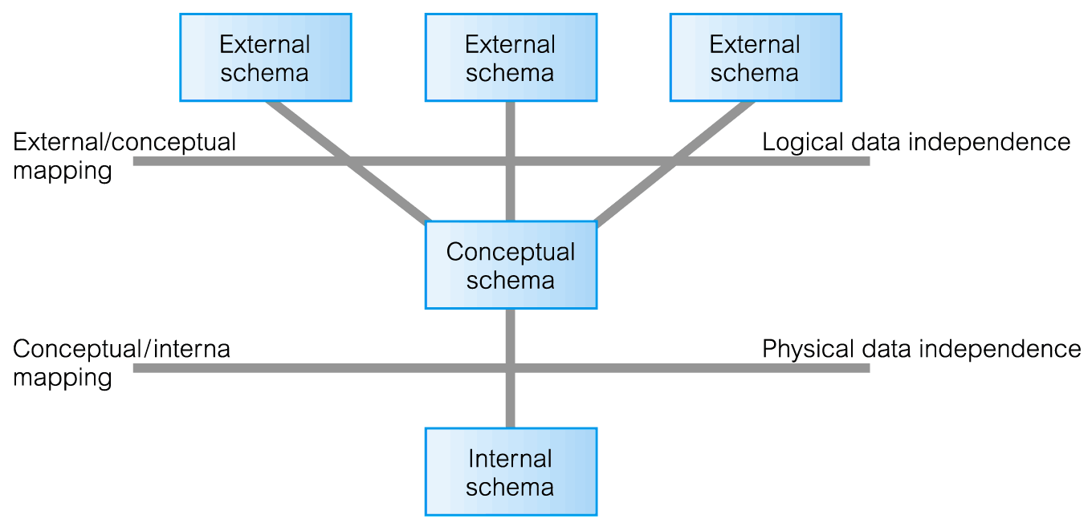
and the ANSI-SPARC Three-Level Architecture
Logical Data Independence
Refers to immunity of external schemas to changes in conceptual schema.
Conceptual schema changes (e.g. addition/removal of entities).
Should not require changes to external schema or rewrites of application programs.
Physical Data Independence
Refers to immunity of conceptual schema to changes in the internal schema.
Internal schema changes (e.g. using different file organizations, storage structures/devices).
Should not require change to conceptual or external schemas.

Slide 25
Components of DBMS Environment
Hardware
Can range from a PC to a network of computers.
Software
DBMS, operating system, network software (if necessary) and also the application programs.
Pearson Education © 2009

Slide 26
Components of DBMS Environment
Data
Used by the organization and a description of this data
Procedures
Instructions and rules that should be applied to the design and use of the database and DBMS.
People
Pearson Education © 2009

Slide 27
Data Model
Integrated collection of concepts for describing data, relationships between data, and constraints on the data in an organization.
To represent data in an understandable way.
Data Model comprises:
a structural part;
a manipulative part;
possibly a set of integrity rules.

Slide 28
Data Models
Conceptual data models (Object-based):
Entity-Relationship
Semantic
Functional
Object-Oriented
Logical data models (Record_based):
Relational Data Model
Network Data Model
Hierarchical Data Model
Physical Data Models

Slide 29
Categories of Data Models
Hardware independent
Software independent
Conceptual
model
Hardware independent
Software dependent
Logical
model
Hardware dependent
Software dependent
Physical
model

Slide 30
Roles in the Database Environment
Communicate
Procedure
User
Requirement
Write
Write
DB Designer
System Analyst
Application
programmer
Design
DBA
Program
Manage
App
Program
DBMS
Use
Naïve End User
DB
Use
Sophisticated End User
H/W

Slide 31
Roles in the Database Environment
System Analyst: Determine the user requirements and develop the system specifications.
Database Designer: Identify the data and choose the appropriate structure to represent and store the data.
Application Programmer: Implement the application program based on the system specification.
Database administrator (DBA): Administrates the DB, DBMS and related software.
Pearson Education © 2009

Slide 32
Roles in the Database Environment
Database End-users: They use the data for queries, reports and some of them update the database content (data). End-users can be categorized into:
Naïve users: Invokes one of the permanent application programs that have been written previously.
Sophisticated users: form requests in a database query language.
Pearson Education © 2009

