Slide 1
Chapter 8
SQL: Data Definition
Pearson Education © 2009

Slide 2
Chapter 6 - Objectives
Data types supported by SQL standard and Identifiers.
Purpose of integrity enhancement feature of SQL.
How to define integrity constraints using SQL.
How to use the integrity enhancement feature in the CREATE and ALTER TABLE statements.

Slide 3
Identifiers
May contain A-Z, a-z, 0-9, _
No longer than 128 characters
Start with letter
Cannot contain spaces

Slide 4
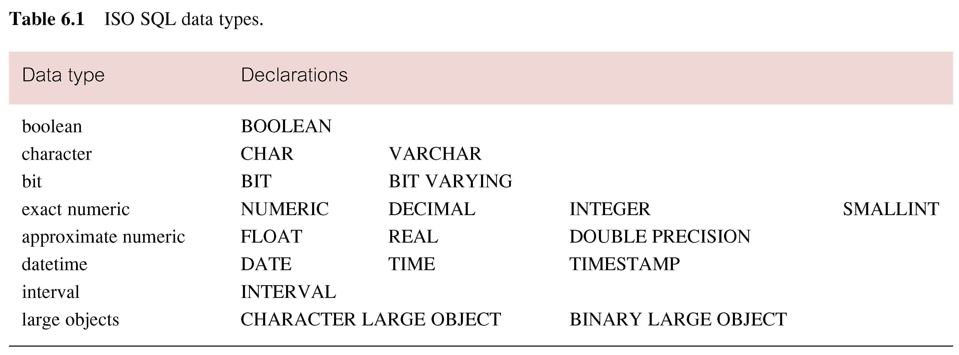
ISO SQL Data Types
Pearson Education © 2009

Slide 5
Integrity Enhancement Feature
Consider five types of integrity constraints defined in CREATE & ALTER:
Required data
Domain constraints
Entity integrity
Referential integrity
General constraints.

Slide 6
Integrity Enhancement Feature 1- Required Data
1- Required Data
Null is distinct from blank or zero.
Syntax:
columnName dataType [NOT NULL | NULL]
Example:
position VARCHAR(10) NOT NULL

Slide 7
Integrity Enhancement Feature 2-Domain Constraints
2- Domain Constraints
CHECK
Syntax:
CHECK (search condition)
Example:
sex CHAR NOT NULL
CHECK (sex IN (‘M’, ‘F’))
salary DECIMAL NOT NULL
CHECK (salary > 10000)
bno INT
CHECK (bno IN(SELECT branchno FROM branch))

Slide 8
PRIMARY KEY
Primary key of a table must contain a unique, non-null value for each row.
ISO standard supports PRIMARY KEY clause in CREATE and ALTER TABLE statements:
Syntax:
PRIMARY KEY(staffNo)
Example:
PRIMARY KEY(clientNo, propertyNo)
Can only have one PRIMARY KEY clause per table.
Can still ensure uniqueness for alternate keys using UNIQUE:
UNIQUE(telNo)
pno VARCHAR(5) NOT NULL UNIQUE;

Slide 9
FOREIGN KEY
FK is column or set of columns that links each row in child table containing foreign FK to row of parent table containing matching PK.
ISO standard supports definition of FKs with FOREIGN KEY clause in CREATE and ALTER TABLE:
- Syntax:
FOREIGN KEY (FK column (,…))
REFERENCES table_name [(CK column (,…))]
- Example:
FOREIGN KEY(bNo) REFERENCES Branch (branchNo)

Slide 10
Data Definition
SQL DDL allows database objects such as schemas, domains, tables, views, and indexes to be created and destroyed.
Main SQL DDL statements are:
CREATE SCHEMA DROP SCHEMA
CREATE DOMAIN DROP DOMAIN
CREATE/ALTER TABLE DROP TABLE
CREATE VIEW DROP VIEW
Many DBMSs also provide:
CREATE INDEX DROP INDEX

Slide 11
Data Definition
Relations and other database objects exist in an environment.
Each environment contains one or more catalogs, and each catalog consists of set of schemas.
Schema is named collection of related database objects.
Objects in a schema can be tables, views, domains, assertions, collations, translations, and character sets. All have same owner.

Slide 12
CREATE TABLE
- Syntax:
CREATE TABLE TableName
(colName dataType [NOT NULL] [UNIQUE]
[DEFAULT defaultOption]
[CHECK searchCondition]
[PRIMARY KEY (listOfColumns),]
[UNIQUE (listOfColumns),] […,]
[FOREIGN KEY (listOfFKColumns)
REFERENCES ParentTableName ] [(listOfCKColumns)],
);

Slide 13
CREATE TABLE
Creates a table with one or more columns of the specified dataType.
With NOT NULL, system rejects any attempt to insert a null in the column.
Can specify a DEFAULT value for the column.
Primary keys should always be specified as NOT NULL.
FOREIGN KEY clause specifies FK along with the referential action.

Slide 14
Example - CREATE TABLE
CREATE TABLE PropertyForRent (
propertyNo VARCHAR(5) NOT NULL, ….
rooms SMALLINT NOT NULL DEFAULT 4,
rent DECIMAL(6,2) NOT NULL, DEFAULT 600,
ownerNo VARCHAR(5) NOT NULL,
staffNo VARCHAR(5)
branchNo VARCHAR(5) NOT NULL,
PRIMARY KEY (propertyNo),
FOREIGN KEY (staffNo) REFERENCES Staff
);

Slide 15
ALTER TABLE
Add a new column to a table.
Drop a column from a table.
Set a default for a column.
Drop a default for a column.

Slide 16
ALTER TABLE
- Syntax
ALTER TABLE tablename
[ADD [COLUMN] ColumnName dataType [NOT NULL] [UNIQUE]
[DEFAULT defaultOption] [CHECK (search condition)] ]
[DROP[COLUMN] ColumnName [RESTRICT | CASCADE]]
[ALTER ColumnName SET DEFAULT DefaultOption]
[ALTER ColumnName DROP DEFAULT]

Slide 17
ALTER TABLE 1- Add a new column to a table 2- Drop a column from a table
Add new column to Client table.
ALTER TABLE Client
ADD SMALLINT PRooms;
Remove the city attribute from the client table.
ALTER TABLE Client
Drop City;

Slide 18
ALTER TABLE 3-Drop a default for a column 4-Set a default for a column
- Example :
Change Staff table by removing default of ‘Assistant’ for position column and setting default for sex column to female (‘F’).
ALTER TABLE Staff
ALTER position DROP DEFAULT;
ALTER TABLE Staff
ALTER sex SET DEFAULT ‘F’;

Slide 19
DROP TABLE
- Syntax:
DROP TABLE TableName [RESTRICT | CASCADE]
- Example:
DROP TABLE PropertyForRent;
Removes named table and all rows within it.
With RESTRICT, if any other objects depend for their existence on continued existence of this table, SQL does not allow request.
With CASCADE, SQL drops all dependent objects (and objects dependent on these objects).

