Slide 1
Chapter 7
Normalization
Chapter 14 & 15 in Textbook

Slide 2
Database Design
Steps in building a database for an application:
Real-world
domain
Conceptual
model
DBMS data
model
Create
Schema
(DDL)
Modify
data (DML)

Slide 3
How to produce a good relation schema?
1. Start with a set of relation.
2. Define the functional dependencies for the relation to specify the PK.
3. Transform relations to normal form.

Slide 4
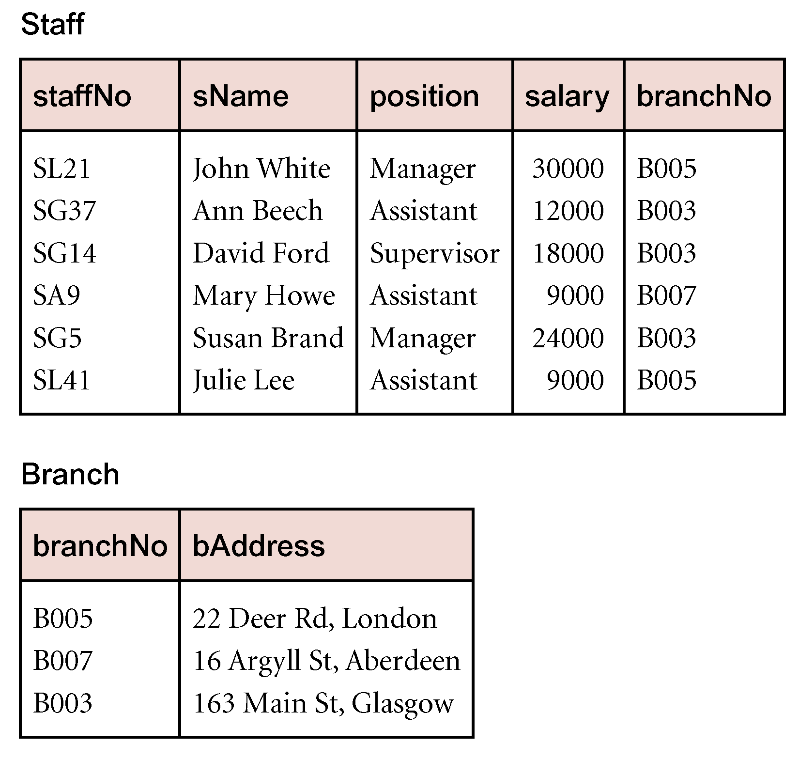
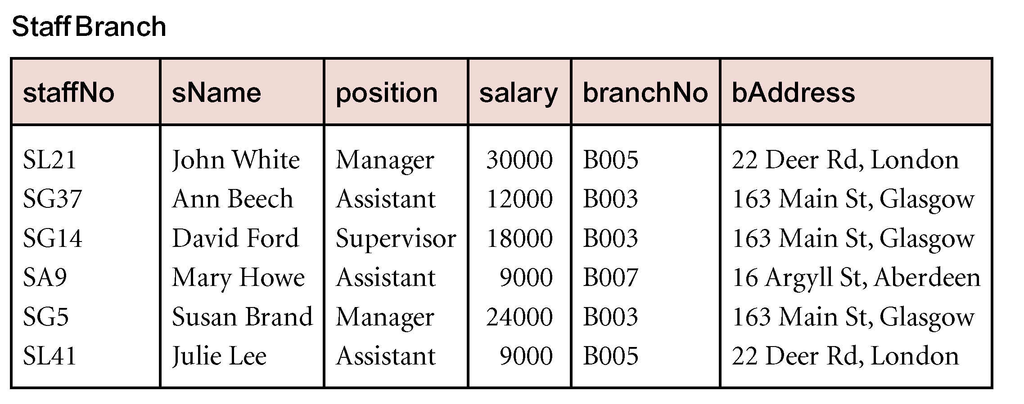
Data Redundancy and Update Anomalies
(branchNo) is repeated in the Staff relation, to represent where each member of staff is located
Redundant data
Pearson Education © 2009

Slide 5
Data Redundancy and Update Anomalies
Relations that contain redundant information may potentially suffer from update anomalies.
Types of update anomalies include
Insertion
Deletion
Modification
Pearson Education © 2009

Slide 6
Relation Decomposition
Normalization process involve decomposing a relation.
Decomposition require to be reversible.
Functional dependencies guarantee decomposition to be reversible.
While normalization, two important properties associated with decomposition:
Lossless-join property: enables us to find any instance of the original relation from corresponding instances in the smaller relations.
Dependency preservation property: enables us to enforce a constraint on the original relation by enforcing some constraint on each of the smaller relations.
Pearson Education © 2009

Slide 7
Functional Dependencies
Describes the relationship between attributes in a relation.
If A and B are attributes of relation R,
B is functionally dependent on A, denoted A → B, if each value of A is associated with exactly one value of B. B may have several values of A.
Determinant Dependent
An alternative way to describe the relation ship between attribute A an B is to say that “ A functionally determines B”
A
B is functionally
dependent on A
B
Pearson Education © 2009

Slide 8
An Example Functional Dependency
1:1 or M:1 relationship between attributes in a relation
1:M relationship between attributes in a relation
Pearson Education © 2009

Slide 9
Example Functional Dependency that holds for all Time
Consider the values shown in staffNo and sName attributes of the Staff relation.
Based on sample data, the following functional dependencies appear to hold.
staffNo → sName
sName → staffNo
However, the only functional dependency that remains true for all possible values for the staffNo and sName attributes of the Staff relation is:
staffNo → sName
Pearson Education © 2009

Slide 10
Characteristics of Functional Dependencies
Full functional dependency:
Full functional dependency indicates that if A and B are attributes of a relation, B is fully functionally dependent on A,
If B is functionally dependent on A, but not on any proper subset of A.
A → B is a full functional dependency if removal of any attribute from A results in the dependency no longer existing.
Pearson Education © 2009

Slide 11
Example Full Functional Dependency
In the Staff relation
staffNo, sName → branchNo
staffNo→ branchNo
True - each value of (staffNo, sName) is associated with a single value of branchNo.
However, branchNo is also functionally dependent on a subset of (staffNo, sName), namely staffNo. Example above is a partial dependency.
Partial dependency
Fully dependency
Pearson Education © 2009

Slide 12
Transitive Dependencies
Important to recognize a transitive dependency because its existence in a relation can potentially cause update anomalies.
Transitive dependency describes a condition where A, B, and C are attributes of a relation such that if
A → B
B → C
Then C is transitively dependent on A via B
A → C
Provided that A is not functionally dependent on B or C.
B → A, and C → A doesn't exist
Pearson Education © 2009

Slide 13
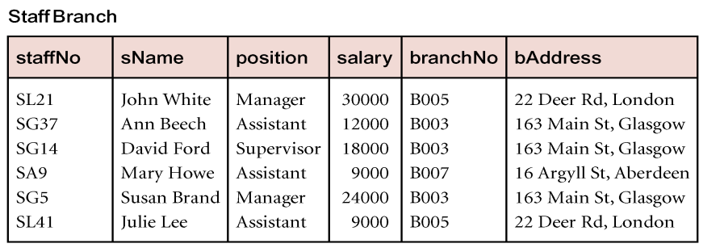
Example Transitive Dependency
Consider functional dependencies in the StaffBranch relation.
staffNo → sName, position, salary, branchNo, bAddress
branchNo → bAddress
Transitive dependency, staffNo → bAddress exists via branchNo (staffNo functionally determines the bAddress via branchNo ).
And, neither branchNo nor bAddress functionally determines staffNo.
branchNo → staffNo , and bAddress → staffNo doesn't exist
Pearson Education © 2009

Slide 14
Summary Characteristics of Functional Dependencies
Main characteristics of functional dependencies used in normalization:
There is a one-to-one relationship between the determinant and dependent.
Holds for all time.
There must be a full functional dependency between determinant and dependent.
Pearson Education © 2009

Slide 15
Identifying Functional Dependencies
There are two approach to Identifying all functional dependencies :
1. Identifying all functional dependencies between a set of attributes is quite simple if the meaning of each attribute and the relationships between the attributes are well understood.
This information should be provided by the enterprise (discussions with users and/or documentation)
The missing information Ex: documentation is incomplete
(database designer use their common sense and/or experience).
2. It may possible to identify functional dependencies if sample data is available that is true representation of all possible data.
Pearson Education © 2009

Slide 16
Example - Identifying a set of functional dependencies for the StaffBranch relation
Identifing the functional dependencies for the StaffBranch relation as:
staffNo → sName, position, salary, branchNo, bAddress
branchNo → bAddress
bAddress → branchNo
branchNo, position → salary
bAddress, position → salary
Hint : Assume that position held and branch determine a member of staff’s salary.
Pearson Education © 2009

Slide 17
Identifying the Primary Key for a Relation using Functional Dependencies
Main purpose of identifying a set of functional dependencies for a relation is to specify the set of integrity constraints that must hold on a relation.
An important integrity constraint to consider first is the identification of candidate keys, one of which is selected to be the primary key for the relation.
All attributes that are not part of a candidate key should be functionally dependent on the key.
Pearson Education © 2009

Slide 18
Example - Identify Primary Key for StaffBranch Relation
StaffBranch relation has five functional dependencies.
staffNo → sName, position, salary, branchNo, bAddress
branchNo → bAddress
bAddress → branchNo
branchNo, position → salary
bAddress, position → salary
The determinants are staffNo, branchNo, bAddress, (branchNo, position), and (bAddress, position).
To identify all candidate key(s), identify the attribute (or group of attributes) that uniquely identifies each tuple in this relation.
The only candidate key and therefore primary key for StaffBranch relation, is staffNo, as all other attributes of the relation are functionally dependent on staffNo.
Pearson Education © 2009

Slide 19
Closure
Closure (inferred from) X⁺: The set of all functional dependencies that are implied by a given set of functional dependencies X is called the closure of X, written X⁺ .
If t & u agree here
Then they must agree here
C ⊆ B
X A B
X⁺ A C
B
A
C
t
u
So surely they will agree here

Slide 20
Inference Rules for Functional Dependencies
Armstrong’s axioms (inference rules): The set of inference rules specifies how functional dependencies can be inferred from given one.
Inference rules:
Reflexivity If B ⊆ A, then A B
Augmentation If A B, then A,C B,C
Transitivity If A B and B C, then A C
Self-Determination A A
Decomposition If A B,C, then A B and A C
Union If A B and A C, then A B,C

Slide 21
Minimal Sets of Functional Dependencies
Complete set of functional dependencies for a relation can be very large.
We need to reduce the set to a manageable size, by applying the inference rules repeatedly until they stop producing new FDs.
Assume S1 & S2 are set of dependencies:
S1 ⊆ S2, then (S2 is a cover for S1) OR (S1 is covered by S2)
if S2 is a cover for S1
& S1 is a cover for S2
S1 equivalent to S2

Slide 22
Minimal Sets of Functional Dependencies
A set of functional dependencies X is minimal if it satisfies the following:
Every dependency in X has a single attribute for its right-hand side.
Can’t replace any dependency A B in X with C B , where C ⊆ A, & still have a set of dependencies equivalent to X.
Can’t remove any dependency from X and still have a set of dependencies that is equivalent to X.

Slide 23
Minimal Sets of Functional Dependencies
1. For each X {A1, A2, .. An}, create X A1, X A2, …., X An.
2. A, B C is equivalent to B C, then replace A, B C with B C.
3. X - {A B} equivalent to X, then remove A B.

Slide 24
Exercise
Q5: Given the relation R ( W, X, Y,Z) and the following functional dependencies:
FD1: X →W
FD2: W, Z → X, Y
FD3: Y → W, X
FD4: X, Z → W
Compute the minimal set of functional dependencies.

Slide 25
Exercise ( cont.)
FD1: X →W
FD2: W, Z → X, Y
FD3: Y → W, X
FD4: X, Z → W
Step1 (single attribute on RH side):
FD1: X →W
FD2.1: W, Z → X
FD2.2: W, Z → Y
FD3.1: Y → W
FD3.2 :Y→ X
FD4: X, Z → W

Slide 26
Exercise ( cont.)
FD1: X →W
FD2.1: W, Z → X
FD2.2: W, Z → Y
FD3.1: Y → W
FD3.2 :Y→ X
FD4: X, Z → W
Step2 (determine if fd2.1 , fd 2.2 or fd4 fd can be simplified):
Replace FD4: X, Z → W with FD1: X →W
FD1: X →W
FD2.1: W, Z → X
FD2.2: W, Z → Y
FD3.1: Y → W
FD3.2 :Y→ X
FD4: X, Z → W

Slide 27
Exercise ( cont.)
FD1: X →W
FD2.1: W, Z → X
FD2.2: W, Z → Y
FD3.1: Y → W
FD3.2 :Y→ X
Step3 determine if there is redundancy:
FD1: X →W
FD2.1: W, Z → X ( beacuse of FD2.2 W,Z→Y FD3.2 Y→X )
FD2.2: W, Z → Y
FD3.1: Y → W ( beacuse of FD3.2 Y→X FD1 X→W )
FD3.2 :Y→ X
Minimal set is :
FD1: X →W
FD2.2: W, Z → Y
FD3.2 :Y→ X

Slide 28
The Process of Normalization
Normalization is a technique for analyzing relations based on their CK & Functional dependencies.
1NF
2NF
3NF
BCNF
Stronger in format
Less vulnerable to update anomalies
4NF
5NF
Higher Normal
Form

Slide 29
The Purpose of Normalization
Normalization is a bottom-up approach to database design that begins by examining the relationships between attributes. It is performed as a series of tests on a relation to determine whether it satisfies or violates the requirements of a given normal form.
Purpose:
Guarantees no redundancy due to FDs
Guarantees no update anomalies
Normal Forms:
First Normal Form (1NF)
Second Normal Form (2NF)
Third Normal Form (3NF)
Boyce-Codd Normal Form (BCNF)
Fourth Normal Form (4NF)
Fifth Normal Form (5NF)

Slide 30
First Normal Form (1NF)
Unnormalized form (UNF): A relation that contains one or more repeating groups.
First normal form (1NF): A relation in which the intersection of each row and column contains one & only one value.
Unnormalized relation
CLIENT_PROPERTY
ClientNo
Name
PropertyNo
CR76
John Key
PG4
PG16
CR56
Aline Stewart
PG4
PG36
PG16

Slide 31
UNF 1NF Approach 1
Expand the key so that there will be a separate tuple in the original relation for each repeated attribute(s). Primary key becomes the combination of primary key and redundant value.
1NF relation
Disadvantage: introduce redundancy in the relation.
CLIENT_PROPERTY
ClientNo
Name
PropertyNo
CR76
John Key
PG4
CR76
John Key
PG16
CR56
Aline Stewart
PG4
CR56
Aline Stewart
PG36
CR56
Aline Stewart
PG16

Slide 32
UNF 1NF Approach 2
If the maximum number of values is known for the attribute, replace repeated attribute (PropertyNo) with a number of atomic attributes (PropertyNo1, PropertyNo2, PropertyNo3).
1NF relation
Disadvantage: introduce NULL values in the relation.
CLIENT_PROPERTY
ClientNo
Name
PropertyNo1
PropertyNo2
PropertyNo3
CR76
John Key
PG4
PG16
NULL
CR56
Aline Stewart
PG4
PG36
PG16

Slide 33
UNF 1NF Approach 3
Remove the attribute that violates the 1NF and place it in a separate relation along with a copy of the primary key.
CLIENT
PROPERTY
ClientNo
Name
ClientNo
PropertyNo
CR76
John Key
CR76
PG4
CR76
PG16
CR56
Aline Stewart
CR56
PG4
1NF relation
CR56
PG36
CR56
PG16
1NF relation

Slide 34
Full Functional Dependency
If A and B are attributes of a relation.
B is fully functionally dependent on A if B is functionally dependent on A, but not on any proper subset of A.
B is partial functional dependent on A if some attributes can be removed from A & the dependency still holds.
StaffNo, Sname BranchNo Partial dependency
ClientNo, PropertyNo RentDate Full dependency

Slide 35
Second Normal Form (2NF)
Second normal form (2NF): A 1NF relation in which every attribute is fully nontrivial functionally dependent on the PK. (non-prime attributes fully dependent on PK.)
Applies to relations with composite primary keys & partial dependencies.
1NF relation
CLIENT_RENTAL
ClientNo
PropertyNo
cName
pAddress
RentStart
RentFinish
Rent
OwnerNo
OName

Slide 36
1NF 2NF
1. Start with 1NF relation.
2. Find the FDs of a relation.
3. Test the FDs whose determinant attribute is part of the PK.

Slide 37
1NF 2NF
CLIENT_RENTAL
ClientNo
PropertyNo
cName
pAddress
RentStart
RentFinish
Rent
OwnerNo
OName
(ClientNo, PropertyNo) PK
ClientNo, PropertyNo RentStart, RentFinish Full Dependency
ClientNo CName Partial Dependency
PropertyNo Paddress, Rent, OwnerNo, Oname Partial Dependency
OwnerNo OName

Slide 38
1NF 2NF
4. Remove partial dependencies by placing the functionally dependent attributes in a new relation along with a copy of their determinants.
2NF relation 2NF relation
2NF relation
CLIENT
RENTAL
ClientNo
cName
ClientNo
PropertyNo
RentStart
RentFinish
PROPERTY_OWNER
PropertyNo
pAddress
Rent
OwnerNo
OName

Slide 39
Transitive Dependency
A, B, C are attributes of a relation, such that:
If A B and B C, then C is transitively dependent on A via B.
Provided A is NOT functionally dependent on B or C (nontrivial FD).
Example:
StaffNo BranchNo , BranchNo Address
StaffNo Address

Slide 40
Third Normal Form (3NF)
Third normal form (3NF): A 2NF relation in which NO non-prime attribute is transitively dependent on the PK.
3NF relation 3NF relation
2NF relation
CLIENT
RENTAL
ClientNo
cName
ClientNo
PropertyNo
RentStart
RentFinish
PROPERTY_OWNER
PropertyNo
pAddress
Rent
OwnerNo
OName

Slide 41
2NF 3NF
1. Identify the PK in the 2NF relation.
2. Identify FDs in this relation.
3. If transitive dependencies exist, place transitively dependent attributes in a new relation along with a copy of their determinants.
3NF relation 3NF relation
OWNER
PROPERTY_FOR_RENT
OwnerNo
OName
PropertyNo
pAddress
rent
OwnerNo

Slide 42
Review of Decompositions
1NF
CLIENT_RENTAL
2NF
CLIENT
RENTAL
PROPERTY_OWNER
3NF
CLIENT
RENTAL
OWNER
PROPERTY_FOR_RENT

Slide 43
General Definition of 2NF & 3NF
Second normal form (2NF): A 1NF relation in which every non-primary-key attribute is fully functionally dependent on the CK.
Third normal form (3NF): A 2NF relation in which NO non-primary-key attribute in a nontrivial FD is transitively dependent on the CK.

Slide 44
Review Example
STAFF_PROPERTY_INSPECTION
Pno
pAddress
iDate
iTime
comments
StaffNo
sName
CarReg
PG4
PG16
Lawrence St,
Glasgow
5 Novar Dr.,
Glasgow
18-Oct-00
22-Apr-01
1-Oct-01
22-Apr-01
24-Oct-01
10:00
09:00
12:00
13:00
14:00
Replace crockery
Good order
Damp rot
Replace carpet
Good condition
SG37
SG14
SG14
SG14
SG37
Ann
David
David
David
Ann
M23JGR
M53HDR
N72HFR
M53HDR
N72HFR
Unnormalized relation

Slide 45
UNF 1NF
STAFF_PROPERTY_INSPECTION
Pno
pAddress
iDate
iTime
comments
StaffNo
sName
CarReg
PG4
PG4
PG4
PG16
PG16
Lawrence St, Glasgow
Lawrence St,Glasgow
Lawrence St,Glasgow
5 Novar Dr., Glasgow
5 Novar Dr., Glasgow
18-Oct-00
22-Apr-01
1-Oct-01
22-Apr-01
24-Oct-01
10:00
09:00
12:00
13:00
14:00
Replace crockery
Good order
Damp rot
Replace carpet
Good condition
SG37
SG14
SG14
SG14
SG37
Ann
David
David
David
Ann
M23JGR
M53HDR
N72HFR
M53HDR
N72HFR
1NF

Slide 46
1NF 2NF
STAFF_PROPERTY_INSPECTION
Pno
iDate
pAddress
iTime
comments
StaffNo
sName
CarReg
Pno, iDate iTime, comments, StaffNo, sName, carReg
Pno pAddress Partial Dependency
StaffNo Sname

Slide 47
1NF 2NF
PROPERTY
Pno
pAddress
Pno pAddress
2NF
PROPERTY_INSPECTION
Pno
iDate
iTime
comments
StaffNo
sName
CarReg
2NF
Pno, iDate iTime, comments, StaffNo, Sname, CarReg
StaffNo Sname Transitive Dependency

Slide 48
2NF 3NF
PROPERTY
Pno
pAddress
3NF
STAFF
StaffNo
sName
3NF
PROPERTY_INSPECTION
Pno
iDate
iTime
comments
StaffNo
CarReg
3NF
PROPERTY(Pno, pAddres)
STAFF(StaffNo, sName)
PROPERTY_INSPECT(Pno, iDate, iTime, comments, staffNo, CarReg)

