Slide 1
Chapter 4
The Relational Model
Pearson Education © 2009

Slide 2
Chapter 4 - Objectives
Terminology of relational model.
How tables are used to represent data.
Connection between mathematical relations and relations in the relational model.
Properties of database relations.
How to identify CK, PK, and FKs.
Meaning of entity integrity and referential integrity.
Purpose and advantages of views.
Pearson Education © 2009

Slide 3
Relational Model Terminology
A relation is a table with columns and rows.
  Only applies to logical structure of the database, not the physical structure.
Attribute is a named column of a relation.
Domain is the set of allowable values for one or more attributes.
Pearson Education © 2009

Slide 4
Relational Model Terminology
Tuple is a row of a relation.
Degree is the number of attributes in a relation.
Cardinality is the number of tuples in a relation.
Relational Database is a collection of normalized relations with distinct relation names.
Pearson Education © 2009

Slide 5
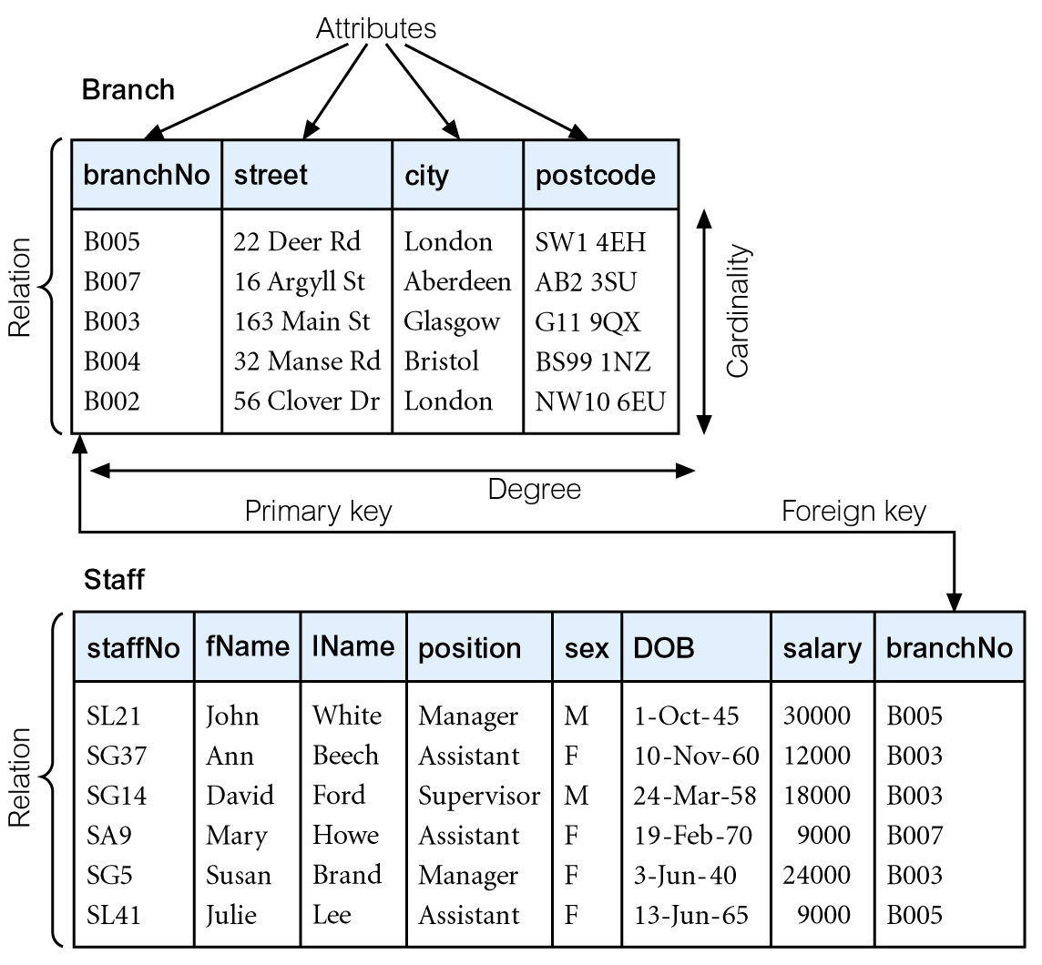
Instances of Branch and Staff Relations
Pearson Education © 2009

Slide 6
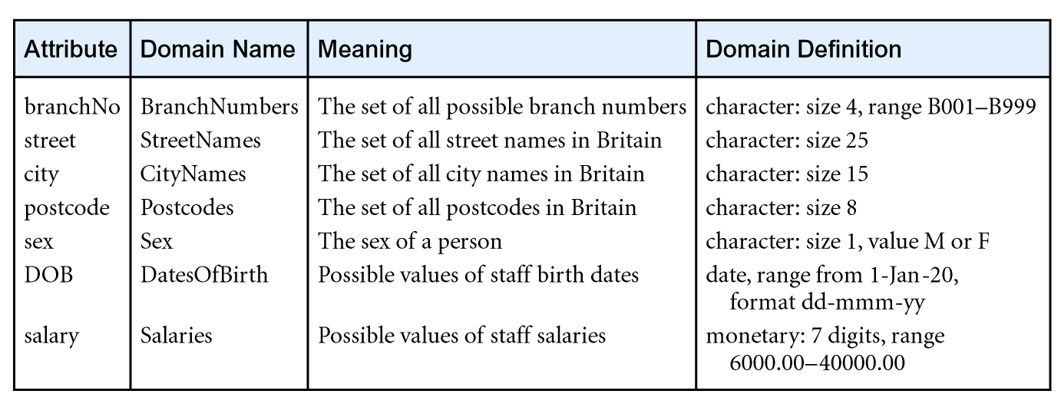
Examples of Attribute Domains
Pearson Education © 2009

Slide 7
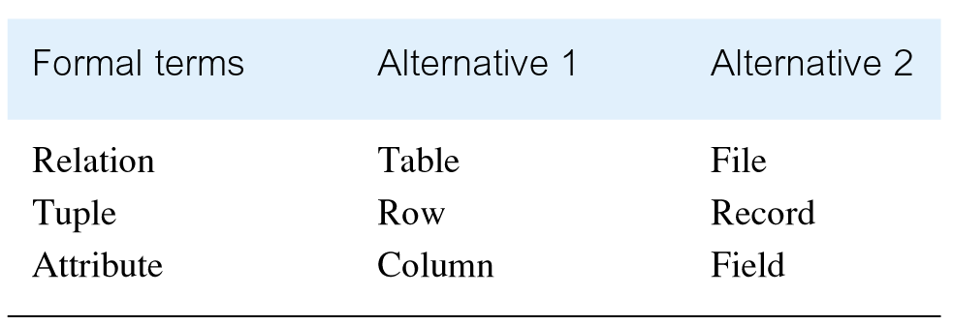
Alternative Terminology for Relational Model
Pearson Education © 2009

Slide 8
Database Relations
Relation schema
  Named relation defined by a set of attribute and domain name pairs.
  R1(A1,A2,A3,....,An)
Relational database schema
  Set of relation schemas, each with a distinct name.
  R{R1,R2,R3, ... , Rn)
Pearson Education © 2009

Slide 9
Properties of Relations
Relation name is distinct from all other relation names in relational schema.
Each cell of relation contains exactly one atomic (single) value.
Each attribute has a distinct name.
Values of an attribute are all from the same domain.
Pearson Education © 2009

Slide 10
Properties of Relations
Each tuple is distinct; there are no duplicate tuples.
Order of attributes has no significance.
Order of tuples has no significance, theoretically.
Pearson Education © 2009

Slide 11
Relational Keys
Candidate Key
  An attribute, or set of attributes, that uniquely identifies a tuple within a relation.
  In each tuple of R, values of K uniquely identify that tuple (uniqueness).
  No proper subset of K has the uniqueness property (irreducibility).
Pearson Education © 2009

Slide 12
Relational Keys
Primary Key
  Candidate key selected to identify tuples uniquely within relation.
Alternate Keys
  Candidate keys that are not selected to be primary key.
Foreign Key
  Attribute, or set of attributes, within one relation that matches candidate key of some (possibly same) relation.
Pearson Education © 2009

Slide 13
Integrity Constraints
Null
  Represents value for an attribute that is currently unknown or not applicable for tuple.
  Deals with incomplete or exceptional data.
  Represents the absence of a value and is not the same as zero or spaces, which are values.
Pearson Education © 2009

Slide 14
Integrity Constraints
Entity Integrity
  In a base relation, no attribute of a primary key can be null.
Referential Integrity
  If foreign key exists in a relation, either foreign key value must match a candidate key value of some tuple in its home relation or foreign key value must be wholly null.
Pearson Education © 2009

Slide 15
Integrity Constraints
General Constraints
  Additional rules specified by users or database administrators that define or constrain some aspect of the enterprise.
Pearson Education © 2009

Slide 16
Views
Base Relation
  Named relation corresponding to an entity in conceptual schema, whose tuples are physically stored in database.
View
  Dynamic result of one or more relational operations operating on base relations to produce another relation.
Pearson Education © 2009

Slide 17
Views
A virtual relation that does not necessarily actually exist in the database but is produced upon request, at time of request.
Contents of a view are defined as a query on one or more base relations.
Views are dynamic, meaning that changes made to base relations that affect view attributes are immediately reflected in the view.
Pearson Education © 2009

Slide 18
Purpose of Views
Provides powerful and flexible security mechanism by hiding parts of database from certain users.
Permits users to access data in a customized way, so that same data can be seen by different users in different ways, at same time.
Can simplify complex operations on base relations.
Pearson Education © 2009

Slide 19
Updating Views
All updates to a base relation should be immediately reflected in all views that reference that base relation.
If view is updated, underlying base relation should reflect change.
Pearson Education © 2009

Slide 20
Updating Views
There are restrictions on types of modifications that can be made through views:
  Updates are allowed if query involves a single base relation and contains a candidate key of base relation.
  Updates are not allowed involving multiple base relations.
  Updates are not allowed involving aggregation or grouping operations.
Pearson Education © 2009

