Slide 1
Extra notations
Entity-Relationship Modeling
"Extended"

Slide 2
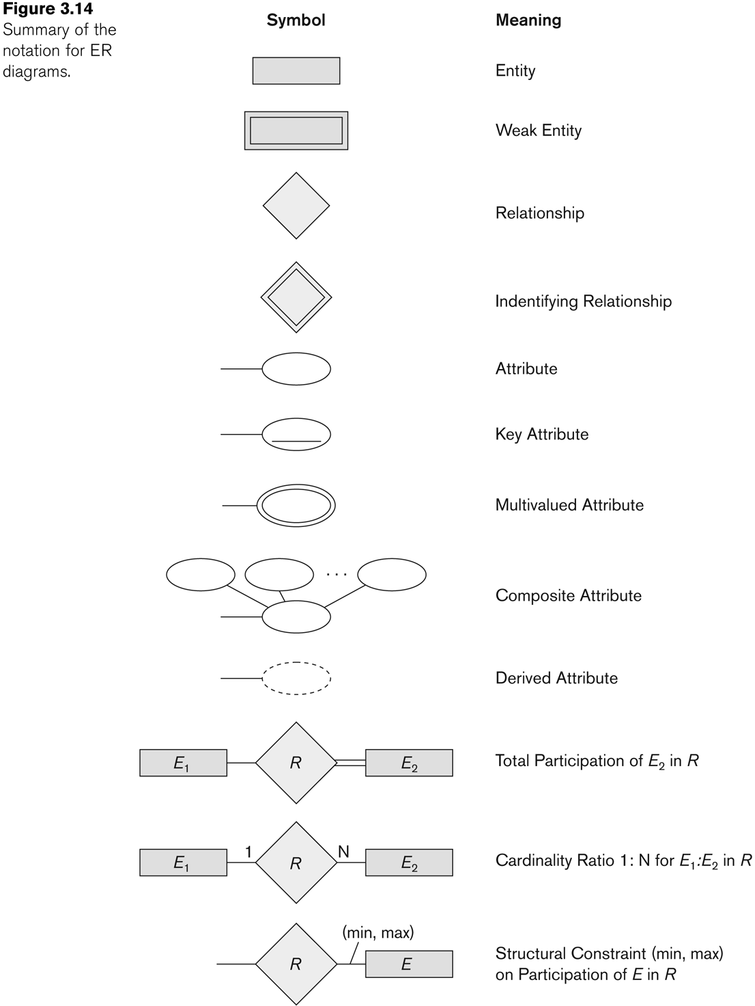
Summary of notation for ER diagrams

Slide 3
Example COMPANY Database
We need to create a database schema design based on the following (simplified) requirements of the COMPANY Database:
  The company is organized into DEPARTMENTs. Each department has a name, number and an employee who manages the department. We keep track of the start date of the department manager. A department may have several locations.
  Each department controls a number of PROJECTs. Each project has a unique name, unique number and is located at a single location.

Slide 4
Example COMPANY Database (Contd.)
  We store each EMPLOYEE’s social security number, address, salary, sex, and birthdate.
    Each employee works for one department but may work on several projects.
    We keep track of the number of hours per week that an employee currently works on each project.
    We also keep track of the direct supervisor of each employee.
  Each employee may have a number of DEPENDENTs.
    For each dependent, we keep track of their name, sex, birthdate, and relationship to the employee.

Slide 5
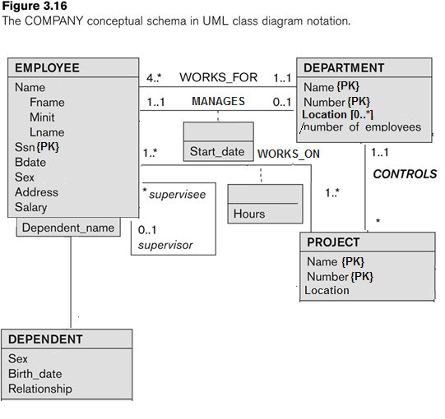
COMPANY ER Schema Diagram UML notation
Employee
Department
Manager
Department
1 ..1
0..*

Slide 6
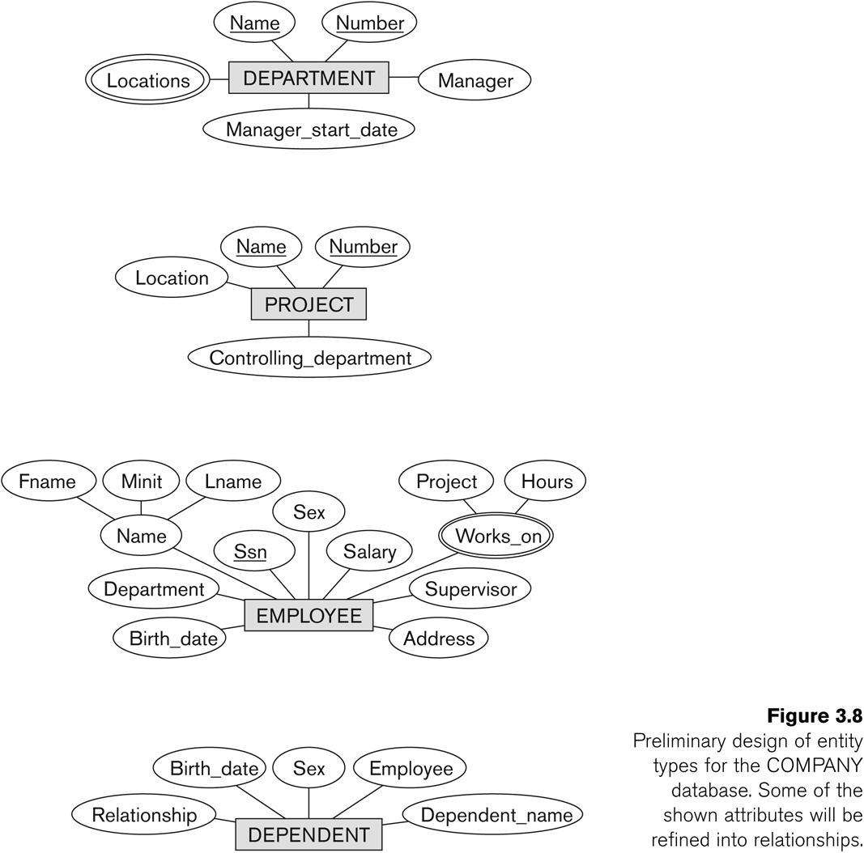
Initial Design of Entity Types:
EMPLOYEE, DEPARTMENT, PROJECT, DEPENDENT

Slide 7
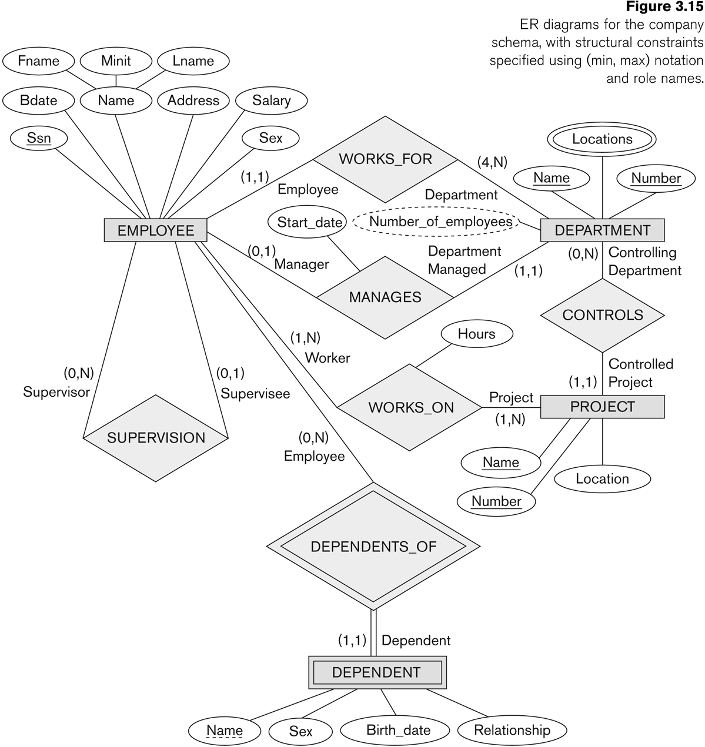
COMPANY ER Schema Diagram using (min, max) notation

Slide 8
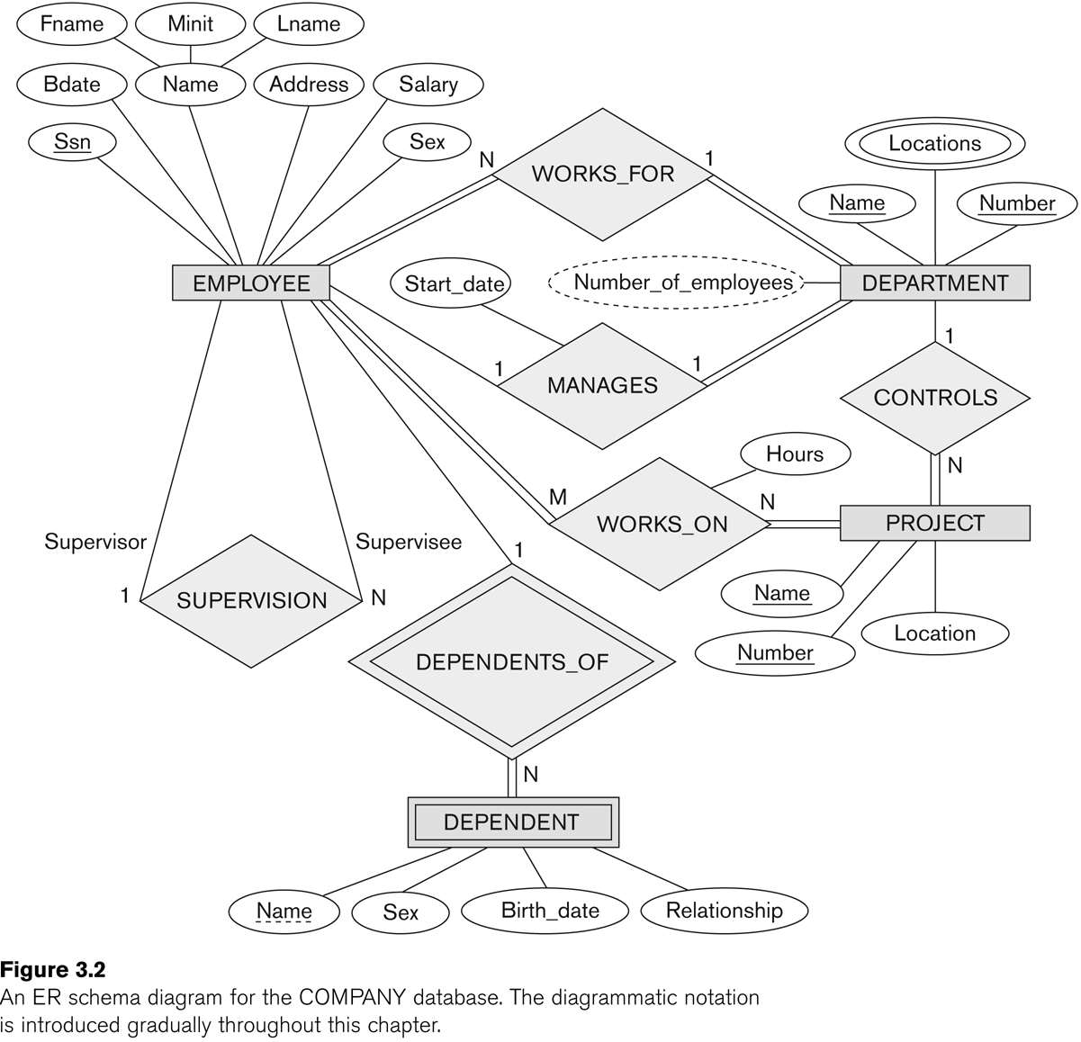
Chen Notation

Slide 9
Summary of notation for ER diagrams

Slide 10
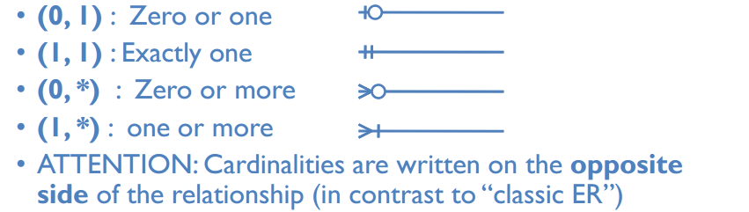
Crow's Foot Notation
Crow’s Foot

