Slide 1
Chapter 1
Introduction to Databases
Pearson Education © 2009

Slide 2
Chapter 1 - Objectives
Some common uses of database systems.
Database Concepts.
Characteristics of file-based systems.
Problems with file-based approach.
Meaning of the term database.
Meaning of the term Database Management System (DBMS).
Typical functions of a DBMS.
Major components of the DBMS environment.
Personnel involved in the DBMS environment.
Advantages and disadvantages of DBMSs.
Pearson Education © 2009

Slide 3
Examples of Database Applications
Purchases from the supermarket
Purchases using your credit card
Booking a holiday at the travel agents
Local Examples :
Edugate and ERegister.
KSU Library.
Saudi Airlines Reservations.
Pearson Education © 2009

Slide 4
Database Concepts
Data is a meaningless static value. e.g. Ali, 3421. What does 3421 means?
Information is the data you process in a manner that makes it meaningful. Information can be provided only if proper data exists. e.g. “Ali ID number is 0987”.
A database (DB) is a shared collection of logically related data (and a description of this data), designed to meet the information needs of an organization.
Data is what you store in database.
Information is what you retrieve from a database.
Pearson Education © 2009

Slide 5
Database Concepts
A database application is a collection of data and the programs that allow the manipulation of these data to meet the information needs of an enterprise.
Database Management System (DBMS): A software system that enables users to define, create, maintain, and control access to the database, i.e. implementing database application.
application program ( of a Database) :a computer program that interacts with database by issuing an appropriate request (SQL statement) to the DBMS.
Database System (DBS): is a single large repository of data, defined once and managed using DBMS while used by many application programs (DBMS + Application Program).

Slide 6
DBS Environment
Users/Programmers
DBS
Application Programs
DBMS
Query Process
Data Access
Database
Meta-Data
Data
Pearson Education © 2009

Slide 7
File-Based Systems
Collection of application programs that perform services for the end users (e.g. reports)where each program defines and manages its own data.
Data
Entry & Reports
File
handling
User 1 (Sales)
File Def
Sales Application Program
Sales File
Data
Entry & Reports
File
handling
User 2 (HR)
File Def
HR Application Program
HR File
Pearson Education © 2009

Slide 8
Limitations of File-Based Approach
Separation and isolation of data
Each program maintains its own set of data.
Users of one program may be unaware of potentially useful data held by other programs.
Duplication of data
Same data is held by different programs.
Wasted space and potentially different values and/or different formats for the same item.
Pearson Education © 2009

Slide 9
Limitations of File-Based Approach
Both property and client details are duplicated
Pearson Education © 2009

Slide 10
Limitations of File-Based Approach
Data dependence
File structure is defined in the application code.
Incompatible file formats
Programs are written in different languages, and so cannot easily access each other’s files.
Fixed Queries/Proliferation of application programs
Programs are written to satisfy particular functions.
Any new requirement needs a new program.
Pearson Education © 2009

Slide 11
Database Approach
Because (These limitations of the FBS approach attributed to two factors( :
Definition of data was embedded in application programs, rather than being stored separately and independently.
No control over access and manipulation of data beyond that imposed by application programs.
Result:
the database and Database Management System (DBMS).
Pearson Education © 2009

Slide 12
Database
Shared collection of logically related data (and a description of this data), designed to meet the information needs of an organization.
System catalog (metadata) provides description of data to enable program–data independence.
Logically related data comprises entities, attributes, and relationships of an organization’s information.
Pearson Education © 2009

Slide 13
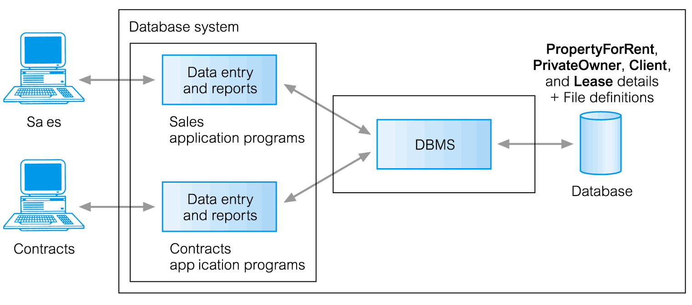
Database Systems (DBS)
DBS is a single large repository of data, defined once and managed using DBMS while used by many application programs (DBMS + Application Program).
DBS
Data
Entry & Reports
User 1 (Sales)
Sales Application Program
DBMS
Data
Entry & Reports
Database
User 2 (HR)
HR Application Program
Pearson Education © 2009

Slide 14
Database Management System (DBMS)
A software system that enables users to define, create, maintain, and control access to the database.
DBMS facilitates the following:
Create and Define a DB through Data Definition Language (DDL).
Construct and Load a DB contents.
Manipulate a DB -query & update the DB- through Data Manipulation Language (DML).
Control access to data (security, integrity, concurrency, recovery)
Some Relational DBMS vendors/products like :
Access & SQL Server/MS , MySQL,Oracle ..etc
Pearson Education © 2009

Slide 15
Components of DBMS Environment
Hardware
Can range from a PC to a network of computers.
Software
DBMS, operating system, network software (if necessary) and also the application programs.
Pearson Education © 2009

Slide 16
Components of DBMS Environment
Data
Used by the organization and a description of this data
Procedures
Instructions and rules that should be applied to the design and use of the database and DBMS.
People
Pearson Education © 2009

Slide 17
Roles in the Database Environment
Communicate
Procedure
User
Requirement
Write
Write
DB Designer
System Analyst
Application
programmer
Design
DBA
Program
Manage
App
Program
DBMS
Use
Naïve End User
DB
Use
Sophisticated End User
H/W

Slide 18
Roles in the Database Environment
System Analyst: Determine the user requirements and develop the system specifications.
Database Designer: Identify the data and choose the appropriate structure to represent and store the data.
Application Programmer: Implement the application program based on the system specification.
Database administrator (DBA): Administrates the DB, DBMS and related software.
Pearson Education © 2009

Slide 19
Roles in the Database Environment
Database End-users: They use the data for queries, reports and some of them update the database content (data). End-users can be categorized into:
Naïve users: Invokes one of the permanent application programs that have been written previously.
Sophisticated users: form requests in a database query language.
Pearson Education © 2009

Slide 20
Advantages of DBMSs
Control of data redundancy
Data consistency
More information from the same amount of data
Sharing of data
Improved data integrity
Improved security
Enforcement of standards (ex: data format)
Pearson Education © 2009

Slide 21
Advantages of DBMSs
Balance conflicting requirements (DBA)
Improved data accessibility and responsiveness
Increased productivity (DBMS tools)
Improved maintenance through data independence
Increased concurrency
Improved backup and recovery services
Pearson Education © 2009

Slide 22
Disadvantages of DBMSs
Complexity
Size (disk, memory)
Cost of DBMS
Additional hardware costs
Cost of conversion existing application
Higher impact of a failure (central DB )
Pearson Education © 2009

