Slide 1
CS1201: Programming Language 2
By:Nouf Aljaffan
Edited by : Nouf Almunyif
Classes and objects
Inheritance

Slide 2
Inheritance
Inheritance and composition are meaningful ways to relate two or more classes.
Inheritance implements an is-a relationship:
For example - a mustang is-a car.
Inheritance lets us create new classes from existing classes.
The new classes that we create from the existing classes are called the derived classes; . Is also referred to as the subclass.
the existing classes are called the base classes. Is also called the superclass.
The derived classes inherit the properties of the base classes.
Each derived class, in turn, becomes a base class for a future derived class.
A derived class can redefine the member functions of a base class, but this redefinition applies only to the objects of the derived class.

Slide 3
Hierarchical Inheritance
Inheritance is hierarchical:
A derived class can also act as a base class to a lower-level derived class.
The higher the class in the hierarchy, the more general information it contains.
The lower the class in the hierarchy, the more specific information it contains.
Attributes in a derived class overwrite the same ones in a base class.

Slide 4
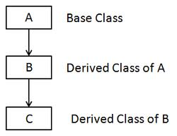
Hierarchical Inheritance

Slide 5
Hierarchical Inheritance

Slide 6
Hierarchical Inheritance
vehicle
is-a
Land vehicle
Water vehicle
is-a
is-a
car
bicycle
boat
submarine

Slide 7
class inheritance definition:
class Derived_Class_name: accessId Base_Class_name
{
DClassMembersList
};
accessId define how can the derived class access
the Base class members .
Access identifier can be either public, protected and privet.

Slide 8
Reviewing public, protected, and private
When a class member is declared :
as public, it can be accessed by any other part of a program.
as private, it can be accesses only by members of its class.
Further, derived classes do not have access to private base class members.
as protected, it can be accessed only by members of its class.
However, derived classes also have access to protected base class members.
Thus, protected allows a member to be inherited, but to remain private within a class hierarchy.

Slide 9
Cont..
When a base class is inherited by use of (accessId )
public, (default)
its public members become public members of the derived class.
its protected members become protected members of the derived class.
protected, its public and protected members become protected members of the derived class.
private, its public and protected members become private members of the derived class.
In all cases, private members of a base class remain private to that base class.

Slide 10
Inheritance and accessibility
Access Specifier | Accessible from own class | Accessible from Derived Class | Accessible from Objects outside class
Public | Yes | Yes | Yes
Protected | Yes | Yes | No
Private | Yes | No | No

Slide 11
Example ( public access)
#include <iostream>
using namespace std;
class rectangleType // base class
{
protected:
double length;
double width;
public:
rectangleType() {length = 0;
width = 0;}
rectangleType( double L, double w)
{setDimension( L , w); }
void setDimension ( double L, double w)
{ if ( L >= 0 ) length = L;
else length = 0;
if ( w >= 0 )width= w;
else width = 0;
}
double getLength()
{ return length;}
double getWidth()
{ return width;}
double area()
{return length * width;}
double perimeter()
{ return 2 * ( length + width );}
void print(){
cout<<"Length = "<< length << " ; Width = " << width;
}
};

Slide 12
class boxType: public rectangleType {
private:
double height;
public:
boxType() { height = 0 ;}
boxType( double L, double w, double h) {setDimension( L, w, h); }
~boxType(){}
void setDimension ( double L, double w, double h)
{ rectangleType::setDimension( L , w );
if ( h >= 0)‏ height = h;
else height = 0;}
double getHeight() { return height; }
double area() { return 2 * ( length * width + length * height + width * height ); }
double volume() {return rectangleType::area() * height; }
void print() { rectangleType::print();
cout << " ; Height = " << height;}
};

Slide 13
Cont. Example
Void main()‏
{
rectangleType myRectangle1;
rectangleType myRectangle2(8, 6);
boxType myBox1;
boxType myBox2(10, 7, 3);
cout << "\n myRectangle1: ";
myRectangle1.print();
cout << endl;
cout << " Area of myRectangle1: " << myRectangle1.area() << endl;
cout << "\n myRectangle2: ";
myRectangle2.print();
cout << endl;
cout << " Area of myRectangle2: " << myRectangle2.area() << endl;
}

Slide 14
Example ( public access)
#include <iostream>
using namespace std;
class rectangleType // base class
{
protected:
double length;
double width;
public:
rectangleType() {length = 0;
width = 0;}
rectangleType( double L, double w)
{setDimension( L , w); }
void setDimension ( double L, double w)
{ if ( L >= 0 ) length = L;
else length = 0;
if ( w >= 0 )width= w;
else width = 0;
}
double getLength()
{ return length;}
double getWidth()
{ return width;}
double area()
{return length * width;}
double perimeter()
{ return 2 * ( length + width );}
void print(){
cout<<"Length = "<< length << " ; Width = " << width;
}
};

Slide 15
class boxType: public rectangleType {
private:
double height;
public:
boxType() { height = 0 ;}
boxType( double L, double w, double h) {setDimension( L, w, h); }
~boxType(){}
void setDimension ( double L, double w, double h)
{ rectangleType::setDimension( L , w );
if ( h >= 0)‏ height = h;
else height = 0;}
double getHeight() { return height; }
double area() { return 2 * ( length * width + length * height + width * height ); }
double volume() {return rectangleType::area() * height; }
void print() { rectangleType::print();
cout << " ; Height = " << height;}
};

Slide 16
Cont. Example
void main()‏
{
rectangleType myRectangle1; rectangleType myRectangle2(8, 6);
boxType myBox1; boxType myBox2(10, 7, 3);
cout << "\n myRectangle1: ";
myRectangle1.print();
cout << " Area of myRectangle1: " << myRectangle1.area() << endl;
cout << "\n myRectangle2: ";
myRectangle2.print(); cout << endl;
cout << " Area of myRectangle2: " << myRectangle2.area() << endl;
myBox1.print();
cout<<"surface area of Mybox" <<myBox1.area();
cout<<"volume of mybox1 is " <<myBox1.volumn();
myBox2.print();
cout<<"surface area of Mybox" <<myBox2.area();
cout<<"volume of mybox1 is " <<myBox2.volumn();
}

Slide 17
Cont. Example

Slide 18
Over-written Functions
These functions are NOT overloaded, since they have exactly the same prototype (and header), and they are not in the same class.
They are over-written functions.
The over-written function that is closest to the object defined takes precedence.

Slide 19
public, (default)
its public members become public members of the derived class.
its protected members become protected members of the derived class.
Example : base class inherited as public

Slide 20
#include <iostream>
using namespace std;
class base // base class
{int pri; //private by default
protected:
int prot;
public:
int pub;
void set(int b) { pri=b;}
void setprot(int p) {prot=p;}
void show(){ cout<<"in base pri :"<<pri<<"\n";}
};
class drived: public base
// drivedclass
{
int k;
public:
drived( int x) {k =x; }
void showK(){
cout<<" in derived k : "<< k << "\n";
cout<<" in deraived prot from base : "<<prot<<endl;
//cout << pri; this is error
}
} ;//end of class
void main(){
drived ob(3);
ob.set(5); // access member of base
ob.show(); // access member of base
ob.showK(); // access member of drived class
//ob.prot=5;error
}

Slide 21
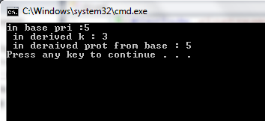

Slide 22
protected
its public and protected members become protected members of the derived class.
Example : using protected for inheritance of base class

Slide 23
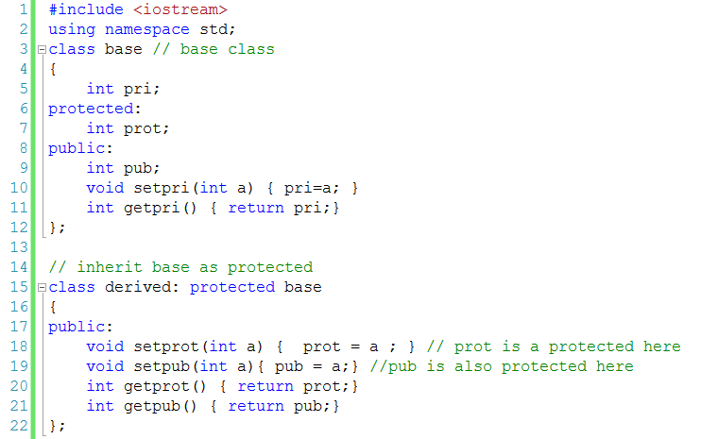

Slide 24
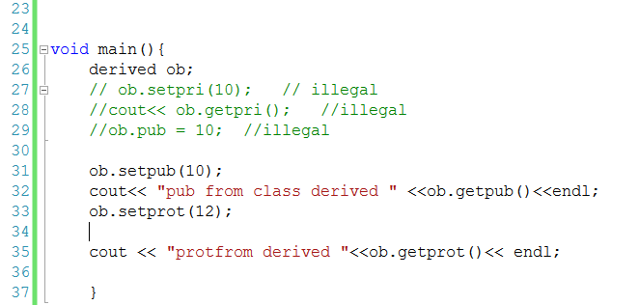

Slide 25
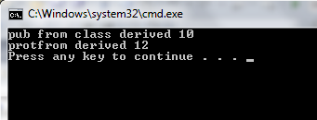

Slide 26
private
its public and protected members become private members of the derived class.
In all cases, private members of a base class remain private to that base class.

Slide 27
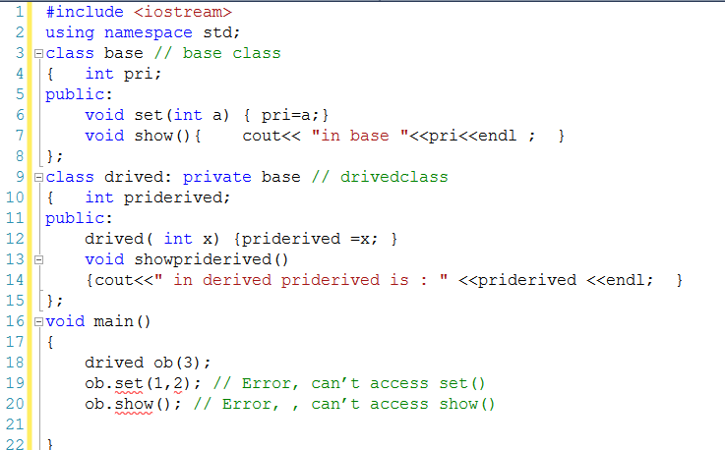

Slide 28
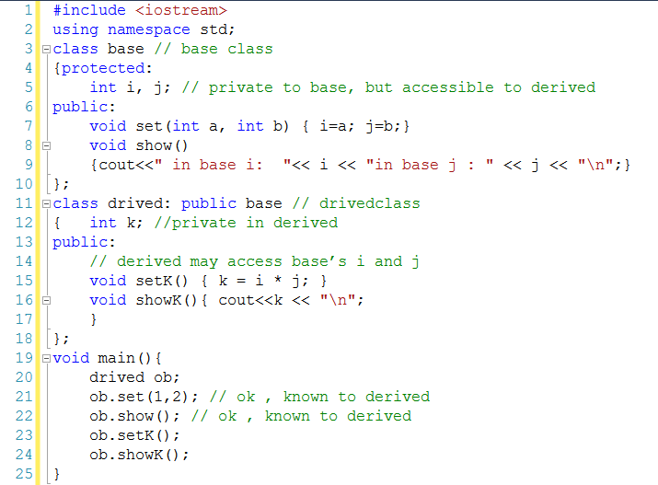
using protected member READ

Slide 29
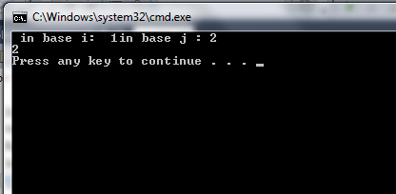

Slide 30
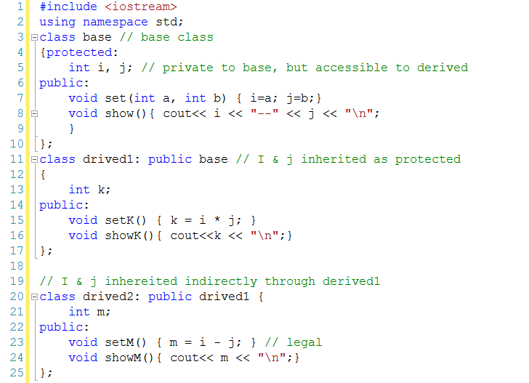
using protected member

Slide 31
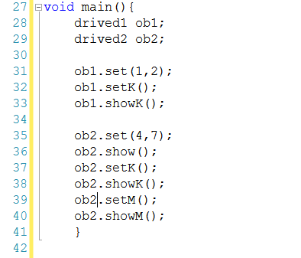
using protected member

Slide 32
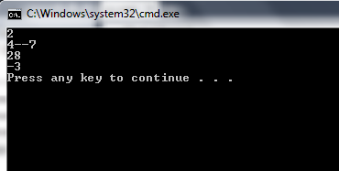

Slide 33
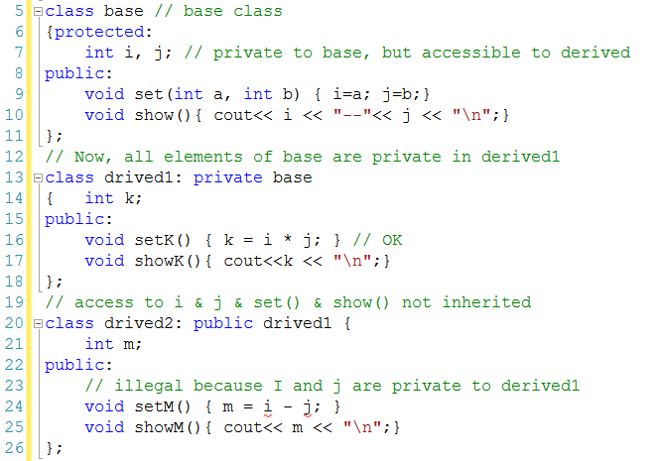
using protected member

Slide 34
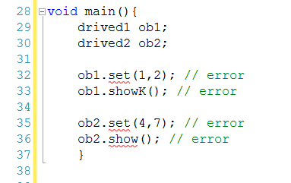
using protected member

