Slide 1
Programming II
Array of objects

Slide 2
Using the this Pointer
Objects use the this pointer implicitly or explicitly.
this is used implicitly when accessing members directly.
It is used explicitly when using keyword this.
The type of the this pointer depends on the type of the object and whether the executing member function is declared const.

Slide 3
this Example

Slide 4
this Example
Implicitly using the this pointer to access member x
Explicitly using the this pointer to access member x
Using the dereferenced this pointer and the dot operator

Slide 5
Common Programming Error
Attempting to use the member selection operator (.) with a pointer to an object is a compilation error
the dot member selection operator may be used only with an lvalue such as an object’s name, a reference to an object or a dereferenced pointer to an object.

Slide 6
static Class Members
static data member
Only one copy of a variable shared by all objects of a class.
Can be declared public, private or protected.
Fundamental-type static data members
Initialized by default to 0.
If you want a different initial value, a static data member can be initialized once (and only once).
const static data member of int or enum type
Can be initialized in its declaration in the class definition.
Exists even when no objects of the class exist (ex:Employee::count;)
Also accessible through any object of that class
Employee e("Maher","Ahmed",10000);
e. Count;
Static member function can access only static data, because the function might be called when no objects exist

Slide 7
Function prototype for static member function
static data member keeps track of number of Employee objects that currently exist

Slide 8
static data member is defined and initialized at file scope in the .cpp file
static member function can access only static data, because the function might be called when no objects exist

Slide 9
Non-static member function (i.e., constructor) can modify the class’s static data members

Slide 10
Calling static member function using class name and binary scope resolution operator
Dynamically creating Employees with new
Calling a static member function through a pointer to an object of the class

Slide 12
Arrays of objects
An array of class objects is defined in the same manner as build-in types.
Employee list [10]; //Classname arrayname [size]
Defines an array to hold 10 Student objects, one for each student I own.
Which constructor is used?
The default constructor is used because no arguments are specified.
The are several ways to use other constructors to form these objects,:
that is, to pass arguments to the constructor.
Static array: int primes[5] = {1,2,3,5,7};
Employee list [3] = { Employee(“Saleh", "Mohammed",, 10000); Employee(“Noura”, "Salman",12000); Employee(“Sara","Sadd",8000); }
Dynamic Array: int * primes = new int [5];
Employee *list= new Employee [10]; //The default constructor will be used.

Slide 13
Arrays of Class Objects-Example
Employee list[60]; //call the efault constructor 60 times
string f , l;
double s;
//to fill the objects details from the user , you have to use set function
for (int i = 0;i < 60; i++){
cout<<"Enter the first name , last name , and Salary of the employee:\n";
cin>>f>>l>>s;
list [i].setFirstName(f);
list [i].setLastName(l);
List[i].setSalary();
}
//to print the data into the screen
cout <<left<<setw(15)<<"First Name"<<setw(15)<<"Last Name"<<"Salary\n";//header
for (int i = 0;i < 60; i++){
cout<<left<<setw(15)<<list[i].getFirstName()<<setw(15)<<list[i].getLastName()<<list[i.getSalary ()<<endl;
}

Slide 14
Example
#include <iostream>
#include <new>
using namespace std;
class Rectangle {
int width;
int height;
public:
Rectangle(int w=0, int h=0) {
width = w;
height = h;
cout << "Constructing " << width << " by " << height << " rectangle.\n";
}
~Rectangle() {
cout << "Destructing " << width << " by " << height << " rectangle.\n";
}
void set(int w, int h) {
width = w;
height = h;
}
int area() {
return width * height;
}
};
int main() {
int size , w , h;
Rectangle *p;
cout << "How many rectangles?";
cin>>size;
p = new Rectangle [size];
cout << "\n";
for(int i=0; i < size; i++)
{cout<<"Provide the dimensions of a rectangle:";
cin>>w;
cin>>h;
p[i].set(w,h);
}
for(int i=0; i < size; i++)
cout << "Area is " << p[i].area() << endl;
delete [] p;
return 0;
}
Rectangle
-width:int -hieght:int
+Rectangle ( int=0,int=0) +set ( int , int):void +area():int +~Rectangle()

Slide 15
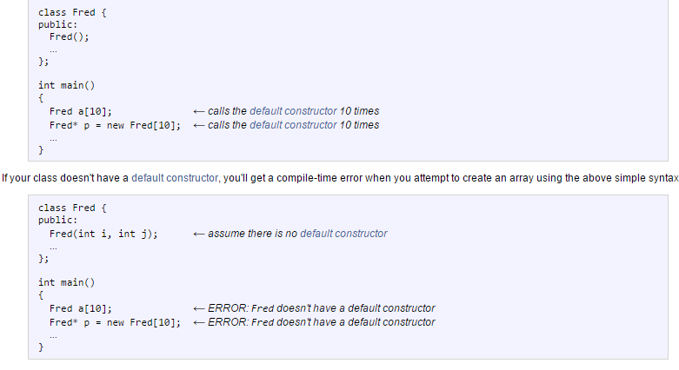
Most Common Error

