Slide 1
CSC1201: Programming Language 2
Pointers

Slide 2
Topics
Pointers
Memory addresses
Declaration
Dereferencing a pointer
Pointers to pointer

Slide 3
Computer Memory
Each variable is assigned a memory slot (the size depends on the data type) and the variable’s data is stored there
Memory address:
1020
1024
1032
…
…
100
…
1024
…
a
int a = 100;
Variable a’s value, i.e., 100, is
stored at memory location 1024

Slide 4
Pointers
A pointer is a variable used to store the address of a memory cell.
We can use the pointer to reference this memory cell
1020
1024
1032
…
…
100
…
1024
…
integer
pointer

Slide 5
Pointer Types
Pointer
C++ has pointer types for each type of object
Pointers to int objects
Pointers to char objects
Pointers to user-defined objects
(e.g., RationalNumber)
Even pointers to pointers
Pointers to pointers to int objects

Slide 6
Pointer Variable
Declaration of Pointer variables
type* pointer_name;
//or
type *pointer_name;
where type is the type of data pointed to (e.g. int, char, double)
Examples:
int *n;
RationalNumber *r;
int **p; // pointer to pointer

Slide 7
Address Operator &
The "address of " operator (&) gives the memory address of the variable
Usage: &variable_name
1020
1024
…
…
100
…
…
…
a
int a = 100;
//get the value,
cout << a; //prints 100
//get the memory address
cout << &a; //prints 1024

Slide 8
Address Operator &
1020
1024
1032
…
88
100
…
…
…
a
b
#include <iostream>
using namespace std;
void main(){
int a, b;
a = 88;
b = 100;
cout << "The address of a is: " << &a << endl;
cout << "The address of b is: " << &b << endl;
}
The address of a is: 1020
The address of b is: 1024

Slide 9
Pointer Variables
Memory address:
1020
1024
1032
The value of pointer p is the address of variable a
A pointer is also a variable, so it has its own memory address
…
88
100
…
1024
…
a
p
int a = 100;
int *p = &a;
cout << a << " " << &a <<endl;
cout << p << " " << &p <<endl;
100 1024
1024 1032

Slide 10
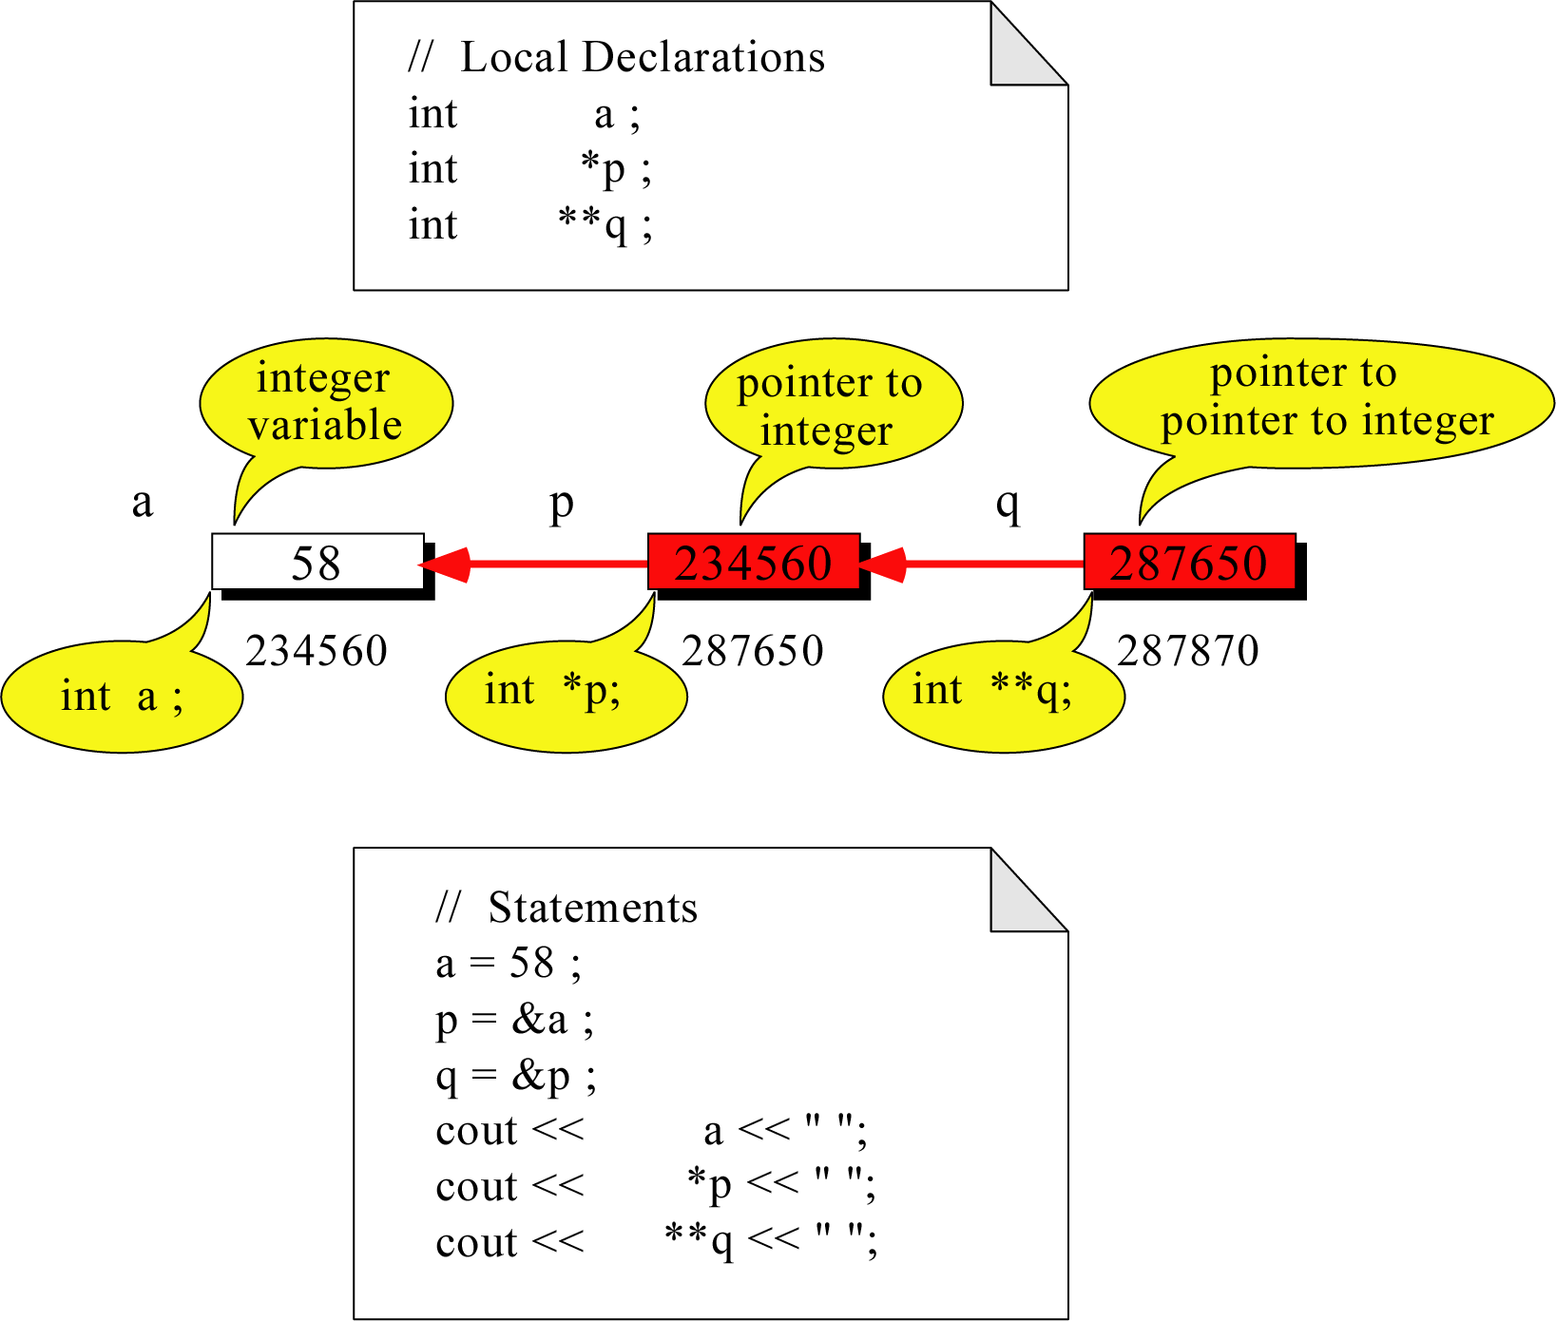
Pointer to Pointer
What is the output?
58 58 58

Slide 11
Dereferencing Operator *
We can access to the value stored in the variable pointed to by using the dereferencing operator (*),
1020
1024
1032
…
88
100
…
1024
…
a
p
int a = 100;
int *p = &a;
cout << a << endl;
cout << &a << endl;
cout << p << " " << *p << endl;
cout << &p << endl;
100
1024
1024 100
1032

Slide 12
Don’t get confused
Declaring a pointer means only that it is a pointer: int *p;
Don’t be confused with the dereferencing operator, which is also written with an asterisk (*). They are simply two different tasks represented with the same sign
int a = 100, b = 88, c = 8;
int *p1 = &a, *p2, *p3 = &c;
p2 = &b; // p2 points to b
p2 = p1; // p2 points to a
b = *p3; //assign c to b
*p2 = *p3; //assign c to a
cout << a << b << c;
888

Slide 13
A Pointer Example
The code
void doubleIt(int x, int * p)
{
*p = 2 * x;
}
int main(int argc, const char * argv[])
{
int a = 16;
doubleIt(9, &a);
return 0;
}
Memory Layout
Box diagram
main
16
p (8200)
8192
a
doubleIt
x (8196)
9
a (8192)
16
main
doubleIt
x
9
a gets 18
p
Notes:
Note the signature of main() – it’s an array parameter. And, like other examples we’ve given, it takes the number of elements as a parameter. Why?

Slide 14
Another Pointer Example
value1==? / value2==?
Also, p1=? p2=?
#include <iostream>
using namespace std;
int main (){
int value1 = 5, value2 = 15;
int *p1, *p2;
p1 = &value1; // p1 = address of value1
p2 = &value2; // p2 = address of value2
*p1 = 10; // value pointed to by p1=10
*p2 = *p1; // value pointed to by p2= value // pointed to by p1
p1 = p2; // p1 = p2 (pointer value copied)
*p1 = 20; // value pointed to by p1 = 20
cout << "value1==" << value1 << "/ value2==" << value2;
return 0;
}

Slide 15
Reference Variables
A reference is an additional name to
an existing memory location
Pointer:
Reference:
x
9
x
ref
9
ref
int x = 9;
int &ref = x;
int x=9;
int *ref;
ref = &x;
Notes:
References fix some of those pointer problems.
If we wanted something called “ref” to point to a variable x, we’d declare a pointer variable and assign the address of x into it. With references, we’d attach an additional name – ref – to the same memory location as x.
Note how the pointer necessitates an extra variable, whereas the reference didn’t

Slide 16
Reference Variables
A reference variable serves as an alternative name for an object
#include <iostream>
using namespace std;
int main (){
int m = 10;
int &j = m; // j is a reference variable
cout << "value of m = " << m << endl; //print 10
j = 18;
cout << "value of m =" << m << endl; // print 18
return 0;
}

Slide 17
Reference Variables
A reference variable always refers to the same object. Assigning a reference variable with a new value actually changes the value of the referred object.
Reference variables are commonly used for parameter passing to a function

Slide 18
Traditional Pointer Usage
#include <iostream>
using namespace std;
void IndirectSwap(char *Ptr1, char *Ptr2){
char temp = *Ptr1;
*Ptr1 = *Ptr2;
*Ptr2 = temp;
}
int main() {
char a = 'y';
char b = 'n';
IndirectSwap(&a, &b);
cout << a << b << endl;
return 0;
}

Slide 19
Pass by Reference
void IndirectSwap(char& y, char& z) {
char temp = y;
y = z;
z = temp;
}
int main() {
char a = 'y';
char b = 'n';
IndirectSwap(a, b);
cout << a << b << endl;
return 0;
}

Slide 20
Example
#include <iostream>
#include <string>
using namespace std;
//===============================
int main() {
int *p;
int x = 37;
cout <<"x= " << x<<endl;
p=&x;
cout <<"*p= "<< *p <<" , x= "<<x<<endl;
*p=85;
cout <<"*P= " <<*p <<" , x= "<<x<<endl;
cout <<" Address of p is : "<< &p <<endl;
cout<<"value of p : "<< p<<endl;
cout<< " value of memory location pointed to by *p = "<<*p<<endl;
cout<<"Address of X = " << &x<<endl;
cout <<" Value of x = " << x<<endl;
return 0;
}

Slide 21
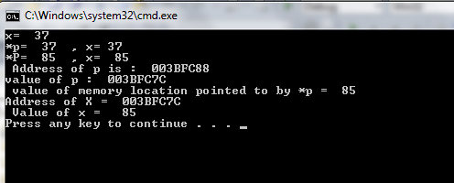

Slide 22
Pointers ( Advanced)

Slide 23
Topics
Pointers and Functions
Array Name is a constant pointer
Relationship between pointers and arrays
Pointer Arithmetic
NULL Pointer
Dynamic Pointers
Pointer Types
Constant pointers

Slide 24
Pointers and Functions
Pointers are full-fledged types
Can be used just like other types
Can be function parameters
Can be returned from functions
Example: int* findOtherPointer(int* p);
This function declaration:
Has "pointer to an int" parameter
Returns "pointer to an int" variable

Slide 25
Pointers and Functions Example
// This program uses two functions that accept addresses of
// variables as arguments.
#include <iostream>
Using namespace std;
// Function prototypes
void getNumber(int *);
void doubleValue(int *);
void main(void)
{
int number;
getNumber(&number) // Pass address of number to getNumber
doubleValue(&number); // and doubleValue.
cout << "That value doubled is " << number << endl;
}

Slide 26
Program continues
// Definition of getNumber. The parameter, Input, is a pointer.
// This function asks the user for a number. The value entered
// is stored in the variable pointed to by Input.
void getNumber(int *input)
{
cout << "Enter an integer number: ";
cin >> *input;
}
// Definition of doubleValue. The parameter, val, is a pointer.
// This function multiplies the variable pointed to by val by
// two.
void doubleValue(int *val)
{
*val *= 2;
}

Slide 27
Program Output with Example Input
Enter an integer number: 10 [Enter]
That value doubled is 20

Slide 28
Pointer Arithmetic: Pointer Assignments
Pointer variables can be "assigned": int *p1, *p2; p2 = p1;
Assigns one pointer to another
"Make p2 point to where p1 points"
Do not confuse with: *p1 = *p2;
Assigns "value pointed to" by p1, to "value pointed to" by p2

Slide 29
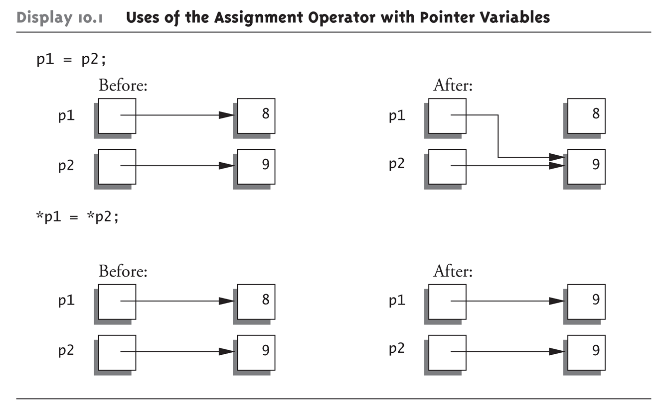
Pointer Assignments Graphic:

Slide 30
Pointer Arithmetic
Some mathematical operations may be performed on pointers.
The ++ and – operators may be used to increment or decrement a pointer variable.
An integer may be added to or subtracted from a pointer variable. This may be performed with the +, - +=, or -= operators.
A pointer may be subtracted from another pointer.
Operations meaningless unless performed on an array ( next slides)
Pointer comparison ( <, == , > )

Slide 31
Array Name is a constant pointer
Example:
#include <iostream>
using namespace std;
void main (){
int a[5];
cout << "Address of a[0]: " << &a[0] << endl
<< "Name as pointer: " << a << endl;
}
Result:
Address of a[0]: 0x0065FDE4
Name as pointer: 0x0065FDE4

Slide 32
Array Name is a constant pointer
Dereferencing An Array Name
This element is called a[0] or *a
#include <iostream>
using namespace std;
void main(){
int a[5] = {2,4,6,8,22};
cout << *a << " "
<< a[0];
} //main
a[0]
2
a
a[1]
4
a[2]
6
a[3]
8
a[4]
22
a

Slide 33
Relationship Between Arrays and Pointers
Pointer to the array
To access an array, any pointer to the first element can be used instead of the name of the array.
We could replace *p by *a
#include <iostream>
using namespace std;
void main(){
int a[5] = {2,4,6,8,22};
int *p = a;
cout << a[0] << " "
<< *p;
}
a
p
a[0]
2
2 2
a[1]
4
a[2]
6
a[3]
8
a[4]
22
a

Slide 34
Relationship Between Arrays and Pointers
Pointer to the array (cont.)
Both a and p are pointers to the same array.
#include <iostream>
using namespace std;
void main(){
int a[5] = {2,4,6,8,22};
int *p = &a[1];
cout << a[0] << " "
<< p[1];
cout << a[1] << " "
<< p[0];
}
a[0]
a[0]
2 2
4 4
2
p
a[1]
4
a[2]
6
p[0]
a[3]
8
a[4]
22

Slide 35
Relationship Between Arrays and Pointers
Pointer to the array (cont.)
Given a pointer p, p+n refers to the element that is offset from p by n positions.
a
2
p - 1
4
p
a + 1
a + 2
6
p + 1
a + 3
8
p + 2
a + 4
22
p + 3

Slide 36
Relationship Between Arrays and Pointers
Dereferencing Array Pointers
a[0] or *(a + 0)
2
a
a[1] or *(a + 1)
4
a + 1
a[2] or *(a + 2)
6
a + 2
a[3] or *(a + 3)
8
a + 3
a[4] or *(a + 4)
22
a + 4
*(a+n) is identical to a[n]
Note: flexible pointer syntax

Slide 37
Relationship Between Arrays and Pointers Pointer Arithmetic
Example:
Assume long (long integer) is 4 bytes, and pointer variable is 4 bytes.
long a[10]={5, 10, 15, …};
long *pa, **ppa;
int i=5;
pa = a;
ppa = &pa;
Expression | Value | Note
pa+1 | 644 | 640+1*4
pa+3 | 652 | 640+3*4
pa+i | 660 | 640+i*4
ppa+1 | 704 | 700+1*4
ppa+i | 720 | 700+i*4
*pa+1 | 6 | 5+1
*(pa+1) | 10 | a[1]=pa[1]=*(a+1)
pa[2] | 15 | 648
*ppa | 640 | value of pa
*ppa+1 | 644 | pa+1
*(ppa+1) | invalid | *(704)
**ppa+1 | 6 | a[0]+1 = 5+1
*(*ppa+1) | 10 | *(pa+1)=*(640+1*4)
a
5 | 640
10 | 644
15 | 648
20 | 652
25 | 656
30 | 660
35 | 664
40 | 668
45 | 672
50 | 676
800
700
700
640
ppa
pa
Variable | Address | Value
a | 640 | 5
 | 644 | 10
 | 648 | 15
 | … | …
pa | 700 | 640
ppa | 800 | 700

Slide 38
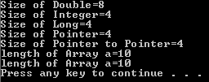
example
// This program uses the sizeof operator to determine the size.
#include <iostream>
using namespace std ;
void main(){
long a[10]={5, 10, 15,20,25,30,35,40,45,50};
long *pa, **ppa;
int i=5;
pa = a;
ppa = &pa;
cout<<"Size of Double="<<sizeof(double) <<endl;
cout<<"Size of Integer="<<sizeof(int) <<endl;
cout<<"Size of Long="<<sizeof(long)<<endl;
cout<<"Size of Pointer="<<sizeof(pa)<<endl;
cout<<"Size of Pointer to Pointer="<<sizeof(ppa)<<endl;
cout<<“length of Array a="<<sizeof(a) /sizeof(long)<<endl;
cout<<“length of Array a="<<sizeof(a) /sizeof(a[0])<<endl;}
pv+n
⇔
pv + n*sizeof(variable type that pointer point to)

Slide 39
Relationship Between Arrays and Pointers Pointer Arithmetic
// This program uses a pointer to display the contents
// of an integer array.
#include <iostream>
void main(void)
{
int set[8] = {5, 10, 15, 20, 25, 30, 35, 40};
int *nums, index;
nums = set;
cout << "The numbers in set are:\n";
for (index = 0; index < 8; index++)
{
cout << *nums << " ";
nums++;
}
cout << "\nThe numbers in set backwards are:\n";
for (index = 0; index < 8; index++)
{
nums--;
cout << *nums << " ";
}
}
The numbers in set are:
5 10 15 20 25 30 35 40
The numbers in set backwards are:
40 35 30 25 20 15 10 5

Slide 40
Relationship Between Arrays and Pointers Comparing Pointers
If one address comes before another address in memory, the first address is considered “less than” the second. C++’s relational operators maybe used to compare pointer values.

Slide 41
Relationship Between Arrays and Pointers Comparing Pointers
// This program uses a pointer to display the contents
// of an integer array.
#include <iostream>
void main(void)
{
int set[8] = {5, 10, 15, 20, 25, 30, 35, 40};
int *nums = set; // Make nums point to set
cout << "The numbers in set are:\n";
cout << *nums << " "; // Display first element
while (nums < &set[7])
{
nums++;
cout << *nums << " ";
}
cout << "\nThe numbers in set backwards are:\n";
cout << *nums << " "; // Display last element
while (nums > set)
{
nums--;
cout << *nums << " ";
}
}
The numbers in set are:
5 10 15 20 25 30 35 40
The numbers in set backwards are:
40 35 30 25 20 15 10 5

Slide 42
Relationship Between Arrays and Pointers Comparing Pointers
Comparing addresses in pointers is not the same as comparing the values pointed at by pointers:
if (ptr1 == ptr2) // compares
// addresses
if (*ptr1 == *ptr2) // compares
// values

Slide 43
Most Common Error-1
Recall previous example: int a[10]; int * IntPtr;
a and p are pointer variables
Can perform assignments: p = a; // Legal.
p now points where a points
To first indexed variable of array a
a = p; // ILLEGAL!
Array pointer is CONSTANT pointer!

Slide 44
Most Common Error-2
Array type NOT allowed as return-type of function
Example: int [] someFunction(); // ILLEGAL!
Instead return pointer to array base type: int* someFunction(); // LEGAL!

Slide 45
NULL pointer
NULL is a special value that indicates an empty pointer
If you try to access a NULL pointer, you will get an error
int *p;
p = 0;
cout << p << endl; //prints 0
cout << &p << endl;//prints address of p
cout << *p << endl;//Error!

Slide 46
Static vs. Dynamic Object
Static Memory Allocation
Memory is allocated at compilation time
Dynamic Memory
Memory is allocated at running time

Slide 47
Static vs. Dynamic Objects (cont.)
Static object
Memory is acquired automatically
Memory is returned automatically when object goes out of scope
Dynamic object
Memory is acquired by program with an allocation request
new operation
Dynamic objects can exist beyond the function in which they were allocated
Object memory is returned by a deallocation request
delete operation

Slide 48
Static Memory Allocation
Static – Done by the compiler automatically (implicitly).
Global variables or objects -- memory is allocated at the start of the program, and freed when program exits; alive throughout program execution
Can be access anywhere in the program.
Local variables (inside a function) – memory is allocated when the function starts and freed when the function returns.
A local variable cannot be accessed from another function.
Allocation and free are done implicitly.
No need to explicitly manage memory is nice (easy to work with), but has limitations!
Using static allocation, the array size must be fixed.
Consider the grade roster for the class? What is the number of people in the class?(next lectures)

Slide 49
Dynamic Memory Allocation Object (variable) creation: New
Syntax
ptr = new SomeType;
where ptr is a pointer of type SomeType
Example
int* p = new int;
Uninitialized int variable
p

Slide 50
Dynamic Objects New Operator
Since pointers can refer to variables…
No "real" need to have a standard identifier
Can dynamically allocate variables
Operator new creates variables
No identifiers to refer to them
Just a pointer!
p1 = new int;
Creates new "nameless" variable, and assigns p1 to "point to" it
Can access with *p1
Use just like ordinary variable

Slide 51
Dynamic Objects Example

Slide 52
Dynamic Objects Example (cont.)

Slide 53
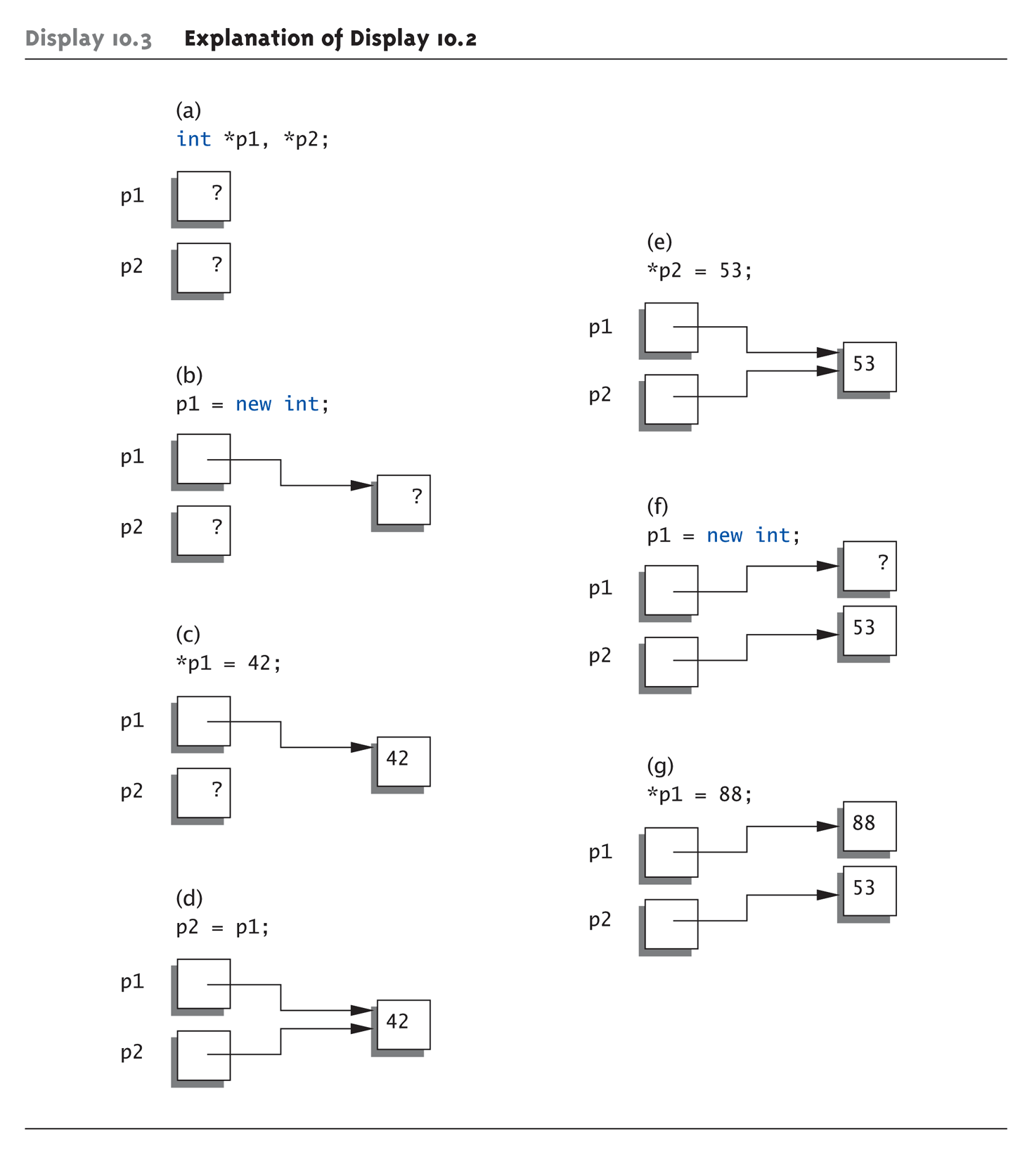
Example Graphic

Slide 54
Dynamic Objects Memory Management
Heap
Also called "freestore"
Reserved for dynamically-allocated variables
All new dynamic variables consume memory in freestore
If too many → could use all freestore memory
Future "new" operations will fail if freestore is "full"

Slide 55
Dynamic Objects Memory Management: Checking new Success
Older compilers:
Test if null returned by call to new: int *p; p = new int; if (p == NULL) { cout << "Error: Insufficient memory.\n"; exit(1); }
If new succeeded, program continues

Slide 56
Dynamic Objects Memory Management: Checking new Success
Newer compilers:
If new operation fails:
Program terminates automatically
Produces error message
Still good practice to use NULL check

Slide 57
Dynamic Objects Destruction: Delete Operator
Syntax
delete p;
storage pointed to by p is returned to free store and p is now undefined
Example
int* p = new int;
*p = 10;
delete p;
p
10

Slide 58
Dynamic Objects Destruction: Delete Operator (cont.)
De-allocate dynamic memory
When no longer needed
Returns memory to freestore
Example: int *p; p = new int(5); … //Some processing… delete p;
De-allocates dynamic memory "pointed to by pointer p"
Literally "destroys" memory

Slide 59
Dynamic Objects Dangling Pointers
delete p;
Destroys dynamic memory
But p still points there!
Called "dangling pointer"
If p is then dereferenced ( *p )
Unpredicatable results!
Often disastrous!
Avoid dangling pointers
Assign pointer to NULL after delete: delete p; p = NULL;

Slide 60
Dynamic vs. Automatic Variables
Dynamic variables
Created with new operator
Created and destroyed while program runs
Local variables
Declared within function definition
Not dynamic
Created when function is called
Destroyed when function call completes
Often called "automatic" variables
Properties controlled for you

Slide 61
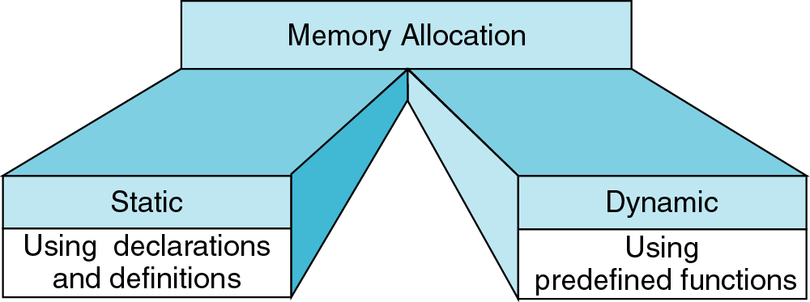
new
delete
{
int a=3;
int * ptr= &a;
…
}
int* ptr;
ptr = new int;
…
delete ptr;

Slide 62
Define Pointer Types
Can "name" pointer types
To be able to declare pointers like other variables
Eliminate need for "*" in pointer declaration
typedef int* IntPtr;
Defines a "new type" alias
Consider these declarations:
IntPtr p; or
int *p;
“The two are equivalent”

Slide 63
Example

Slide 64
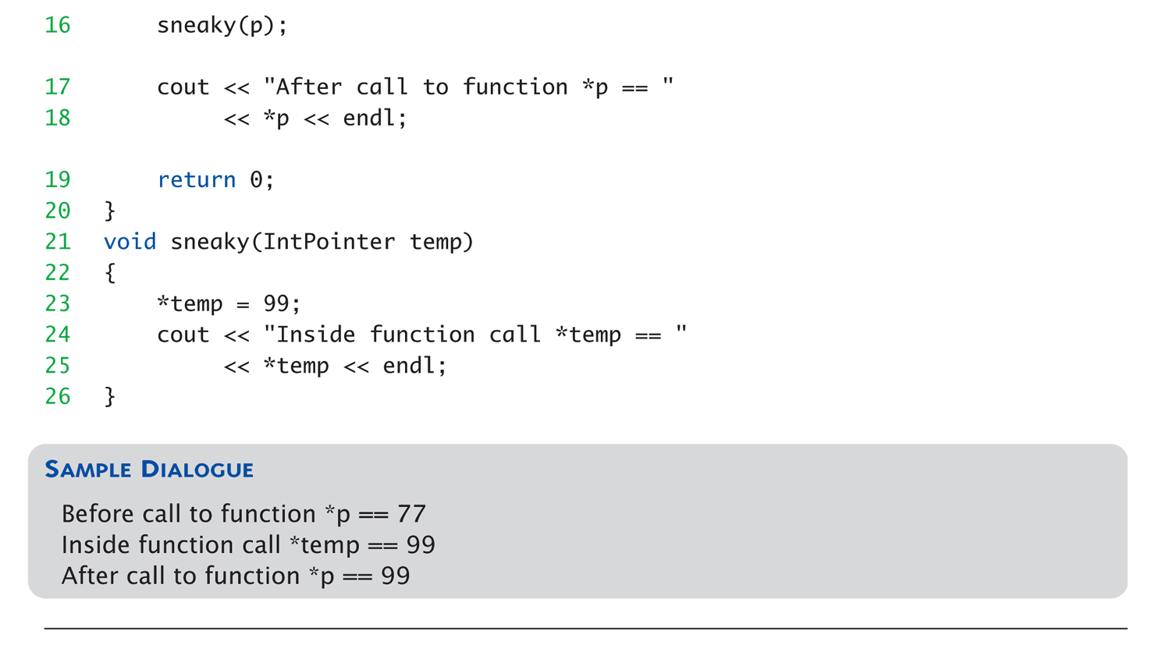
Example (cont.)

Slide 65
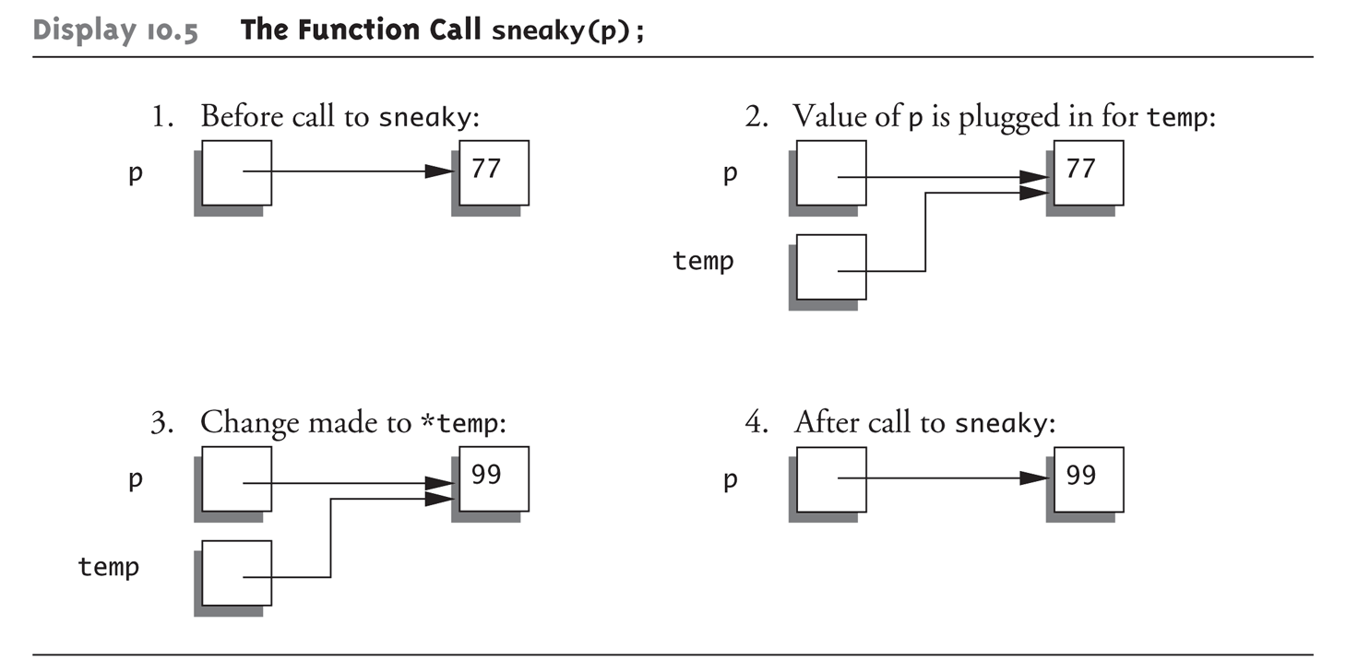
Example Graphic: The Function Call sneaky(p);

Slide 66
Constant pointer
There are two places the const keyword can be placed within a pointer variable declaration .
const int * ptr;
declares a changeable pointer to a constant integer.
The integer value cannot be changed through this pointer, but the pointer may be changed to point to a different constant integer.
int * const ptr;
declares a constant pointer to changeable integer data.
The integer value can be changed through this pointer, but the pointer may not be changed to point to a different constant integer.
const int * const ptr;
forbids changing either the address ptr contains or the value it points to.

Slide 67
Constant pointer

Slide 68
References:
Savitch, Walter J.(2013) Absolute C++.
Gaddis, Tony (2012) Starting Out with C++: From Control Structures Through Objects. Boston: Pearson.
(2011) Introduction to C++ Notes. Massachusetts Institute of Technology

