Slide 1
Arrays
Editedby : Nouf almunyif

Slide 2
Arrays Declaration
Name of array (Note that all elements of this array have the same name, c)
Array
Group of consecutive memory locations
Same name and type
a collection of variables of the same type.
Declaration:
Type array_name[ size]
Examples
int A[10];
An array of ten integers .
Char str[20];
An array of twenty characters .
int a[ 100 ], b[ 27 ] ;
Defining multiple arrays of same type .
double arrayD[5];
c[0]
-45
c[1]
6
c[2]
0
c[3]
72
c[4]
1543
c[5]
-89
c[6]
0
c[7]
62
c[8]
-3
c[9]
1
c[10]
6453
c[11]
78
Position number of the element within array c

Slide 3
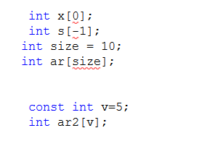
type can be any valid C data type Size must be an integer constant greater than zero.

Slide 4
Array Accessing an element
Name of array (Note that all elements of this array have the same name, c)
all array have zero as the index of first element .
Format of calling an element of an array:
arrayname[ position_number ]
First element at position 0
n element array named c:
c[ 0 ], c[ 1 ]...c[ n – 1 ]
c[0]
-45
c[1]
6
c[2]
0
c[3]
72
c[4]
1543
c[5]
-89
c[6]
0
c[7]
62
c[8]
-3
c[9]
1
c[10]
6453
c[11]
78
Position number of the element within array c

Slide 5
Name of array (Note that all elements of this array have the same name, c)
Array elements are like normal variables
c[ 0 ] = 3;
printf( "%d", c[ 0 ] );
Scanf(“%d”,&c[0]);
int a = c[2];
++c[8];
Perform operations in subscript. If x equals 3
c[ 5 - 2 ] == c[ 3 ] == c[ x ]
Similarly, if a = 5 and b = 6, then the statement
c[a + b] += 2;
c[0]
-45
c[1]
6
c[2]
0
c[3]
72
c[4]
1543
c[5]
-89
c[6]
0
c[7]
62
c[8]
-3
c[9]
1
c[10]
6453
c[11]
78
Position number of the element within array c

Slide 6
Array Initialization
After declaration, array contains some garbage value.
Static initialization
int month_days[] = {31, 28, 31, 30, 31, 30, 31, 31, 30, 31, 30, 31} ;
int n [5] = {0}, d [] ={1,2,3,4,5};
EXAMPLE : Define an array temperature of 5 elements contains float numbers , array size ? :
double temperature [5];
Initialize it with these numbers : 12.3 , 7.5 , 65 , 72.1, 87.5 .
double temperature [5] = {12.3 , 7.5 , 65 , 72.1, 87.5 } ;

Slide 7
Defining and Initializing an Array
double temperature [5] = {12.3 , 7.5 , 65 , 72.1, 87.5 };
temperature [0]
12.3
temperature [1]
7.5
temperature [2]
65.0
Elements
temperature [3]
72.1
temperature [ 4 ]
87.5
Index

Slide 8
Initializing Arrays
int N[ ] = { 1, 2, 3, 4, 5 };
If size omitted, the size is determined from the 5 initializers .
int N[5] = { 0 } ;
int B[20] = {2, 4, 8, 16, 32};
Unspecified elements are guaranteed to be zero .
If not enough initializers, rightmost elements become 0 .
int C[4] = {2, 4, 8, 16, 32};
Error — compiler detects too many initial values .
C arrays have no bounds checking .
int D[5] = {2*n, 4*n, 8*n, 16*n, 32*n};
Automatically only ; array initialized to expressions .

Slide 9
Assigning Values
You cannot assign one array to another :
int A[5]={9,8,7,6,5},B[5];
A=B; //error … illegal
Instead, we must assign each value individually .
Notes:
scalar variable - a single data item
vs.
data structure - a data aggregate

Slide 10
Run time initialization
int x [3] ;
x[0] =1;
x[1] =5;
x[2] =8;
what if the array size was 100 ?

Slide 11
Run time initialization use loop
A
1
[0]
int A[5];
int i;
for(i = 0; i < 5; i++) A[i] = i+1;
[1]
2
[2]
3
Elements
[3]
4
[4]
5

Slide 12
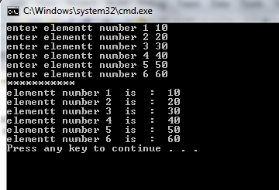
Run time initialization( from user)
#include <stdio.h>
//////////////////////////////////
void main()
{
int i;
int A[6];
for(i = 0; i < 6; i++)
{ printf("enter elementt number %d ",i+1);
scanf("%d" , &A[i]); }
printf("***********\n");
for(i = 0; i < 6; i++)
printf("elementt number %d is: %d\n",i+1,A[i]);
}//end main

Slide 13
Manipulating Arrays
For loops are used to:
Initializing array elements .
Reading elements .
Printing elements .
Performing operations :
Sum elements .
Find largest/ smallest element .
Search for an element .
Sort elements .

Slide 14
Manipulating Arrays
int a [size];
Reading Elements :
for (index =0; index <= size-1; index++ ) OR for (index =0; index < size ; index++ )
{
printf("Enter value : ”);
scanf("%d" , &a[index]);
}
Printing Elements :
for (index =0; index <= size-1; index++)
printf("value : %d” , a[index] );
Sum Array elements Elements :
for ( j=0; j < size; j++) sum += a[j];

Slide 15
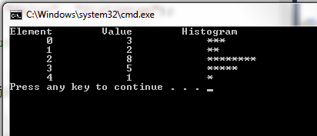
Histogram printing program

Slide 16
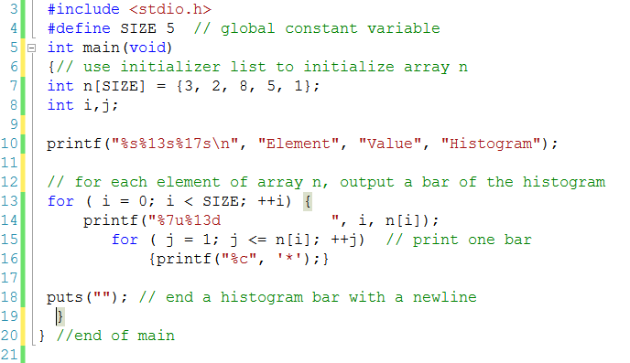
Histogram printing program

Slide 17
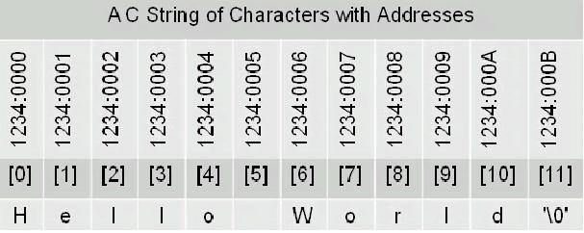
Strings in C
No “Strings” keyword
A string is an array of characters.
OR
char string[] = “hello world”;
char *string = “hello world”;

Slide 18
Character arrays initialization
Static initialization
Run time initialization
char string1[] = “hello world”;
char string1[6] = “world”;
char string2[] = { 'f', 'i', 'r', 's', 't', ‘\0’ }; ‘\0’ denotes the end of string
Char string3[4]= {’w’,’o’,’w’,’\0’};
char string1[20];
scanf( "%s", string1 ); //Reads characters until whitespace encountered
// Can write beyond end of array, be careful

Slide 19
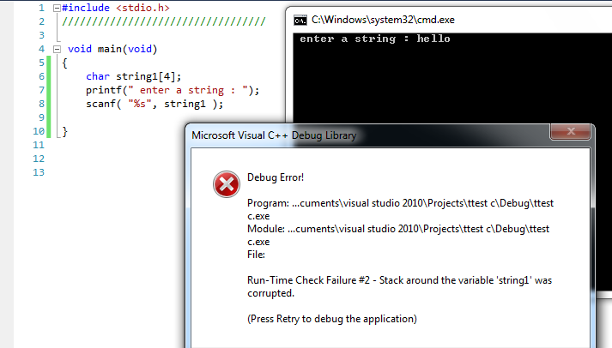
write beyond end of array

Slide 20
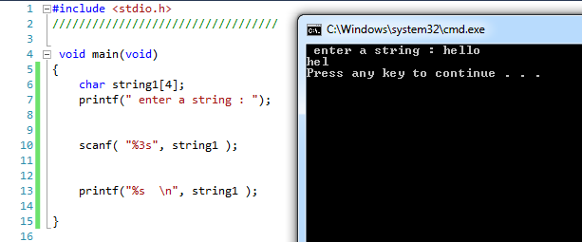
write beyond end of array

Slide 21
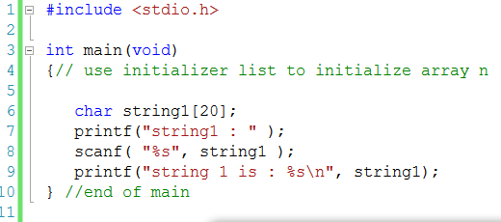
Reads characters until whitespace encountered

Slide 22
#include <stdio.h>
#define SIZE 20
int main(void)
{int i ;
char string1[SIZE]; // reserves 20 characters
char string2[] = "string literal"; // reserves 15 characters
// read string from user into array string1
printf("%s", "Enter a string (no longer than 19 characters): ");
scanf("%19s", string1);
// output strings
printf("string1 is: %s \n",string1);
printf("string2 is: %s \n",string2);
printf("string1 with spaces between characters is:\n");
// output characters until null character is reached
for ( i = 0;( i < SIZE )&& (string1[i] != '\0'); ++i)
printf("%c ", string1[i]);
puts("");
printf("string2 with spaces between characters is:\n");
for ( i = 0;(string2[i] != '\0'); ++i)
printf("%c ", string2[i]);
puts(""); }//end main

Slide 24
Passing Arrays to Functions
Passing array elements
Passed by call-by-value
Pass subscripted name (i.e., myArray[ 3 ]) to function
Function prototype
void myFunction( int b );
Function call
myFunction( myArray[3]);

Slide 25
#include <stdio.h>
#define SIZE 5
// function prototype
void modifyElement(int e);
void main ()
{int a[SIZE] = {0, 1, 2, 3, 4}; // initialize array a
printf("Effects of passing array element by value:\n\n");
printf("The value of a[3] is %d\n", a[3]);// output value of a[3]
modifyElement(a[3]);
printf("The value of a[3] is %d\n", a[3]);// output value of a[3]
}//end main
void modifyElement(int e)
{// multiply parameter by 2
printf("Value in modifyElement is %d\n", e *= 2);
}

Slide 26
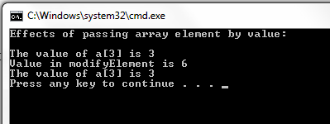

Slide 27
Passing Arrays to Functions
Passing arrays
int myArray[ 24 ];
myFunction( myArray, 24 );
Arrays passed call-by-reference
Name of array is address of first element
Function prototype
void myFunction( int b[], int arraySize );
Parameter names optional in prototype
int b[] could be written int []
int arraySize could be simply int

Slide 28
#include <stdio.h>
#define SIZE 5
// function prototype
void modifyArray(int b[], int size);
void main ()
{int i ;
int a[SIZE] = {0, 1, 2, 3, 4}; // initialize array a
puts("Effects of passing entire array by reference:\n");
printf("the values of the original array are:");
// output original array
for ( i = 0; i < SIZE; ++i)
{ printf("%3d", a[i]);}
puts("");
modifyArray(a, SIZE); // pass array a to modifyArray by reference
printf("The values of the modified array are:");
for ( i = 0; i < SIZE; ++i)
{printf("%3d", a[i]);}
puts("");
}//end main

Slide 29
void modifyArray(int b[], int size)
{// multiply each array element by 2
int j ;
for ( j = 0; j < size; ++j)
{b[j] *= 2; }// actually modifies original array
}

Slide 31
Case Study
Bubble sort
Computing Mean, Median and Mode Using Arrays

Slide 38
Exercise
Searching Arrays: Linear Search

Slide 39
Exercise
Write loops that perform each of the following one-dimensional array operations:
a) Read the 20 elements of double array sales from the keyboard.
b) Add 1000 to each of the 75 elements of double array allowance.
298 Chapter 6 C Arrays
c) Initialize the 50 elements of integer array numbers to zero.
d) Print the 10 values of integer array GPA in column format.

