Slide 1
FILE handeling

Slide 2
File
The file is a permanent storage medium in which we can store the data permanently.

Slide 3
Types of file can be handled
sequential file
random access file
binary file

Slide 4
File structure
C uses a structure called FILE (defined in stdio.h) to store the attributes of a file
File-pointer:
Is a pointer variable which can be store the address of a special file.
Declaration of a file pointer:-
FILE * file_pointer;

Slide 5
File structure
The standard input is stdin
The standard output is stdout
The standard error is stderr

Slide 6
Steps in Processing a File
Create the stream via a pointer variable using the FILE structure: FILE *p;
Open the file, associating the stream name with the file name.
Read or write the data.
Close the file.

Slide 7
File Operation – fopen()
opening a file:
Before performing any type of operation, a file must be opened
for this fopen() function is used.
syntax:
file-pointer=fopen(“FILE NAME ”,”Mode of open”);
example:
FILE *fp=fopen(“ar.c”,”r”);
If fopen() unable to open a file than it will return NULL to the file pointer.

Slide 8
More On fopen
from Figure 7-3 in Forouzan & Gilberg, p. 399

Slide 9
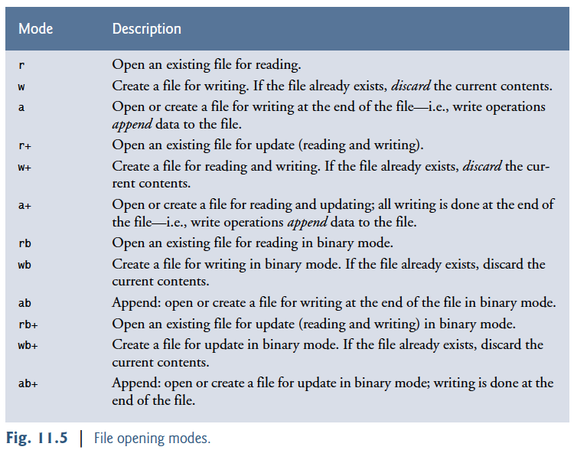
Modes of open

Slide 10
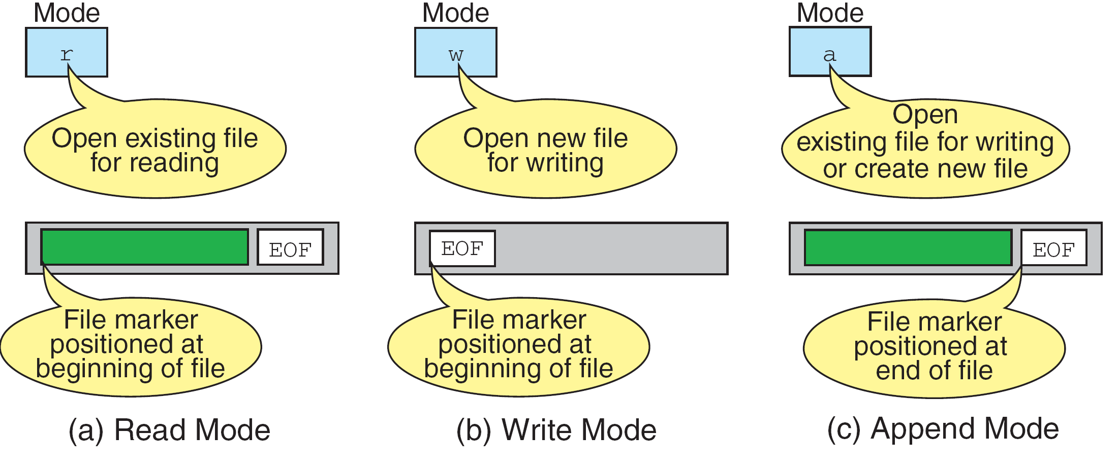
More on File Open Modes
from Figure 7-4 in Forouzan & Gilberg, p. 401

Slide 11
File Operation – fclose()
We need to close the file before ending the program or beginning another mode with that same file.
To close a file, we use fclose function
Syntax: fclose(file-pointer);

Slide 12
File Operation – Reading and Writing a Char
fgetc() is used for reading a character from the file
Syntax:
character_variable= fgetc(file_pointer);
Example:
fgetc(stdin) == getchar()
fputc() is used to writing a character to a file
Syntax:
fputc(character , file_pointer);
Eaxmple:
fputc('a', stdout) == putchar(‘a’)

Slide 13
File Operation – Reading and Writing a string
fscanf() is used for reading a character from the file
Syntax:
fscanf(file_pointer, “format”, value1, value2, ..., valueN);
Example:
fscanf(stdin, "%d%29s%lf", &account, name, &balance);
fprintf() is used to writing a character to a file
Syntax:
fprintf(file_pointer, “format”, value1, value2, ..., valueN);
Example:
fprintf(stdout, "%d %s %.2f\n", account, name, balance);

Slide 14
File Operations: foef()
Using feof to Check for the End-of-File Indicator
The function returns a nonzero (true) value when the end-of-file indicator has been set;
otherwise, the function returns zero.
The end-of-file indicator is set for the standard input when the user enters the end-of-file key combination.
Syntax:
feof(file_pointer)

Slide 15
Reading and Write char from a Sequential-Access File
#include <stdio.h>
void main() {
FILE *fp; /* Pointer to the file */
char c; /* Character variable to read the content of file */
/* Opening a file in r mode*/
fp= fopen ("C:\\myfiles\\newfile.txt", ”r");
/* loop to read each character in the file*/
while(!feof(fp)) {
c = fgetc(fp);
fputc(c, stdout); }
fclose(fp);
}

Slide 16
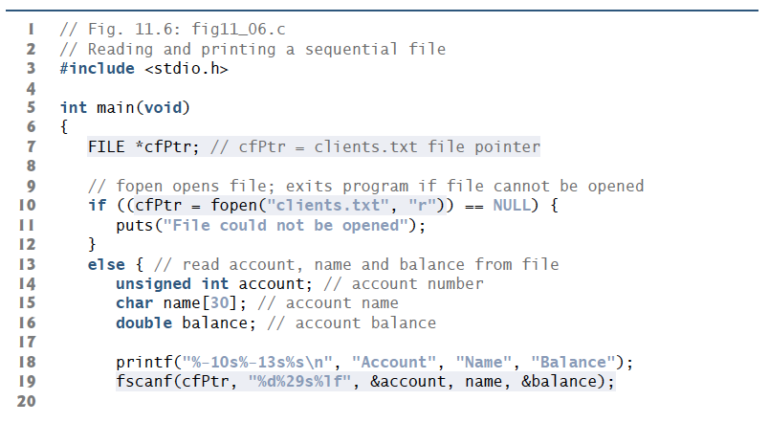
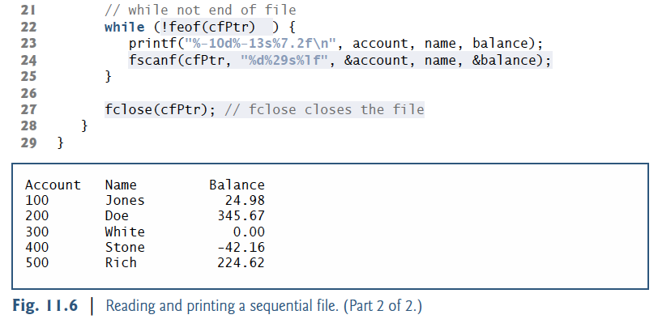
Reading from a Sequential-Access File

Slide 17
Writing to a File
#include <stdio.h>
void main() {
FILE *fp; char c ;
fp=fopen("C:\\myfiles\\newfile.txt", ”a");
do{
puts(“Enter your name and age”);
char name[120]; int age;
scanf(“%s %d”,name,&age);
fprintf(fp,”%s %d\n”, name, age);
puts(“Enter 1 to continue and 0 to to stop”
c = getchar();
}while(c != ‘0’);
fclose(fp);
}

Slide 18
File Operation – rewind()
rewind() is used to move the file pointer to the beginning of the given file.
Syntax:
rewind (file_pointer);

Slide 19
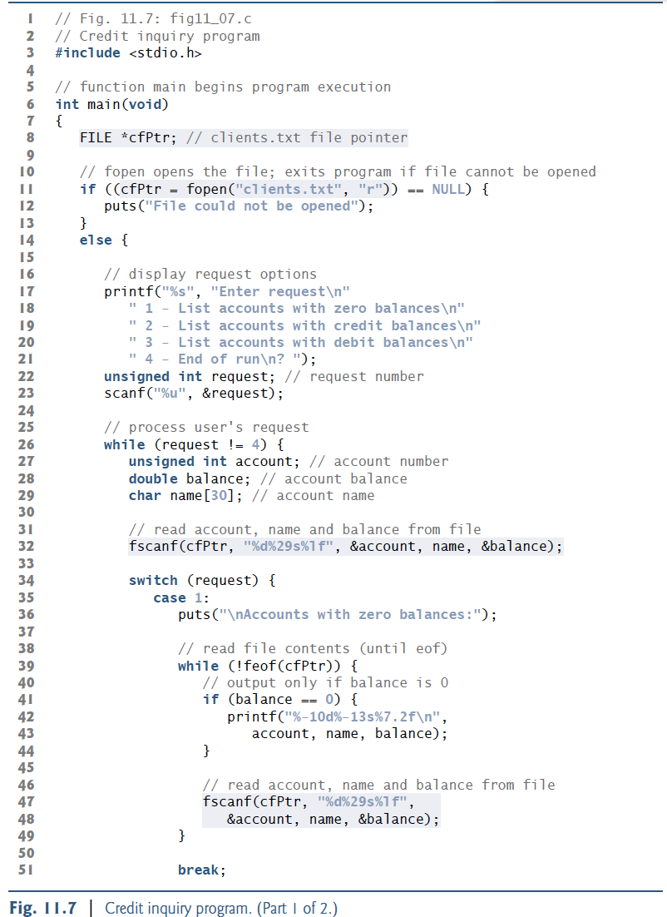
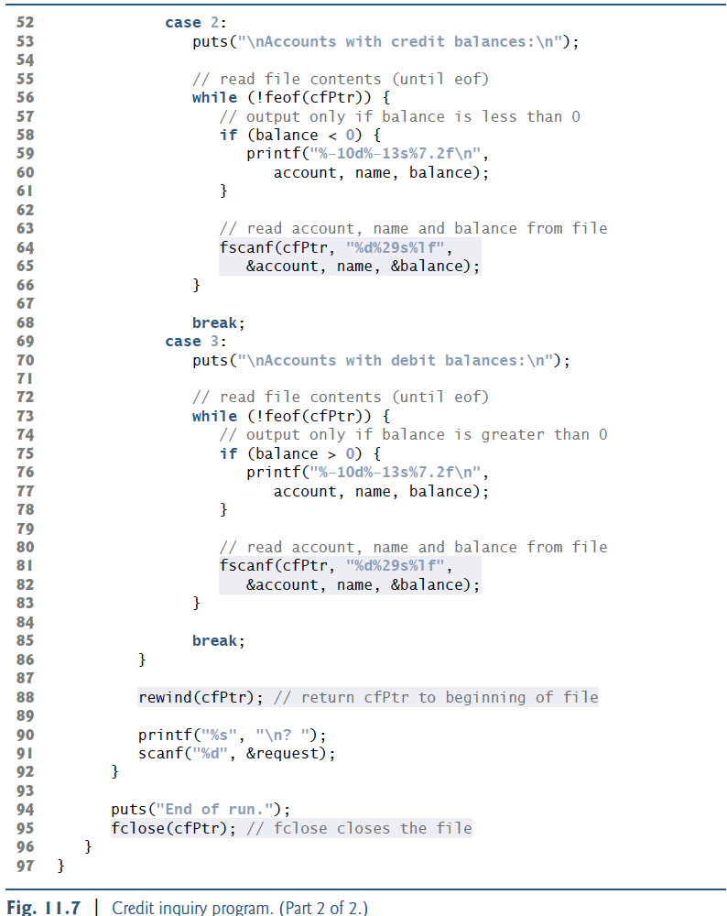

Slide 20
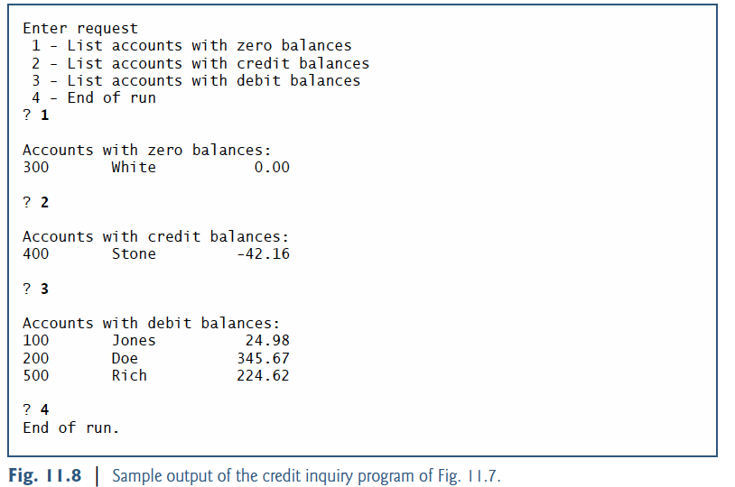

Slide 21
Questions?

