Slide 1
Arrays

Slide 2
Arrays Declaration
Name of array (Note that all elements of this array have the same name, c)
Array
Group of consecutive memory locations
Same name and type
Declaration:
Type arrayname[ size]
Examples
int c[11];
char a[2];
double arrayD[5];
c[0]
-45
c[1]
6
c[2]
0
c[3]
72
c[4]
1543
c[5]
-89
c[6]
0
c[7]
62
c[8]
-3
c[9]
1
c[10]
6453
c[11]
78
Position number of the element within array c

Slide 3
Array Initialization
After declaration, array contains some garbage value.
Static initialization
Run time initialization
int month_days[] = {31, 28, 31, 30, 31, 30, 31, 31, 30, 31, 30, 31},
n [5] = {0},
d [] ={1,2,3,4,5};
int i;
int A[6];
for(i = 0; i < 6; i++) A[i] = 6 - i;

Slide 4
Array Accessing an element
Name of array (Note that all elements of this array have the same name, c)
Format of calling an element of an array:
arrayname[ position_number ]
First element at position 0
n element array named c:
c[ 0 ], c[ 1 ]...c[ n – 1 ]
Array elements are like normal variables
c[ 0 ] = 3;
printf( "%d", c[ 0 ] );
int a = c[2];
Perform operations in subscript. If x equals 3
c[ 5 - 2 ] == c[ 3 ] == c[ x ]
c[0]
-45
c[1]
6
c[2]
0
c[3]
72
c[4]
1543
c[5]
-89
c[6]
0
c[7]
62
c[8]
-3
c[9]
1
c[10]
6453
c[11]
78
Position number of the element within array c

Slide 5
5
1 /* Fig. 6.8: fig06_08.c
2 Histogram printing program */
1. Initialize array
2. Loop
3. Print
3 #include <stdio.h>
4 #define SIZE 10
5
6 int main()
7 {
8 int n[ SIZE ] = { 19, 3, 15, 7, 11, 9, 13, 5, 17, 1 };
9 int i, j;
10
11 printf( "%s%13s%17s\n", "Element", "Value", "Histogram" );
12
13 for ( i = 0; i <= SIZE - 1; i++ ) {
14 printf( "%7d%13d ", i, n[ i ]) ;
15
16 for ( j = 1; j <= n[ i ]; j++ ) /* print one bar */
17 printf( "%c", '*' );
18
19 printf( "\n" );
20 }
21
22 return 0;
23 }

Slide 6
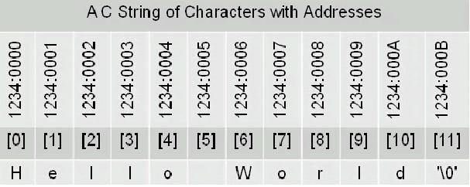
Strings in C
No “Strings” keyword
A string is an array of characters.
OR
char string[] = “hello world”;
char *string = “hello world”;

Slide 7
Character arrays initialization
Static initialization
‘\0’ denotes the end of string
Run time initialization
char string1[] = “hello world”;
char string1[6] = “world”;
char string2[] = { 'f', 'i', 'r', 's', 't', '\0’ };
Char string3[4]= {’w’,’o’,’w’,’\0’};
char string1[];
scanf( "%s", string2 ); //Reads characters until whitespace encountered
// Can write beyond end of array, be careful

Slide 8
1. Initialize strings
2. Print strings
2.1 Define loop
2.2 Print characters
individually
2.3 Input string
3. Print string
Program Output

Slide 9
Passing Arrays to Functions
Passing arrays
int myArray[ 24 ];
myFunction( myArray, 24 );
Arrays passed call-by-reference
Name of array is address of first element
Passing array elements
Passed by call-by-value
Pass subscripted name (i.e., myArray[ 3 ]) to function
myFunction( myArray[3]);
Function prototype
void myFunction( int b[], int arraySize );
Parameter names optional in prototype
int b[] could be written int []
int arraySize could be simply int
Function prototype
void myFunction( int b );

Slide 10
1. Function definitions
2. Pass array to a function
2.1 Pass array element to a function
3. Print
Entire arrays passed call-by-reference, and can be modified
Array elements passed call-by-value, and cannot be modified

Slide 12
Case Study
Bubble sort
Computing Mean, Median and Mode Using Arrays

Slide 19
Exercise
Searching Arrays: Linear Search

Slide 20
Exercise
Write loops that perform each of the following one-dimensional array operations:
a) Read the 20 elements of double array sales from the keyboard.
b) Add 1000 to each of the 75 elements of double array allowance.
c) Initialize the 50 elements of integer array numbers to zero.
d) Print the 10 values of integer array GPA in column format.

Slide 21
Any Questions?
Chapter 6 C Arrays

