Slide 1
Function

Slide 2
Variable Scope
LOCAL
GLOBAL

Slide 3
Variable Scope (local scope)
The scope of a variable starts when it is declared in a block {} and,
it only stays alive until the end of the block.
Example If the block defines:
A function body, the variable is alive from where it is declared until the end of the function.
a loop body or if-statement body, the variable only lives till the end of loop/if
You can add a block anywhere you want in the code, and it will define the scope for any variables declared within it.

Slide 4
Example scopes
int main ( ) {
int i;
for (i=0; i < 10; i++ ) {
int total = i;
}
int j = total; // error! total out of scope
{
int k;
// use k
}
int m = j;
…
}
i
total
j
k
m

Slide 5
Variable Scope
int main ( ) {
int i = 5, j = 0;
for (j = 0; j < 10; j++) {
int i = j; // OK, this is new i
int k = 5;
doSomething (i);
}
int sum = k; // compile error, no k in scope
j = i; // sets j to 5
for (j = 0; j < 100; j++ ) {
int i = j; // yet another new i
}
int i = 0; // compile error –redefined variable
}
You can reuse names, as long as they are not in overlapping scopes.
In fact, you can reuse names in a scope which is nested inside another scope

Slide 6
Static variables
Local variables declared with the keyword static are still known only in the function
static local variables retain their value when the function is exited.
declares local variable count to be static and initializes it to 1.
static int count = 1;
All numeric variables of static storage duration are initialized to zero by default if you do not explicitly initialize them.

Slide 7
Variable Scope (global scope)
int total = 5;
int main ( ) {
int total = 4; // OK, this is nested scope
….
}
int sub1 ( ) {
int i = total; // OK, i set to 5
}
This is for variables defined outside of functions
Global variables have scope from the point they are defined throughout the rest of file
Local variables of same name can be nested inside global variables

Slide 8
Exercise
int i = 10;
int main ( ) {
i ?
for (j = 0; j < 10; j++ ) {
int i = 20;
i?
}
i ?
int i = 30;
i ?
}

Slide 9
Style rules
Only use global variables if you really, really have to !!!
2 different approaches for local variables inside a function
Declare all variables at the top of the function
This is the way you used to have to do it in C
Helps the reader to know where to look for the variable declaration
Declare variables as they are needed
Minimizes scope
Allows you to set the value only once, rather then once at declaration and then again at first use
Either approach is OK – probably the most common in industry is to declare as needed
Don’t re-use names heavily, except for maybe i, j, k

Slide 10
Function

Slide 11
Definition – Function
A fragment of code that accepts zero or more argument values, produces a result value, and has zero or more side effects.
A method of encapsulating a subset of a program or a system
To hide details
To be invoked from multiple places
To share with others
Notes:
11

Slide 12
Functions
Predefined functions: available in C / C++ standard library such as stdio.h, math.h, string.h etc.
User-defined functions: functions that programmers create for specialized tasks.

Slide 13
Predefined Functions
#include <math.h>
sin(x) // radians
cos(x) // radians
tan(x) // radians
atan(x)
atan2(y,x)
exp(x) // e^{x}
log(x) // log_{e} x
log10(x) // log₁₀ x
sqrt(x) // x ≥ 0
pow(x, y) // x^{y}
...
#include <stdio.h>
printf()
fprintf()
scanf()
sscanf()
...
#include <string.h>
strcpy()
strcat()
strcmp()
strlen()
...
Functions called by writing
functionName (argument)
Notes:
13

Slide 14
Predefined Functions (continued)
See also things like
<pthread.h> // concurrent execution
<socket.h> // network communications
... // many, many other facilities
Fundamental Rule: if there is a chance that someone else had same problem as you, …
… there is probably a package of functions to solve it!
Notes:
14

Slide 15
User-defined Functions
resultType functionName(type₁ param1, type₂ param2, …) {
…
body
…
}
If no result, resultType should be void
Warning if not!
If there is a result, use return keyword to return a value.
The return value must match the return data type.
A function can contain multiple return statements.
If no parameters, use void between ()
Notes:
15

Slide 16
Using Functions
Let int f(double x, int a) be (the beginning of) a declaration of a function.
Then f(expr₁, expr₂) can be used in any expression where a value of type int can be used – e.g.,
N = f(pi*pow(r,2), b+c) + d;

Slide 17
Using Functions (continued)
This is a parameter
Let int f(double x, int a) be (the beginning of) a declaration of a function.
Then f(expr₁, expr₂) can be used in any expression where a value of type int can be used – e.g.,
N = f(pi*pow(r,2), b+c) + d;
This is an argument
This is also an argument

Slide 18
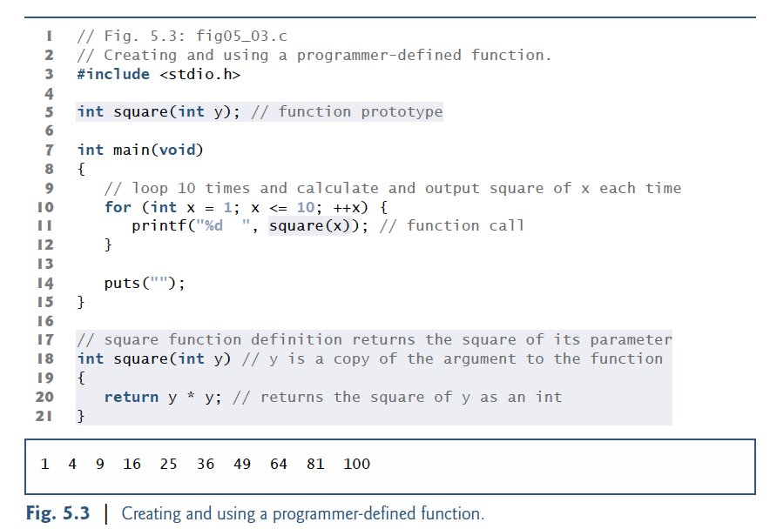

Slide 19
Function Prototypes
There are many, many situations in which a function must be used separate from where it is defined –
before its definition in the same C program
In one or more completely separate C programs
This is actually the normal case!
Therefore, we need some way to declare a function separate from defining its body.
Called a Function Prototype
Notes:
19

Slide 20
Function Prototypes (continued)
Definition:– a Function Prototype in C is a language construct of the form:–
return-type function-name (parameter declarations) ;
I.e., exactly like a function definition, except with a ';' instead of a body in curly brackets
Notes:
20

Slide 21
Header Files
Header files
Contain function prototypes for library functions
<cstdlib> , <cmath>, etc.
Load with #include <filename>
Example: #include <cmath.h>
Custom header files
Defined by the programmer
Save as filename.h
Loaded into program using
#include "filename.h"

Slide 22
Passing Arguments By Value and By Reference
When arguments are passed by value, a copy of the argument’s value is made and passed to the called function.
Changes to the copy do not affect an original variable’s value in the caller.
void f(int x)
When an argument is passed by reference, the caller allows the called function to modify the original variable’s value.
void f(int& x)

Slide 23
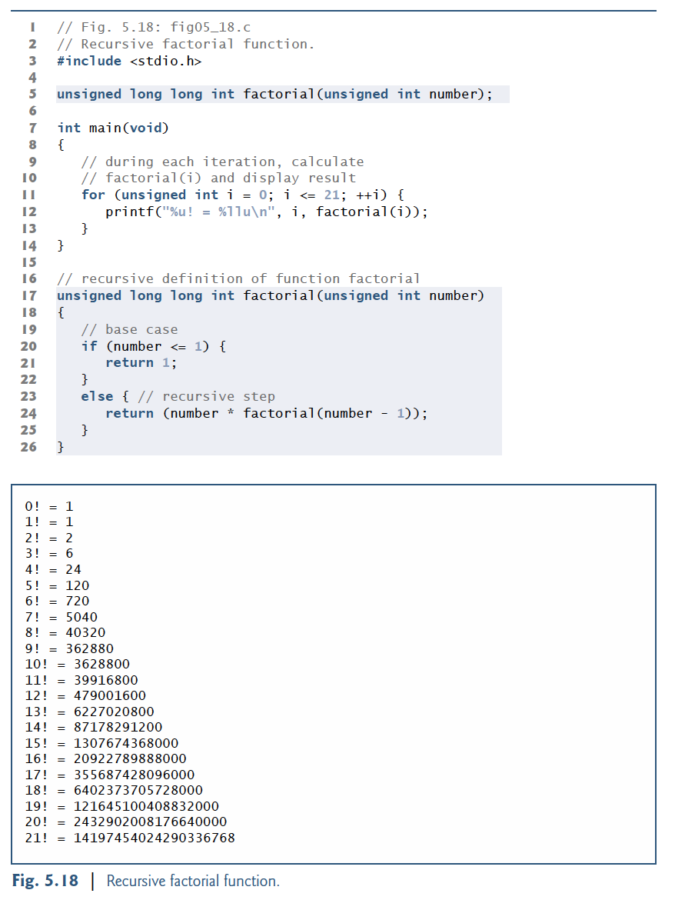
Recursion
Recursive functions
Are functions that calls themselves
Example: factorial
n! = n * ( n – 1 ) * ( n – 2 ) * … * 1
Recursive relationship ( n! = n * ( n – 1 )! )
5! = 5 * 4!
4! = 4 * 3!…
Base case (1! = 0! = 1)

Slide 24
The Fibonacci Series
f( 3 )
Fibonacci series: 0, 1, 1, 2, 3, 5, 8...
Each number sum of two previous ones
Example of a recursive formula:
fib(n) = fib(n-1) + fib(n-2)
C code for fibonacci function
long fibonacci( long n )
{
if ( n == 0 || n == 1 ) // base case
return n;
else if ( n < 0 )
return –1;
else
return fibonacci( n - 1 ) + fibonacci( n – 2 );
}
return
f( 2 )
+
f( 1 )
return
f( 1 )
+
f( 0 )
return 1
return 1
return 0

Slide 25
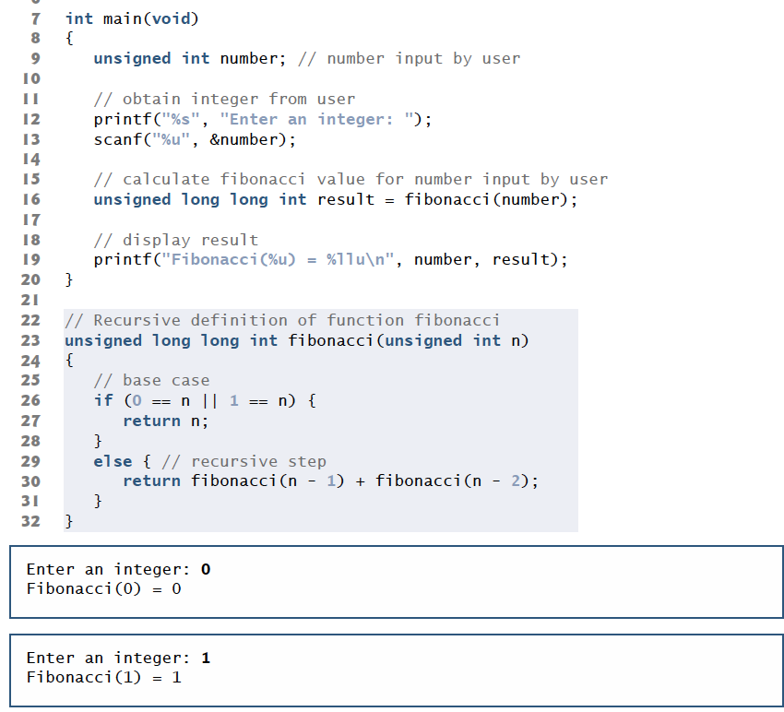
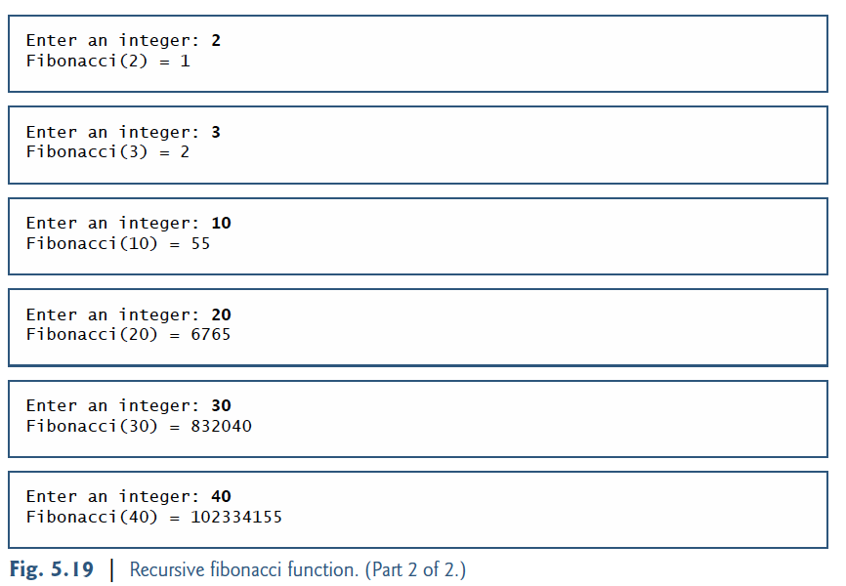

Slide 26
Recursion vs. Iteration
Repetition
Iteration: explicit loop
Recursion: repeated function calls
Termination
Iteration: loop condition fails
Recursion: base case recognized
Both can have infinite loops
Balance between performance (iteration) and good software engineering (recursion)

