Slide 1
Branching/ Selections edited by :Nouf al munyif

Slide 2
Branching forms
(1) If Statement
(3) Nested If..else Statement
if (expression)
{Block of statements; }
if (expression)
{ Block of statements; }
else if(expression)
{ Block of statements; }
else
{ Block of statements; }
(2) If ..else Statement
if (expression)
{Block of statements; }
else
{Block of statements; }

Slide 3
1. if Selection statement

Slide 4
Decision Making: Equality and Relational Operators

Slide 6
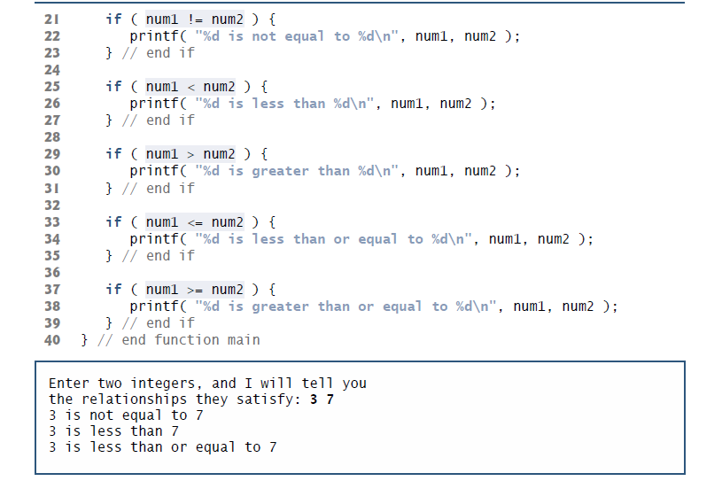

Slide 8
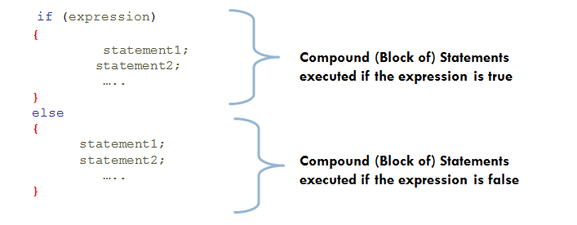
Branching if syntax

Slide 9
2. if…else Selection statement

Slide 10
Exercise
Test whether the value of the variable count is greater than 10. If it is, print “Count is greater than 10.”
Write a code that read x and change its value as follows:
If x is even, divide x by 2.
If x is odd, multiply x by 3 and subtract 1.

Slide 11
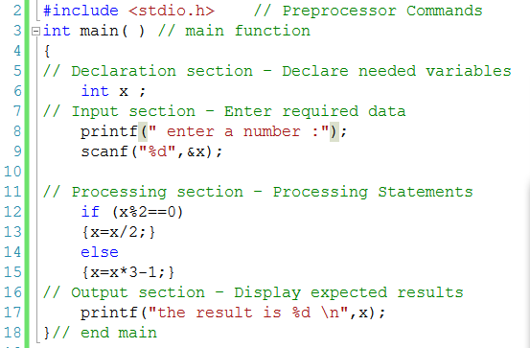

Slide 12
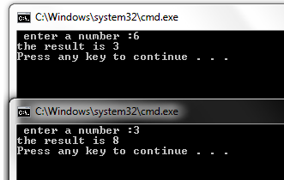

Slide 13
Conditional operator ?:
The( ? : ) operator is just like an if ... else statement except that because it is an operator you can use it within expressions.
? : is a ternary operator in that it takes three values, this is the only ternary operator C has.
? : takes the following form:
if condition is true ? then X return value : otherwise Y value;

Slide 14
Conditional operator ?:
if condition is true ? then X return value : otherwise Y value;

Slide 15
If..else vs ?:
max = x >= y ? x : y ;
if ( x > = y )
max = x ;
else
max = y ;

Slide 16
Nested if...else Statements
if (testExpression1)
{ // statements to be executed if testExpression1 is true }
else if(testExpression2)
{ // statements to be executed if testExpression1 is false
// and testExpression2 is true }
else if (testExpression 3)
{ // statements to be executed if testExpression1
//and testExpression2 is false and testExpression3 is true }
. .
else
{ // statements to be executed if all test expressions are false }

Slide 17
Nested if...else Statements

Slide 18
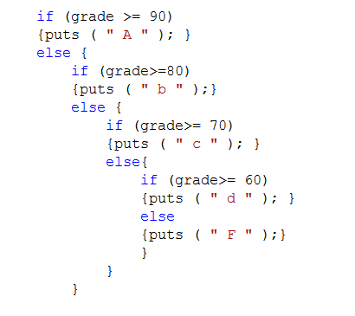
Nested if...else Statements

Slide 19
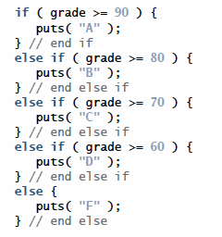
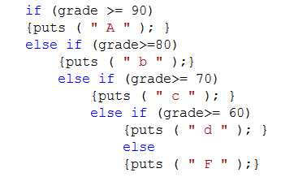
Nested if...else Statements

Slide 20
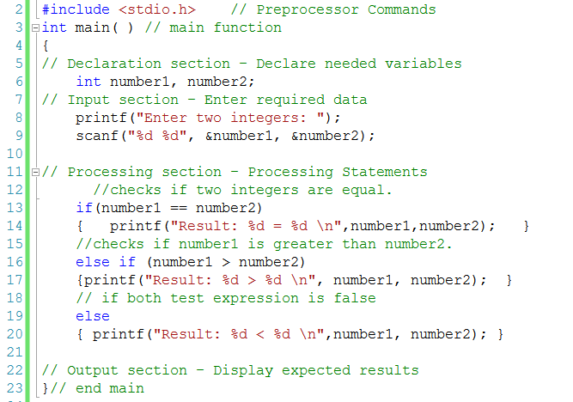
example

Slide 21
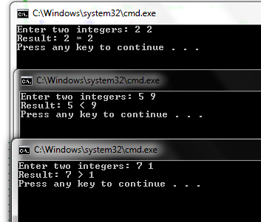

Slide 22
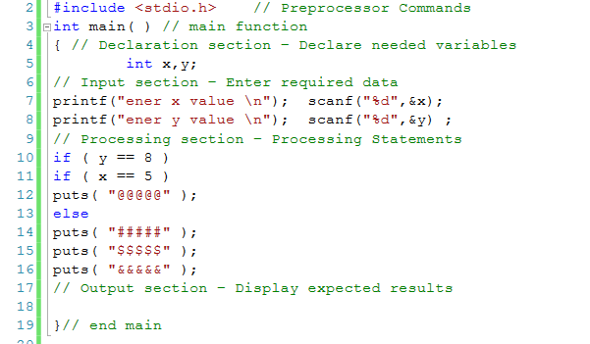
what will be printed if x=5 y=8

Slide 23
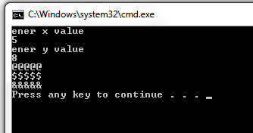

Slide 24
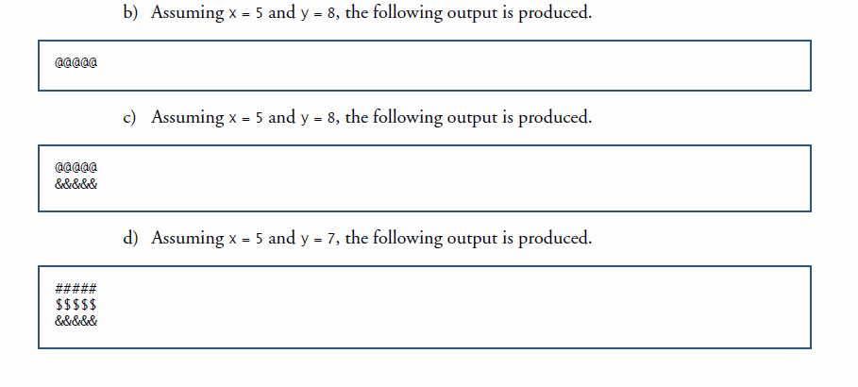
Modify the previous code to produce the output shown.

Slide 25
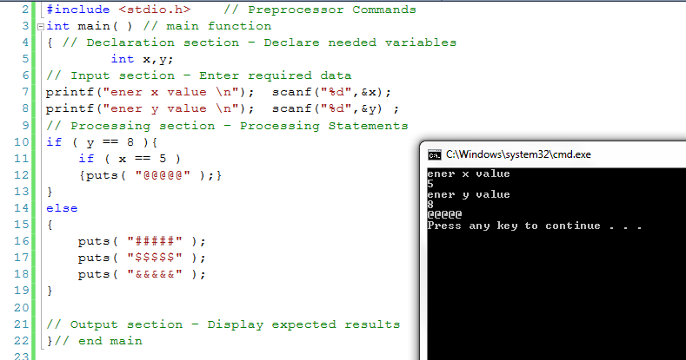

Slide 26
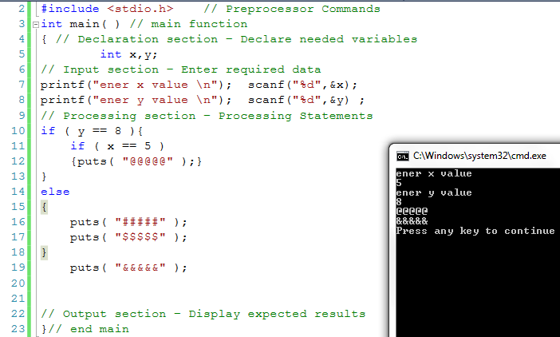

Slide 27
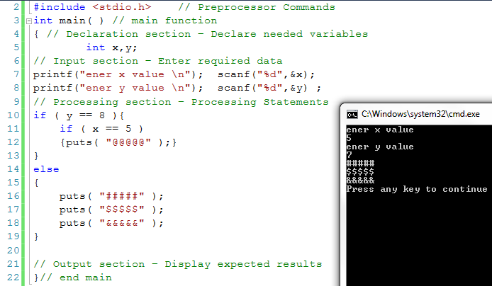

Slide 28
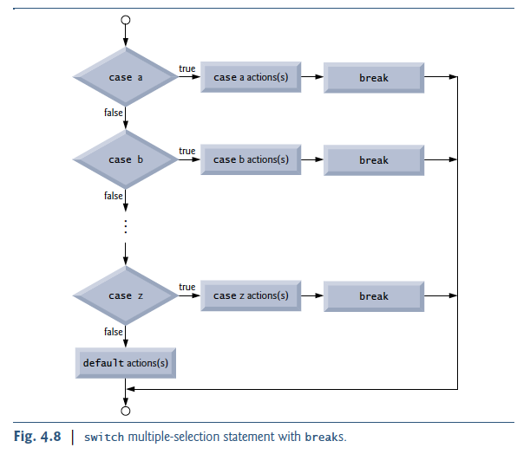
switch statement
switch( expression ) {
case constant-expression1: statements1; break;
[case constant-expression2: statements2; break;]
[case constant-expression3: statements3; ;break;]
[default : statements4;]
}
limited by
The expression can be integer or char
and cannot be float or any other data type.
No two case statement constants may be the same.
Character constants are automatically converted to integer.

Slide 29
switch statement

Slide 30
Operators

Slide 31
Assignment Operators

Slide 32
Increment and Decrement Operators

Slide 33
Increment and Decrement Operators
For Example :-
int i, j = 2 ;
i = ++ j ; /* prefix :- i has value 3, j has value 3 */
i = j++ ; /* postfix :- i has value 3, j has value 4 */

Slide 35
Exercise 1
Identify and correct the errors in each of the following statements:
if ( c < 7 );{
printf( "C is less than 7\n" );
}
if ( c => 7 ) {
printf( "C is greater than or equal to 7\n" );
}

Slide 36
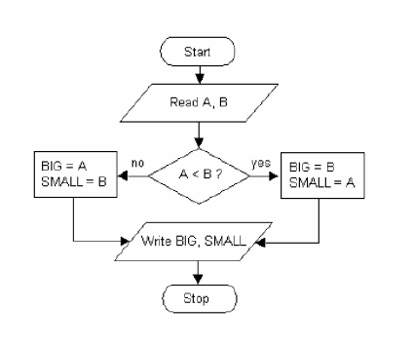
Exercise 2
Convert the algorithm to C source code

Slide 37
Declaration of answer and assigning it a value
The general form of the assignment statement is:
variable = expression;

Slide 38
Exercises
Define the variables x, y and z to be of type int where x= 9, y=2, z=0
Prompt the user to enter a float and store it in z.
Define the variable result, compute the product of the numbers in the variables x, y and z, and use that product to initialize the variable result.
Print "The product is" followed by the value of the integer variable result.

Slide 39
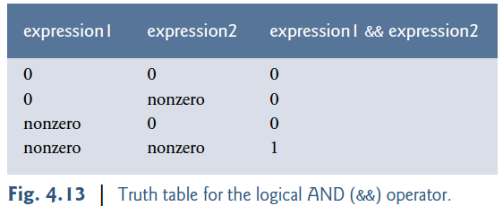
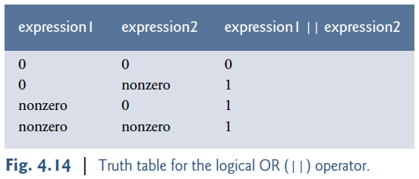
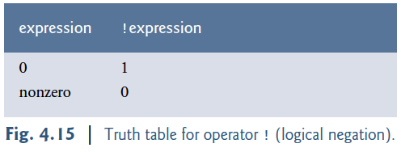
Logical Operator
Logical AND (&&) Operator
Logical OR (||) Operator
Logical Negation (!) Operator

