Slide 1
Algorithms & Pseudocode & Flowcharts
Dr. Nouf Aljaffan
naljaffan@ksu.edu.sa

Slide 2
Objectives
Learn how to write an algorithm using Flowchart and Pseudocode

Slide 3
Stages in Program Development Process
1- Analysis of a problem
2- Create the algorithm
3- Compile the program
4- Execute the program
5- Testing and Debugging the Program

Slide 4
(2) Create the algorithm
Plan for solution and use basic statements and expression to develop the algorithm

Slide 5
Computational Thinking
https://youtu.be/mUXo-S7gzds

Slide 6
Computational Thinking
Decomposition
Breaking down data, processes, or problems into smaller, manageable parts
Pattern Recognition
Observing patterns, trends, and regularities in data
Abstraction
Identifying the general principles that generate these patterns
Algorithm Design
Developing the step by step instructions for solving this and similar problems
Notes:
https://community.computingatschool.org.uk/files/8221/original.pdf
https://barefootcas.org.uk/wp-content/uploads/2014/10/Computational-thinking-Barefoot-Computing.pdf

Slide 7
What Can a Program Do?
Read Input
Sequence
Calculate
Store data
Compare and branch
Iterate or Loop
Write Output

Slide 8
Sequence
Compare and branch
Iterate or Loop
Entry
Test condition p
false
true
“false” statement a
“true” statement a
Exit
No

Slide 9
Planning the Solution
Pseudocode is a semi-programming language used to describe the steps in an algorithm.
Flowchart is a graphical representation of an algorithm.

Slide 10
Planning the Solution
 | 1) Flowchart | 2) Pseudocode
Start/End |  | Begin/End (not necessary)
Input/Output |  | Read/Print : read x,y
Process |  | [An equation] : x=y+6 Comput: compute x as y+6
Decision |  | If/ if-else / While
Predefined process |  | [function_name()]: average(x,y)
Line |  | Not Applicable
Connector |  | Not Applicable

Slide 11
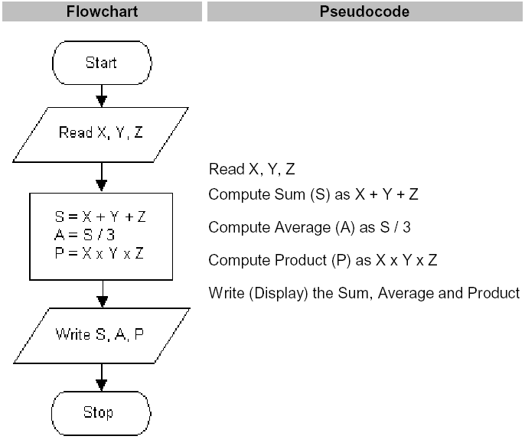
Example 1 Sequence

Slide 12
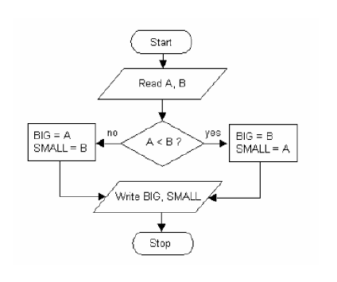
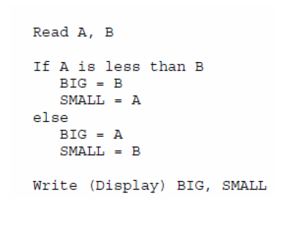
Example 2 Compare and branch
Flowchart
Pseudocode

Slide 13
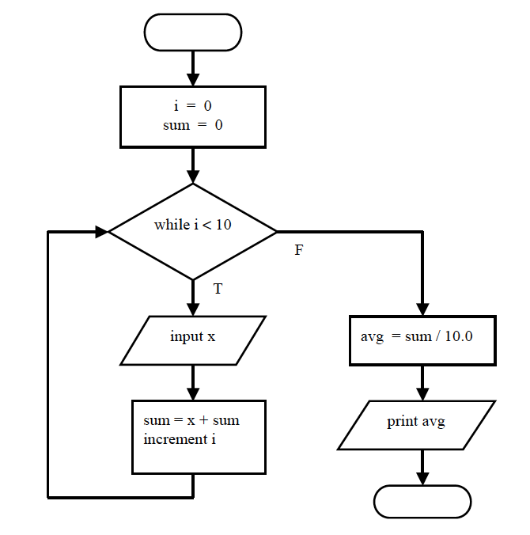
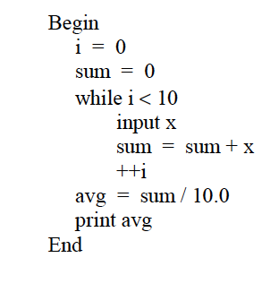
Example 3 Iterate or Loop
Flowchart
Pseudocode
start
End

Slide 14
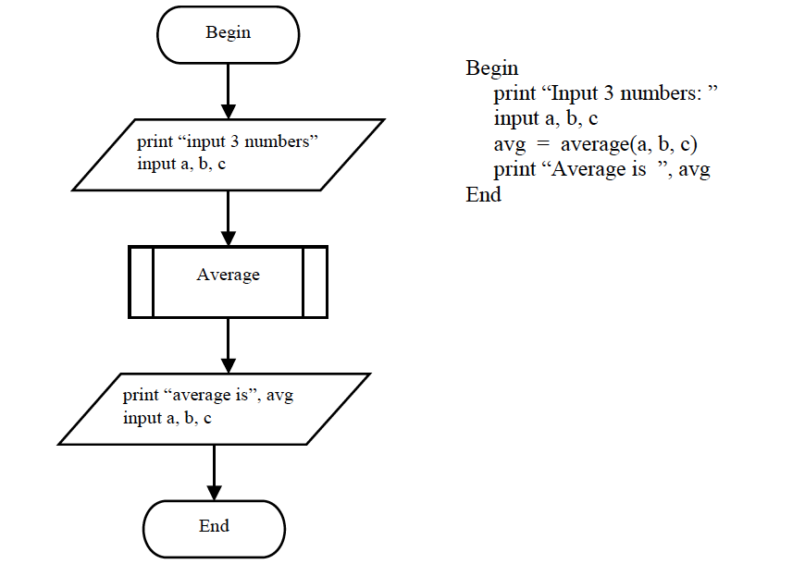
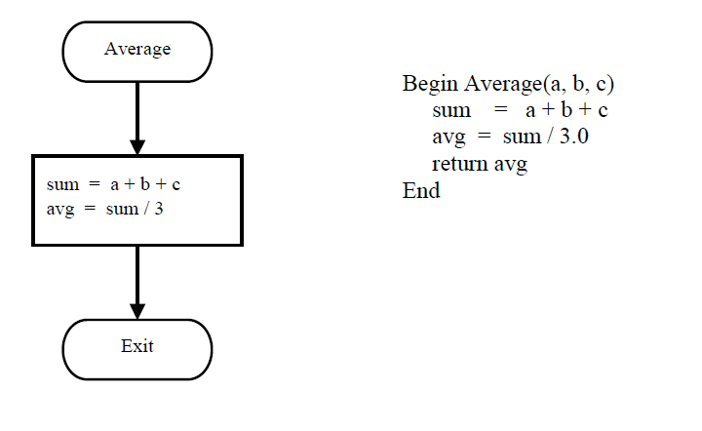
Example 4 Calling predefined processor

Slide 15
Exercise 1
Write an algorithm to find the perimeter of triangle

Slide 16
Exercise 2
Write an algorithm to find greatest of given three numbers
1
Write an algorithm to check whether given integer value is PRIME or NOT.
2

Slide 17
Exercise 3
ABC company plans to give a 6% year-end bonus to each of its employees earning Rs 6,000 or more per month , and a fixed Rs 250 bonus to the remaining employees. Write an algorithm to calculate the bonus for an employee

Slide 18
Conclusion
The flowchart and the pseudocode were explained
There are many styles of pseudocode.
Flowchart could be time-consuming but a good tool in education.

Slide 19
Question!

Slide 20
References
https://computationalthinkingcourse.withgoogle.com/unit

