Slide 1
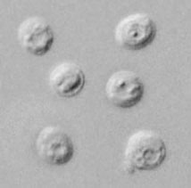
Cryptosporidium parvum
By : T. Moudy Bin Saleh

Slide 2
Classification
Phylum: Apicomplexa
Class: Conoidasida
Order: Eucoccidiorida
Family: Cryptosporidiidae
Genus: Cryptosporidium
Species: C. parvum

Slide 3
Causal Agents
Cryptosporidiosis (or "Crypto" for short) is a disease that causes watery diarrhea. It is caused by microscopic germs parasites called Cryptosporidium.
Although Crypto can affect all people, some groups are likely to develop more serious illness. For people with weakened immune systems, symptoms can be severe (life-threatening illness). For example: people with AIDS and cancer who are taking certain immunosuppressive drugs.

Slide 4
Site of infection
Most parasite species infect the small intestines of their hosts (mammals) whereas others infect the respiratory tract (birds) or stomach (reptiles).
The parasites are located within parasitophorous vacuoles covered by host microvillous membranes.

Slide 5
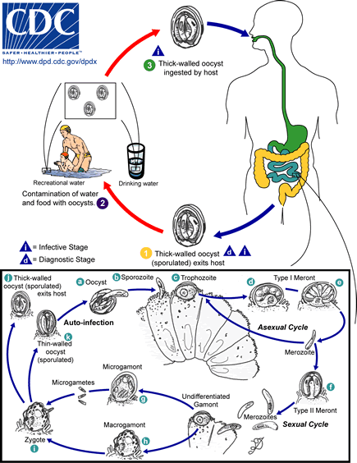
Life cycle

Slide 6
Life cycle
They undergo cyclic asexual merogony (schizogony) followed by sexual gamogony (♂ microgametes fertilize ♀ macrogametes) resulting in the formation of small oocysts which undergo exogenous sporulation (forming 4 naked sporozoites).
They undergo several cycles of asexual merogonous development before gamonts are formed. After fertilization, the oocysts mature in the gut and are usually infective as soon as they are excreted from the host.

Slide 7
Laboratory Diagnosis
Acid-fast staining methods, with or without stool concentration, are most frequently used in clinical laboratories.
For greatest sensitivity and specificity, immunofluorescence microscopy is the method of choice (followed closely by enzyme immunoassays).
Molecular methods are mainly a research tool.

Slide 8
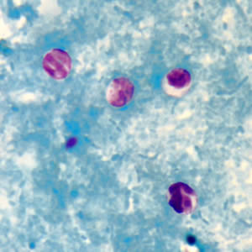
Laboratory Identification of Parasitic Diseases
Cryptosporidium parvum oocysts in wet mount, under differential interference contrast (DIC) microscopy. The oocysts are rounded and measure 4.2 µm - 5.4 µm in diameter. Sporozoites are visible inside the oocysts, indicating that sporulation has occurred.
Cryptosporidium sp. oocysts stained with modified acid-fast

Slide 9
Video

Slide 10
Thank you

