Slide 1
MANAGEMENT OF PATIENT WITH COPD

Slide 2
LEARNINIG OBJECTIVES
On completion of this chapter, the learner will be able to:
1. Describe the pathophysiology of chronic obstructive pulmonary
disease (COPD).
2. Discuss the major risk factors for developing COPD and nursing
interventions to minimize or prevent these risk factors.
3. Use the nursing process as a framework for care of the patient with
COPD.
4. Develop a teaching plan for patients with COPD.
5. Describe the pathophysiology of asthma.
6. Discuss the medications used in asthma management.
7. Describe asthma self-management strategies.
8. Describe the pathophysiology of cystic fibrosis.

Slide 3
Definition of COPD
Chronic obstructive pulmonary disease (COPD) is a disease
state characterized by airflow limitation that is not fully reversible.
COPD may include diseases that cause airflow obstruction
(eg, emphysema, chronic bronchitis) or a combination of these
disorders. Other diseases such as cystic fibrosis, bronchiectasis,
and asthma were previously classified as types of chronic obstructive
lung disease. However, asthma is now considered a separate
disorder and is classified as an abnormal airway condition
characterized primarily by reversible inflammation.
COPD can coexist with asthma. Both of these diseases have the same major symptoms; however, symptoms are generally more variable in asthma than in COPD.

Slide 4
Pathophysiology of COPD
In COPD, the airflow limitation is both progressive and associated with an abnormal inflammatory response of the lungs
The inflammatory response occurs throughout
the airways, parenchyma, and pulmonary vasculature. Because of the chronic inflammation and the body’s attempts
to repair it, narrowing occurs in the small peripheral airways.
Over time, this injury-and-repair process causes scar tissue
formation and narrowing of the airway lumen.

Slide 5
Pathophysiology
Airflow obstruction may also be due to parenchymal destruction as seen with emphysema, a disease of the alveoli or gas exchange units.
Early in the course of COPD, the inflammatory response causes pulmonary vasculature changes that are characterized by thickening of the vessel wall. These changes may occur as a result of exposure to cigarette smoke or use of tobacco products or as a result of the release of inflammatory mediators

Slide 6
copd
http://www.animatedcopdpatient.com/
http://www.animatedcopdpatient.com/

Slide 7
Chronic Bronchitis
Chronic bronchitis, a disease of the airways, is defined as the presence of cough and sputum production for at least 3 months in each of 2 consecutive years. In many cases, smoke or other environmental pollutants irritate the airways, resulting in hypersecretionof mucus and inflammation.

Slide 8
BRONCHITIS
This constant irritation causes the
mucus-secreting glands and goblet cells to increase in number, ciliary function is reduced, and more mucus is produced. The bronchial walls become thickened, the bronchial lumen is narrowed, and mucus may plug the airway

Slide 9
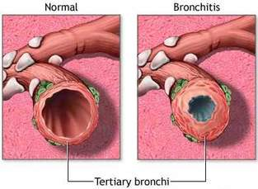

Slide 10
Emphysema
Emphysema” is a pathological term that describes an abnormal distention of the air spaces beyond the terminal bronchioles, with
destruction of the walls of the alveoli. It is the end stage of a process that has progressed slowly for many years.

Slide 11
As the walls of the alveoli are destroyed (a process accelerated by recurrent infections),
the alveolar surface area in direct contact with the pulmonary capillaries continually decreases, causing an increase in dead space (lung area where no gas exchange can occur) and impaired oxygen diffusion, which leads to hypoxemia.

Slide 12
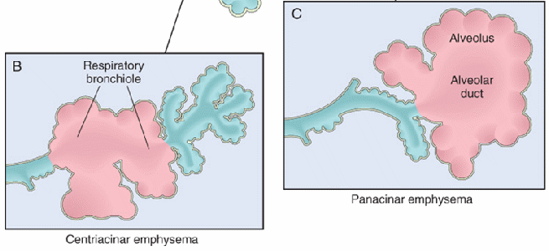
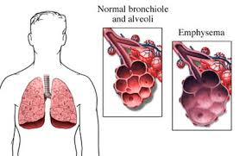

Slide 13
Risk Factors for COPD
Exposure to tobacco smoke accounts for an estimated 80% to 90% of COPD cases
Passive smoking
Occupational exposure
Ambient air pollution
Genetic abnormalities, including a deficiency of alpha1- antitrypsin, an enzyme inhibitor that normally counteracts
the destruction of lung tissue by certain other enzymes

Slide 14
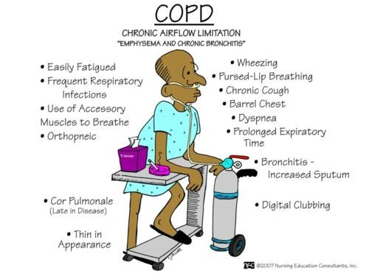
Clinical manifestations of COPD

Slide 15
• ASSESSMENT
Key Factors to Assess in the COPD
Patient’s Health History
Exposure to risk factors—types, intensity, duration
Past medical history—respiratory diseases/problems, including
asthma, allergy, sinusitis, nasal polyps, history of respiratory
infections
Family history of COPD or other chronic respiratory diseases
Pattern of symptom development
History of exacerbations or previous hospitalizations for
respiratory problems
Presence of comorbidities
Appropriateness of current medical treatments
Impact of the disease on quality of life
Available social and family support for patient
Potential for reducing risk factors (eg, smoking cessation)

Slide 16
Diagnostic findings
Spirometry is used to evaluate airflow obstruction, which is determined by the ratio of FEV1 (volume of air that the patient can forcibly exhale in 1 second) to forced vital capacity (FVC).
Obstructive lung disease is defined as a FEV1/FVC ratio of less than 70%.
Arterial blood gas measurements may also be obtained to assess baseline oxygenation and gas exchange.

Slide 17
Diagnostic findings
In addition, a chest x-ray may be obtained to exclude alternative diagnoses
Lastly, alpha1 antitrypsin deficiency screening may be performed for patients under age 45 or for those with a strong family history of COPD.

Slide 18
COMPLICATIONS OF COPD
Respiratory insufficiency and failure are major life-threatening complications of COPD. The acuity of the onset and the severity of respiratory failure depend on the patient’s baseline pulmonary function, pulse oximetry or arterial blood gas values, comorbid conditions, and the severity of other complications of COPD.

Slide 19
Medical Management
RISK REDUCTION
PHARMACOLOGIC THERAPY
Bronchodilators.
Corticosteroids
Other medication like flue vaccine

Slide 20
Oxygen therapy on COPD
Oxygen therapy can be administered as long-term continuous therapy, during exercise, or to prevent acute dyspnea. Longterm oxygen therapy has been shown to improve the patient’s quality of life and survival .For patients with an arterial oxygen pressure (PaO2) of 55 mm Hg or less on room air, maintaining a constant and adequate oxygen saturation (>90%) is associated with significantly reduced mortality and improved quality of life.

Slide 21
Indications for oxygen supplementation include
PaO2 of 55 mm Hg or less or evidence of tissue hypoxia and organ damage such as cor pulmonale, secondary polycythemia, edema from right heart failure, or impaired mental status. In patients with exercise-induced hypoxemia, oxygen supplementation during exercise can improve performance. Patients who are hypoxemic while awake are likely to be so during sleep. Therefore, nighttime oxygen therapy is recommended as well, and the prescription for oxygen therapy is for continuous, 24-hour use. Intermittent oxygen therapy is indicated for those who desaturate only during exercise or sleep.

Slide 22
NURSING ALERT on o2 therapy for COPD
Because hypoxemia stimulates respiration in the patient with severe COPD, increasing the oxygen flow to a high rate may greatly raise the patient’s blood oxygen level. At the same time, this will suppress the respiratory drive, causing increased retention of carbon dioxide and CO2 narcosis. The nurse should closely monitor the patient’s respiratory response to oxygen administration via physical assessment, pulse oximetry, and/or arterial blood gases.

Slide 23
Surgical intervention
Bullectomy
Lung Volume Reduction Surgery
Lung transplantation

Slide 24
PULMONARY REHABILITATION
The primary goal of rehabilitation:
is to restore patients to the highest level of independent function possible and to improve their quality of life
Most pulmonary rehabilitation programs include educational, psychosocial, behavioral, and physical components. Breathing exercises and retraining and exercise programs are used to improve functional status, and the patient is taught methods to alleviate symptoms.

Slide 25
Nursing management
Patient education
Breathing exercises
Inspiratory muscle training
Activity pacing
Self-Care Activities
Physical Conditioning
Oxygen Therapy.
Nutritional Therapy
Coping Measures.

Slide 26
Nursing care of patient with COPD
Assessment
Assessment involves obtaining information about current symptoms as well as previous disease manifestations.

Slide 27
NURSING DIAGNOSIS
Based on the assessment data, the patient’s major nursing diagnoses may include the following:
• Impaired gas exchange and airway clearance due to chronic
inhalation of toxins
• Impaired gas exchange related to ventilation–perfusion
inequality
• Ineffective airway clearance related to bronchoconstriction,
increased mucus production, ineffective cough, bronchopulmonary
infection, and other complications
• Ineffective breathing pattern related to shortness of breath,
mucus, bronchoconstriction, and airway irritants
• Activity intolerance due to fatigue, ineffective breathing
patterns, and hypoxemia
• Deficient knowledge of self-care strategies to be performed
at home.
• Ineffective coping related to reduced socialization, anxiety,
depression, lower activity level, and the inability to work

Slide 28
Planning and Goals
The major goals for the patient may include smoking cessation,improved gas exchange, airway clearance, improved breathing pattern, improved activity tolerance, maximal self-management,improved coping ability, adherence to the therapeutic program and home care, and absence of complications.

Slide 29
Nursing Interventions
PROMOTING SMOKING CESSATION
IMPROVING GAS EXCHANGE:
the nurse must administer the medications (bronchodilators & corticosteroids) properly and be alert for potential side effects.
ACHIEVING AIRWAY CLEARANCE :
Diminishing the quantity and viscosity of sputum can clear the
airway and improve pulmonary ventilation and gas exchange it can be achieved through :

Slide 30
All pulmonary irritants should be eliminated or reduced, particularly cigarette smoking, which is the most persistent source of pulmonary irritation.
Breathing & coughing exercise
Chest physiotherapy with postural drainage
Increase fluid intake

Slide 31
IMPROVING BREATHING PATTERNS
Training in diaphragmatic breathing reduces the respiratory rate, increases alveolar ventilation, and sometimes helps expel as much air as possible during expiration.
Pursed-lip breathing helps to slow expiration, prevents collapse of small airways, and helps the patient to control the rate and depth of respiration. It also promotes relaxation, which enables the patient to gain control of dyspnea and reduce feelings of panic

Slide 32
IMPROVING ACTIVITY TOLERANCE
Education is focused on rehabilitative therapies to promote independence in executing activities of daily living
These may include pacing activities throughout the day or using supportive devices to decrease energy expenditure.
The nurse evaluates the patient’s activity tolerance and limitations and teaching strategies to promote independent activities of daily living.

Slide 33
ENHANCING SELF-CARE STRATEGIES
Setting Realistic Goals
Avoid extreme temperature :
The nurse instructs the patient to avoid extremes of heat and cold. Heat increases the body temperature, thereby raising oxygen requirements; cold tends to promote bronchospasm. Air pollutants such as fumes, smoke, dust, and even talcum, lint, and aerosol sprays may initiate bronchospasm. High altitudes aggravate hypoxemia.

Slide 34
Modifying Lifestyle
Patients with COPD should adopt a lifestyle of moderate activity,ideally in a climate with minimal shifts in temperature and humidity. As much as possible, the patient should avoid emotional disturbances and stressful situations that might trigger a coughing episode.
Smoking cessation is the single most important therapeutic intervention for patients with COPD. There are many strategies, including prevention, cessation with or without oral or topical patch medications, and behavior modification techniques.

Slide 35
MONITORING AND MANAGING POTENTIAL COMPLICATIONS:
The nurse caring for the patient with COPD must assess for various complications, such as life-threatening respiratory insufficiency and failure and respiratory infection and atelectasis, which may increase the patient’s risk for respiratory failure.

Slide 36
Thank you

