Slide 1
CONVECTION
Convection Heat Transfer

Slide 2

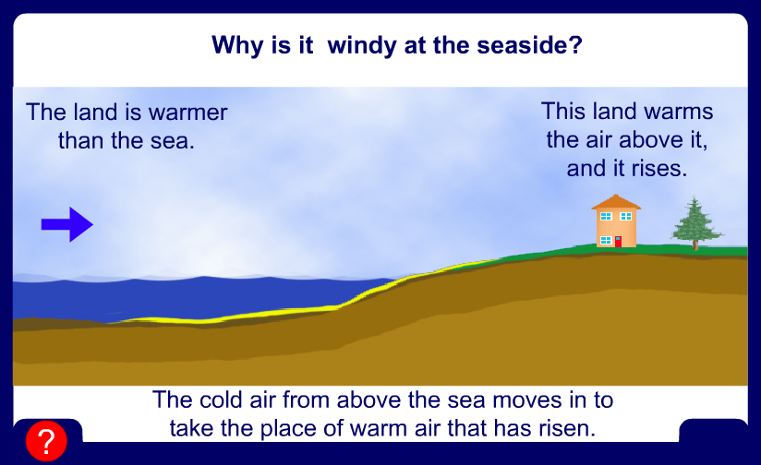
Why is it windy at the seaside?

Slide 3
Cold air sinks
Where is the freezer compartment put in a fridge?
Freezer compartment
It is warmer at the bottom, so this warmer air rises and a convection current is set up.
It is put at the top, because cool air sinks, so it cools the food on the way down.

Slide 4
Convection
Convection is the transfer of heat by the motion of liquids and gases.
  Convection in a gas occurs because gas expands when heated.
  Convection occurs because currents flow when hot gas rises and cool gas sink.
  Convection in liquids also occurs because of differences in density.

Slide 6
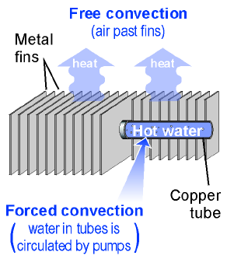
Free and Forced Convection
When the flow of gas or liquid comes from differences in density and temperature, it is called free convection.
When the flow of gas or liquid is circulated by pumps or fans it is called forced convection.

Slide 7
Heat Convection Equation
Heat transfer coefficient
(watts/m^{2o}C)
Area contacting fluids (m²)
Heat flow
(watts)
q_{H} = h A (T₂ -T₁)
Temperature
difference (ºC)

Slide 8

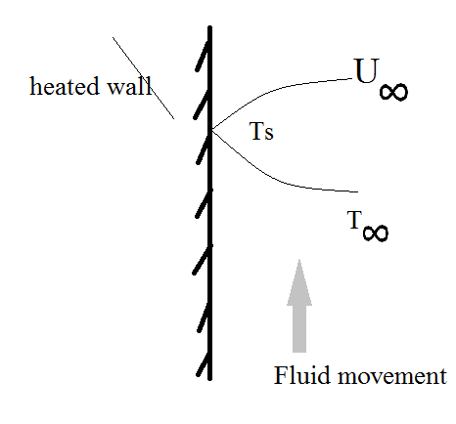
Heat transfer from a solid to the surrounding fluid
In this method of heat transfer, the heat transfers from a surface to the fluid depends on the fluid flow properties as well as the thermal properties of the fluid.
The following discussion is for a Newtonian fluids.

Slide 9
CONVECTIVE HEAT TRANSFER COEFFICIENT
The convective heat transfer coefficient depends on:
1)The fluid flow characteristics.
2)Thermal and physical properties of the fluid.
The methods which have been used to evaluate this coefficient are empirical relationships. Or a derived equations from a theoretical basis.
Some times called film coefficient (the thin layer in contact)
h[w/m².k] depends on : ρ, µ, v, Cp, k, L
Unitless numbers usually used to predict h.

Slide 10
CONVECTION: h=? Natural or Forced in different cases
Perpendicular on cylindrical pipes | Perpendicular on cylindrical pipes
Flat horizontal plate | Flat horizontal plate
Boiling | Inside cylindrical tube
condensation

Slide 11

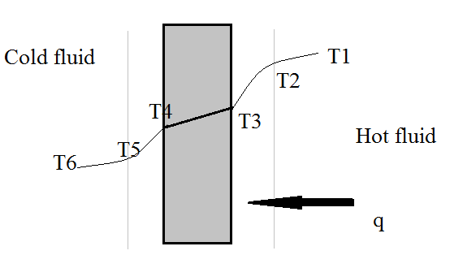

Introduction and dimensionless numbers
Flow condition:
1-Laminar.
2-Transient.
3- Turbulent.

Slide 12





In order to calculate the value of heat transfer coefficient (h) there are some dimensionless equations which help to find the closer h value under a variable situations.
Prandtl number: the ratio of the shear component of diffusivity for momentum µ/ρ to the diffusivity for heat k/ρC_{p.} and physically relates the relative thickness of the hydrodynamic layer and thermal boundary layer.

Slide 13


NUSSELT number:
Relates data for the heat transfer coefficient h to the thermal conductivity k of the fluid and a characteristic dimension D.
REYNOLD number:
GRSHOF number:
Represent the ratio of the buoyancy forces to the viscous forces in free convection and plays a role similar to that of Reynolds number in forced convection.

Slide 14
The volumetric expansion coefficient is defined as:
Ethyl alcohol: 112 x 10⁻⁵ /deg. C
Methyl alcohol: 120 “
Benzene: 124 “
Glycerin: 51 “
Air: 3 “

Slide 15
True for any material
Ideal gas only

Slide 16


Correlations for forced convection over a flat surface
In forced convection h value depends on:
1-Reynold’s Number
2- Geometry.
Re< 500,000 laminar
Re>500,000 Turbulent

Slide 17



If the flow is laminar:
Re_{L}<500,000
If the turbulent part is longer than the laminar then:
Re_{L}>500,000
But if both parts is important at the stage of Re_{L}=500,000 then:

Slide 18
Flow Perpendicular to a Single Cylinder
Use properties at the film temperature. Velocity is free field velocity of fluid.

Slide 19
Flow Past a Single Sphere
Use properties at film temperature.

Slide 20

Forced convection inside cylindrical pipes
All properties taken at T_{B} (Bulk temperature) the average temperature of the fluid at any section of the pipe.
D: the internal diameter of the pipe.
Re_{D}< 2300 Laminar flow.
Re_{D}>2300 Turbulent flow.

Slide 21
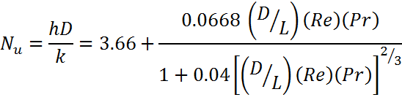


If the temperature at the surface of the pipe is constant and laminar flow:
Relation (1):
If D/L is very small then Nu =3.66
Relation (2): If the pipe is short and laminar flow:
If :

Slide 22
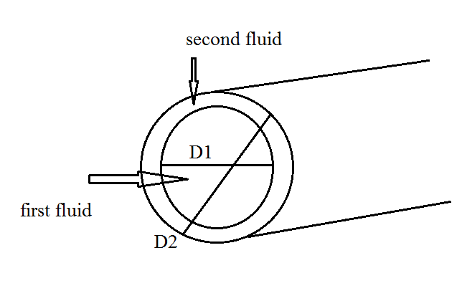


In heat transfer from fluid to another one of them inside a pipe and the other outside the pipe and inside the external pipe (include the internal pipe).
The last relation can be used except the special dimension for Nu and Re
We use D_{H}
All properties approximated at total temperature average except µs approximated at the surface

Slide 23







inside cylindrical pipes
Turbulent flow
For turbulent flow there are many correlations some of the famous are:
n=0.4 if T_{s}>T_{fluid}
n=0.3 if T_{s}<T_{fluid}
For fluids having viscosity higher than water this correlation is more precise:

Slide 24

Free or Natural Convection
In this case of heat transfer Groshof number has been suggested, which describes the fluid motion, under two conditions:
1- Fluid is not induced by external force.
2- the motion within the fluid is brought about by the influence of temperature on the fluid density and development of buoyant force.
X= length of the body involved in the free convection
β= coefficient of expansion for fluid being heated .
∆T= the difference in temperature between the surface and the fluid .

Slide 25
Empirical Correlations
Typical correlations for heat transfer coefficient developed from experimental data are expressed as:
For Turbulent
For Laminar

Slide 26

Nu: average convective heat transfer coefficient for the surface.
K= thermal conductivity ration for heat exchangers.
a, k depends on the geometry and orientation of the surface.
Surface | K | a | Condition
Vertical plate | 0.59 | 0.25 | 10⁴ <G_{r} P_{r}<10⁹
Vertical cylinder | 0.021 | 0.4 | G_{r} P_{r}>10⁹
Horizontal cylinder | 0.525 | 0.25 | It gives good results especially when P_{r}>0.5 and 10³<G_{r}<10⁹

Slide 27
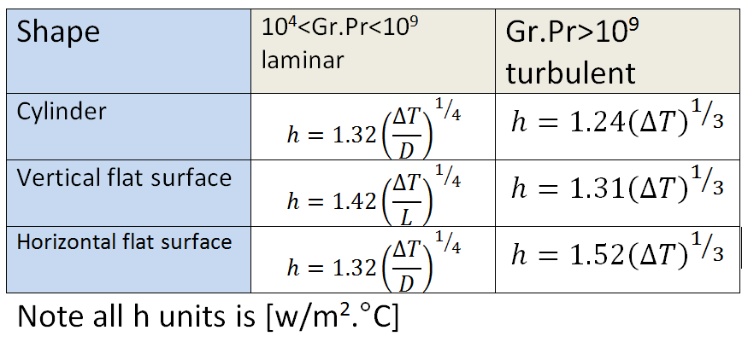
When the medium is air natural convection
horizontal
are

Slide 28
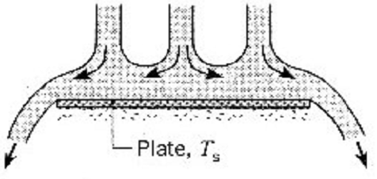
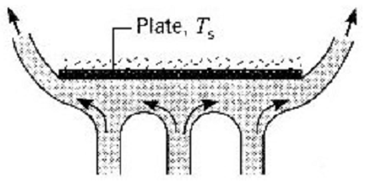
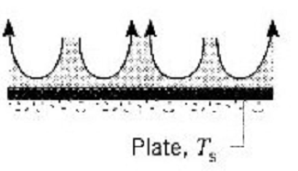
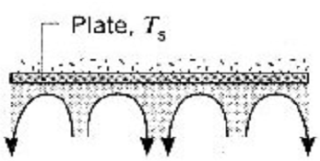
Horizontal Plate
Cold Plate (Ts < T∞)
Hot Plate (Ts > T∞)
Active Upper Surface
Active Lower Surface

Slide 29
Empirical Correlations : Horizontal Plate
Define the characteristic length, L as
Upper surface of heated plate, or Lower surface of cooled plate :
Lower surface of heated plate, or Upper surface of cooled plate :
Note: Use fluid properties at the film temperature

Slide 30
Boiling and Condensation

Slide 31
Classification of Boiling
Microscopic classification or Boiling Science basis:
Nucleated Boiling
Bulk Boiling
Film Boiling
Macroscopic Classification or Boiling Technology basis:
Flow Boiling
Pool Boiling

Slide 32



Further Behavior of A Pool of Liquid
Natural Convection
Increasing DT
Onset of Boiling
Isolated Bubble Regime

Slide 33
Boiling
Boiling occurs when the surface temperature T_{w} exceeds the saturation temperature T_{sat} corresponding to the liquid pressure
Boiling process is characterized by formation of vapor bubbles, which grow and subsequently detach from the surface
Bubble growth and dynamics depend on several factors such as excess temp., nature of surface, thermo physical properties of fluid (e.g. surface tension, liquid density, vapor density, etc.). Hence, heat transfer coefficient also depends on those factors.

Slide 34
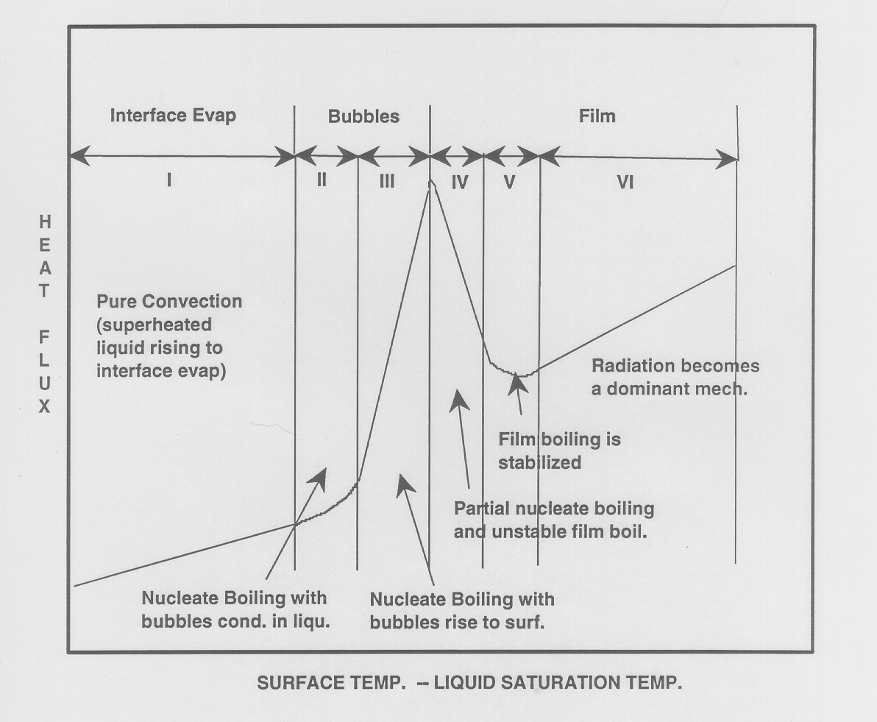
Pool Boiling Curve

Slide 35
Modes of Pool Boiling
Free convection boiling
Nucleate boiling
Transition boiling
Film boiling

Slide 36
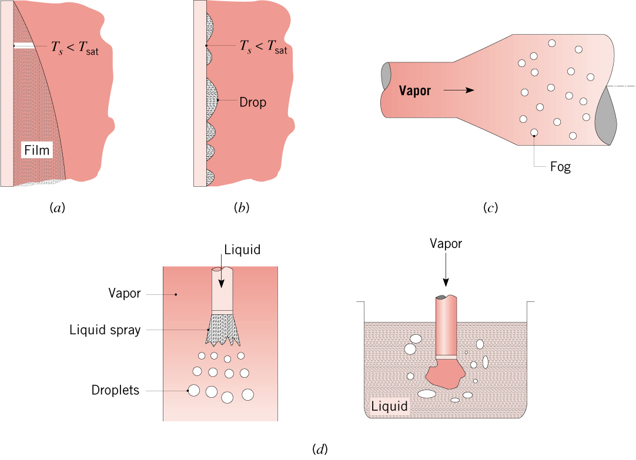
Condensation
Condensation occurs when the temperature of a vapor is reduced below its saturation temperature
Condensation heat transfer
Film condensation
Heat transfer rates in drop wise condensation may be as much as 10 times higher than in film condensation
Drop wise condensation

Slide 37
Laminar Film condensation on a vertical wall (VW)

Slide 38
Laminar Film condensation on a vertical wall (cont..)

Slide 39
Example
Laminar film condensation of steam
Saturated steam condenses on the outside of a 5 cm-diameter vertical tube, 50 cm high. If the saturation temperature of the steam is 302 K, and cooling water maintains the wall temperature at 299 K, determine: (i) the average heat transfer coefficient, (ii) the total condensation rate, and (iii) the film thickness at the bottom of the tube.
Given: Film condensation of saturated steam
Required: (i) Average heat transfer coefficient, (ii) total condensation rate, (iii) and film thickness
1. Effect of tube curvature negligible
2. Effect of liquid sub cooling negligible
3. Laminar

Slide 40
Example (contd...)
Evaluate h_{fg} at the saturation temperature of 302 K

Slide 41
Example (contd...)

Slide 42
Example (contd...)

Slide 44
THANK YOU

