Slide 1
Fourier's law of heat conduction
Heat conduction

Slide 2
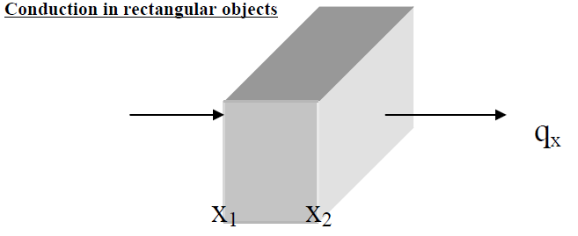
Steady state heat conduction
Steady state means that temperature in an object may vary by location but it does not change with time.

Slide 3
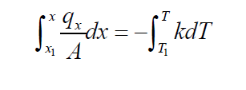
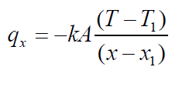
Fourier's law describes the rate of heat conduction in a solid
Boundary Conditions
x = x_{1,} T = T₁
x = x₂ , T = T₂
Separating the variables,
Integrating from x₁ to x (some interior location within the slab)

Slide 4
Where L= thickness of the slab
Thermal Resistance concept:
In the flow of electricity, the electrical resistance is determined from the ratio of electric potential divided by the electric current. Similarly, we may consider heat resistance as a ratio of the driving potential (temperature difference) divided by the rate of heat transfer.
Thus,

Slide 5
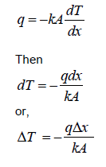
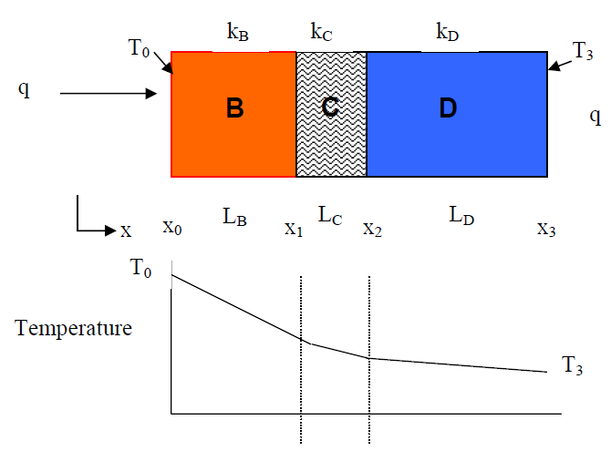
HEAT CONDUCTION IN MULTILAYERED SYSTEMS
COMPOSITE RECTANGULAR WALL (IN SERIES)
In a single layer, the rate of heat transfer is:

Slide 6
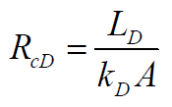
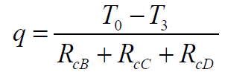
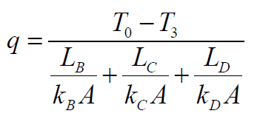
Using the Resistance Concept:

Slide 7
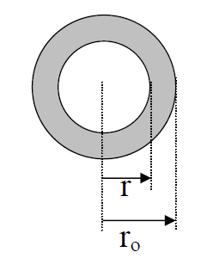
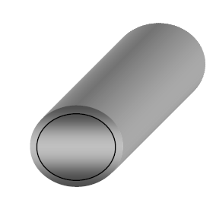

Conduction in cylindrical objects
Fourier's Law in cylindrical coordinates
$q_{r}=−k(2πrL)\frac{dT}{dr}$
Boundary Conditions
T =T_{i} at r = r_{i}
T=T_{o} at r = r₀

Slide 8
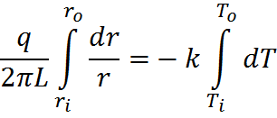
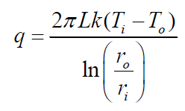
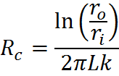
Separating variables:
Integrating :

Slide 9
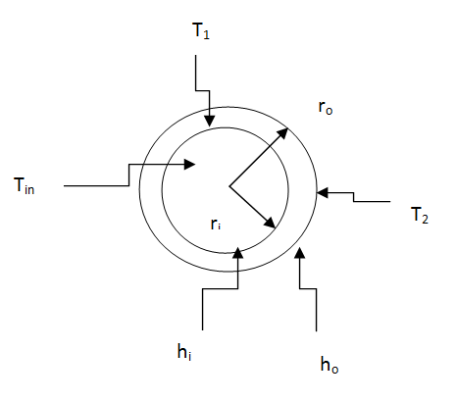
OVERALL HEAT TRANSFER COEFFICIENT
Heat transfer to the internal wall
Heat transfer through the wall
Where A_{lm}

Slide 10
Outside the wall
By summing the three equation 1,2, and 3 the result is :

Slide 11
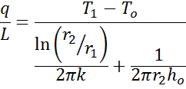
Critical thickness for insulation

Slide 12
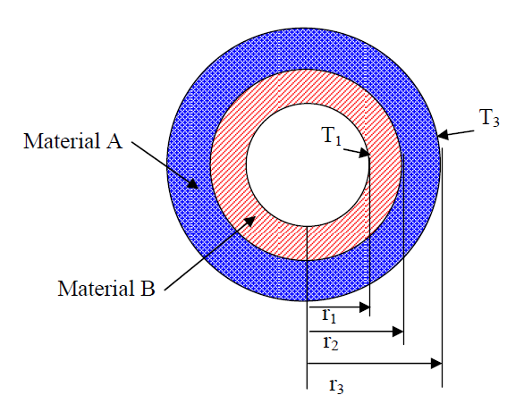
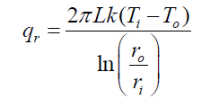
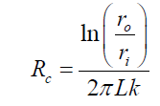
COMPOSITE CYLINDRICAL TUBE
for a single-layer pipe:
and resistance due to conduction
Thermal resistance diagram:

Slide 13
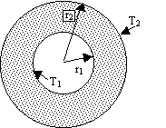
Heat Conduction in a Spherical Shell
Fourier's Law in radial coordinates
Substituting the area of a sphere
Integrating, between r = r₁ and r₂, and T₁ and T₂

Slide 14
The thermal resistance is expressed as

Slide 15
Conduction with internal heat generation
In some cases it energy may be produced in an identical shape inside the system like electrical heaters or in respiration in fresh food products such as fruits and vegetables.

Slide 16
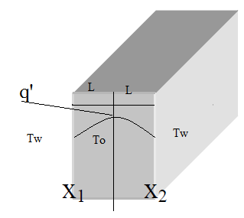
Rate of heat in
+ rate of heat generation
= rate of heat out
+ rate of heat accumulation
By taking the limit
And for a pure conductive material

Slide 17
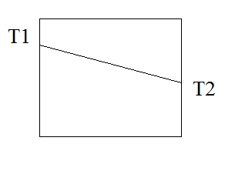
Note that if the heat generation zero then :
By integration
Then we get

Slide 18
At x=-L, T=T_{w}
And at x=L, T=T_{w}
And by solving 1 and 2
At x=0, T_{o}=center temperature:

Slide 19
Total heat at both sides =total heat generated at steady state case.

Slide 20
Home work #2 Temperature change with change of distance from the center of generation
Draw the relationship between temperature and distance x from the center of the wall knowing that:
T_{a} | q' | L | H | k
25 | 5 | 1 | 10 | 2
°C | w/m³ | m | w/m².°k | w/m.°k
Home work should be submitted after 6 days from the lecture.

