Slide 1
Complications OF HYPERLIPIDEMIA
MOHAMMED ALMAHMOUD
434103291
Endocrine Block

Slide 2
THE MOST IMPORTANT ONE IS ATHEROSCLEROSIS The lesion of atherosclerosis is called atheroma or atheromatous plaque

Slide 3
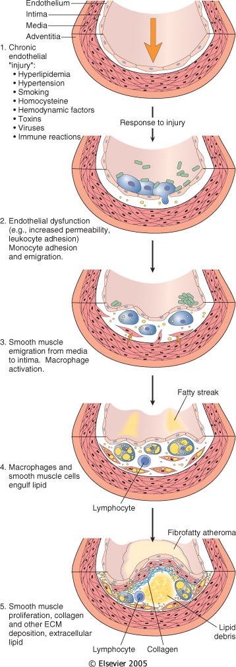

Slide 4
THIS CAN HAPPEN IN ANY BLOOD VESSEL, BUT THE MOST COMMON : 1- Abdominal Aorta 2- Coronary Artery 3- Popliteal Artery 4- Internal carotid Artery

Slide 5
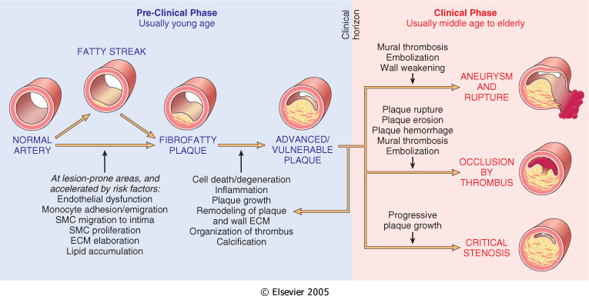
So what ? >>The atheroma either block the vessel, rupture with thrombosis or aneurysm.

Slide 6
1- Stroke 2- MI 3- Angina 4- Small bowel infarction 5- Aneurysm 6- Hypertension ( if it is in the renal artery ) 7- Peripheral vascular disease

Slide 7
Thank you

