Slide 1
Wireless sensor network & Private mobile computer
By: Safia Ali Al-Masoud

Slide 2
Outlines
WSN Definition
WSN Application
WSN advantages & disadvantages
Private mobile computer
Devices of Private mobile computer
Limitations of Private mobile computer
Private mobile computer Advantages & Disadvantages

Slide 3
Wireless sensor network (WSN)
Wireless sensor network (WSN) is a group of spatially dispersed and dedicated sensors for monitoring and recording the physical conditions of the environment and organizing the collected data at a central location.

Slide 4
Application
Area Monitoring.
Health care monitoring.
Air pollution monitoring.
Forest fire detection.

Slide 5
Cont. app
Landslide detection
Water quality monitoring
Natural disaster prevention

Slide 6
Advantages
Fixable to go through physical partitions.
Avoids a lot of wiring.
Can accommodate new device at any time .
It can be accessed through a centralized monitor.

Slide 7
Disadvantges
Easy for hackers to hack a network
Costly at large
Life of nodes
Energy life
Gets distracted by various elements
Low speed of communication

Slide 8
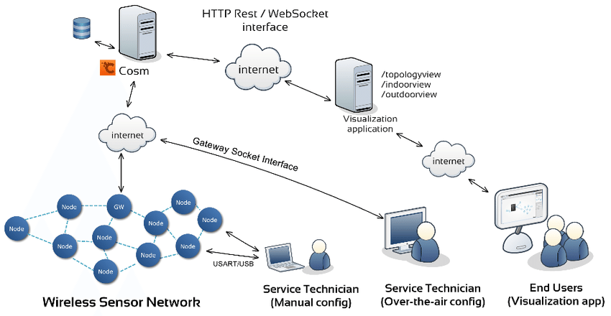
Wireless sensor network (WSN)

Slide 9
Mobile Private Network
Mobile Private Network (MPN) is a service that provides an efficient & secured point-to-point data connectivity between mobile devices or terminals into one private network mobile network.

Slide 10
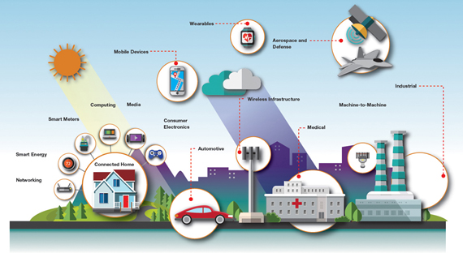

Slide 11
Benefits of mpn
Outside gatherings can't get to your information while it is being transmitted. The information trade is totally private and isolated from the Web.
With a devoted system asset, MPN can give a quick and dependable access to business programming, database or terminals, making it a perfect stage for continuous cooperation.

Slide 12
cont.benfit
Companies are able to connect to their employees using the corporate network, as long there is mobile data connection. It also enables terminals such as POS machines to be truly mobile via a highly secure private connection.

Slide 13
Advantages
High Security level
Upgraded System Execution
Intranet availability anyplace

Slide 14
Disadvantages
Costs - new technologies and devices are often costly to purchase and require ongoing maintenance and upkeep.
Workplace distractions - as the range of technologies and devices increases, so does the potential for them to disrupt productivity and workflow in the business.

Slide 15
How it work
Mobile Private Network (MPN) enables the exchange of data between mobile devices or terminals through mobile network
With a static IP and a dedicated APN (Access Point Name) assigned to each SIM card, the communication between devices is private and secure via intranet, separating the private APN from the other public APN, directly connecting the SIM to client’s servers.

Slide 17
Devices
Cellular phones, communication gadgets which can call from a separation through cell organizing innovation.
Wearable PCs, for the most part restricted to practical keys and essentially expected as consolidation of programming operators, for example, wrist trinkets, keyless inserts, and so forth.

Slide 18
Cont. dev
Cellular phones, communication gadgets which can call from a separation through cell organizing innovation.
Wearable PCs, for the most part restricted to practical keys and essentially expected as consolidation of programming operators, for example, wrist trinkets, keyless inserts, and so forth.

Slide 19
Limitations
Range and bandwidth: Mobile Internet access is generally slower than direct cable connections, using technologies such as GPRS and EDGE.
Transmission interferences: Weather, terrain, and the range from the nearest signal point can all interfere with signal reception.

Slide 20
References
Wikipedia, Wireless Sensor Network URL: https://en.wikipedia.org/wiki/Wireless_sensor_network
Mobile Private Network URL: https://www.robi.com.bd/new-business-page/mobile-private-network?lang=eng#qxlxOYhRXJXgD0uy.97
Difference between Wireless Sensor Networks and Wireless ad hoc Networks URL: https://zaidmufti.wordpress.com/2016/09/09/difference-between-wireless-sensor-networks-and-wireless-ad-hoc-networks/

