Slide 1
Differences between
WSN & MANET
By: Dana Alotaibi

Slide 2
1
WSN
Applications and Types
2
MANET
Applications and Types
3
The differences
WSN and MANET

Slide 3
WSN
Is stands for "Wireless sensor network"
A WSN refers to a group of spatially dispersed and dedicated sensors for monitoring and recording the physical conditions of the environment and organizing the collected data at a central location.
1
Notes:
https://www.techopedia.com/definition/25651/wireless-sensor-network-wsn

Slide 4
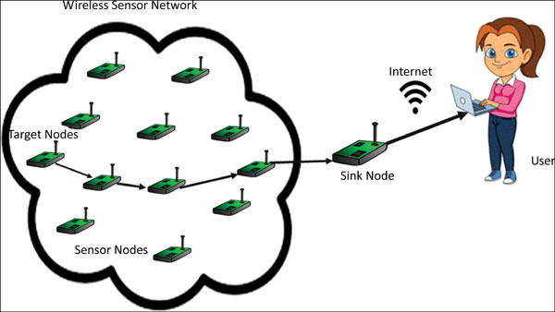
WSN

Slide 5
Application of WSN
Object tracking
Bio-medical applications
Fire detection
Traffic monitoring
2
Notes:
https://www.researchgate.net/publication/322578488_MANET_and_WSN_WHAT_MAKES_THEM_DIFFERENT

Slide 6
Type of WSN
Terrestrial WSNs
Underground WSNs
Underwater WSNs
Multimedia WSNs
Mobile WSNs
3
Notes:
https://www.elprocus.com/introduction-to-wireless-sensor-networks-types-and-applications/

Slide 7
MANET
Is stands for "Mobile Ad Hoc Network."
A MANET is a type of ad hoc network that can change locations and configure itself.
Because MANETS are mobile, they use wireless connections to connect to various networks. This can be a standard Wi-Fi connection, or another medium, such as a cellular or satellite transmission.
4
Notes:
https://techterms.com/definition/manet

Slide 8
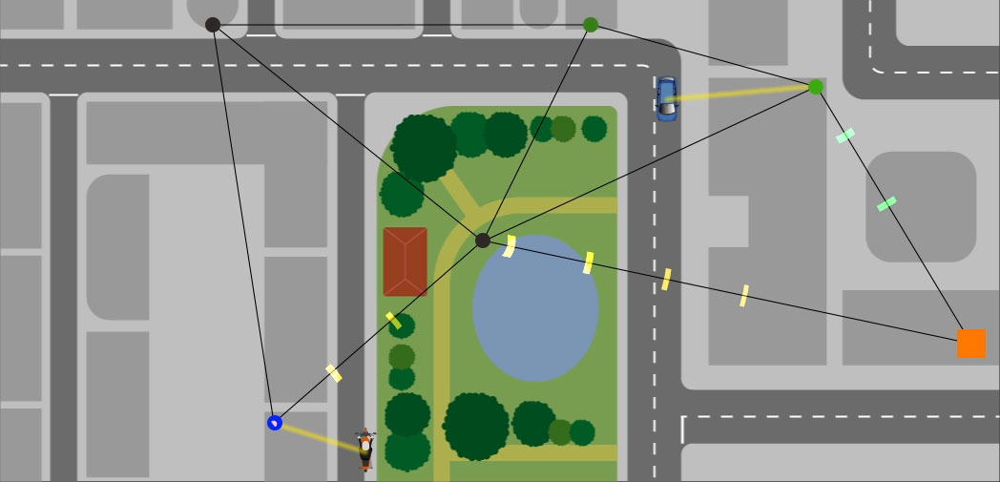
MANET

Slide 9
Application of MANET
Battlefield communication
Search-and-rescue
Robot data acquisition
Mini site operations
2
Notes:
https://www.researchgate.net/publication/322578488_MANET_and_WSN_WHAT_MAKES_THEM_DIFFERENT

Slide 10
Type of MANET
SPANs
iMANETs
VANETs
Stands for Smartphone Based Mobile Ad-Hoc Networks.
Used across mobile phone devices by creating peer-to-peer network through the help of Wi-Fi and Bluetooth Technology.
Stands for Internet Based Mobile Ad-Hoc Networks.
Works on the concept of networking protocols including: User Datagram protocol, Transmission control Protocol, Internet protocol and Routing information protocol.
Stands for Vehicular Mobile Ad-Hoc Networks.
used across vehicles and road safety devices for communication purpose which in turn responsible for smooth and secure vehicle behaviour across the roads.
5
Notes:
https://www.minigranth.com/mobile-adhoc-networks/types-manet/

Slide 11
VANETs
https://www.youtube.com/watch?v=14fOqMBn9aw

Slide 12
Differences between
WSN & MANET
Notes:
https://zaidmufti.wordpress.com/2016/09/09/difference-between-wireless-sensor-networks-and-wireless-ad-hoc-networks/

Slide 13
Interaction
WSN | MANET
With environment | Closed to humans
2

Slide 14
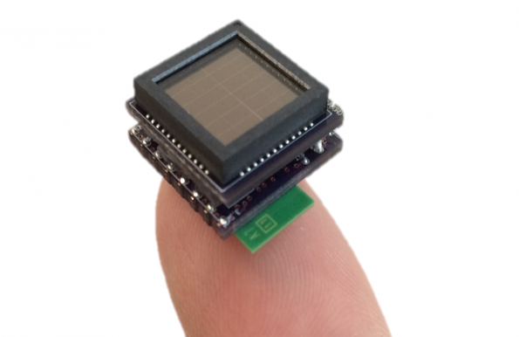
Size
WSN | MANET
These are very small devices | They are larger in size, for example :Laptops and PDA’s.
6

Slide 15
Range
WSN | MANET
Transmission range is small (3 to 30 meters ). | Transmission range is large (10 to 500 meters).
6

Slide 16
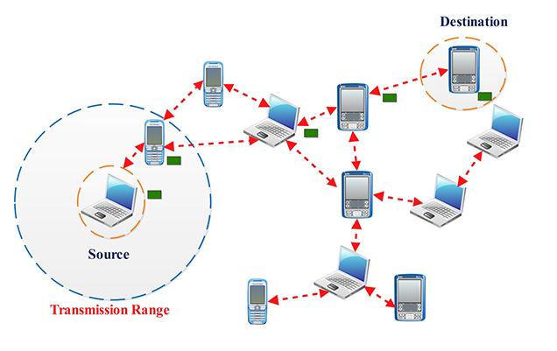
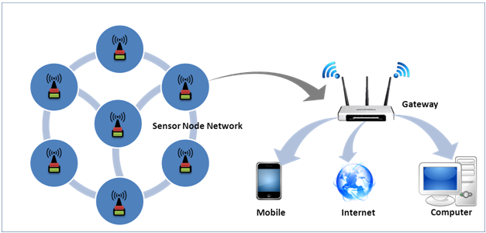
Data Movement
WSN | MANET
Data moves from many nodes to the Gateway . | Data moves from one device to many (Broadcasting )
6

Slide 17
Power capacity
WSN | MANET
Have small and limited power capacity . | Power sources have larger capacity.
6

Slide 18
Cost
WSN | MANET
The nodes ( sensors ) are inexpensive | Compared to WSN they are Expensive.
6

Slide 19
Identifiers
WSN | MANET
No unique IDs used in the network | Unique IDs used in the network
6

Slide 20
Density
&
Redundancy
WSN | MANET
The node density is high. Networks are highly redundant. | Node density is low . They have less redundant networks .
6

Slide 21
Data Type
WSN | MANET
Scalar, like temperature, humidity and fire sensors, among others | Huge data, like files and audio-visual information
6

Slide 22
Attending
The nodes
WSN | MANET
Nodes remain unattended they are designed for a prolonged lifetime. | Unlike WSN they don’t remain unattended. Battery can be replaced.
6

Slide 23
Resources
WSN | MANET
Limited resources like: Memory and processing. | Memory size is big, and the processing power is Higher.
6

Slide 24
Bandwidth Requirement
WSN | MANET
Low bandwidth | High bandwith
6

Slide 25
Network size
WSN | MANET
Depends on extension of the observed area | Depends on active users
2
Notes:
https://www.researchgate.net/publication/322578488_MANET_and_WSN_WHAT_MAKES_THEM_DIFFERENT

Slide 26
CONCLUSION
1
WSN is a special type of ad hoc networks; both are using a wireless channel and the other radio waves technologies working in the same frequency.
2
WSN focus on environment interaction whereas MANET interaction closed to human.
3
WSN is data centralized, but the control of the network is published among the nodes in MANET
4
In WSN, data rate is very low but so rich multimedia data can be carried in MANET.
5
Sensor network has very huge number of nodes that usually spread once in their life time, while MANET has less number of nodes that usually move in an ad hoc manner.
2
Notes:
https://www.researchgate.net/publication/322578488_MANET_and_WSN_WHAT_MAKES_THEM_DIFFERENT

Slide 27
Answer The Qustions

Slide 28
Any Qustions?

Slide 29
Refrences
1
https://www.techopedia.com/definition/25651/wireless-sensor-network-wsn
2
https://www.researchgate.net/publication/322578488_MANET_and_WSN_WHAT_MAKES_THEM_DIFFERENT
3
https://www.elprocus.com/introduction-to-wireless-sensor-networks-types-and-applications/
4
https://techterms.com/definition/manet
5
https://www.minigranth.com/mobile-adhoc-networks/types-manet/
6
https://zaidmufti.wordpress.com/2016/09/09/difference-between-wireless-sensor-networks-and-wireless-ad-hoc-networks/

