Slide 1
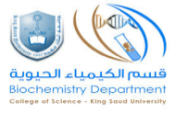
COGULATION PROFILE
BCH 471
Experiment (10)
Clotting time, Bleeding time, and Prothrombin time

Slide 2
Coagulation
Coagulation is a complex process by which blood forms clots.
It is an important part of haemostasis (the cessation of blood loss from a damaged vessel).
Disorders of coagulation can lead to an increased risk of bleeding (hemorrhage) or clotting (thrombosis).

Slide 3
Hemostasis is maintained in the body via three mechanisms:
Vascular spasm - Damaged blood vessels constrict
Platelet plug formation - Platelats adhere to damaged endothelium to form platelet plug (primary hemostasis)
Blood Coagulation - Clots form upon the conversion of fibrinogen to Fibrin (secondary hemostasis).

Slide 4
Clotting Cascade
A cascade is a mechanism in which enzymes activate other enzymes sequentially usually leading to an amplification of an initial signal.
Pathways
Extrinsic
Intrinsic
Each of these pathways leads to the conversion of factor X (inactive) to factor Xa (active)
Initially independent, then they converge on common pathway leading to the formation of a fibrin clot

Slide 5
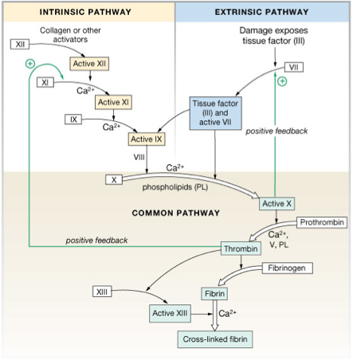

Slide 6
Clotting time
Test for intrinsic system
Simple test but takes time and rarely done now
Method:
Venous blood is taken and placed on glass test tube at 37°C and it observed at time intervals until clotting occurs
Normal blood takes 5-10min to clot
Longer periods → Coagulation defects (e.g. Hemophilia)

Slide 7
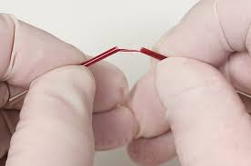
Clotting time - capillary method

Slide 8
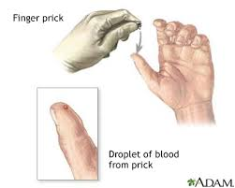
BLEEDING TIME
Provides assessment of platelet count and function
Method:
It is determined by noting time at which blood coming out a small cut, no longer forms a spot on a piece of filter paper placed in contact with cut surface
The normal range from 2-4 min

Slide 9
PROTHROMBIN TIME (PT)
Measures effectiveness of the extrinsic pathway
Method:
An excess of tissue factor and Ca2+ ions are added to diluted plasma containing citrate (anticoagulant) and then the time taken for the mixture to clot is measured
Normal value →10-15 secs
High PT → low levels of thrombin
Results from liver disease due to deficiency of prothrombin, fibrinogen, V, VII and X factors

