Slide 1
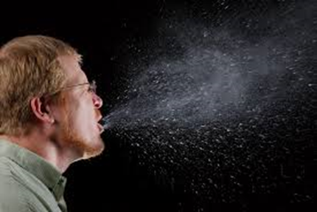
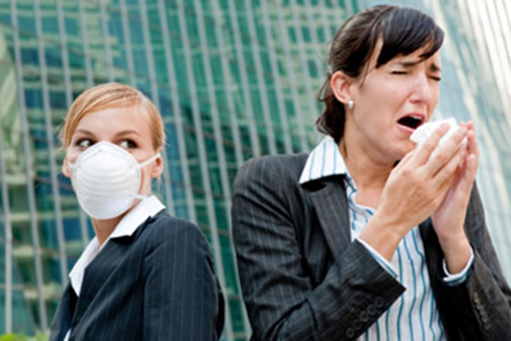
Microbial air pollution
CLS 416

Slide 2
Pollution
Pollution occurs when undesirable compounds or microorganisms enter an environment and change the quality of this environment so that the balance in the ecosystem is endangered.

Slide 3
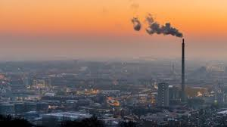
Pollutants might be:
Specific chemicals from industry, Insecticides, sewage.
such as: mercury, Lead, DDT, H₂S, SO₂, methane & carbon monoxide.
Microorganisms and there toxins.
Radiation.

Slide 4
Composition of the atmosphere

Slide 5
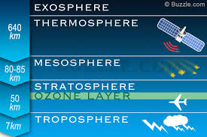
Layers of the atmosphere
Troposphere- 15km up
Stratosphere- 50km up (Ozone layer)
Mesosphere- 85km up (meteors burn)
Thermosphere- 600km up- (satellites occur)
Exosphere- 10,000km up
NASA /Augest 2017

Slide 6
Air has no indigenous microflora
Air does not support the growth of microbial flora, but act as a transport medium.
Characteristics of the atmosphere:
High light intensities
Extreme temperature variations, mostly high temp.
low amount of organic matter
Scarcity of available water, dry
Troposphere: layers of the atmosphere closest to the earth,
extends to 11km above the earth surface.
Characterized by the heavy load of m.o.
Temp. variation, where a drop of 1⁰C/150m up
to the atmosphere.

Slide 7
Airborne Bacterial Diseases/Pathogens
Whooping cough/Bordetella pertussis
Psittacosis/Chlamydia psittaci
Diphtheria/Corynebacterium diphtheriae
Q. fever/Coxiella burnettii
Sinusitis, Bronchitis/Haemophilus influenzae
Tuberculosis/Mycobacterium tuberculosis
Primary atypical pneumonia/Mycoplasma pneumoniae
Pneumococcal pneumonia/Neisseria meningitidis
Scarlet fever and others/Streptococcus pyogenes
Pneumonic plague/Yersinia pestis

Slide 8
Systemic mycoses/Causative agents
Aspergillosis/Aspergillus fumigatus
Blastomycosis/Blastomyces dermitidis
Gilchrist’s disease/B. braziliensis
Candidiasis/Candida albicans
Coccidiomycosis/Coccidioides immitis
Cryptococcosis/Cryptococcus neoformans
Histoplasmosis/Histoplasma capsulatlum

Slide 9
Viral diseases/Causative agents
Mumps/ Mumps virus
Influenza/ Myxovirus influenzae (A, B, C)
Poliomyelitis/ Poliovirus
Common cold/ Rhinovirus
German measles/ Rubella virus
Measles/ Rubeola virus
Chickenpox/ Varicella virus
Small pox/ Variola poxvirus

Slide 10
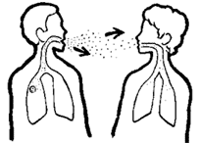
Modes of transmission of respiratory tract infections
Direct droplet inhalation:
Inhalation of droplet nuclei: from one person to the other at a close distance within a short period of time. Ex:
N. meningitidis
B. pertussis
Corynebacteria
Infectious mononucleosis

Slide 11
Direct airborne:
Droplet nuclei suspended in the atmosphere for a period of time before being inhaled.
Ex: Measles, chickenpox, Mycobacteria, SARS
Indirect airborne:
Big droplets that settle on surfaces, that dry up and are inhaled with dust, air current…
Ex : bacillus spores
Fungal spores
Chlamydia
Q- fever

Slide 15
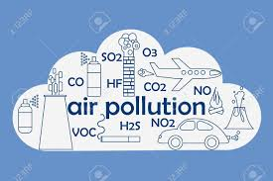
Sources of microbial air pollution
Outdoor air
Dust from surfaces of earth (soil)
Water droplets from surface of water.
Bursting of air bubbles at water surface
Human activities: industrial, agricultural, sewage
treatment (trickling filters)

Slide 16
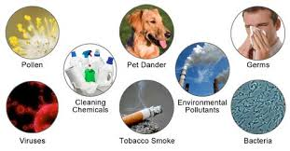
Indoor air
Expelled from nose & mouth; Sneezing, coughing
Hospital manipulation; Handling soiled linen,
Lab techniques (aerosols)
Slaughter house

Slide 17
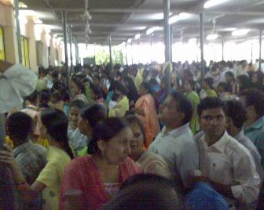
Degree of indoor air contamination depends on: - Ventilation rate - Crowding of people - Type & degree of activity

Slide 20
Control of Air borne Microorganisms
Ventilation
Ultraviolet radiation. (wavelength of 254 nm)
direct irradiations or indirect- shielded irradiations
Bactericidal vapours.
Vapours of propylene glycol and triethylene glycol are strongly germicidal. These are colorless, tasteless, non-irritating, nontoxic, and not explosive or corrosive.
0.5 mg of propylene glycol can kill a liter of heavily contaminated air within 15 seconds.
Filtration; Laminar air flow system +HEPA filter.

